Slide 1

EmoLearn Emotion Detection from Images and Webcam
2/7/2023(SUN)
Presented by Nu Nu Hlaing

Slide 2
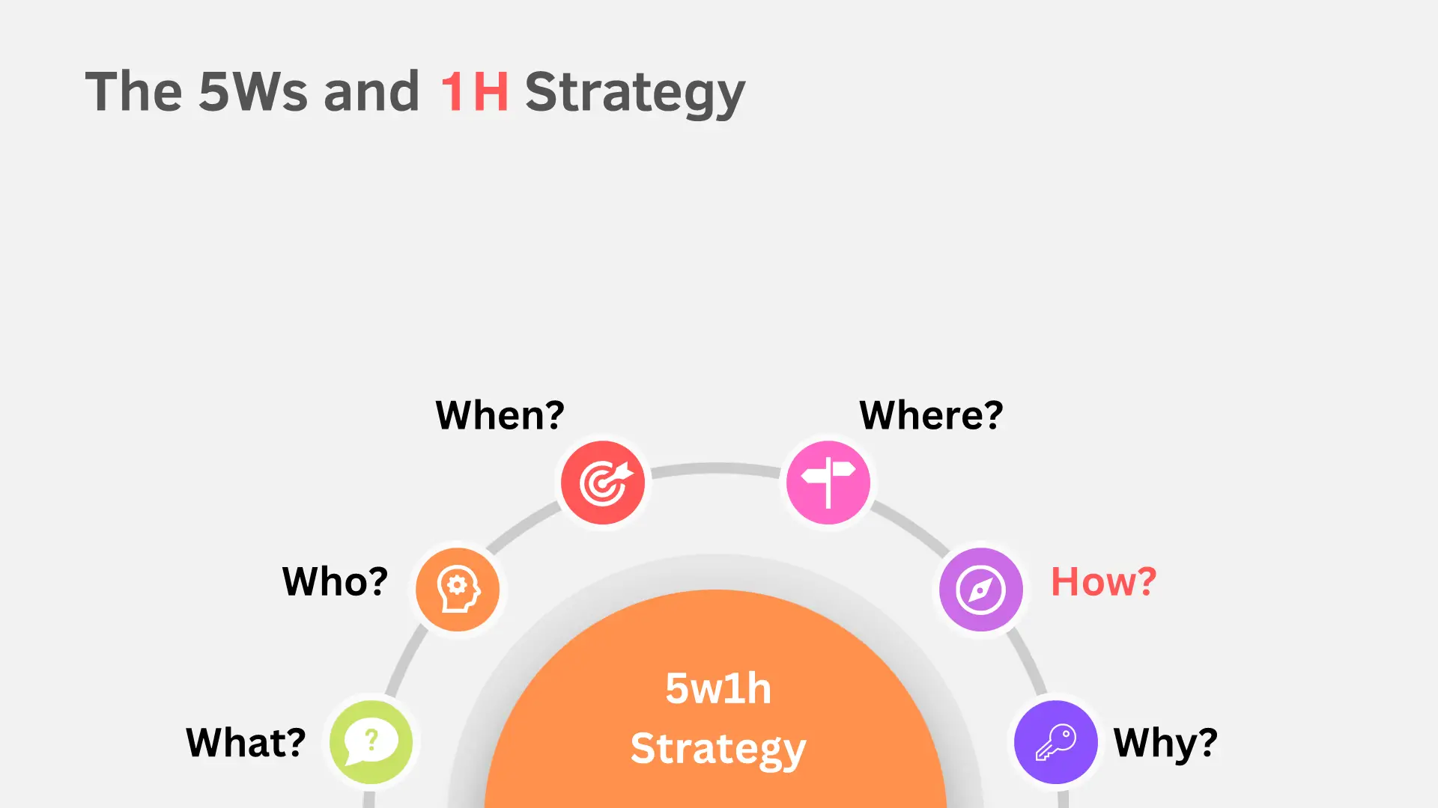
5Ws1H
Who, What, When, Where, Why, How

Slide 3


Who
1W
Supervised by
Sir Phyo Thu Htet
Founder and CEO of Simbolo
Nu Nu Hlaing
Candidate of Batch-10

Slide 4
What is EmoLearn?
2W
What
An emotion detection system detect and classify emotions using deep learning techniques (CNN)
Train a model that can accurately recognize and classify human emotions, acting like a human brain to detect emotions.
Innovate to analyze and recognize human emotions in real-time using a webcam.
Aims to interpret and categorize emotions into seven distinct categories, including happy, sad, anger, fear, disgust, surprise, and neutral.

Slide 5
Project Timeline
3W
When
Within 2 weeks (19/6/23 ~ 2/7/23)
Planning (2days)
Data Collection and Preparation (3days)
Evaluation and Validation (5days)
User Interface Development (1days)
Prepare Presentation Slide (2days)

Slide 6
Where Can We Run EmoLearn?"
4W
Where
EmoLearn runs on desktop computers and laptops with webcams and image processing capabilities.
It can easily find in GitHub repository.
https://github.com/NuNuHlaing/EmoLearn.git
It requires computing infrastructure, GPUs, and data storage for optimal performance.

Slide 7
Purpose of EmoLearn
5W
Why
Human-computer interaction
Healthcare
To assess mental health conditions, monitoring patients' emotional well-being
To enhance user experiences in digital interfaces, virtual assistants, or gaming
Safety and security
Safer driving through real-time emotion detection in vehicles.
Education
Market research
To assess student engagement and emotional responses to personalize learning experiences
To advance market research and consumer behavior analysis

Slide 8
Potential Benefits & Impact
5W
Why
Trained to recognize emotions in people of all races and genders.
It can enhance communication, empathy, and personalized experiences in different areas of life.
It has the potential to revolutionize human-computer interaction and bring positive changes to various aspects of our lives.

Slide 9
1H
How
The process of EmoLearn typically involves several steps
Data Collection
Data Preprocessing
Understanding Algorithms
Training
Modelling
Experiments
Evaluation

Slide 10
Data Collection : Collection & Splitting
1H
How
From Google, From GitHub, From ImageNet
Total Data – 35, 915
Train Data – 80% – 28,737
Angry : 3,995, Disgust : 436, Fear: 4,097, Happy : 7,244, Neutral : 4,965, Sad : 4,830, Surprise : 3,171
Test Data – 20% – 7,178
Angry : 958, Disgust :111, Fear :1,024, Happy : 1774, Neutral : 1,233, Sad : 1,247, Surprise : 831

Slide 11
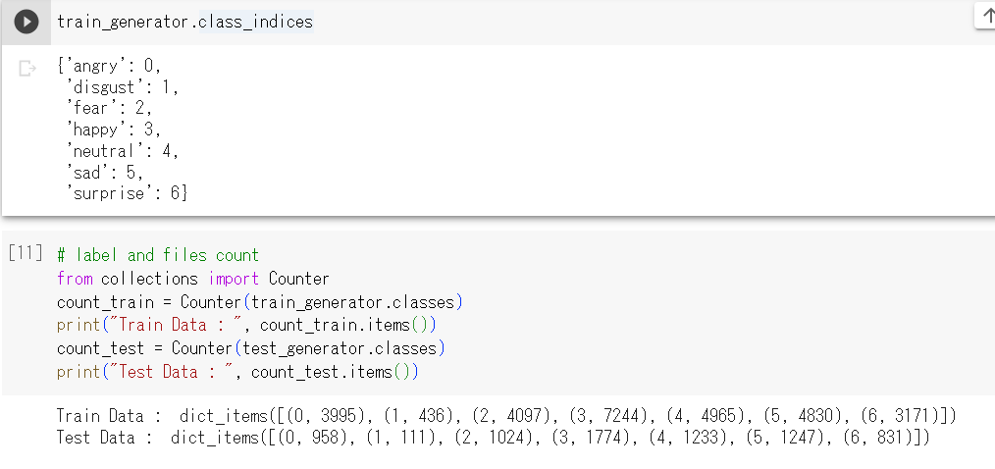
Data Collection : Collection & Splitting
1H
How

Slide 12
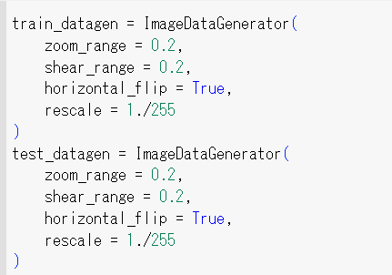
Data PreProcessing : Normalization & Labeling
1H
How
All the images are normalized to (48, 48) as the image data had variety of sizes
The images are rescaled to 1./255
The images are sheared by 20%
zoom-in and zoom-out by 20%

Slide 13
Model Training : Understanding of Algorithms
1H
How
Three algorithms for prediction
Artificial Neural Network (ANN)
Convolutional Neural Network(CNN)
Haar Cascade Classifier

Slide 14
What is ANN?
1H
How
ANN, also known as a fully connected neural network or a multi-layer perceptron, is a basic and versatile type of neural network.
ANN pass information in one direction, through various input nodes, until it makes it to the output node.
The network may or may not have hidden node layers, making their functioning more interpretable.

Slide 15
What is CNN?
1H
How
A convolutional neural network (CNN) is a network architecture for deep learning that learns directly from data.
CNNs are mainly credited for their role in image and video recognition, recommendation systems, and image analysis and classification.
Three of the most common layers are convolution, activation or ReLU, and pooling.
Convolution layer focus on interpreting simple features in an image such as its edges and colors.
Rectified linear unit (ReLU) layer is abled to recognize complex features such as object shapes.
Pooling layer is abled to identify the target object.

Slide 16
ANN or CNN Experiments
1H
How
Criteria | Artificial Neural Networks (ANNs) | Convolutional Neural Networks (CNNs)
Type of Data | Tabular Data, Text Data | Image Data
Performance | ANN is considered to be less powerful than CNN. | CNN is considered to be more powerful than ANN.
Application | Facial recognition and Computer vision. | Facial recognition, text digitization and Natural language processing.
Main advantages | Having fault tolerance, Ability to work with incomplete knowledge. | High accuracy in image recognition problems, Weight sharing.
Disadvantages | Hardware dependence | Large training data needed

Slide 17

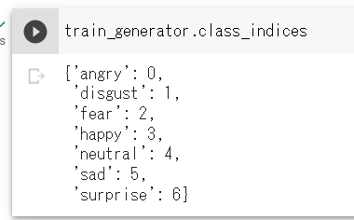
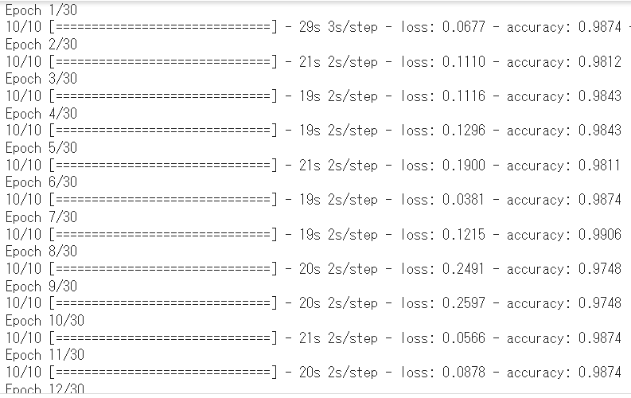
ANN or CNN Experiments
1H
How
Target Size: 48, 48
Epochs: 30, Batch_Size: 10

Slide 18
Result of Experiments
1H
How
Algorithm | Amount of Data | Accuracy Score | Precision Score | Recall Score | F1 Score
ANN | Total Data – 434 Train Data – 350 Test Data – 84 | 76% | 81% | 76% | 73%
CNN | Total Data – 434 Train Data – 350 Test Data – 84 | 91% | 95% | 91% | 92%
The results are showed the CNN method is great for testing and training images.

Slide 19
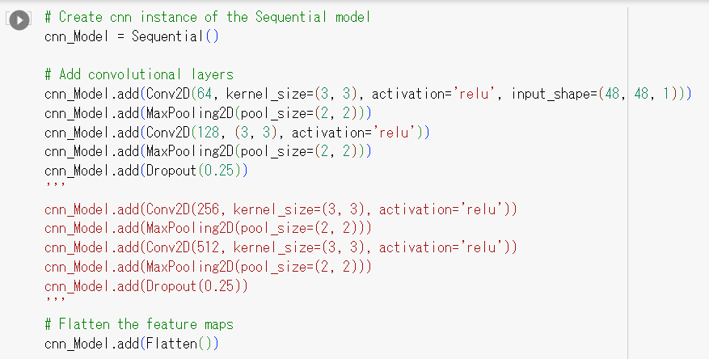

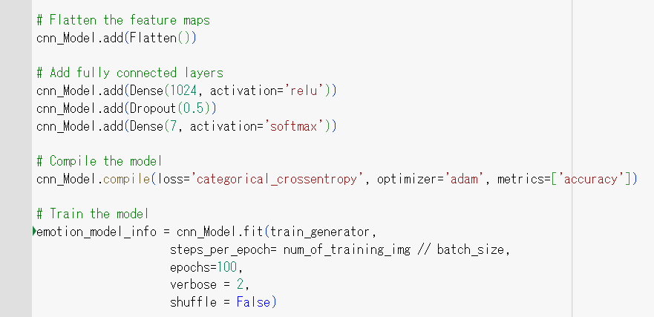
Modelling: CNN Architecture
1H
How
Target Size: 48, 48
Epochs: 100, Batch_Size: 64

Slide 20
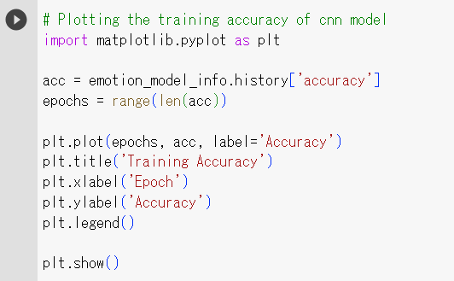
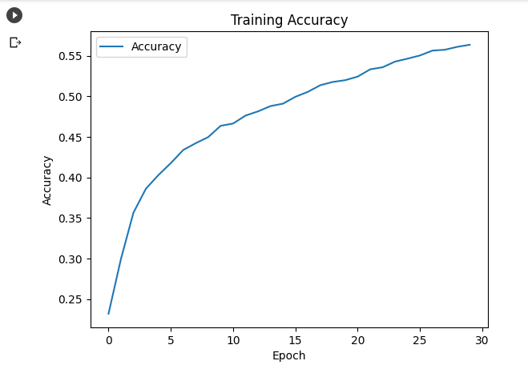
Plotting Accuracy
1H
How

Slide 21
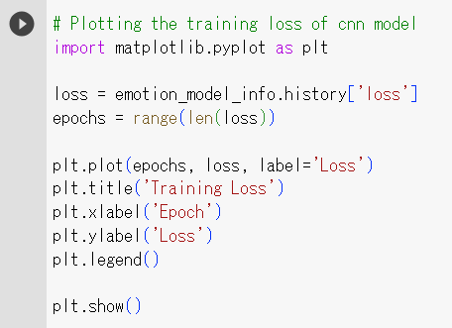
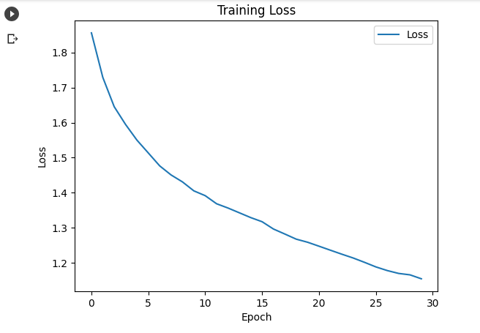
Plotting Loss
1H
How

Slide 22
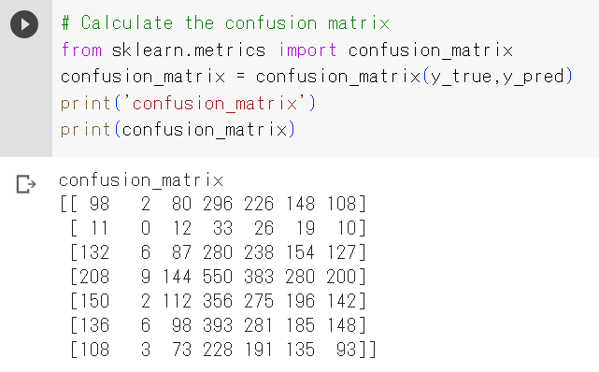
Evaluation
1H
How

Slide 23
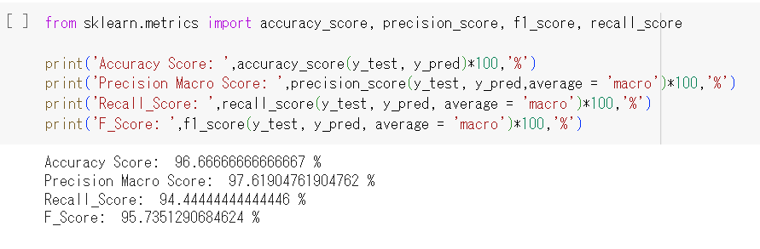
Evaluation
1H
How

Slide 24

What is Haar Cascade Classifier?
1H
How
Machine learning-based pre-trained classifiers used to identify faces in a real time video.
It works four stages.
Haar-feature selection: A Haar-like feature consists of dark regions and light regions.
Creation of Integral Images: A given pixel in the integral image is the sum of all the pixels on the left and all the pixels above it.
AdaBoost Training: It combines multiple “weak classifiers” (best features) into one “strong classifier”.
Cascade Classifier: It significantly reduces the computation time and makes the process more efficient.

Slide 25
What is Haar Cascade Classifier?
1H
How
The Haar cascade method is used to detect faces in each frame of the webcam feed.
The region of image containing the face is resized to 48x48 and is passed as input to the CNN.
The network outputs a list of softmax scores for the seven classes of emotions.
The emotion with maximum score is displayed on the screen.

Slide 26
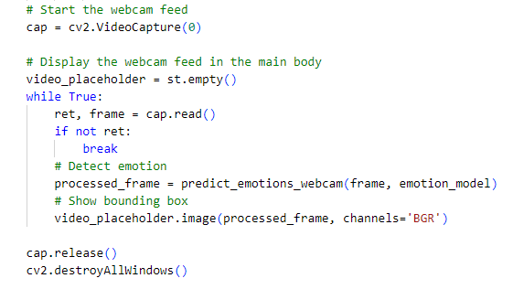
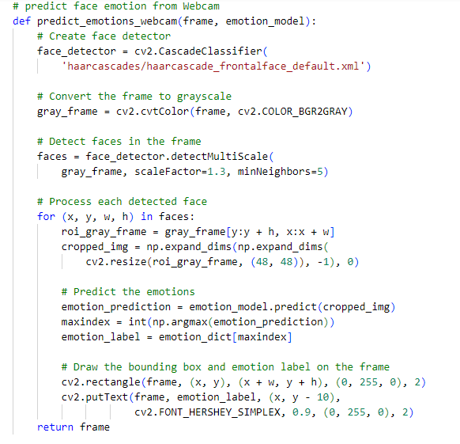
Emotion Detection from Webcam
1H
How
Webcam feed and detect emotion
Draw bounding box and detect emotion

Slide 27
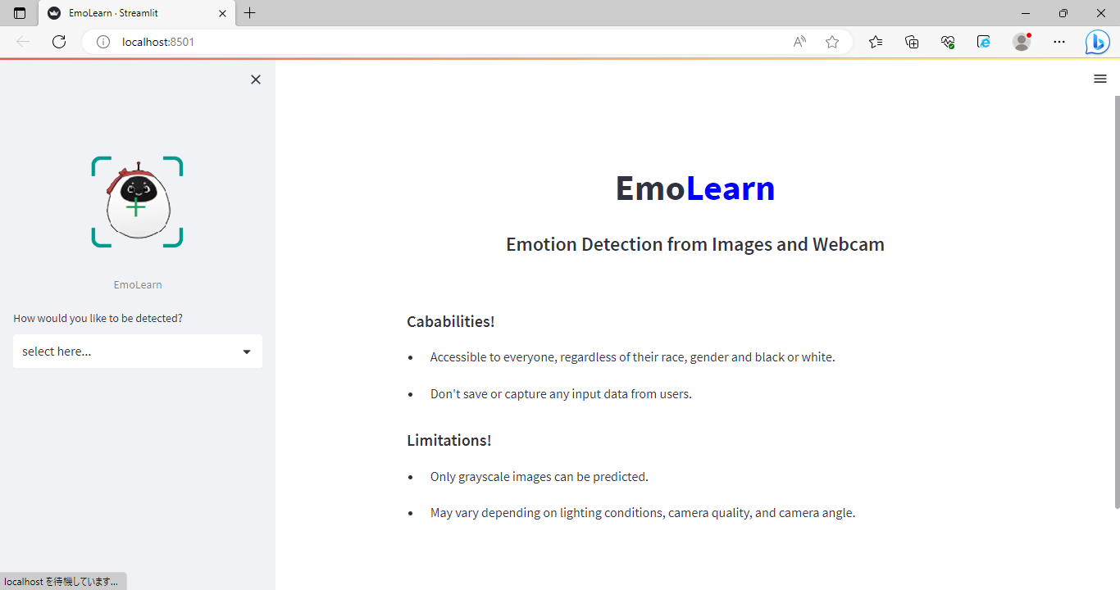
User Interface
1H
How
EmoLearn develops user interface using Streamlit
Title and Description
Capabilities and Limitations
Image Upload Section
Webcam Feed
Emotion Prediction Results

Slide 28
AI Ethics
Privacy & Security
Explainability
・don’t save any input data from users
・ avoid deploying the system where it could be used for unethical purposes
・ easy to use with user-centric design
Limitations
Avoidance of Harm
・ only grayscale Image with extension 'jpeg', 'jpg', ‘png’
・ may vary depending on lighting conditions, camera quality, and camera angle
・ don’t cause harm upon individuals' rights
・ avoid emotional manipulation

Slide 29
Model optimization : To extend the model to be more culturally sensitive and adaptable. Dataset expansion : To expand and diversify the dataset to ensure it represents a wide range of cultures, and expressions. Data augmentation: To improve performance in challenging environments, such as low-light conditions or low-resolution images. Color image support: To modify model to handle color images as input.
Future Work

Slide 30
Demo with Streamlit!

Slide 31
Refrences
Emotion detection: https://github.com/juan-csv/emotion_detection
Face Recognition: https://github.com/juan-csv/face-recognition
Haar Cascade: https://github.com/opencv/opencv/tree/master/data/haarcascades
Dataset from Google, Github, ImageNet
Open Source Libraires

Slide 32
Q & A

Slide 33
Thank You!
Do you have any questions?
nunuhlaing2011@gmail.com

