Slide 1
Workshop on data security and privacy
Banco de Portugal and Irving Fisher Committee · Session 5 · Lisbon, 15 September 2026
Quantitative risk assessment for data privacy
Probability models, estimation uncertainty and governance thresholds
Ronald Rethabile Malamule Mahomane
Department of Computing, Mathematical and Statistical Sciences, University of Namibia, Windhoek
School of Pathology, Faculty of Health Sciences, University of the Witwatersrand, Johannesburg
Basis Energy, Victoria, Australia
Working paper. Please do not circulate the figures without the accompanying assumptions.
Notes:
Twenty-three frames, numbered to the paper sections. All figures and numbers come from the paper, so any question can be answered by naming a section.

Slide 2
A release decision has three parts, and most of the difficulty in practice comes from collapsing them
EXECUTIVE SUMMARY · SECTION 1
Context
Question
Answer
Situation. Institutions release granular data under a duty of confidentiality. The protection mechanisms are documented, implemented and taught.
Complication. The decision rule is not. A committee weighs measures against public value, and the quantity that did the work, how much residual risk the institution would carry, is never written down.
What licenses a release, on whose authority, and with how much evidence?
1
A probability model
conditional on a declared adversary
2
A statistical estimate
A committee can answer none of the three from the papers it is given today.
with its uncertainty carried into the rule
3
A policy decision
tolerance, harm class, owner, expiry, error probability
Two failures follow from collapsing them: a committee that treats a point estimate as the risk releases at its own boundary about half the time, and an institution that treats a protection parameter as a tolerance never states the probability it accepted.
R. R. M. Mahomane · Quantitative risk assessment for data privacy · Session 5, Lisbon, 15 September 2026
2 / 29
Notes:
This frame is the paper in one screen. Everything after it is support.

Slide 3
Fourteen results, in three groups, and two of them are negative results with immediate consequences
THE ARGUMENT
1
The measures are theorems, not definitions
The two negative results
One. A k-anonymous release does not deliver a risk of 1/k. In the simulation a 10-anonymous release holds a record identified with probability 0.744 against a nominal 0.100.
2
The figure is an estimate, with a budget behind it
3
The tolerance is a policy quantity, and it is implied
4
Evidence: simulation, real files, seven policies attacked
Two. A programme of low-risk releases can be attacked far above the bound its marginals imply. Four ordinary releases pool to 1.86 times that bound.
5
The case: one credit register, five harms
6
The record to file with every release decision
Both negative results bear on rules that institutions operate today, which is why they are the spine of the talk.
R. R. M. Mahomane · Quantitative risk assessment for data privacy · Session 5, Lisbon, 15 September 2026
3 / 29
Notes:
Point at this once. The room should leave remembering the two negative results.

Slide 4
Three stages: what the adversary faces, what the institution computes, and what it then decides
THE WHOLE ARGUMENT ON ONE PAGE
1 THE RELEASE
Population
Sample
Mechanism
Release
everyone in scope
who is in the file
coarsening, suppression, noise
what goes out of the door
2 THE MEASUREMENT
Declared adversary
Linkage probability
Estimate and bound
key, side information, whether membership is known
the chance this adversary matches this record
B simulated attacks, one-sided upper bound
3 THE DECISION
The threshold
Compare
Release, or alter the setting
tolerance, owner, expiry date, adversary, harm class, error probability
is the bound at or below the tolerance?
the record is what a supervisor reads later
Two things the three stages do not settle. A programme of releases needs its own joint simulation, because the marginal figures cannot bound what an adversary achieves by pooling them. And a formal privacy mechanism runs a separate accountant, with its own budget and its own owner, because its parameter is not a linkage probability.
R. R. M. Mahomane · Quantitative risk assessment for data privacy · Session 5, Lisbon, 15 September 2026
4 / 29
Notes:
Use this frame to orient the room, and again at the end if a question crosses stages. Everything after it fills in one box of this picture.

Slide 5
Reciprocal frequency is a theorem under four assumptions, and two of them fail in the normal case
A
The measures are theorems
PART A · SECTION 3
Pr{δ_{a} = t | S_{t} = 1, K_{a}(X_{t}) = k, f_{k}} = 1 / f_{k}
(1)
HOLDS
FAILS
FAILS
HOLDS
Unperturbed key
Key observed without error
Records in a class exchangeable
Uniform selection among them
the key is recorded as it is
with reporting error
with a correlated covariate
it follows from exchangeability
With perturbed keys or measurement error the risk is the expected maximum posterior over candidates, and measurement error cannot be declared to reduce risk. It changes likelihood ratios, and it may spread posterior mass or concentrate it.
In the simulation
Key reporting error lowers adversary success from 0.4663 to 0.3812. Adding one noisy continuous covariate returns it to 0.4642. The reciprocal-frequency figure was right by cancellation rather than by argument.
An adversary with identifying side information breaks exchangeability and achieves a posterior above 1 / f k.
R. R. M. Mahomane · Quantitative risk assessment for data privacy · Session 5, Lisbon, 15 September 2026
5 / 29
Notes:
Two of the four fail in the normal case, and the two that fail are the two nobody checks.

Slide 6
One release supports several published "risks" that differ by an order of magnitude, because they describe different experiments
A
The measures are theorems
PART A · SECTION 3
Prosecutor, mean 1 / f k
0.4663
Why they differ
Reciprocal of mean frequency
0.1910
The attack population and the conditioning event belong beside every figure. Membership-conditional risk times the inclusion probability is the unconditional risk, and quietly applying or omitting that factor moves the answer by an order of magnitude.
Plug-in population frequency
0.0636
Journalist, naive
0.0500
Marketer, unconditional
0.0233
20 times
Journalist, computed truth
0.0227
separates the largest published figure from the smallest, on one file and one release.
Synthetic register: N = 200,000, inclusion probability 0.05, n = 10,035. All three of the first four figures have been published as "the" re-identification risk of a microdata file.
Only the first row answers the question a committee thinks it is asking.
R. R. M. Mahomane · Quantitative risk assessment for data privacy · Session 5, Lisbon, 15 September 2026
6 / 29
Notes:
Walk down the bars once. The point is the spread, not any single figure.

Slide 7
k-anonymity is the decision rule sup R ≤ 1/k under those same assumptions, and it fails when they do
A
The measures are theorems
PART A · SECTION 3.4 · NEGATIVE RESULT 1
sup_{t ∈ I} R_{pros}(t, θ) ≤ τ ⟺ min_{k} f_{k} ≥ ⌈1/τ⌉
(2)
nominal 1 / k
worst released target
Cell count | Kept | Average risk | Above 1/k
3 | 0.541 | 0.2573 | 0.748
5 | 0.335 | 0.1852 | 0.492
10 | 0.155 | 0.1129 | 0.326
20 | 0.048 | 0.0787 | 0.267
0.900
0.868
0.744
0.768
0.333
0.200
0.100
0.050
What the rule actually assumes
k = 3
k = 5
k = 10
k = 20
Exact exchangeable matching, an estimate with no uncertainty, and a tolerance that is the reciprocal of an integer. Only the third is a policy choice.
A 10-anonymous release contains a record whose own re-identification probability is 0.744, with a one-sided lower bound of 0.638. Even the average over released targets, 0.1129, exceeds the nominal 0.100.
The same reading applies to l-diversity and t-closeness: they change the risk model, not the decision rule.
R. R. M. Mahomane · Quantitative risk assessment for data privacy · Session 5, Lisbon, 15 September 2026
7 / 29
Notes:
The chart is the frame. Nominal in cyan, achieved in navy, and the gap is the negative result.

Slide 8
A risk measure is a claim about four assumptions, not a property of the file
A
The measures are theorems
PART A · SUMMARY
WHAT YOU HAVE
WHAT YOU MUST ASSUME
WHAT YOU MAY REPORT
The released file
Unperturbed key
HOLDS
All four hold
a key, a sampling fraction and a mechanism
the reciprocal frequency 1 / f k
Key observed without error
FAILS
Records in a class exchangeable
FAILS
Any one fails
the expected maximum posterior over candidates, which is larger
Uniform selection among them
HOLDS
Worked example: the census sample
Eighty-six per cent of records are unique on their key. Exact matching reports 0.1093, and the declared adversary, which drops the assumption that the key is observed without error, achieves 0.3540 on the same file.
So the question to ask of any published risk figure is not how it was computed. It is which of the four it assumed.
R. R. M. Mahomane · Quantitative risk assessment for data privacy · Session 5, Lisbon, 15 September 2026
8 / 29
Notes:
Use this to close Part A. The middle column is the whole section.

Slide 9
The figure is an estimate, so the tolerance and the evidence standard are one decision
B
The figure is an estimate
PART B · SECTION 4
A rule that releases whenever the point estimate is below the tolerance releases at the boundary about half the time. The admissible rule uses a one-sided bound instead.
Tolerance | B at 5% | B at 1%
0.05 | 59 | 90
0.01 | 299 | 459
0.001 | 2,995 | 4,603
0.0001 | 29,956 | 46,050
0.00001 | 299,572 | 460,515
sup_{t ∈ T} R^{up}_{1−α}(t, θ) ≤ τ (one-sided upper bound)
(3)
With no success in B independent attacks the exact one-sided bound is about 3/B at 95 per cent. Certifying a tolerance is therefore a simulation budget.
Independent simulated attacks needed to certify the bound with no observed success.
And it cuts both ways
One setting on the frontier has a point estimate of 0.1058 from 1,200 replicates and a bound of 0.1216, so a tolerance of 0.12 rejects a release its own point estimate accepts. Increasing B is the honest response.
An institution adopting a very small tolerance has committed to a large simulation programme, or to a model in place of simulation.
Observing no successful attack is not evidence of a small risk. The strength of that statement is set entirely by B.
R. R. M. Mahomane · Quantitative risk assessment for data privacy · Session 5, Lisbon, 15 September 2026
9 / 29
Notes:
The certification table is the most quotable thing in the paper for a governance audience.

Slide 10
Three assumptions inside a certified tolerance, each measured rather than listed as a limitation
B
The figure is an estimate
PART B · SECTION 8 · PROPOSITIONS 12 AND 13
THE ADVERSARY ACTS AT ONE HALF ONLY IF ITS STAKES ARE EQUAL AND ALLEGING IS FREE
Watching your own simulation is not free
Gain h | False cost | Act cost | Acts above | Coverage | Precision | Yield
1 | 1 | 0 | 0.500 | 0.114 | 0.739 | 0.084
10 | 1 | 0.5 | 0.136 | 0.355 | 0.463 | 0.165
1 | 5 | 0.5 | 0.917 | 0.034 | 0.978 | 0.033
An institution that runs 4,000 attacks, looks at its bound twenty times and stops when it first falls below the truth does so wrongly in 20 per cent of 500 runs at a nominal 5 per cent. The anytime-valid sequence does it in none, and costs 1.06 times the width: 0.249 against 0.235.
The same pooled attack on the same release, read at the three thresholds three payoff structures imply. An adversary that gains ten times what a false allegation costs it acts at 0.136, not one half, and collects more than double the yield. An institution that assumes one half is assuming a payoff structure it has not stated.
Tolerance | Fixed sample | If you may stop | Ratio
0.01 | 299 | 984 | 3.3
0.001 | 2,995 | 12,417 | 4.1
And a declared drift of 0.05 lifts the bound on the reference attack from 0.274 to 0.382. The one policy that meets the tolerance pooled can absorb 0.029 and no more.
Optional stopping, the attacker payoff and distribution shift are measured here rather than listed as verbal limitations.
R. R. M. Mahomane · Quantitative risk assessment for data privacy · Session 5, Lisbon, 15 September 2026
10 / 29
Notes:
Table 2 of the paper on the left, Table 1 on the right. If time is short, say the 20 per cent and move on.

Slide 11
Sample-frequency and population-frequency risk are not two estimates of one quantity
B
The figure is an estimate
PART B · SECTION 4.3 · PROPOSITION 4
1 / f_{k} ≥ 1 / F_{k} pathwise, E[1 / f_{k}] ≥ 1 / E[f_{k}] by Jensen
(4)
0.466
0.191
0.064
Sample frequency
Reciprocal of the mean
Population frequency
choice among released candidates
not an unbiased summary of the above
a different experiment entirely
The ordering is pathwise, so the direction of the error is known before any data are seen. The gap in the simulation is a factor of 7.3, and all three figures have appeared in published assessments.
And the simulation error is not the only uncertainty
A nested design redraws the sample 120 times and runs 500 attacks in each. The within-replicate deviation is 0.0112, and the interval for the share of variance the design contributes runs from 0 to 0.19.
Declare the uncertainty set before evaluation. Increasing B shrinks only the term the binomial expression describes.
R. R. M. Mahomane · Quantitative risk assessment for data privacy · Session 5, Lisbon, 15 September 2026
11 / 29
Notes:
The sign of the bias is the useful part: a sample-frequency figure overstates, always, and by a factor you can bound.

Slide 12
The figure you report is an interval, and the interval has a simulation budget behind it
B
The figure is an estimate
PART B · SUMMARY
Declared adversary
B simulated attacks
Estimate and bound
Compare the bound
the model, written down
the evidence you paid for
the point, and the one-sided upper bound
the bound decides, not the point estimate
ONE SETTING ON THE FRONTIER, AGAINST A TOLERANCE OF 0.12
point estimate 0.1058, B = 1,200
tolerance 0.12
upper bound 0.1216
Worked example: what a small tolerance commits you to
Certifying a tolerance of 0.001 with no observed success takes 2,995 independent simulated attacks at 95 per cent. The setting above passes on its point estimate and fails on its bound, so the honest response is a larger B.
So a tolerance is a claim about evidence as much as about risk, and the number of attacks behind it belongs in the record.
R. R. M. Mahomane · Quantitative risk assessment for data privacy · Session 5, Lisbon, 15 September 2026
12 / 29
Notes:
The scale in the middle is the section: the point passes, the bound does not.

Slide 13
A governance threshold has six parts, and each one names a failure it prevents
C
The tolerance is policy
PART C · SECTION 5
G = ( τ, o, d, a, h, α )
(5)
τ tolerance
the residual risk the institution will carry
o named owner
without it the tolerance belongs to nobody and cannot be revised on authority
d expiry date
without it an assessment against a 2019 register governs a 2026 release
a adversary
without it the number has no referent, since risk is only defined given an adversary
h harm class
without it a tolerance set for commercial nuisance is applied where the consequence is physical
α error probability
without it the institution has not said how much evidence it requires
The target set must be explicit too. A maximum over records, a maximum over a protected subgroup and an average over a population are three different controls.
R. R. M. Mahomane · Quantitative risk assessment for data privacy · Session 5, Lisbon, 15 September 2026
13 / 29
Notes:
Read the six parts once. The audience will recognise that their own frameworks carry two or three of them.

Slide 14
Once an institution prices harm against value, the tolerance is implied rather than chosen
C
The tolerance is policy
PART C · SECTION 5.1
φ'(τ*) = κ = c_{h} / λ, τ* decreasing in κ
(6)
Price ratio | Implied tolerance | Selected setting | Records kept
0.25 | 0.464 | 10-year bands, 12 groups, no suppression | 1.00
1.00 | 0.145 | 20-year bands, 3 groups, min cell 5 | 0.94
5.00 | 0.081 | 20-year bands, 3 groups, min cell 20 | 0.58
10.00 | 0.081 | 20-year bands, 3 groups, min cell 20 | 0.58
The use of this is not to compute the tolerance, since the price ratio is no easier to elicit than the tolerance itself. It is to expose the exchange rate a stated tolerance implies. An institution that adopts 0.05 on one release and 0.20 on another has priced harm differently in the two cases, and should be able to say why.
A uniform tolerance across releases is efficient only where the frontier slope is common to them, which it generally is not.
R. R. M. Mahomane · Quantitative risk assessment for data privacy · Session 5, Lisbon, 15 September 2026
14 / 29
Notes:
This is the frame that speaks to the chair rather than to the methodologists.

Slide 15
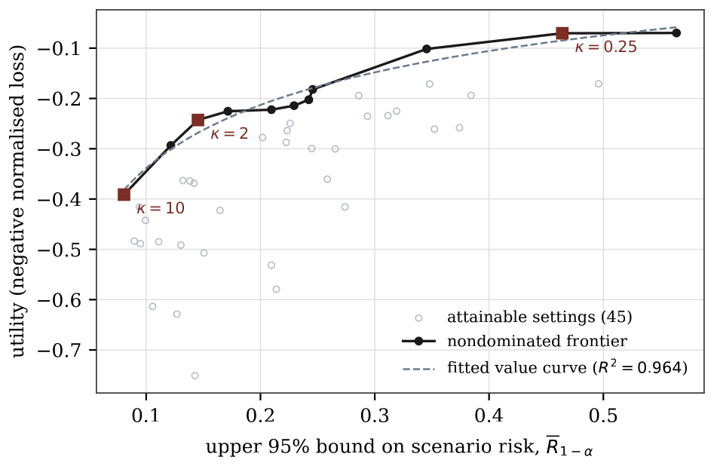
Mechanism choice is a constrained problem on the frontier, and the risk coordinate must be the bound the rule uses
C
The tolerance is policy
PART C · SECTION 6 · PROPOSITION 8
Forty-five mechanism settings, eleven of them nondominated, and the frontier spans risk from 0.081 to 0.564. The conditions for an interior optimum fail on a discrete grid, so the honest report is an approximate optimiser with the search resolution stated.
The frontier is steep where it matters
Halving the bound from 0.1715 to 0.0806 costs 0.17 of utility, half the range the whole frontier spans, and cuts the records retained from 100 to 58 per cent.
A frontier drawn with point estimates and a rule applied with bounds are not the same object. An institution that mixes them will choose mechanisms its own rule rejects.
The marked points are the settings the price ratios of the next frame select, and the risk coordinate is the one-sided bound rather than the point estimate.
R. R. M. Mahomane · Quantitative risk assessment for data privacy · Session 5, Lisbon, 15 September 2026
15 / 29
Notes:
Figure 4 of the paper. Say the steepness result: the cheap protection has already been bought.

Slide 16
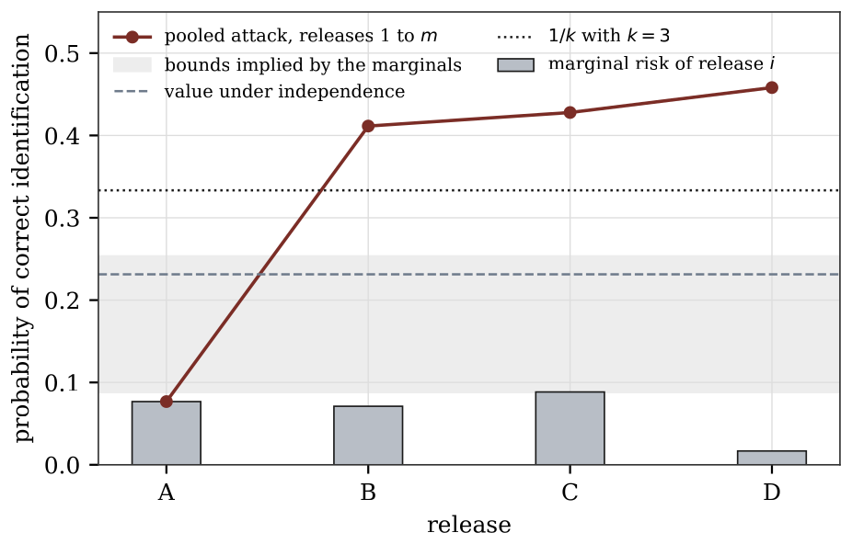
Marginal risks cannot bound what an adversary who pools the releases achieves
C
The tolerance is policy
PART C · SECTION 7 · PROPOSITIONS 9 AND 10
max_{i} R_{i} ≤ R∪ ≤ min(1, Σ_{i} R_{i})
(7)
Both ends of the marginal bound are attained, so the marginals identify no narrower interval. But the union is the wrong event: an adversary holding all releases applies a joint rule, and for every tolerance and every number of releases there exist releases with marginal risk below it whose pooled attack succeeds with probability one.
Four ordinary releases from one sample
Each 3-anonymous on demographic keys, with no unique record anywhere. Marginals 0.0768, 0.0711, 0.0884 and 0.0168, so the bound is [0.0884, 0.2530]. Two releases already reach 0.4114, and four reach 0.4581, which is 1.8 times that bound. 26.0 per cent of targets are uniquely identified by the intersection.
And ranking releases by their own risk does not rank their contribution: release D has the smallest marginal, 0.0168, yet adds 0.030 to the pool, while release C, the largest at 0.0884, adds 0.017.
Marginal figures license no programme claim. A programme tolerance needs direct joint simulation.
R. R. M. Mahomane · Quantitative risk assessment for data privacy · Session 5, Lisbon, 15 September 2026
16 / 29
Notes:
Figure 5 of the paper. The pooled line leaves the band at two releases, not at four.

Slide 17
Formal privacy answers a different question, and its parameter is not a linkage probability
C
The tolerance is policy
PART C · SECTION 9
Pr(H | M ∈ E) ≤ e^{ε} p / ( e^{ε} p + (1 − p) )
(8)
Prior available to the adversary | ε = 0.5 | ε = 1 | ε = 2
0.1, which a 10-anonymous key class supplies | 0.155 | 0.232 | 0.451
At a prior of one third the same ε = 1 permits 0.576. An institution that adopts ε = 1 has not chosen a tolerance of 1. It has chosen a multiplier on whatever prior the adversary brings, and the tolerance it implicitly accepted depends on the key structure of the file.
Scenario-conditional risk
Formal privacy
What a named adversary would achieve against this release. The question a committee, a data protection authority and an affected person all ask.
What any adversary could learn across a programme. It composes without any assumption about dependence, which scenario analysis cannot.
Run an accountant for the programme budget and a scenario assessment for the release decision, and report them separately with their assumptions attached.
R. R. M. Mahomane · Quantitative risk assessment for data privacy · Session 5, Lisbon, 15 September 2026
17 / 29
Notes:
Do not let the room read this as a defeat for the scenario approach. The two answer different questions and both belong in the record.

Slide 18
The tolerance is a policy quantity, and a programme of releases needs its own
C
The tolerance is policy
PART C · SUMMARY
ONE RELEASE
The threshold
The frontier
Release and file
six parts: tolerance, owner, expiry, adversary, harm class, error probability
pick the setting that maximises utility subject to the bound
the record is what a supervisor reads later
A PROGRAMME OF RELEASES
Release 1
Release 2
Release 3
Release 4
One adversary pools them
1.8
low risk
low risk
low risk
low risk
a joint rule on all releases
times the bound the four marginals imply, and two releases are enough
Worked example: the tolerance is implied, and it is not one tolerance
A price ratio of five implies a tolerance of 0.081. An institution that states 0.05 on one release and 0.20 on another has priced harm differently in the two cases, and should be able to say why.
No function of the marginal figures can bound the pooled attack, so a programme tolerance has to be certified by joint simulation.
R. R. M. Mahomane · Quantitative risk assessment for data privacy · Session 5, Lisbon, 15 September 2026
18 / 29
Notes:
Two lanes, and the second is the negative result. Point at the 1.86.

Slide 19
Every claim made on generated data reappears on two files that were actually published
E
Evidence
EVIDENCE · SECTION 11
86.3%
0.98
1.86
of the 29,501 census records are unique on their full key, and the mean reciprocal frequency is 0.928
identifies the worst record in a five-anonymous release, bounded below by 0.925, against a nominal 0.2
times the union bound of 0.381 is what four pooled releases reach, at 0.709
The census sample
The mortgage applications
The declared adversary, which misreads the key with probability 0.10 and holds a noisy reading of income, beats exact matching at every setting by a factor between 3.0 and 3.9: 0.062 against 0.240 at the widest bands. Four of 25 settings are nondominated, and they sit between 0.259 and 0.549.
12.2 per cent of the 1,986 applications sit in a class where every application received the same decision, and 0.65 per cent in a class where every one was denied. Sixteen of 48 published cells hold a single application, so that amount is the published total.
Two of the three effects are larger on the real files than on the synthetic one, because real key components are less redundant than generated ones.
R. R. M. Mahomane · Quantitative risk assessment for data privacy · Session 5, Lisbon, 15 September 2026
19 / 29
Notes:
The 0.98 against a nominal one in five is the number that stops the room. Say it and pause.

Slide 20
Six tests the framework can fail, and what the simulation returned against each
E
Evidence
EVIDENCE · SECTION 14
THE TEST
WHAT CAME BACK
VERDICT
Linkage calibration
a mean gap of 0.007 for the correct model and 0.053 for a misspecified covariate precision, while the two risk estimates differ by 0.001
PASSES
Population-frequency validation
the fitted law recovers the mean population cell to within 1 per cent and the journalist risk to between 13 and 18 per cent, conservatively
PASSES
Adversary stress test
a covariate twice as precise raises the risk by 1 to 76 per cent across the 45 settings, median 40 per cent
INFORMS
Mechanism monotonicity
every row of the k-anonymity table violates the nominal bound on the supremum control
FAILS
Composition
the marginal bound is beaten by a factor of 1.6 at two releases
FAILS
Temporal transport
the only one of the six that cannot be run at assessment time, which is what the expiry date enforces
PENDING
A failure here is informative rather than fatal: it names which claim the release cannot make, and the two that fail are the two negative results.
R. R. M. Mahomane · Quantitative risk assessment for data privacy · Session 5, Lisbon, 15 September 2026
20 / 29
Notes:
Section 14 of the paper, verbatim in substance. Reproducing the equations is an implementation check; these are the tests that could contradict the model.

Slide 21
A credit register creates five different harms at once, and a minimum cell count governs one of them
D
The credit register
THE CASE · SECTION 12.1
What the register is
FIVE HARMS, TOLD APART
A record ties a named borrower to a named lender. The institution publishes from it continuously in three ways at once: a loan-level file for research, aggregates by region, sector and lender, and a monthly series with revisions. That combination makes it a different problem from a demographic file.
1
A borrower is identified
2
A borrower and lender relationship is alleged
3
Arrears status is inferred for a class
The simulated register
4
A lender contribution is reconstructed
32,581 relationships between 20,000 borrowers and 60 lenders. Eighteen sectors, twelve regions and four size classes, so the borrower key has 864 cells. Six monthly vintages with entries and exits, exposure lognormal within size class, arrears at 7 per cent, and the largest lender holding 23 per cent.
5
Two consecutive vintages are differenced
One lever is under test: a minimum cell count on the borrower key. A single risk figure covers the first harm only.
R. R. M. Mahomane · Quantitative risk assessment for data privacy · Session 5, Lisbon, 15 September 2026
21 / 29
Notes:
The room collects this data, so the setting needs no explanation. Spend the time on the five harms.

Slide 22
Raising the cell count halves identification risk for large borrowers and leaves reconstruction untouched
D
The credit register
THE CASE · ONE LEVER, FIVE COLUMNS
Cell count | Kept | Large borrowers | Allegation | Status | Utility
1 | 1.000 | 0.185 | 0.345 | 0.427 | 0.000
5 | 0.993 | 0.204 | 0.343 | 0.388 | −0.039
10 | 0.970 | 0.141 | 0.339 | 0.291 | −0.115
20 | 0.889 | 0.089 | 0.332 | 0.160 | −0.204
large borrowers
allegation true
status disclosed
Identification for the largest size class, the probability that a named relationship is true, and the share of large borrowers whose class reveals their arrears status. Reconstruction is a property of the aggregates and does not appear. Nor is utility one number: of the loss of 0.204 at a cell count of twenty, sectoral exposure and lender supervision lose 0.432 and 0.359, concentration and the arrears ratio 0.011 and 0.004.
cell count 1
5
10
20
Read the columns across rather than down. One lever moves the five harms at five different rates, and the last of them not at all.
R. R. M. Mahomane · Quantitative risk assessment for data privacy · Session 5, Lisbon, 15 September 2026
22 / 29
Notes:
The middle series barely moves. That flat blue line is the frame.

Slide 23
Identification is a subgroup problem, and an alleged relationship is a base-rate statement
D
The credit register
THE CASE · HARMS ONE AND TWO
Identification, by size class
An alleged relationship
Micro
0.040
Prevalence of a given pair | 0.0261
Sensitivity of the rule | 0.221
Specificity of the rule | 0.989
Small
0.082
Medium
0.092
Large
0.185
Scoring matters too: recovering the exact relationship succeeds for 0.0695 of released rows, recovering the right borrower for 0.0925, because a borrower with several lenders can be found through any of them. And the subgroup rests on few targets: [0.138, 0.240] at no suppression and [0.044, 0.158] at a cell count of twenty. What the evidence supports is a fall of roughly half, and a lever that is unreliable at its first step, rising to 0.204 at five before falling.
0.345
is the probability that an allegation is true: 1.5 times the success rate of always naming the largest lender in the market, and wrong about two borrowers in three. A specificity of 0.989 sounds protective and is not, because the prevalence is low, and the cell count barely moves it: 0.332 at twenty.
The lever that governs identification does not govern relationship disclosure, and an institution reporting only the first has not addressed the second.
R. R. M. Mahomane · Quantitative risk assessment for data privacy · Session 5, Lisbon, 15 September 2026
23 / 29
Notes:
Say the specificity point slowly: a rule right 98.9 per cent of the time on non-pairs still produces mostly wrong allegations when pairs are rare.

Slide 24
Seven policies that agencies operate, four attacks, one register, reported the way an attack is reported
D
The credit register
THE CASE · SECTION 13
The adversary
SEVEN POLICIES, EACH IN OPERATIONAL USE
Policy | Release | Pooled | Worst class
No suppression | 0.079 | 0.209 | 0.122
Three contributors | 0.067 | 0.209 | 0.065
Complementary suppression | 0.069 | 0.225 | 0.076
k-anonymity, k = 5 | 0.062 | 0.224 | 0.061
k-anonymity, k = 10 | 0.055 | 0.194 | 0.036
Noisy counts, ε = 1 | 0.000 | 0.000 | n/a
Noisy counts, ε = 5 | 0.005 | 0.005 | n/a
Holds sector, region and size class exactly, plus one noisy reading of log exposure per vintage. It blocks on region, scores the candidates whose key agrees with the target, and names a record only when its posterior passes one half, so it may abstain. Each entry rests on 4,000 simulated attacks.
Four attacks
Identification of one borrower, per release and pooled across the six vintages. An alleged borrower and lender relationship. Arrears status read off a class whose members agree. And a unit change between vintages read as a single loan movement.
Against a tolerance of 0.12 on the pooled attack, the highest-utility policy in the set that meets it is noisy counts at ε = 5, and the price is the loan-level work supervision needs.
The question is not whether a new mechanism is better. It is whether the quantity these policies are calibrated against governs the programme they belong to.
R. R. M. Mahomane · Quantitative risk assessment for data privacy · Session 5, Lisbon, 15 September 2026
24 / 29
Notes:
Every policy in the left table is in use somewhere in this room. That is the reason it is persuasive.

Slide 25
Suppression reduces the risk of a release, does far less to the programme, and the average hides the rest
D
The credit register
THE CASE · SECTION 13.3
1
Every policy reduces it, none removes it
one release
pooled over six vintages
the binding constraint is the exposure reading, not the cell size
0.209
0.209
0.225
0.224
0.194
2
The programme is a different story
0.062 at k = 5 becomes 0.224 across the six vintages
0.079
0.067
0.069
0.062
The adversary is accurate when it acts
0.055
3
it acts on 0.011 of attempts and is right on 0.761 of those
no suppression
three contributors
three, complementary
k = 5
k = 10
4
The average conceals a subgroup
The ordering of policies by the risk of one release is not their ordering by the risk of the programme. The largest gap, 0.162, belongs to k-anonymity at five.
the worst size class at k = 5 has a corrected bound of 0.061
Same tolerance of 0.12: calibrated on one release the answer is a cell count of one, keeping 32,581 relationships. Calibrated on the pooled attack it is fifty, keeping 20,389.
R. R. M. Mahomane · Quantitative risk assessment for data privacy · Session 5, Lisbon, 15 September 2026
25 / 29
Notes:
The bottom strip is the governance headline of the whole talk. Say the two numbers slowly.

Slide 26
The continuous reading does the work, not the key, and five harms need five entries in the threshold
D
The credit register
THE CASE · SECTIONS 13.5 AND 12.1
WITHDRAW THE ADVERSARY INFORMATION, ONE FIELD AT A TIME
FIVE HARMS, FIVE ENTRIES IN THE THRESHOLD
All four fields
0.072
1
Large borrowers: a subgroup tolerance
No size class
0.041
2
An allegation: a tolerance on its truth
No exposure reading
0.026
3
Status: an attribute rule, not a cell count
Region and exposure only
0.003
4
Reconstruction: a contributor rule
Without the exposure reading, the dark bar, the adversary never passes its own decision threshold, because a released cell holds at least five members and nothing separates them. Protection effort spent on the key buys less than protection effort spent on the published continuous variable.
5
The series: a programme tolerance
No tolerance stated for this register
An institution that knows what its adversary can read about exposures knows most of what it needs to know about its own risk.
R. R. M. Mahomane · Quantitative risk assessment for data privacy · Session 5, Lisbon, 15 September 2026
26 / 29
Notes:
The left chart is the operational finding a supervisor can act on this month.

Slide 27
One register, five harms, and five levers rather than one
D
The credit register
THE CASE · SUMMARY
AT k = 20
A borrower is identified
a subgroup tolerance
0.185 → 0.089
A relationship is alleged
a tolerance on its truth
0.345 → 0.332
The credit register
32,581 relationships, six monthly vintages
Arrears status is inferred
an attribute rule
0.427 → 0.160
A contribution is reconstructed
a contributor rule
no change
Two vintages are differenced
a programme tolerance
no change
One lever, five harms, five different rates of response, and two of them do not respond at all. That is why the record needs five entries.
R. R. M. Mahomane · Quantitative risk assessment for data privacy · Session 5, Lisbon, 15 September 2026
27 / 29
Notes:
Close the case with this. The right-hand column is the argument of the whole talk.

Slide 28
The record to file with every release decision, in this order, each stage written down before the next
RECOMMENDATION · SECTION 15
1
Declare
the attack scenario, the target set, the harm class, the uncertainty set and the loss
2
Compute
the point estimate, the one-sided bound and the number of replicates, with the dependence between them stated
3
Review
whether the declared scenario is plausibly conservative, using the six tests
4
Apply
the tolerance, through the named owner, to the bound rather than to the point estimate
5
File
the complete record with its expiry date and evidence sufficient to reproduce the computation
Two further items for a programme
Two separate responsibilities
The joint attack simulation with its own tolerance, and, where a formal mechanism is used, the accountant’s running total with the method named. Neither can be inferred from the single-release records.
The owner owns the residual risk. The analyst owns the correctness of the calculation. They should sit with separate people.
The record does not remove judgement. It puts judgement where it belongs and leaves the calculation reproducible.
R. R. M. Mahomane · Quantitative risk assessment for data privacy · Session 5, Lisbon, 15 September 2026
28 / 29
Notes:
This is Section 15 of the paper. Leave it up for questions.

Slide 29
Quantitative risk assessment for data privacy
THANK YOU
Probability models, estimation uncertainty and governance thresholds
Ronald Rethabile Malamule Mahomane
Department of Computing, Mathematical and Statistical Sciences, University of Namibia, Windhoek
School of Pathology, Faculty of Health Sciences, University of the Witwatersrand, Johannesburg
Basis Energy, Victoria, Australia
ron@basisenergygroup.com
Where to press
Section 7 on composition, Section 8 on optional stopping and the attacker payoff, and Section 13 on the seven policies. Every figure, table and quoted number is produced by the packaged pipeline, and Section 10.9 describes what a run writes.
Questions welcome, and the composition result is the part worth pressing on.
R. R. M. Mahomane · Quantitative risk assessment for data privacy · Session 5, Lisbon, 15 September 2026
29 / 29
Notes:
Leave this up for questions.

