Slide 1
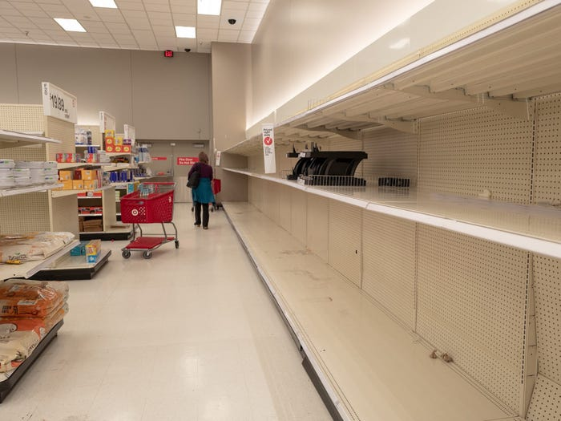
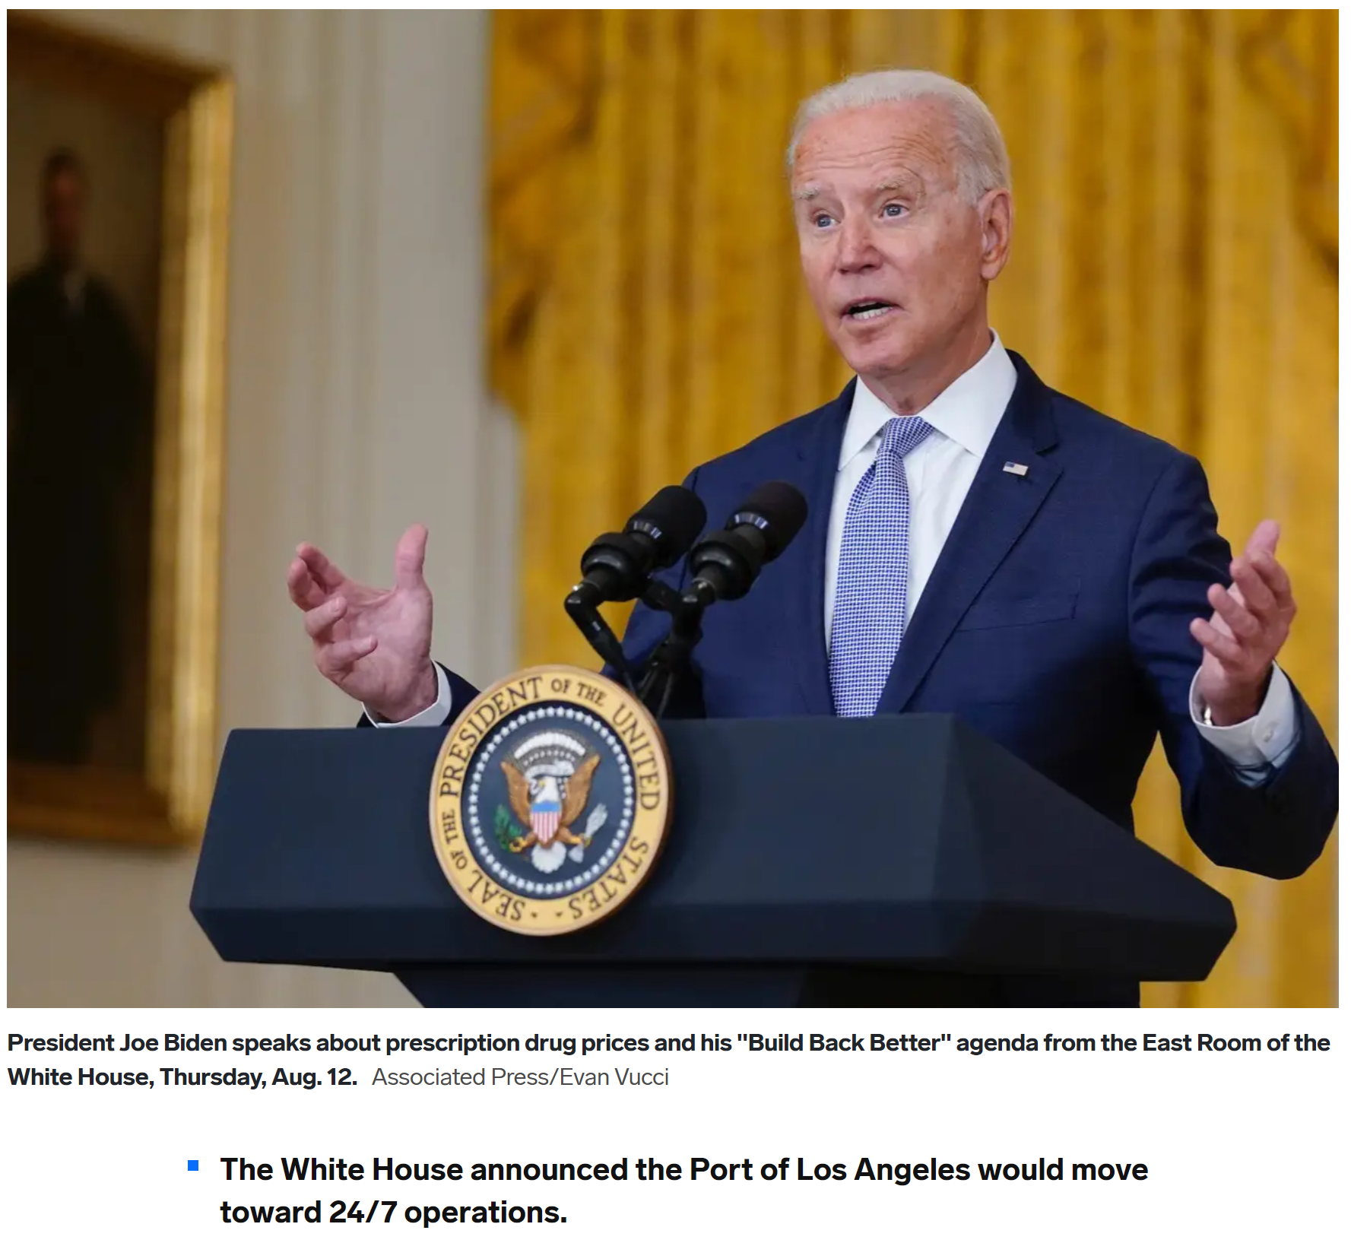


Differential Privacy via a Flask REST API
Jason C. Nucciarone
Introduction/Motivation
Major supply chain issues as the economy tries to recover from the Coronavirus pandemic.
Demand is so high now that it seems like 50 million new Americans joined the market.
Trying to get multiple, small stakeholders to work together (i.e. trucking companies, warehouses).
Can work together through shared data!
Major privacy-related issues
Could share data via public dataset and could work together to gain insights.
Public datasets can be used by adversaries to gain auxiliary information on targets.
No perfect, non-trivial database sanitization algorithm exists!

Slide 2
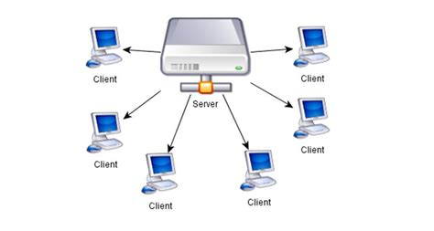
Differential Privacy via a Flask REST API
Jason C. Nucciarone
Your dataset and specific privacy concerns
Payment Protection Program gives valuable insight to economic activity.
Might expose a struggling business. Employees might become target of payday loan companies.
Small businesses might become targets by larger competitors if they are falling behind.
Information might be used to deny a small business an expansion loan.
Your privacy preserving approach
Built a REST API using Flask that communicates with outside parties via HTTP.
User can submit SQL query as a URL which the server will parse.
Server will use SQL query to calculate the sensitivity and the apply noise to query’s results.
Unfortunately, some queries are not very accurate. COUNT and SUM do great while AVG is very inaccurate from the original value.
Since query must be analyzed first to determine sensitivity, only certain SQL queries can be supported.
http://localhost:5000/diff/SELECT+COUNT(*)+FROM +PPP
http://localhost:5000/diff/SELECT+ SUM(PAYROLL_PROCEED)+FROM +PPP+WHERE+BusinessType=‘Corporate’

