Slide 1
Level up your workflow
A presentation about the tools you can use in the i-Ask center to make yourself an unstoppable problem-solving machine

Slide 2
Table of Contents
Expert SSH Clients
Virtualization Tools
Software Tools/User-level package managers
Source code editors
Online Resources
Some good books

Slide 3
Expert SSH Clients

Slide 4
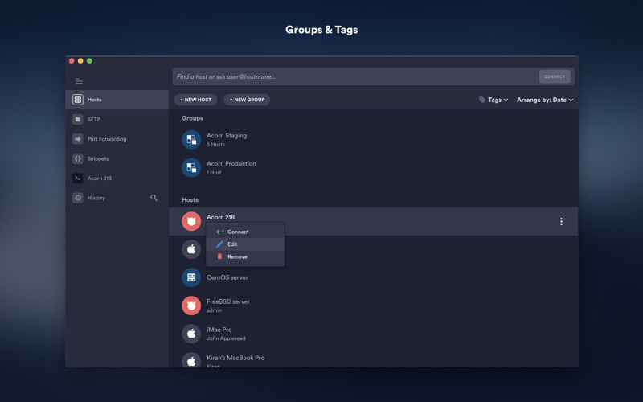

Termius

Slide 5
Termius Pros and Cons
The Pros ☺
The Cons ☹
Cross-Platform
  Your account settings travel with you
Save and run code snippets
Easy to use built-in SFTP client
Free Basic Plan
Ad Free
Premium plan with all the cool features costs money
  Free with GitHub Student
Doesn’t have all the bells and whistles of other professional SSH clients
No X11 forwarding capability

Slide 6
Termius in Action!

Slide 7
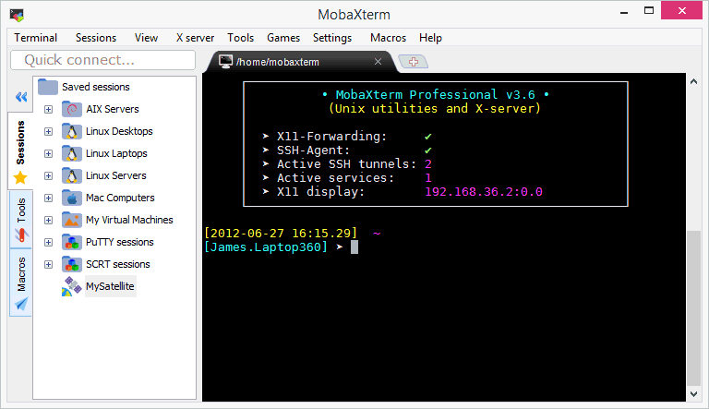
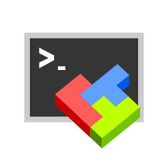
MobaXterm

Slide 8
MobaXterm Pros and Cons
The Pros ☺
The Cons ☹
Can save hosts
Embedded X server
  Has X11-Forwarding capability
Highly configurable with plugins
Graphical SFTP browser
Ads come with Home edition
Featuritis
  Many features are outside the scope of what i-ASK techs do. More geared towards SysAdmins like Chad Franklin
Windows-Only

Slide 9
Virtualization Tools

Slide 10
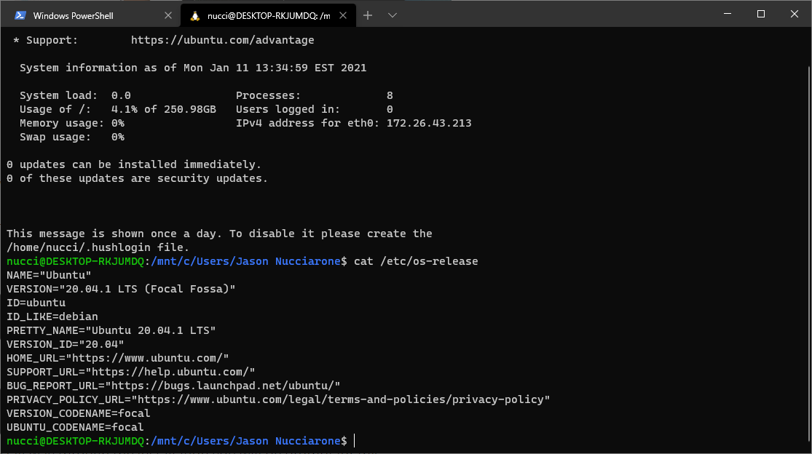
Windows-Subsystem Linux 2 (WSL2)
Light-weight virtualization platform
Run Linux Distros from the Windows command prompt
  Can download distros from Windows Store
Can run Singularity*
Run Docker back-end
Can run graphical Linux/Unix Apps

Slide 11
WSL2 in Action!

Slide 12
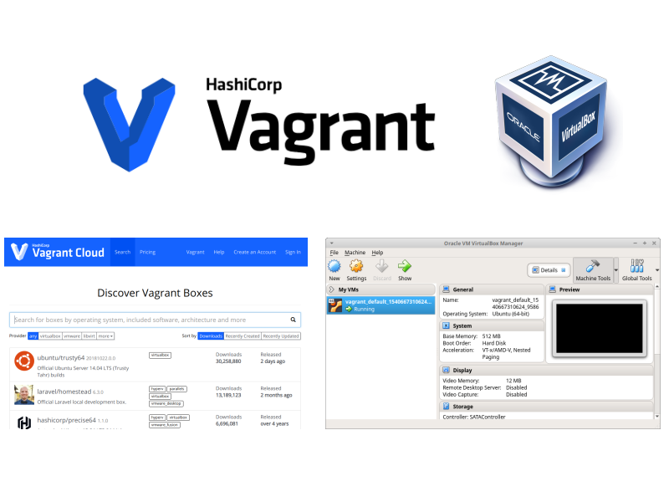
Vagrant
Another light-weight virtualization tool
  Doesn’t mount hard drive like WSL2
Have more distros to choose from
Uses Oracle VirtualBox or VMWare to run VMs
Can run graphical Linux/Unix apps

Slide 13
Vagrant in Action!

Slide 14
Software Tools/
User-level package managers

Slide 15
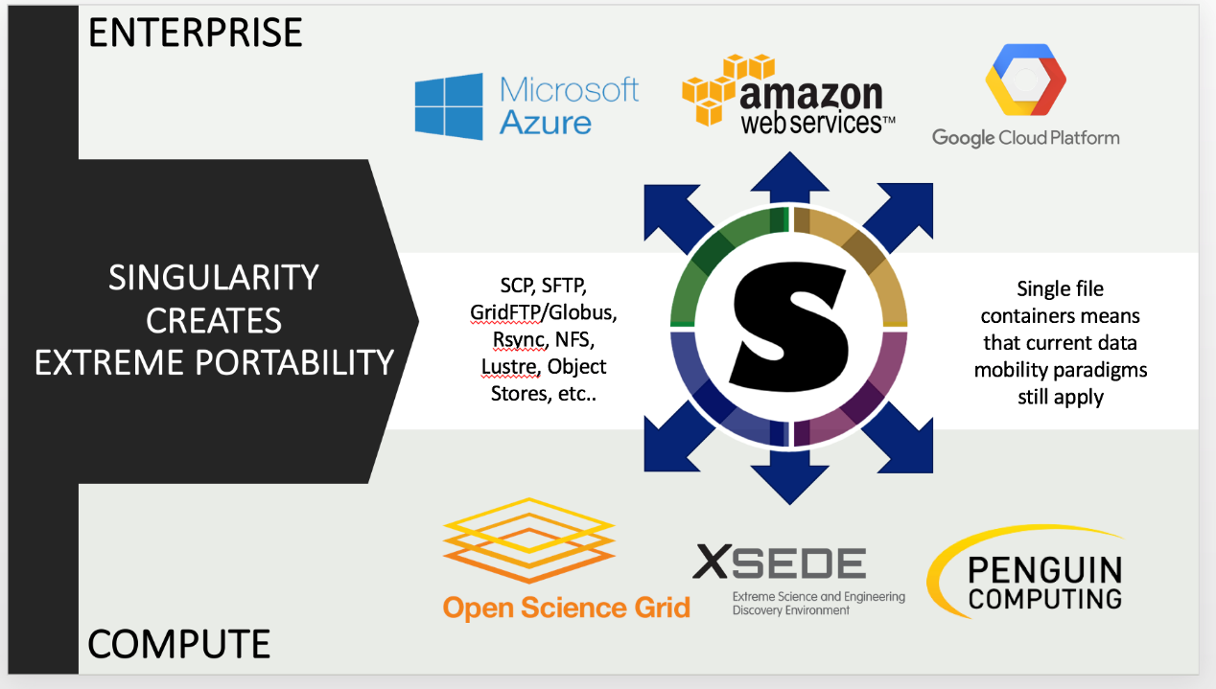
Singularity
The gold-standard for containerization on HPC clusters
Like Docker but more secure
  The same person inside the container as you are outside of it
Great for managing system-level dependencies
Example of Build Definition Files

Slide 16

Spack: A Flexible package manager for HPC
New tool on the block
  Main software stack is deployed using spack
Thousands of packages available!
Can find more documentation here
Example of Spack in use on the cluster (GitHub Repo still a work in progress)

Slide 17

Anaconda (and Anaconda Cloud)
Amazing for all things Python and R
  Has packages for C/C++/Perl too!
Packages are handled in the form of environments
“Duct-tape of the cluster”
Can use environments in Jupyter Notebook
Environments are versatile thanks to YAML files

Slide 18
Anaconda in Action!

Slide 19
Source Code Editors

Slide 20
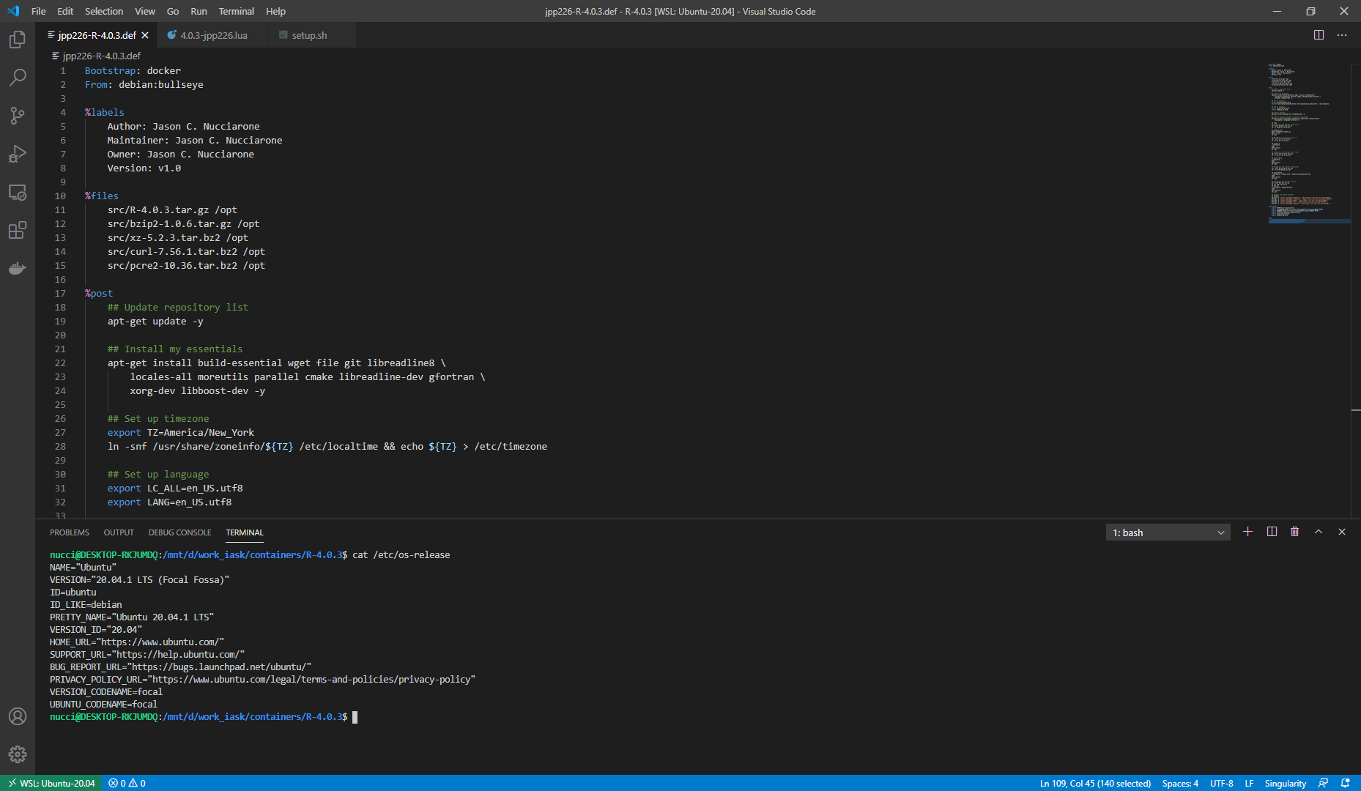
VSCode (or VSCodium)
Awesome source code editor put out by Microsoft
Highly configurable thanks to plugins
  I have plugins for Git, GitLab, Singularity, Docker, etc.
Built-in Markdown Previewer
  Great for writing READMEs!
Remote Development plugin allows for working in WSL2

Slide 21
Online Resources

Slide 22
So Many Resources!
Stack Overflow
Tutorialspoint
  Their shell scripting tutorial is very helpful
Lmod Documentation
i-ASK Center GitHub
My own GitHub
  And other projects

Slide 23
Some Good Books

Slide 24
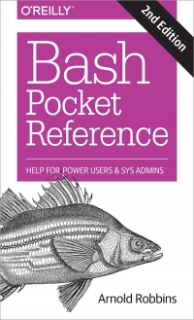
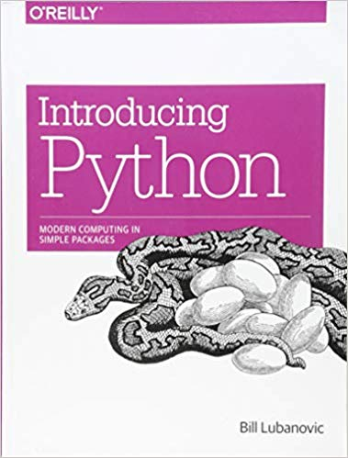
My two favorites

Slide 25


