Slide 1


Singularity and Docker
An introduction to containerizing a researcher's workflow

Slide 2

Table of Contents
What are Singularity and Docker?
Pros and Cons to using one over the other
Interactive Example
Where should you go from here?

Slide 3
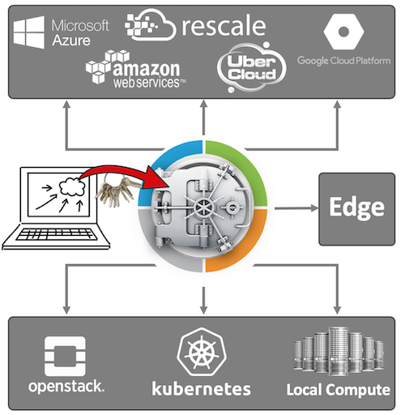
What is Singularity?
The gold-standard for containerization on HPC clusters
Preferred choice for mission-critical workflows
Used in aerospace, oil and gas, and biotechnology industries
Security first mindset
Extremely portable
No one is hacking you!
Can run in any environment that has singularity RE installed

Slide 4
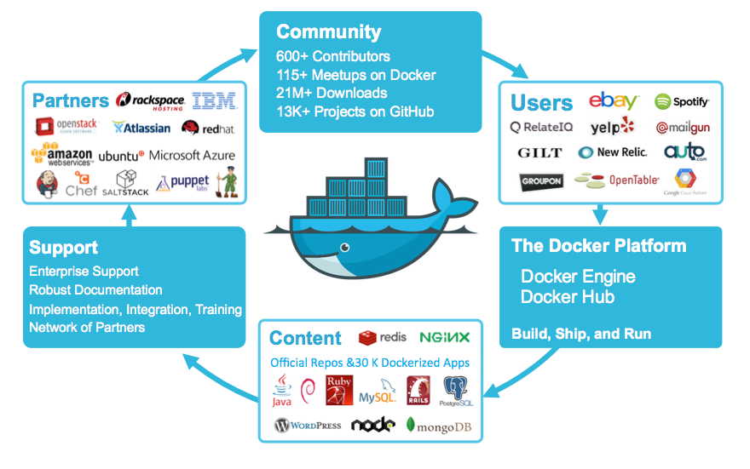
What is Docker?
Another popular, ubiquitous containerization software
Heavily used in the tech industry
  Kubernetes anyone?
Extremely adaptable to any kind of workflow
Cross-Platform
  Works on Linux, MacOS, and Windows

Slide 5
The Pros and Cons of Singularity
The Pros ☺
The Cons ☹
Uber secure
  Singularity containers are read-only
Space efficient
  Containers are compressed to conserve available storage space
Installed on Roar
Can easily manage system-level dependencies
Interoperable with Docker
Only supports static environments
Only available for use on Linux
  Need to use a work-around to build containers on Windows and Mac
User community isn’t as large as compared to Docker
  Finding support can be a little difficult

Slide 6
The Pros and Cons of Docker
The Pros ☺
The Cons ☹
Ubiquitous, virtually used everywhere
Cached builds
  Start from where you left off if build fails
Support dynamic environments
Can modify containers after being built from images
Multithread container downloads and uploads
Not installed on the cluster
Security is managed by user, not built-in
  Container security has become an entire industry because of Docker
Not resource conscious
  Bloated containers

Slide 7
Interactive Example Time

Slide 8

Set up your build environment!
Open the terminal on your computer
Create directory titled VMs
Change into VMs directory and create SINGULARITY directory
In SINGULARITY directory, enter the following commands:
  vagrant init sylabs/singularity-3.6-ubuntu-bionic64
  vagrant up

Slide 9
Time to build your container!
Use the following commands:
  vagrant ssh
  git clone https://github.com/NucciTheBoss/iask_onboarding_spring_2021.git
  cd iask_onboarding_spring_2021/day_2
  sudo singularity build image.sif R-4.0.3-rstudio.def
    sudo password is “vagrant”
Now we wait!

Slide 10

Demonstration!

Slide 11
Where should you go from here?
Feel free to play around with my repository:
  https://github.com/NucciTheBoss/iask_onboarding_spring_2021
Experience is the greatest teacher!
  Create your own containers
  Play around with containers we already created
Ask for help!
  Will, Justin Petucci, and I use Singularity all the time
  Add me as a collaborator on a git repository!
    I can provide input if you need help!

Slide 12


