Slide 1
NuShellX Tutorial
Presented by:
Adam B Jones

Slide 2
Outline
How to obtain NuShellX.
Starting NushellX
Calculating Spectra
Calculating transitions.

Slide 3
How to Obtain NuShellX
From B. A. Brown’s website
  NuShellX@MSU for Windows PC can be obtained by sending an email to:
    brown@nscl.msu.edu
  This version runs directly on any Windows PC without the need for any other software.
  NuShellX@MSU is an adaption of W.D.M.Rae's code NuShellX with input and output files similar to the older Oxbash code.
  W.D.M Rae's original version of the code can be obtained at his website.
    http://www.garsington.eclipse.co.uk/
There are versions of NuShellX that are made to run on different platforms.
  As far as I know only the windows version is kept up to date so be aware that the versions for different platforms may be inconsistent.

Slide 4
Starting NuShellX -login
NuShellX is designed to be used with a special terminal window.
  The window has commands aliased in a way that is supposed be independent of the platform used.
  This is important because NuShellX is designed to set up and run the shell model interactions using scripts to run different programs and manage their inputs and outputs.
To start this terminal window find the shortcut in the login directory:
  The windows example is:
    C:\aaa\nushellx\windows\login
    “nushellx-login” is the name of the shortcut
    You can relocate this shortcut wherever is convenient for you.
The “nushellx-login” shortcut runs the “login-nushellx.bat” script this script sets up the terminal used for nushellx calculations.
  You may need to modify this file to suit your purposes.
  It is recommended that you change the “OMP_NUM-THREADS” variable to 1 less than the number of cores on your machine so that you reduce contention with your operating system.

Slide 5
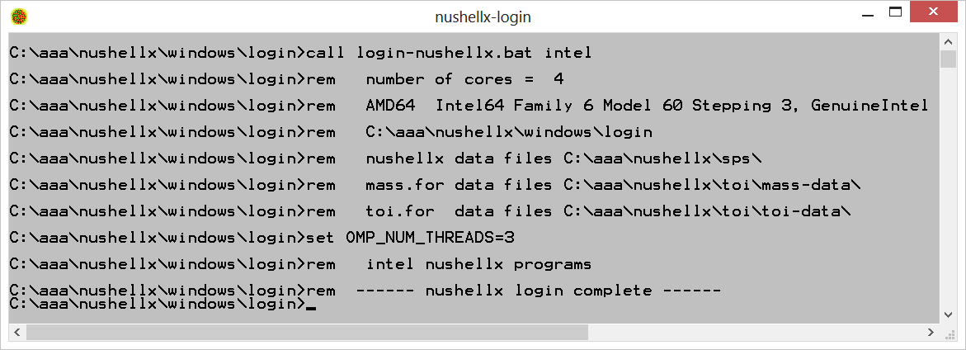
Example NuShellX -login
Below is an example of the nushellx terminal window.
  The login script is set up to print information about the system on startup.
Take a moment and start your own terminal window.
  Verify the OMP_NUM_THREADS is a reasonable value for your system.

Slide 6

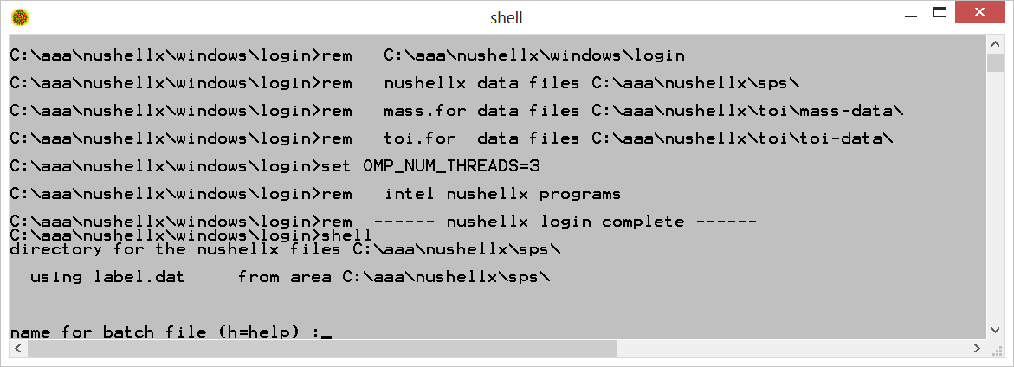
The simplest operation in NuShellX is to calculate the spectrum of a single nucleus.
The first step is to specify the parameters of the calculation and generate the script that will run the calculation.
  This is done by running the program “shell” in the terminal window.
  Be sure to navigate to an empty directory because many files will be created.
  Simply type shell and press enter.

Slide 7
Enter a name for the batch file.
  It is useful to have a naming convention that distinguishes what type of calculation is done.
    Here we will name it after the nucleus we intend to calculate: “ne20”.
We want option “lpe”
  “lpe” is the option to calculate wave functions and spectra.
    The ”lpe” option will be used before any other calculation.
  The “den” option is for calculating wave function overlaps.
    We will discuss this in later slides
  “help” will provide more information.
  “st” ends the generation of the batch file.
    You can put as many calculations in the batch file as you wish.

Slide 8
Next you will be prompted for the model space name: input “sd”.
  The model space names can be found in the first column of the file “label.dat” in the directory following directory
    C:\aaa\nushellx\sps
    This file is an input to NuShellX and the file path is always printed when shell is run.
  The model space refers to the single particle orbitals that the valence particles can occupy.
    “sd” refers to the 1s0d shell of the harmonic oscillator.
    It is critical to choose the appropriate model space for your problem.
You will be asked if you wish to restrict the model space. Press enter.
  A blank answer is the same as “n” for no.
  You may wish to do this if you are calculating in a large space.
  It is not recommended to limit your model space unless absolutely necessary.

Slide 9
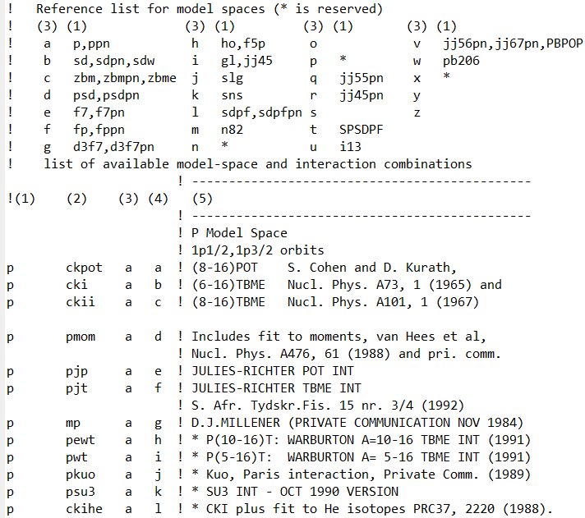
“label.dat”
Model space (*.sp file) name (single-particle state file name)
Interaction (*.int file) name
  In some cases the interaction may consist of several pieces which are read into MATRIX separately. In this case this interaction name is the code word which tells SHELL which *.INT files to include.)
Model space code used for the output files
  (The labels "p" and "n" should be reserved for charge-dependent interaction names)
Interaction code used for the output files
References and information

Slide 10
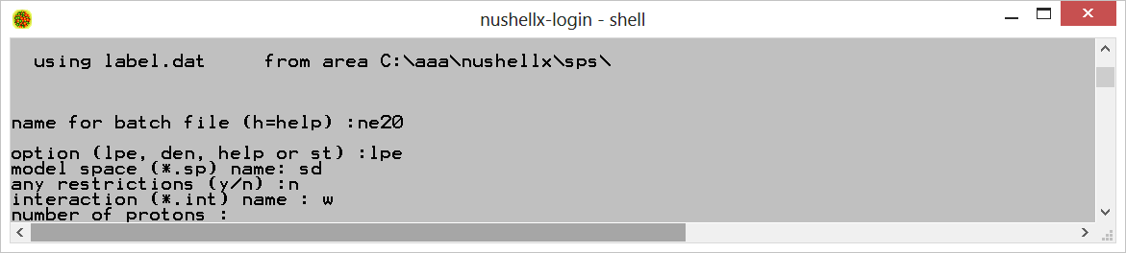
The interaction we will use is “w”:
  The interaction name can be found in the second column “label.dat” file.
  The selection of the appropriate interaction is critical to the validity of a calculation.
    Warning! Not all interactions in the sps directory are intended for the end user.
  The “label.dat” has literature references for some interactions listed in the rightmost column.
    An example row of “label.dat”
      sd w b w ! (W) WILDENTHAL'S A=17-39 "USD" INT (JULY 1982)
    It is recommended that you check the literature for the interaction you use before drawing any conclusions from the results of your calculation.

Slide 11
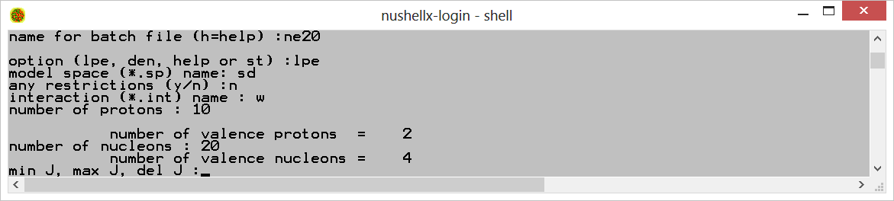
You will be prompted to enter the number of protons: “10”
Number of nucleons is “20”
  The terminal will display the number valence protons and the number of valence nucleons.
    It is a good idea that you check to see if your idea of the many body problem matches up with the output.
    If this doesn’t seem right make sure your model space, proton, and nucleon numbers are correct.
    Hint: negative numbers are bad.

Slide 12
Min J, max J, del J: “0.0, 8.”
  Omitting the “del J” argument is equivalent to using “1.0”
  It is recommended that you calculate all values of angular momenta that you desire at the same time to take advantage of your processor’s parallelism.
    Don’t make different batch files for individual angular momentum values.
  Restricting the momentum is one way to reduce the runtime of the calculation.
Parity “0”
  Restricting parity is another way to reduce the runtime of calculations.
Shell will output an estimate of the runtime for the different angular momentum partitions.
  Check this before you run a calculation for the first time so you know what to expect.
  If any runtime is very large think about what types of restrictions you can make to the angular momentum and parity.
    It is also possible to restrict the number of eigenvalues calculated for each partition
    Only as a last resort should you restrict your model space.

Slide 13
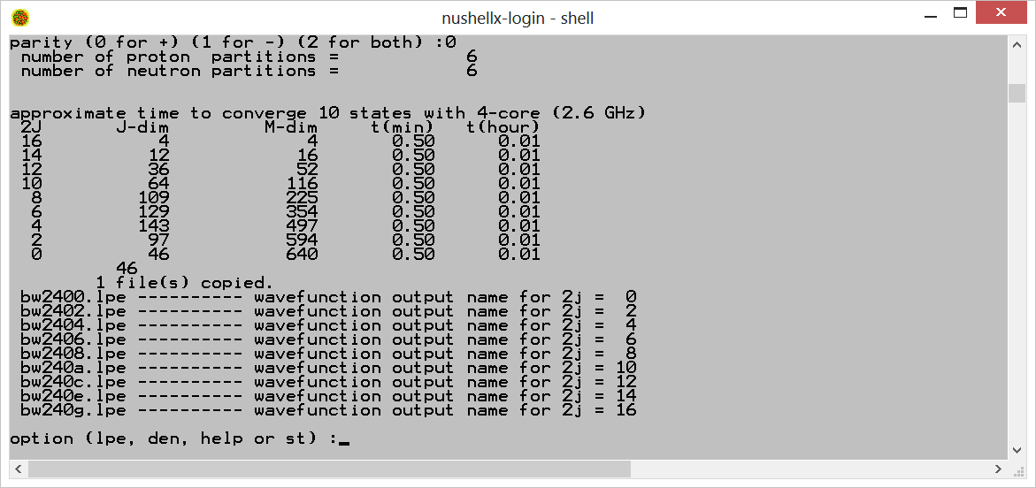
After the runtime estimates for the different partitions shell will output the wavefunction output names.
  These will be important for calculating transitions which we will discuss later.
You will be prompted to enter another option: “st”
  This tells shell you are done specifying a calculation and it should write the batch file.
  If you enter lpe or den you can specify more calculations to be added to the batch file.

Slide 14
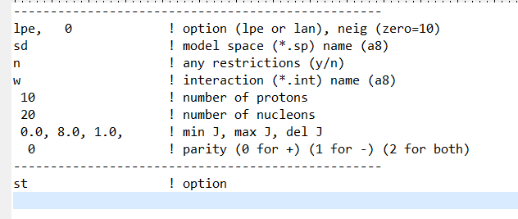
The “.ans” file
This file stores the answers to shell so the batch file can be produced on demand.
This is useful for producing large numbers of batch files using your own code or reproducing a calculation from someone else.
It is also useful if you are prone to typos.
To use the “.ans” file generated in our example type the command:
  “shell ne20.ans”
  The contents of this file are shown below.

Slide 15
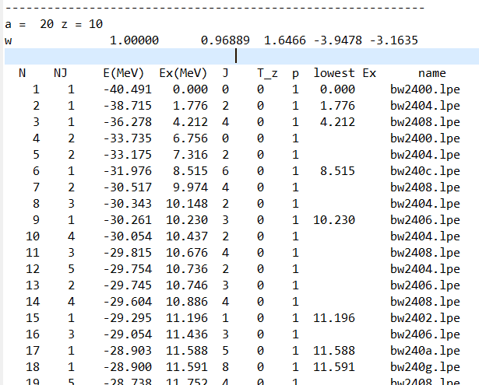
You have exited shell and now will be prompted to run the batch file.
  This will execute a series of programs to generate the outputs that we specified.
Simply type the name you entered at the first prompt:”ne20”
  It should take less than a minute.
  Many hundreds of output files will be generated.
    I have no idea what the function is of most of these files.
NuShellX always generates some human readable output summaries that contain useful information.
  For the spectrum of the nucleus look for an “.lpt” file that starts witht the batch file name.
    In our example it is: “ne20w.lpt”

Slide 16
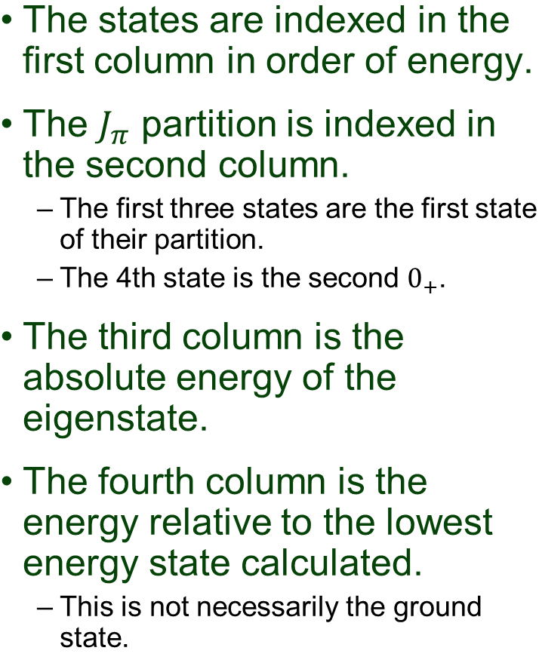

Slide 17
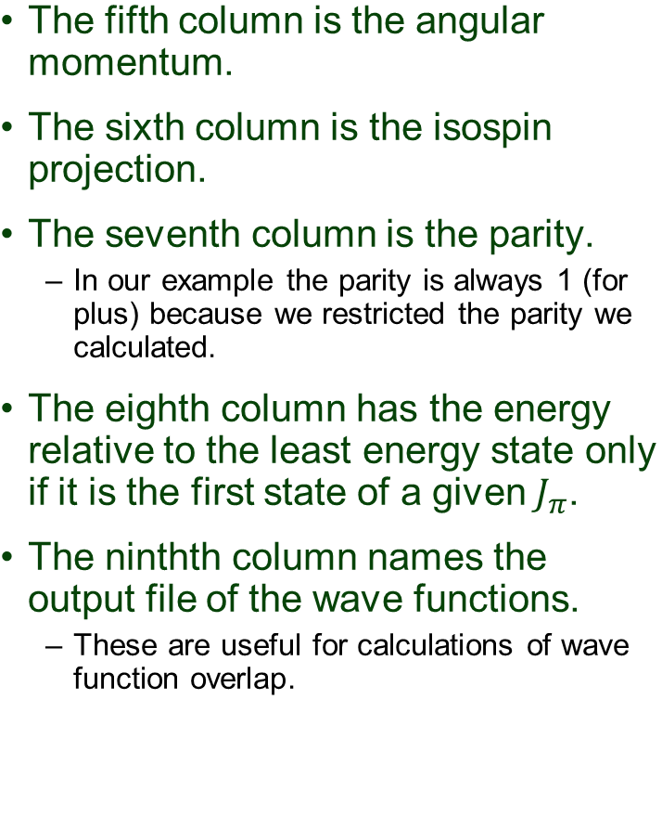

Slide 18
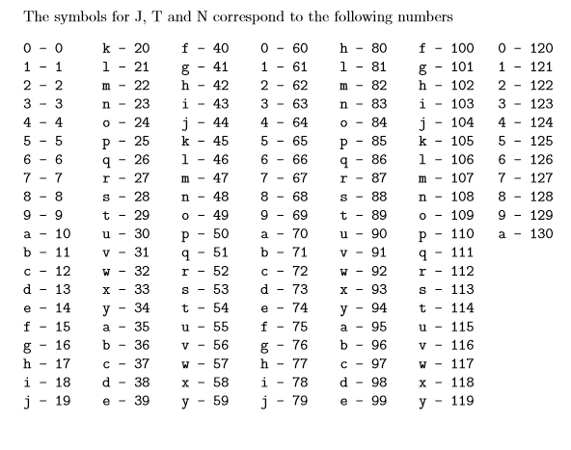
Wave function file names
The name of the wave function files contains information about the states they describe.
Example: bw240c.lpe
  “b” is the symbol for the model space found in label.dat
    Here b stands for the “sd”
  “w” is the symbol for the interaction found in label.dat
    “w” happens to be the name of the potential as well but this is not always the case.
  “2” symbol for the number of valence protons
    Happens to be the number of valence protons but this is true only of single digit numbers.
    See the table to the right
  “4” is the symbol for the number of valence nucleons.
  “0” is the symbol for the parity
    0 for + and 1 for -
  “c” is the symbol for two times the spin.
    12 in this case
    This means the spin is 6.
The table to the right comes from the help file
    C:\aaa\nushellx\help

Slide 19
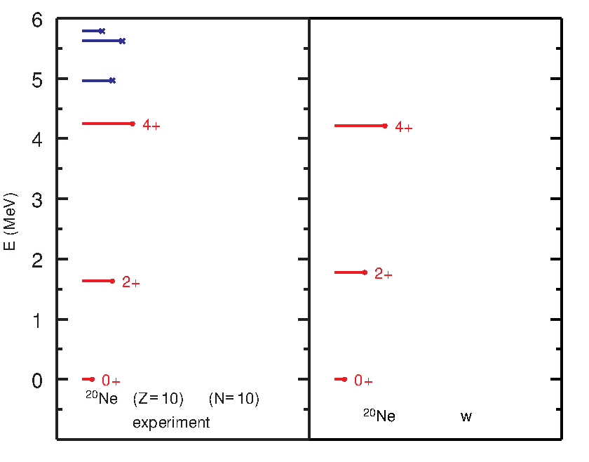
The “.eps” file
NuShellX Will automatically generate simple level scheme diagrams in the encapsulated post script format.
You need an eps viewing program to display these diagrams.
  There is a freeware viewer called “gsview” you can download.
On the right the diagram in the file “ne20w.eps” is shown.
The length of the line is proportional to the angular momentum of the state.
  The angular momentum and parity is labeled only for the lowest level of that angular momentum.
  The color of the line indicates parity.
The experimental values come from a database included with NuShellX.
  I do not know what data is in this database or when it was last updated.
  It is recommended that this data be used only as a qualitative guide.
  Numerical values can be found in the file: “ne20exp.lpt”

Slide 20
We have already calculated the wave functions and energies we need for this example.
The following inputs could have been appended to our previous inputs in shell.
To begin type: “shell”
  Make sure you are still in the directory with the previous output.
We will make a batch script with a different name: “ne20t”
  We could overwrite our previous script but we will keep it for completeness.
We are interested in one body transition densities: “t”
  Note we can also calculate 2 body transition densities and spectroscopic factors.
We need to specify the file name that contains the initial state: “bw2400”
  Note: the final 2 characters are modified by shell when we specify later arguments.
  It should always be safe to end the file name with “00”.

Slide 21
We are interested in only one initial state. “1”
  This is one state for a given angular momentum value.
We need to specify the file for the final state. “bw2400”
  Once again the final two characters will be modified by later input.
We will calculate 5 final states per angular momentum value:”5”
We are interested in only states with J=0 and J=2: 0,2,2
Again: 0,2,2.
  At this point shell has enough information to find the desired wave function overlap files.
We wish to restrict the tensor ranks because we are interested only in E1 and M2 transitions:”y”
For the M1 and E2 transitions: “1,2”
We have everything we need: “st”
Run the batch file by entering: “ne20t”

Slide 22
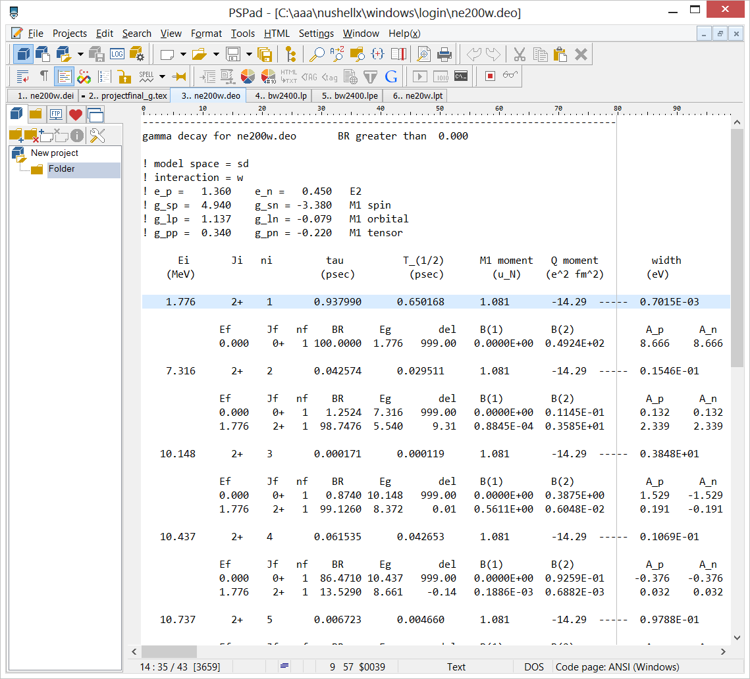
The “.deo” file
After the calculation has run the human readable summary file is output to the current directory:
  In our test case it is: ne200w.deo.
  This file has all the details relevant to gamma decay.
  There is another file that has simpler formatting and some different information with the extension “.dei”. We will not discuss this in detail.
The output is arranged by blocks of initial states.
  Initial state information is in a single row at the start of a block.

Slide 23
The “.deo” file
The lines of initial state information start in the leftmost column and include the following information.
  Initial energy
  Initial angular momentum
  Index of initial state
  Meant Lifetime
  M1 moment
  Q moment
  Width

Slide 24
The “.deo” file
The lines of final state information start in the second column and include the following information.
  final energy
  final angular momentum
  Index of final state
  Branching Ratio
  Energy of the gamma
  del
  B(M1)
  B(E2)
  A_p
  A_n

