Slide 1
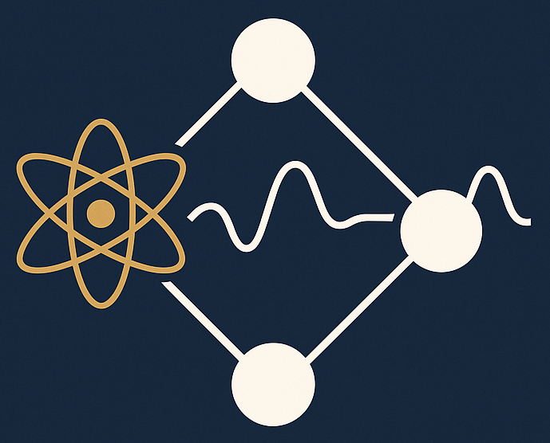
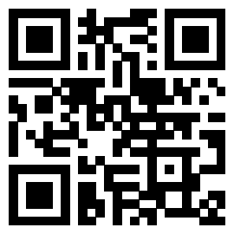
Learning from data for physicists
Bayesian and machine learning methods
by Christian Forssén, Dick Furnstahl, and Daniel Phillips
This text is aimed at physicists seeking to learn from data using Bayesian methods. It is designed primarily for use in an advanced-level course but should also be broadly accessible for individual study to those with a physics background.
https://go.osu.edu/lfd
The book format is powered by Jupyter Book. The complete book as pdf (>900 pages) is also available.
Major parts: Bayesian methods for scientific modeling; Advanced Bayesian methods; MCMC sampling; Machine learning basics; Probabilistic machine learning
Features:
Demonstration code and notebooks are integrated in the Jupyter Book.
Four types of problems: checkpoints (dropdown hints and answers); exercises (answers at end of sections); guided problems (ipynb); projects (complex problems).
Interactive widgets: pdf explorer; Bayesian coin tossing; credible intervals; bivariate gaussians; gaussian processes; MCMC simulations; and more being added!

