Slide 1
AI Chat Bot

Slide 2

What is AI Chat Bot?
In short, AI Chat Bot is a computer program that simulates human conversation or chat, through artificial intelligence.

Slide 3
About the Bot
This is a Chat bot that is designed using Python as the programming language.
It makes use of “ChatterBot” package, which is a machine-learning based conversational dialog engine build in Python which makes it possible to generate responses based on collections of known conversations.
It can presently understand & chat in English language only.

Slide 4
Concepts Used
Artificial Intelligence: Intelligence exhibited by machines for "learning" and "problem solving“.
Machine Learning : Computers the ability to learn without being explicitly programmed.
Natural Language Toolkit (NLTK): Leading open source platform for building Python programs to work with human language data.
Telebot : A Telegram bot library, with simple route decorators.

Slide 5
How Bot is trained?
Training process involves loading example dialog into the chat bot’s database. This either creates or builds upon the graph data structure that represents the sets of known statements and responses.
It makes use of artificial intelligence, computational linguistics and Natural Language Processing (NLP) in which a machine understands natural language (i.e, concerned with the interactions between computers and human).

Slide 6
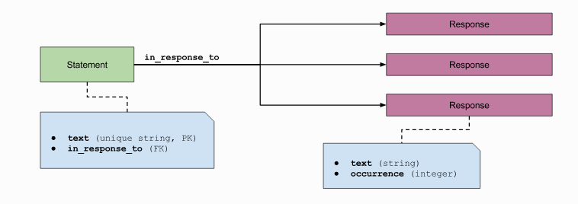
Statement-response relationship

Slide 7
Features
Chat Bot supports the ability to have multiple concurrent chat sessions.
Chat Bot stores knowledge of conversations as statements. Each statement can have any number of possible responses.
This makes it possible for the chat bot to determine if a particular response is more commonly used than another.

Slide 8
Logic Adapters
Logic adapters determine the logic for how Chat Bot selects a response to a given input statement.
The Adapters that are used in this chat bot are:
Best Match Adapter
Mathematical Evaluation Adapter
Low Confidence Response Adapter
Specific Response Adapter
Multi logic Adapter

Slide 9
Best Match Adapter
A logic adapter that returns a response based on known responses to the closest matches to the input statement.
The best match adapter uses a function to compare the input statement to known statements. Once it finds the closest match to the input statement, it uses another function to select one of the known responses to that statement.

Slide 10
Mathematical Evaluation Adapter
The Mathematical Evaluation logic adapter parses input to determine whether the user is asking a question that requires math to be done.
The Mathematical Evaluation logic adapter checks a given statement to see if it contains a mathematical expression that can be evaluated. If one exists, then it returns a response containing the result. This adapter is able to handle any combination of word and numeric operators.
Mathematical Evaluation goes through a set of steps to parse the input and extract the equation that must be solved. The steps, in order, are:
Normalize input: Remove punctuation and other irrelevant data
Convert words to numbers
Extract the equation
Simplify the equation
Solve the equation & return result

Slide 11
Low Confidence Response Adapter
This adapter returns a specified default response if a response can not be determined with a high amount of confidence.
The default response used in our chat bot is "I am sorry, but I do not understand”.

Slide 12
Specific Response Adapter
If the input that the chat bot receives, matches the input text specified for this adapter, the specified response will be returned.

Slide 13
Multi logic Adapter
The logic adapter that the chat bot uses can be specified by setting the logic adapters parameter to the import path of the logic adapter you want to use.
It is possible to enter any number of logic adapters for your bot to use. If multiple adapters are used, then the bot will return the response with the highest calculated confidence value using Multi logic Adapter. If multiple adapters return the same confidence, then the adapter that is entered into the list first will take priority.

Slide 14
Statement comparison
Chat Bot uses Statement objects to hold information about things that can be said. An important part of how a chat bot selects a response is based on its ability to compare two statements to each other.
This Chat bot contains various text-comparison algorithms designed to compare one statement to another to reply with a perfect response.

Slide 15
Algorithms Used
Jaccard Similarity
Levenshtein distance
Sentiment Comparison
Synset Distance

Slide 16
Jaccard Similarity
Calculates the similarity of two statements based on the Jaccard index.
The Jaccard index is composed of a numerator and denominator. In the numerator, we count the number of items that are shared between the sets. In the denominator, we count the total number of items across both sets.
Let’s say we define sentences to be equivalent if 50% or more of their tokens are equivalent.

Slide 17
Examples for Jaccard
Here are two sample sentences:
The young cat is hungry. The cat is very hungry.
When we parse these sentences to remove stopwords, we end up with the following two sets:
{young, cat, hungry} {cat, very, hungry}
In our example above, our intersection is {cat, hungry}, which has count of two. The union of the sets is {young, cat, very, hungry}, which has a count of four. Therefore, our Jaccard similarity index is two divided by four, or 50%. Given our similarity threshold above, we would consider this to be a match.

Slide 18
Levenshtein distance
Compare two statements based on the Levenshtein distance of each statement’s text.
For example, there is a 65% similarity between the statements “where is the post office?” and “looking for the post office” based on the Levenshtein distance algorithm.

Slide 19
Sentiment Comparison
Calculate the similarity of two statements based on the closeness of the sentiment value calculated for each statement.
A basic task in sentiment analysis is classifying the polarity of a given text at the document, sentence, or feature/aspect level—whether the expressed opinion in a document, a sentence or an entity feature/aspect is positive, negative, or neutral. Advanced, "beyond polarity" sentiment classification looks, for instance, at emotional states such as "angry", "sad", and "happy".

Slide 20
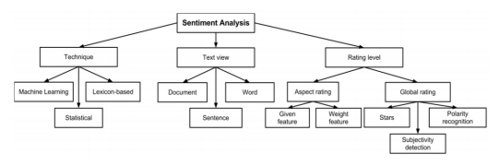
Sentiment Comparison

Slide 21
Synset Distance
Calculate the similarity of two statements. This is based on the total maximum synset similarity between each word in each sentence.
This algorithm uses the wordnet functionality of NLTK to determine the similarity of two statements based on the path similarity between each token of each statement.
This is essentially an evaluation of the closeness of synonyms.

Slide 22
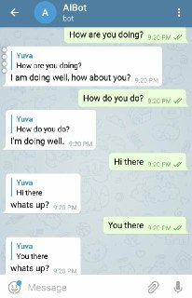
Few Examples
In the adjacent figure, we can see how the chat bot responds to different inputs with same answer and also its intelligence to respond differently to the inputs that are same in meaning.

Slide 23
Telegram
Telegram is a messaging app with a focus on speed and security, it’s super-fast, simple and free.
Here we have used Telegram as the User Interface part of our chat bot.
You can use Telegram to run this chat bot on smartphones, tablets, and even computers.
This chat bot is accessible to any persons from anywhere around the globe over Telegram.

Slide 24
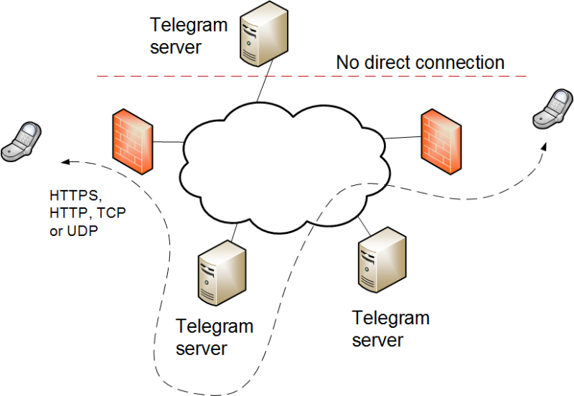
Telegram Bot Architecture

Slide 25
Tools / Software's Used
Visual Studio 2017 as IDE & Code Editor for Python
ChatterBot Python Library.
Telebot Python Library for connecting Python code with Telegram.
Telegram Bot API (mainly BotFather).
NLTK Python Library.

Slide 26
Reference
https://docs.python.org/3/library/index.html
http://chatterbot.readthedocs.io/en/latest/index.html
https://core.telegram.org/bots
http://www.nltk.org/
https://www.wikipedia.org/

Slide 27
Thank You

