Slide 1
Asynchronous Methods for Deep Reinforcement Learning
Under the guidance of Prof. Ashritha R Murthy
By
Nithin Prabhu G
Shwetha U
Yathish G

Slide 2
Contents
Introduction to the problem domain
Statement of the problem
Objectives of the project
Applications
Existing solution methods
Proposed solution methods
Project schedule
Literature Survey
System Requirements and Analysis
Tools and Technology Used
System design
System Implementation
System testing and results analysis
Conclusion and future work
References

Slide 3
Introduction to the problem domain
Deep neural networks provide rich representations that can enable reinforcement learning (RL) algorithms to perform effectively.
By storing the agent’s data in an experience replay memory, the data can be batched or randomly sampled from different time-steps.

Slide 4
Statement of the problem
We propose a conceptually simple and lightweight framework for deep reinforcement learning that uses asynchronous gradient descent for optimization of deep neural network controllers.

Slide 5
Objectives of the project
We present asynchronous variants of three standard reinforcement learning algorithms:
One-step method
Actor critic method
n steps Q-learning method.
We also show that parallel actor-learners have a stabilizing effect on training allowing all three methods to successfully train neural network controllers

Slide 6
Applications
Natural Language Processing.
Optical Character Recognition.
Artificial Intelligence induction.
Speech Recognition applications.
CRM needs for companies are growing day by day.

Slide 7
Existing solution methods
The General Reinforcement Learning Architecture (Gorila) out performs asynchronous training of reinforcement learning agents in a distributed setting[4].
In Gorila, each process contains an actor that acts in its own copy of the environment.
The updated policy parameters are sent to the actor-learners at fixed intervals.

Slide 8
Proposed solution methods
We now present multi-threaded asynchronous n-step Q-learning and advantage actor-critic.
First, we use asynchronous actor-learners, similarly to the Gorila framework , but instead of using separate machines and a parameter server, we use multiple CPU threads on a single machine.
Second, we make the observation that multiple actors-learners running in parallel

Slide 9
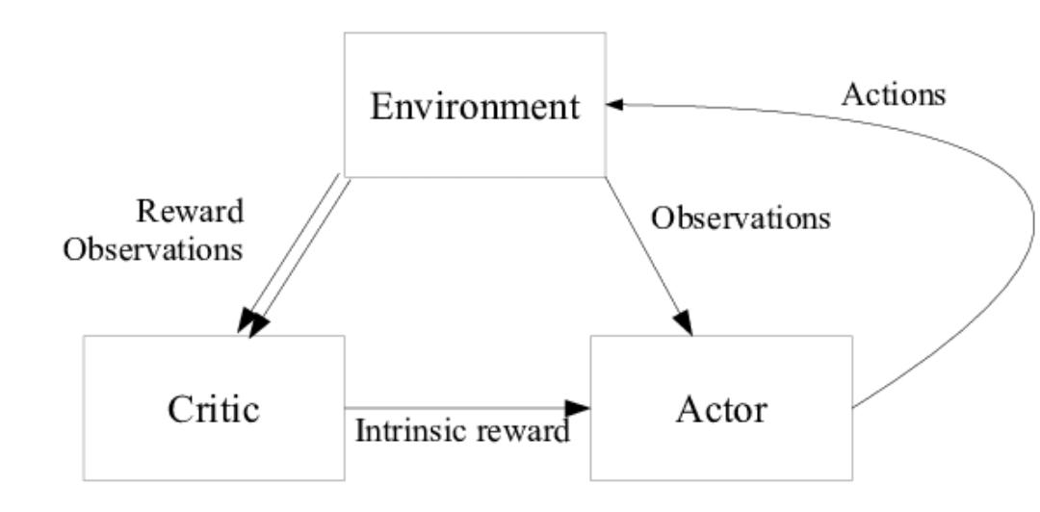
Asynchronous actor critic

Slide 10
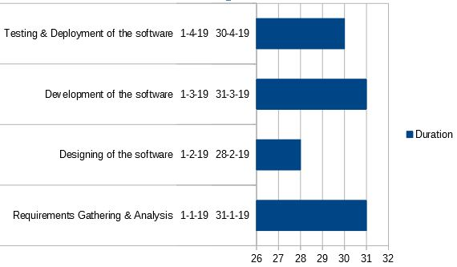
Project schedule (Gantt chart)

Slide 11
Literature Survey
In Gorila, each process contains an actor that acts in its own copy of the environment, a separate replay memory[1].
Each actor learner learns separately and periodically sends updates to weights[2].
Convergence properties of Q learning in the asynchronous optimization setting[3].

Slide 12
Continued
To use reinforcement learning successfully in situations approaching real-world complexity, however, agents are confronted with a difficult task.
Reinforcement learning agents have achieved some successes in a variety of domains, their applicability has previously been limited to domains.
Advances in training deep neural networks to develop a artificial agent, termed a deep Q-network, that can learn successful policies directly.

Slide 13
System Requirements and Analysis
Software Requirements
Operating system : Windows 10
Programming language : Python
Text Editor : Sublime Text Editor
Hardware requirements
Processor 64 bit, 4 core, 2.00 GHZ
RAM 8 GB
Hard disk 14 GB for installation.
Input Device: Standard keyboard and mouse
Output Device: Monitors with decent resolution

Slide 14
Tools and Technology Used
TensorFlow is an open source software library for numerical computation using data flow graphs.
OpenCV (Open source computer vision) is a library of programming functions mainly aimed at real-time computer vision.
Pygame is a cross-platform set of Python modules designed for writing video games.

Slide 15
System design: Deep Q-Network
Deep Q-Network is a convolutional neural network, trained with a variant of Q-learning.
Q-function with a neural network, that takes the state and action as input and outputs the corresponding Q-value.
One forward pass through the network and having all Q-values for all actions available is made use of.

Slide 16
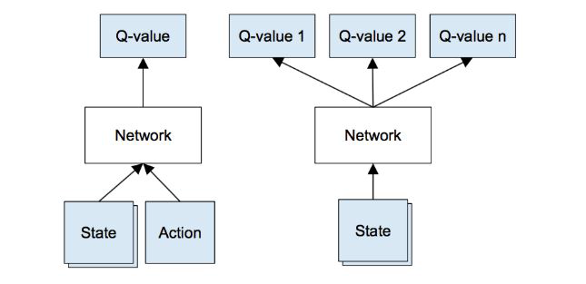
Left: Naive formulation of deep Q-network.
Right: More optimized architecture of deep Q-network

Slide 17
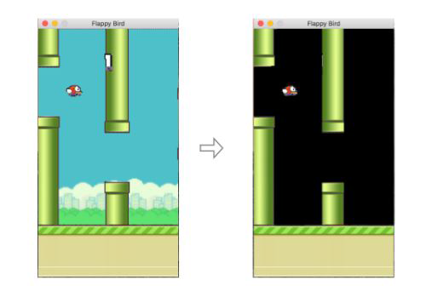
System design: Environment

Slide 18
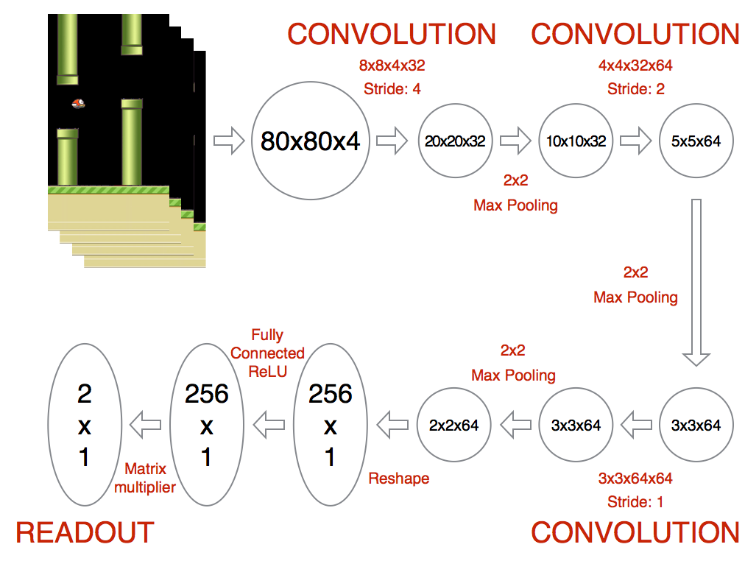
System design: Architecture of the network

Slide 19
System Implementation
The algorithm computes n-step return which is more of a ‘forward view’ algorithm rather than conventional ‘backward view’ programming.
For a single update, it uses exploration policy for each state-action and then computes gradients for n-step Q-learning updates for every state-action.

Slide 20
System testing and results analysis

Slide 21
System testing and results analysis
We have presented asynchronous versions of reinforcement learning algorithm and shown that they are able to train neural network controllers on a variety of domains in a stable manner.
Our results would show that in our proposed framework stable training of neural networks through reinforcement learning
Possible with both value-based and policy-based methods, off policy as well as on policy methods and in discrete as well as continuous domains.

Slide 22
Conclusion and future work
We have presented asynchronous versions of three standard reinforcement learning algorithms and also showed that they are able to train neural network controllers on a variety of domains in a stable manner.
Combining other existing reinforcement learning methods or recent advances in deep reinforcement learning with our asynchronous framework presents many possibilities for immediate improvements to the methods we presented.

Slide 23
References
Mnih, Volodymyr, Kavukcuoglu, Koray, Silver, etc. Human-level control through deep reinforcement learning, Nature, 2015.
Grounds, Matthew and Kudenko, Daniel. Parallel reinforcement learning with linear function approximation, 2008.
Tsitsiklis, John N. Asynchronous stochastic approximation and q-learning. Machine Learning, 1994.
Nair, Arun, Srinivasan, Praveen, etc. Massively parallel methods for deep reinforcement learning, 2015.
Kevin Chen. Deep Reinforcement Learning for Flappy Bird.

Slide 24
Thank You!

