Slide 1



UI Regression Test
(jest, puppeteer, nodejs)

Slide 2
Agenda
UI Regression Test
Jest (javascript testing -> https://facebook.github.io/jest/)
Puppeteer (https://github.com/GoogleChrome/puppeteer)

Slide 3
UI Regression Test
What
Where
When
Why
How

Slide 4
How UI Regression Test
Web Site
Test Suites
Test Step
Tool (Jest, Puppeteer)

Slide 5
Demo

Slide 6
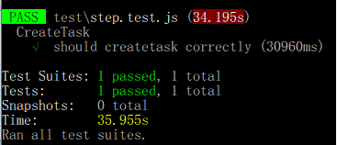
Test Results

Slide 7
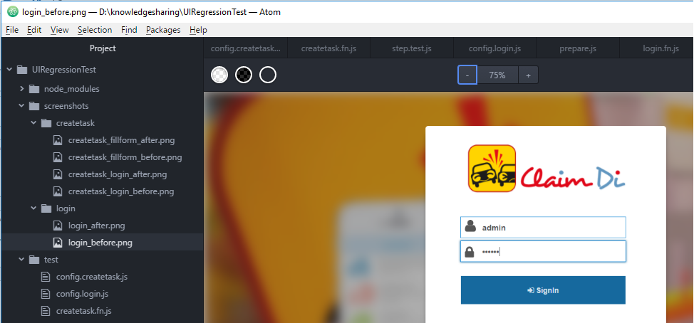
Test Results (2)

Slide 8
Reference
https://mahasak.com/%E0%B8%A1%E0%B8%B2%E0%B8%A5%E0%B8%AD%E0%B8%87%E0%B8%97%E0%B8%B3-ui-regression-test-%E0%B8%94%E0%B9%89%E0%B8%A7%E0%B8%A2-jest-%E0%B9%81%E0%B8%A5%E0%B8%B0-puppeteer-%E0%B8%81%E0%B8%B1%E0%B8%99%E0%B9%80%E0%B8%96%E0%B8%AD%E0%B8%B0-d58925d1ff96

