Slide 1
Electron ReactJS + NodeJS + Private Blockchain

Slide 2
Electron
Build cross platform desktop apps with JavaScript, HTML, and CSS
Desktop Apps with JavaScript, HTML, and CSS
Desktop Apps with URL

Slide 3
React JS
A JavaScript library for building user interfaces
Component-Based
Learn Once, Write Anywhere
Virtual Dom

Slide 4
NodeJS
Express
Enabled CORS
Truffle-Contract
Web3

Slide 5
Truffle Framework
Large system -> Source Control
TDD (Test-driven development)
Network management any deploy (testrpc, private network, …)

Slide 6
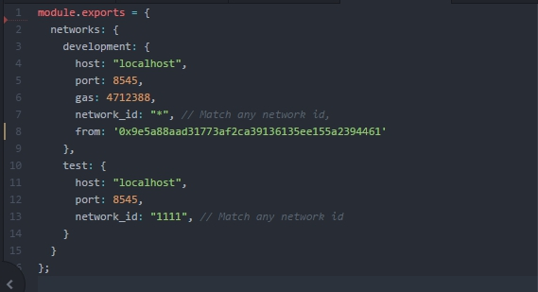
Truffle network config

Slide 7
Overview Workshop
2 contracts (member contract, ticket contract)
API nodejs
UI Reactjs
UI Electronjs

Slide 8






Architecture Workshop
React
Member
Ticket
Electron

Slide 9
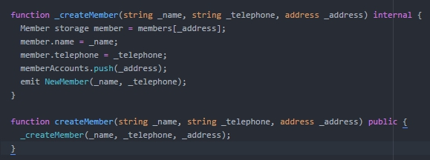
Member Contract

Slide 10
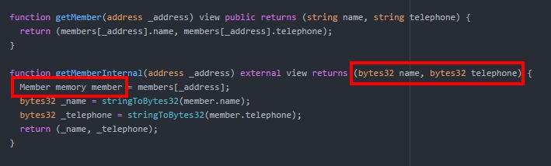
Member Contract

Slide 11
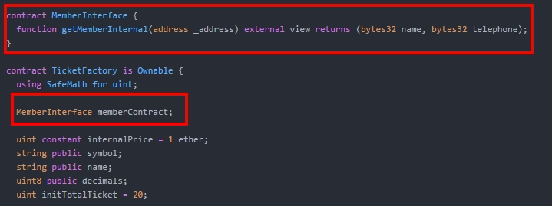
Ticket Contract

Slide 12
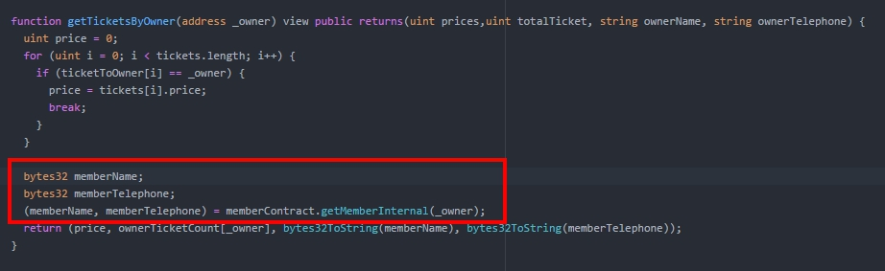
Ticket Contract

Slide 13
API Workshop
Member
GET /account -> get all account
POST /account/create -> create account
GET /account/:account -> get account detail
Ticket
GET /ticket/:account -> get owner ticket
POST /setPriceTicket -> set price ticket
POST /buyTicketFactory -> buy ticket
Other
POST /account/transfer -> transfer ether to account

Slide 14
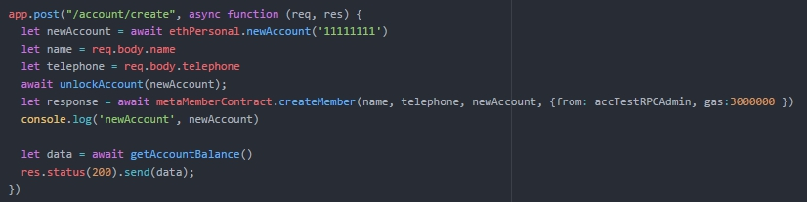
API Workshop
POST /account/create -> create account

Slide 15
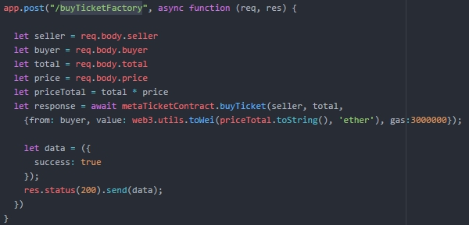
API Workshop
POST /buyTicketFactory -> buy ticket

Slide 16
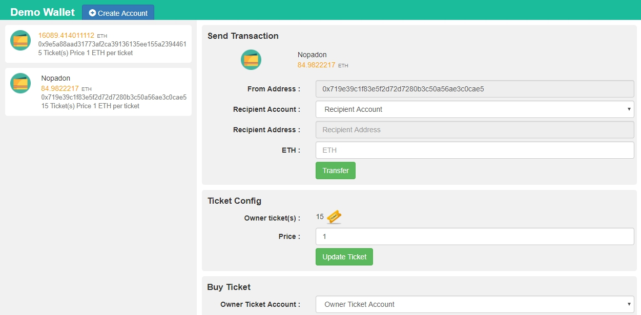
UI Home page

Slide 17
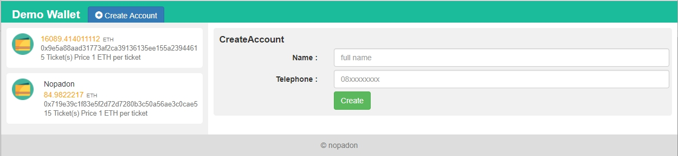
UI Create Account

Slide 18
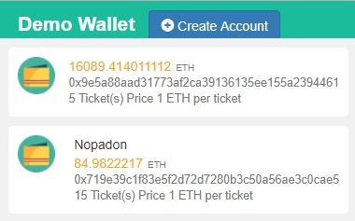
UI Accounts

Slide 19
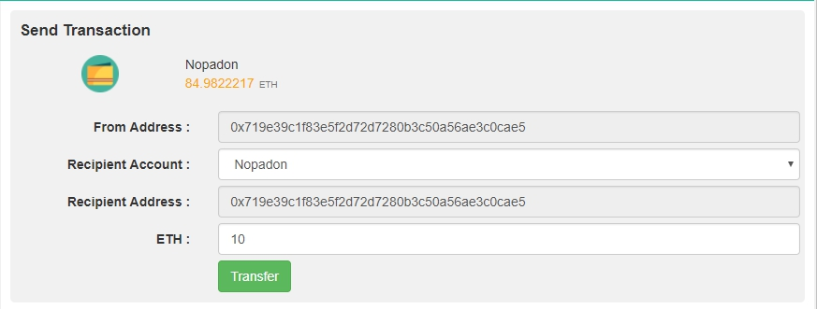
UI Send Transaction (Ether)

Slide 20
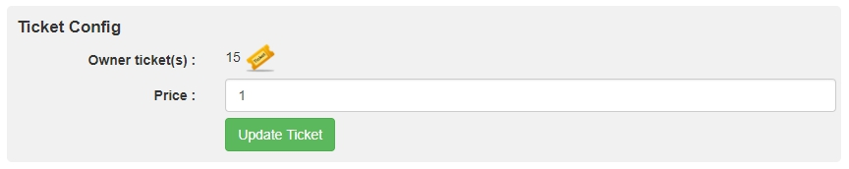
UI Ticket Config

Slide 21
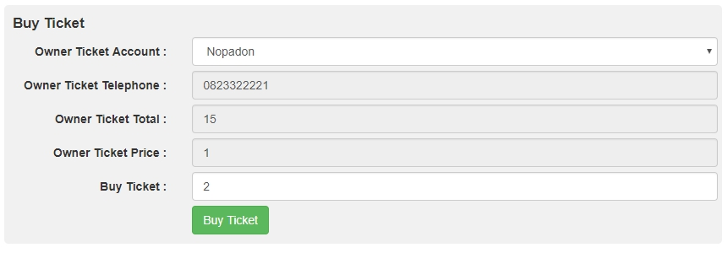
UI Buy Ticket

Slide 22
DEMO

Slide 23
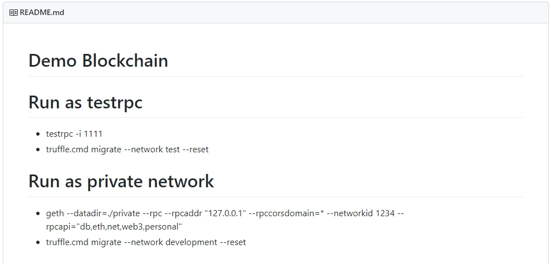
Source Code
https://github.com/Nucool/demoBlockchain

