Slide 1
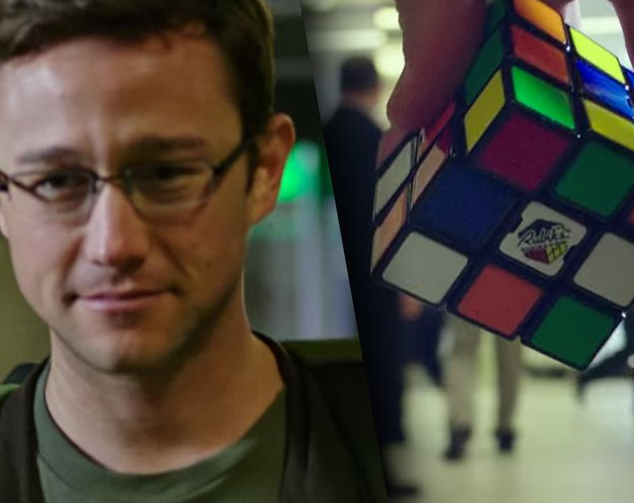
Snowden

Slide 2
Who is Snowden?
Edward joseph snowden
Army
CIA
NSA

Slide 3
What did he do?
Roughly 1.7 million classified documents
Leaked 200.000
Access to 1.5 million
Several programs revealed.

Slide 4
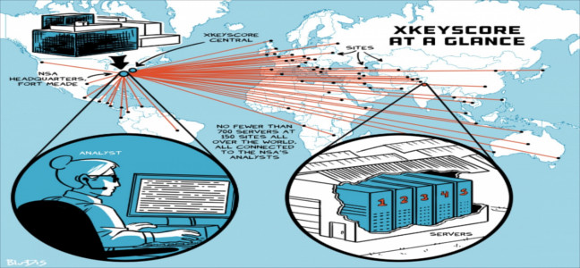

Slide 5
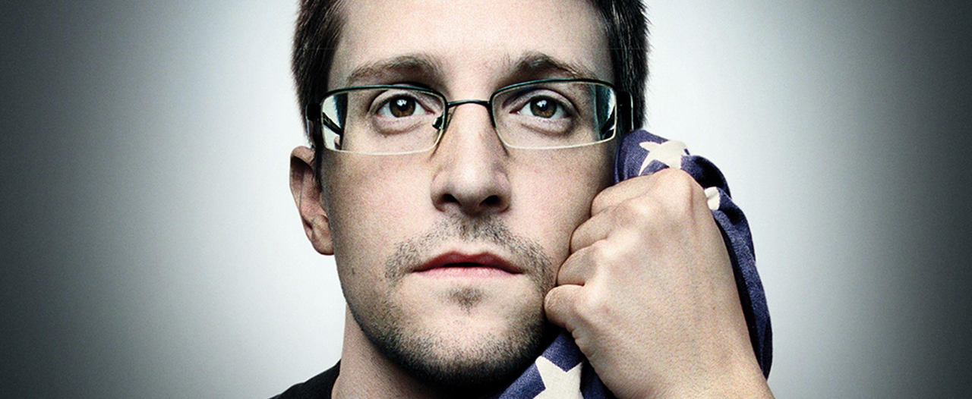
Why did he do it?

Slide 6
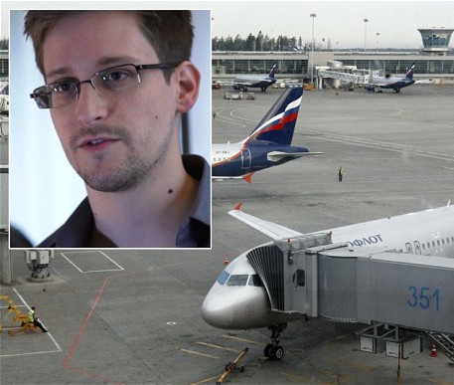
What happened efter?

Slide 7


