Slide 1

Predictability: Can the trend of an expanding epidemic be precisely forecast while the epidemic is still spreading?
Anno Accademico 2019/2020
Manuel Lacal

Slide 2
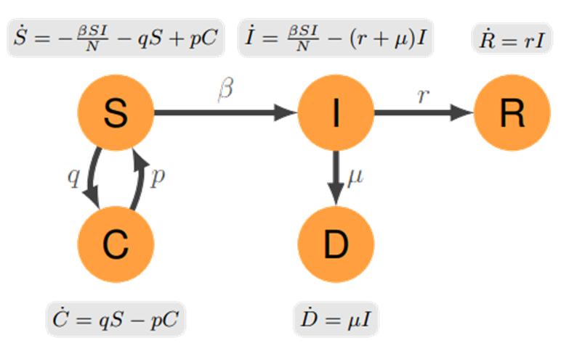
SCIR: SIR model with confinement
Compartments:
S: susceptible individuals
C: individuals sent to confinement
I: infected individuals
D: deaceased individuals
R: recovered individuals
Parameters:
N: total population
β: trasmission rate
µ: rate of death
r: recovery rate
p: individuals that leave the confinement
measures (job, defection)
q: specific measures restricting mobilty
and contacts
Diagram of the epidemic model with equations ruling the dynamics

Slide 3

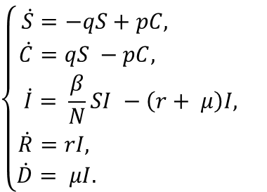


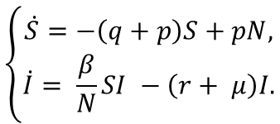
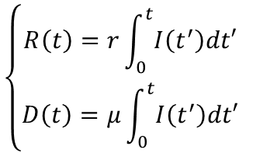


For sufficiently large population, the number of infected individuals at the initial stages of
the infection is well below the population size
neglect the nonlinear term in the equation for the number of susceptible individuals
$$\frac{I\left(t\right)}{N}≪1$$
$$\left\{\begin{aligned}\dot{S}=−qS+pC, \\ \dot{C}=qS −pC, \\ \dot{I}= \frac{β}{N}SI −\left(r+ μ\right)I, \\ \dot{R}=rI, \\ \dot{D}= μI. \end{aligned}\right.$$
$$\left\{\begin{aligned}\dot{S}=−\left(q+p\right)S+pN, \\ \dot{I}= \frac{β}{N}SI −\left(r+ μ\right)I.\end{aligned}\right.$$
(1° order linear ode)
$$C−S=N$$
(1° order linear ode)
$$\left\{\begin{aligned}R\left(t\right)=r\int_{0}^{t}{I\left(t^{′}\right)dt′} \\ D\left(t\right)=μ\int_{0}^{t}{I\left(t^{′}\right)dt′} \end{aligned}\right.$$
Susceptibles equation solution:
$$−\int_{N}^{s\left(t\right)}{\frac{dS^{′}}{\left(q+p\right)S′−pN}}= \int_{0}^{t}{dt^{′}}=t$$
$$−\frac{1}{\left(q+p\right)}log{\left[\left(q+p\right)S^{′}−PN\right]}_{N}^{S\left(t\right)}=−\frac{1}{\left(q+p\right)}log⁡\left[\frac{(q+p)S−PN}{qN}\right]$$
$$S\left(t\right)= \frac{N}{(q+p)}[p+qe^{−\left(q+p\right)t}]$$
$$\left[\left(q+p\right)S−PN\right]=qNe^{−\left(q+p\right)t}$$

Slide 4







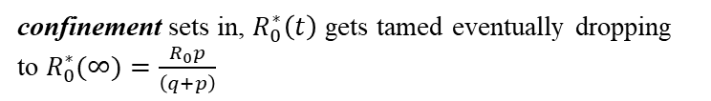

Infectious equation solution:
$$\dot{I}= \frac{β}{N}SI −\left(r+ μ\right)I$$
$$\dot{I}= \frac{β}{(q+p)}[p+qe^{−\left(q+p\right)t}]I −\left(r+ μ\right)I$$
$$log\left(\frac{I}{I_{0}}\right)=\int_{I_{0}}^{I\left(t\right)}{\frac{dI^{′}}{I′}}= \int_{0}^{t}{\left[\frac{β}{(q+p)}\left(p+qe^{−\left(q+p\right)t}\right) −(r+μ)\right]{dt}^{′}}=\frac{β}{(q+p)}\left(pt+\frac{1−qe^{−\left(q+p\right)t}}{(q+p)}\right)−\left(r+μ\right)t$$
initial stages: ${I\left(t\right) \sim e}^{[{(R}_{0}−1)(r+μ)]}$ epidemic spreads for $R_{0}>1$ (stable solution)
$$I\left(t\right)=I_{0}e^{\left\{\frac{β}{\left(q+p\right)\left(r+μ\right)}\left[p+\frac{1−qe^{−\left(q+p\right)t}}{\left(q+p\right)t}\right]−1\right\}\left(r+μ\right)t}$$
$$I\left(t\right)=I_{0}e^{\left\{R_{0}^{∗}(t)−1\right\}\left(r+μ\right)t}$$
confinement sets in, $R_{0}^{∗}\left(t\right)$ gets tamed eventually dropping to $R_{0}^{∗}(∞)=\frac{R_{0}p}{\left(q+p\right)}$
$$R_{0}^{∗}\left(t\right)=\frac{R_{0}}{\left(q+p\right)}\left[p+\frac{1−qe^{−\left(q+p\right)t}}{\left(q+p\right)t}\right]$$
effective basic reproduction number modulated by the confinement
where
$$R_{0}^{∗}\left(t\right)<1$$
the epidemic can be controlled (stable solution)
$$R_{0}=\frac{β}{\left(q+p\right)}$$
its value at the
beginning of the epidemic
it spreads until exhaustion of susceptible individuals (unstable solution)
otherwise

Slide 5





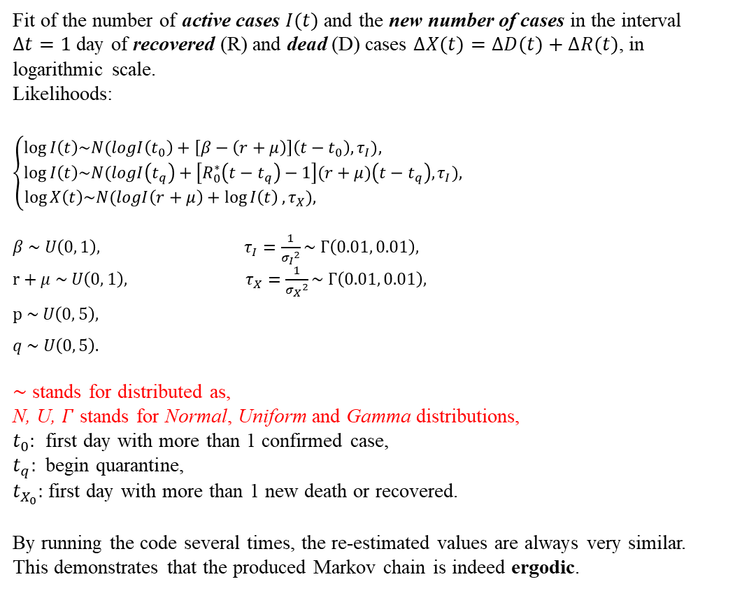









Bayesias parametric model
Fit of the number of active cases $I(t)$ and the new number of cases in the interval $∆t=1$ day of recovered (R) and dead (D) cases $∆X(t)=∆D(t)+∆R(t)$, in logarithmic scale.
Likelihoods:
$$\left\{\begin{aligned}\log{I\left(t\right)\sim N(logI\left(t_{0}\right)+\left[β−\left(r+μ\right)\right]\left(t−t_{0}\right), τ_{I}}), \\ \log{I\left(t\right)\sim N(logI\left(t_{q}\right)+\left[R_{0}^{∗}\left(t−t_{q}\right)−1\right](r+μ)\left(t−t_{q}\right), τ_{I}}), \\ \log{X\left(t\right)\sim N(logI\left(r+μ\right)+\log{I\left(t\right)}, τ_{X}}), \end{aligned}\right.$$
$β \sim U\left(0, 1\right),$ $τ_{I}=\frac{1}{{σ_{I}}^{2}}\sim Γ\left(0.01, 0.01\right),$
$r+μ \sim U\left(0, 1\right),$ $τ_{X}=\frac{1}{{σ_{X}}^{2}}\sim Γ\left(0.01, 0.01\right),$
$$p \sim U\left(0, 5\right),$$
$$q \sim U\left(0, 5\right).$$
$\sim$ stands for distributed as,
N, U, $Γ$ stands for Normal, Uniform and Gamma distributions,
$t_{0}:$ first day with more than 1 confirmed case,
$t_{q}:$ begin quarantine,
$t_{X_{0}}:$ first day with more than 1 new death or recovered.
By running the code several times, the re-estimated values are always very similar.
This demonstrates that the produced Markov chain is indeed ergodic.
Hierarchical model
$$β$$
$τ_{I}$
$τ_{X}$
$$t_{0}<t<t_{q}$$
$$r+μ$$
$$t>t_{q}$$
$$t>t_{X_{0}}$$
$$I$$
$$\overline{I}$$
$$\overline{X}$$
$$X$$
$$p$$
$$q$$
probabilistic distribution
deterministic function
JAGS engine interprets $I$, $X$ corresponding probability distribution as a likelihood, because they have data associated.

Slide 6
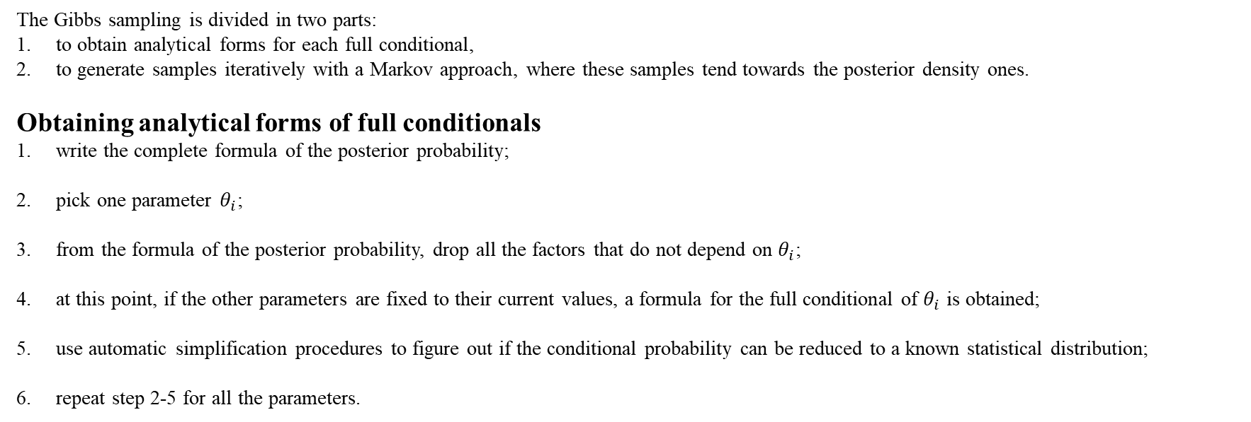
Gibbs sampler algorithm
The Gibbs sampling is divided in two parts:
to obtain analytical forms for each full conditional,
to generate samples iteratively with a Markov approach, where these samples tend towards the posterior density ones.
Obtaining analytical forms of full conditionals
write the complete formula of the posterior probability;
pick one parameter $θ_{i}$;
from the formula of the posterior probability, drop all the factors that do not depend on $θ_{i}$;
at this point, if the other parameters are fixed to their current values, a formula for the full conditional of $θ_{i}$ is obtained;
use automatic simplification procedures to figure out if the conditional probability can be reduced to a known statistical distribution;
repeat step 2-5 for all the parameters.

Slide 7
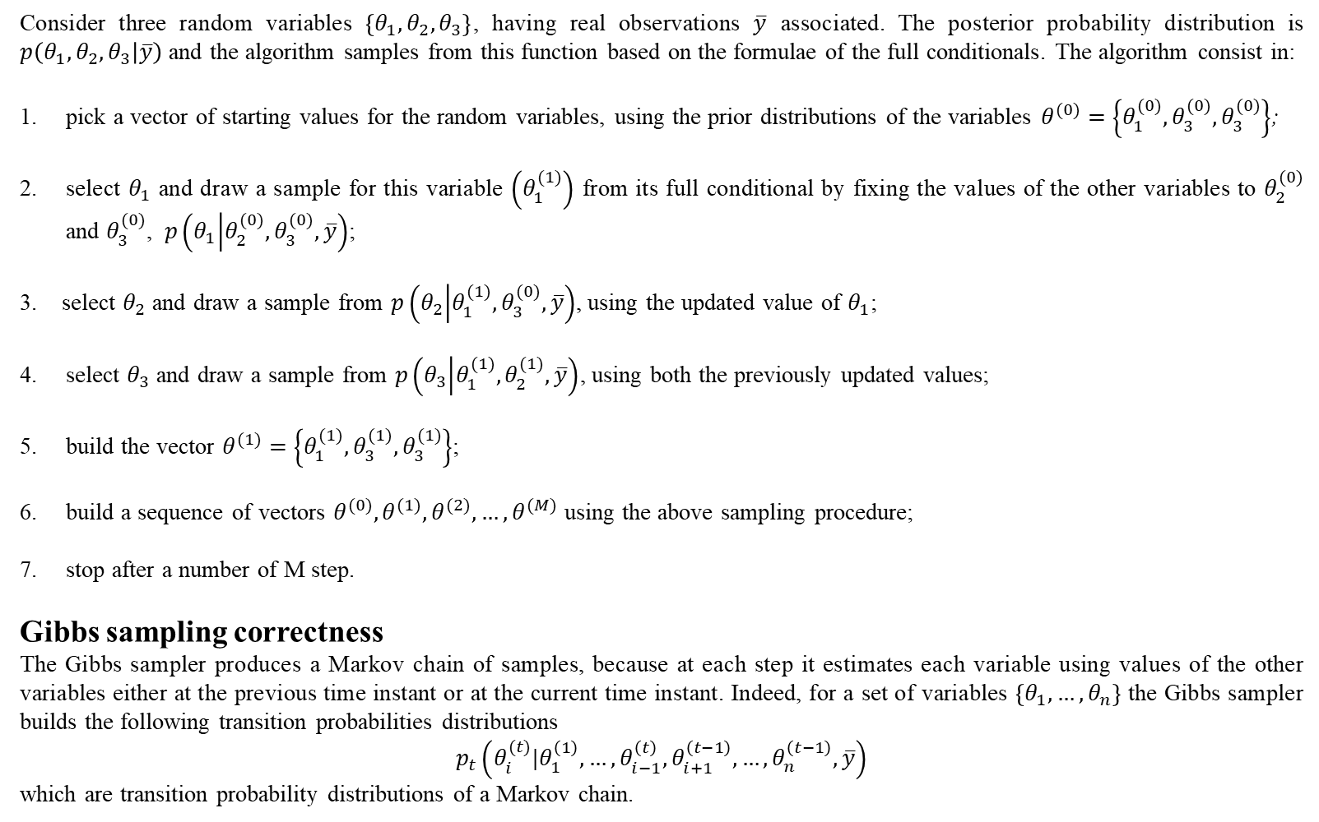
Consider three random variables $\left\{θ_{1},θ_{2},θ_{3}\right\}$, having real observations $\overline{y}$ associated. The posterior probability distribution is $p\left(θ_{1},θ_{2},θ_{3} | \overline{y}\right)$ and the algorithm samples from this function based on the formulae of the full conditionals. The algorithm consist in:
pick a vector of starting values for the random variables, using the prior distributions of the variables $θ^{(0)}=\left\{θ_{1}^{(0)},θ_{3}^{(0)},θ_{3}^{(0)}\right\}$;
select $θ_{1}$ and draw a sample for this variable $\left(θ_{1}^{(1)}\right)$ from its full conditional by fixing the values of the other variables to $θ_{2}^{(0)}$ and $θ_{3}^{(0)}$, $p\left(θ_{1} | θ_{2}^{(0)},θ_{3}^{(0)},\overline{y}\right)$;
3. select $θ_{2}$ and draw a sample from $p\left(θ_{2} | θ_{1}^{(1)},θ_{3}^{(0)},\overline{y}\right)$, using the updated value of $θ_{1}$;
select $θ_{3}$ and draw a sample from $p\left(θ_{3} | θ_{1}^{(1)},θ_{2}^{(1)},\overline{y}\right)$, using both the previously updated values;
build the vector $θ^{(1)}=\left\{θ_{1}^{(1)},θ_{3}^{(1)},θ_{3}^{(1)}\right\}$;
build a sequence of vectors $θ^{(0)},θ^{(1)},θ^{(2)}, …,θ^{(M)}$ using the above sampling procedure;
stop after a number of M step.
Gibbs sampling correctness
The Gibbs sampler produces a Markov chain of samples, because at each step it estimates each variable using values of the other variables either at the previous time instant or at the current time instant. Indeed, for a set of variables $\left\{θ_{1}, …,θ_{n}\right\}$ the Gibbs sampler builds the following transition probabilities distributions
$$p_{t}\left(θ_{i}^{(t)}|θ_{1}^{\left(1\right)},…,θ_{i−1}^{\left(t\right)},θ_{i+1}^{\left(t−1\right)},…,θ_{n}^{\left(t−1\right)},\overline{y}\right)$$
which are transition probability distributions of a Markov chain.

Slide 8
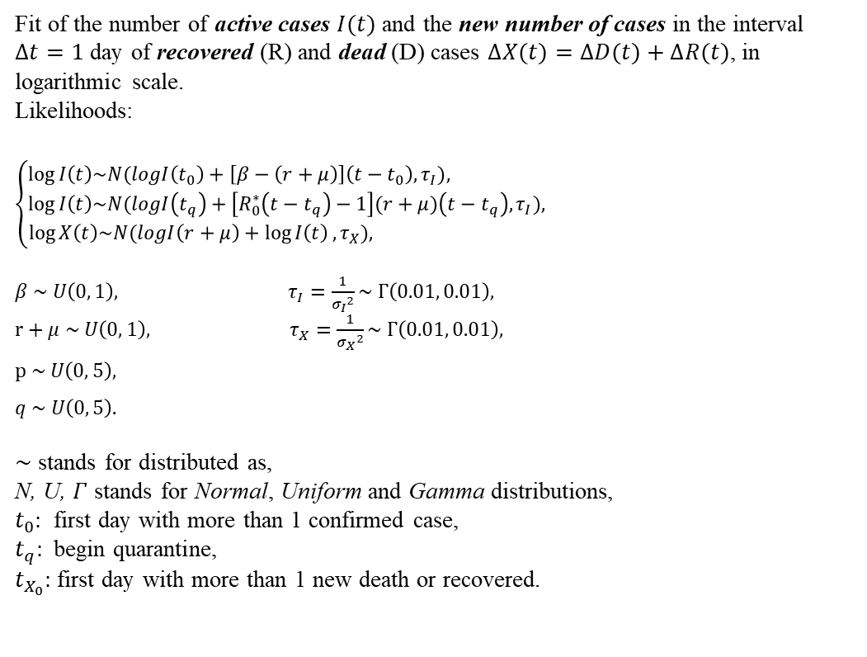
Bayesias parametric Fit
# JAGS Code model { # Regression before any confinement measure (populations are in log scale) for(t in (t0 + 1) : tq) { I[t] ~ dnorm(I[t0] + (beta - rmu) * (t - t0), tauI) # Active cases y[t] ~ dnorm(I[t0] + (beta - rmu) * (t - t0), tauI) # Posterior predictive } # Regression for active cases post-confinement (populations are in log scale)
# tmax: last data-point used for estimation for(t in (tq + 1) : tmax) { I[t] ~ dnorm(I[tq] + ((beta * q) / (p + q)^2 * (1 - exp(-(p + q) * (t - tq))) + (beta - rmu - beta * q / (q + p)) * (t - tq)), tauI) } # Posterior predictive for active cases post-confinement (extended until tf)
# tf: last day to project the data for(t in (tq + 1) : tf) { y[t] ~ dnorm(y[tq] + ((beta * q) / (p + q)^2 * (1 - exp(-(p + q) * (t - tq))) + (beta - rmu - beta * q / (q + p)) * (t - tq)), tauI) } # Regression for new death+recovered cases for(t in tX0 : tmax) { X[t] ~ dnorm(log(rmu) + I[t], tauX # New Deaths + Recovered }
# Posterior predictive for new deaths+recovered (extended until tf) for(t in tX0 : tf) { z[t] ~ dnorm(log(rmu) + y[t], tauX) }
# Prior probability desities for parameters p ~ dunif(0, 5) # Non-informative prior q ~ dunif(0, 5) # Non-informative prior beta ~ dunif(0, 1) # Doubling time is less than 1 per day rmu ~ dunif(0, 1) # rmu is lower than beta (so R0>1) # Priors for precisions (inverse of variance) tauI ~ dgamma(0.01, 0.01) # Non-informative prior tauX ~ dgamma(0.01, 0.01) # Non-informative prior y[t0] <- I[t0] }
Fit of the number of active cases $I(t)$ and the new number of cases in the interval $∆t=1$ day of recovered (R) and dead (D) cases $∆X(t)=∆D(t)+∆R(t)$, in logarithmic scale.
Likelihoods:
$$\left\{\begin{aligned}\log{I\left(t\right)\sim N(logI\left(t_{0}\right)+\left[β−\left(r+μ\right)\right]\left(t−t_{0}\right), τ_{I}}), \\ \log{I\left(t\right)\sim N(logI\left(t_{q}\right)+\left[R_{0}^{∗}\left(t−t_{q}\right)−1\right](r+μ)\left(t−t_{q}\right), τ_{I}}), \\ \log{X\left(t\right)\sim N(logI\left(r+μ\right)+\log{I\left(t\right)}, τ_{X}}), \end{aligned}\right.$$
$β \sim U\left(0, 1\right),$ $τ_{I}=\frac{1}{{σ_{I}}^{2}}\sim Γ\left(0.01, 0.01\right),$
$r+μ \sim U\left(0, 1\right),$ $τ_{X}=\frac{1}{{σ_{X}}^{2}}\sim Γ\left(0.01, 0.01\right),$
$$p \sim U\left(0, 5\right),$$
$$q \sim U\left(0, 5\right).$$
$\sim$ stands for distributed as,
N, U, $Γ$ stands for Normal, Uniform and Gamma distributions,
$t_{0}:$ first day with more than 1 confirmed case,
$t_{q}:$ begin quarantine,
$t_{X_{0}}:$ first day with more than 1 new death or recovered.
Last data-point used for estimation
$$t_{0}<t<t_{q}$$
$$t>t_{q}$$
$$t>t_{X_{0}}$$
Last day to project the data
By running the code several times the re-estimated values are always very similar,
even when the uncertainty on the prior expectations is set to a high value.
This demonstrates that the produced Markov chain is indeed ergodic.

Slide 9
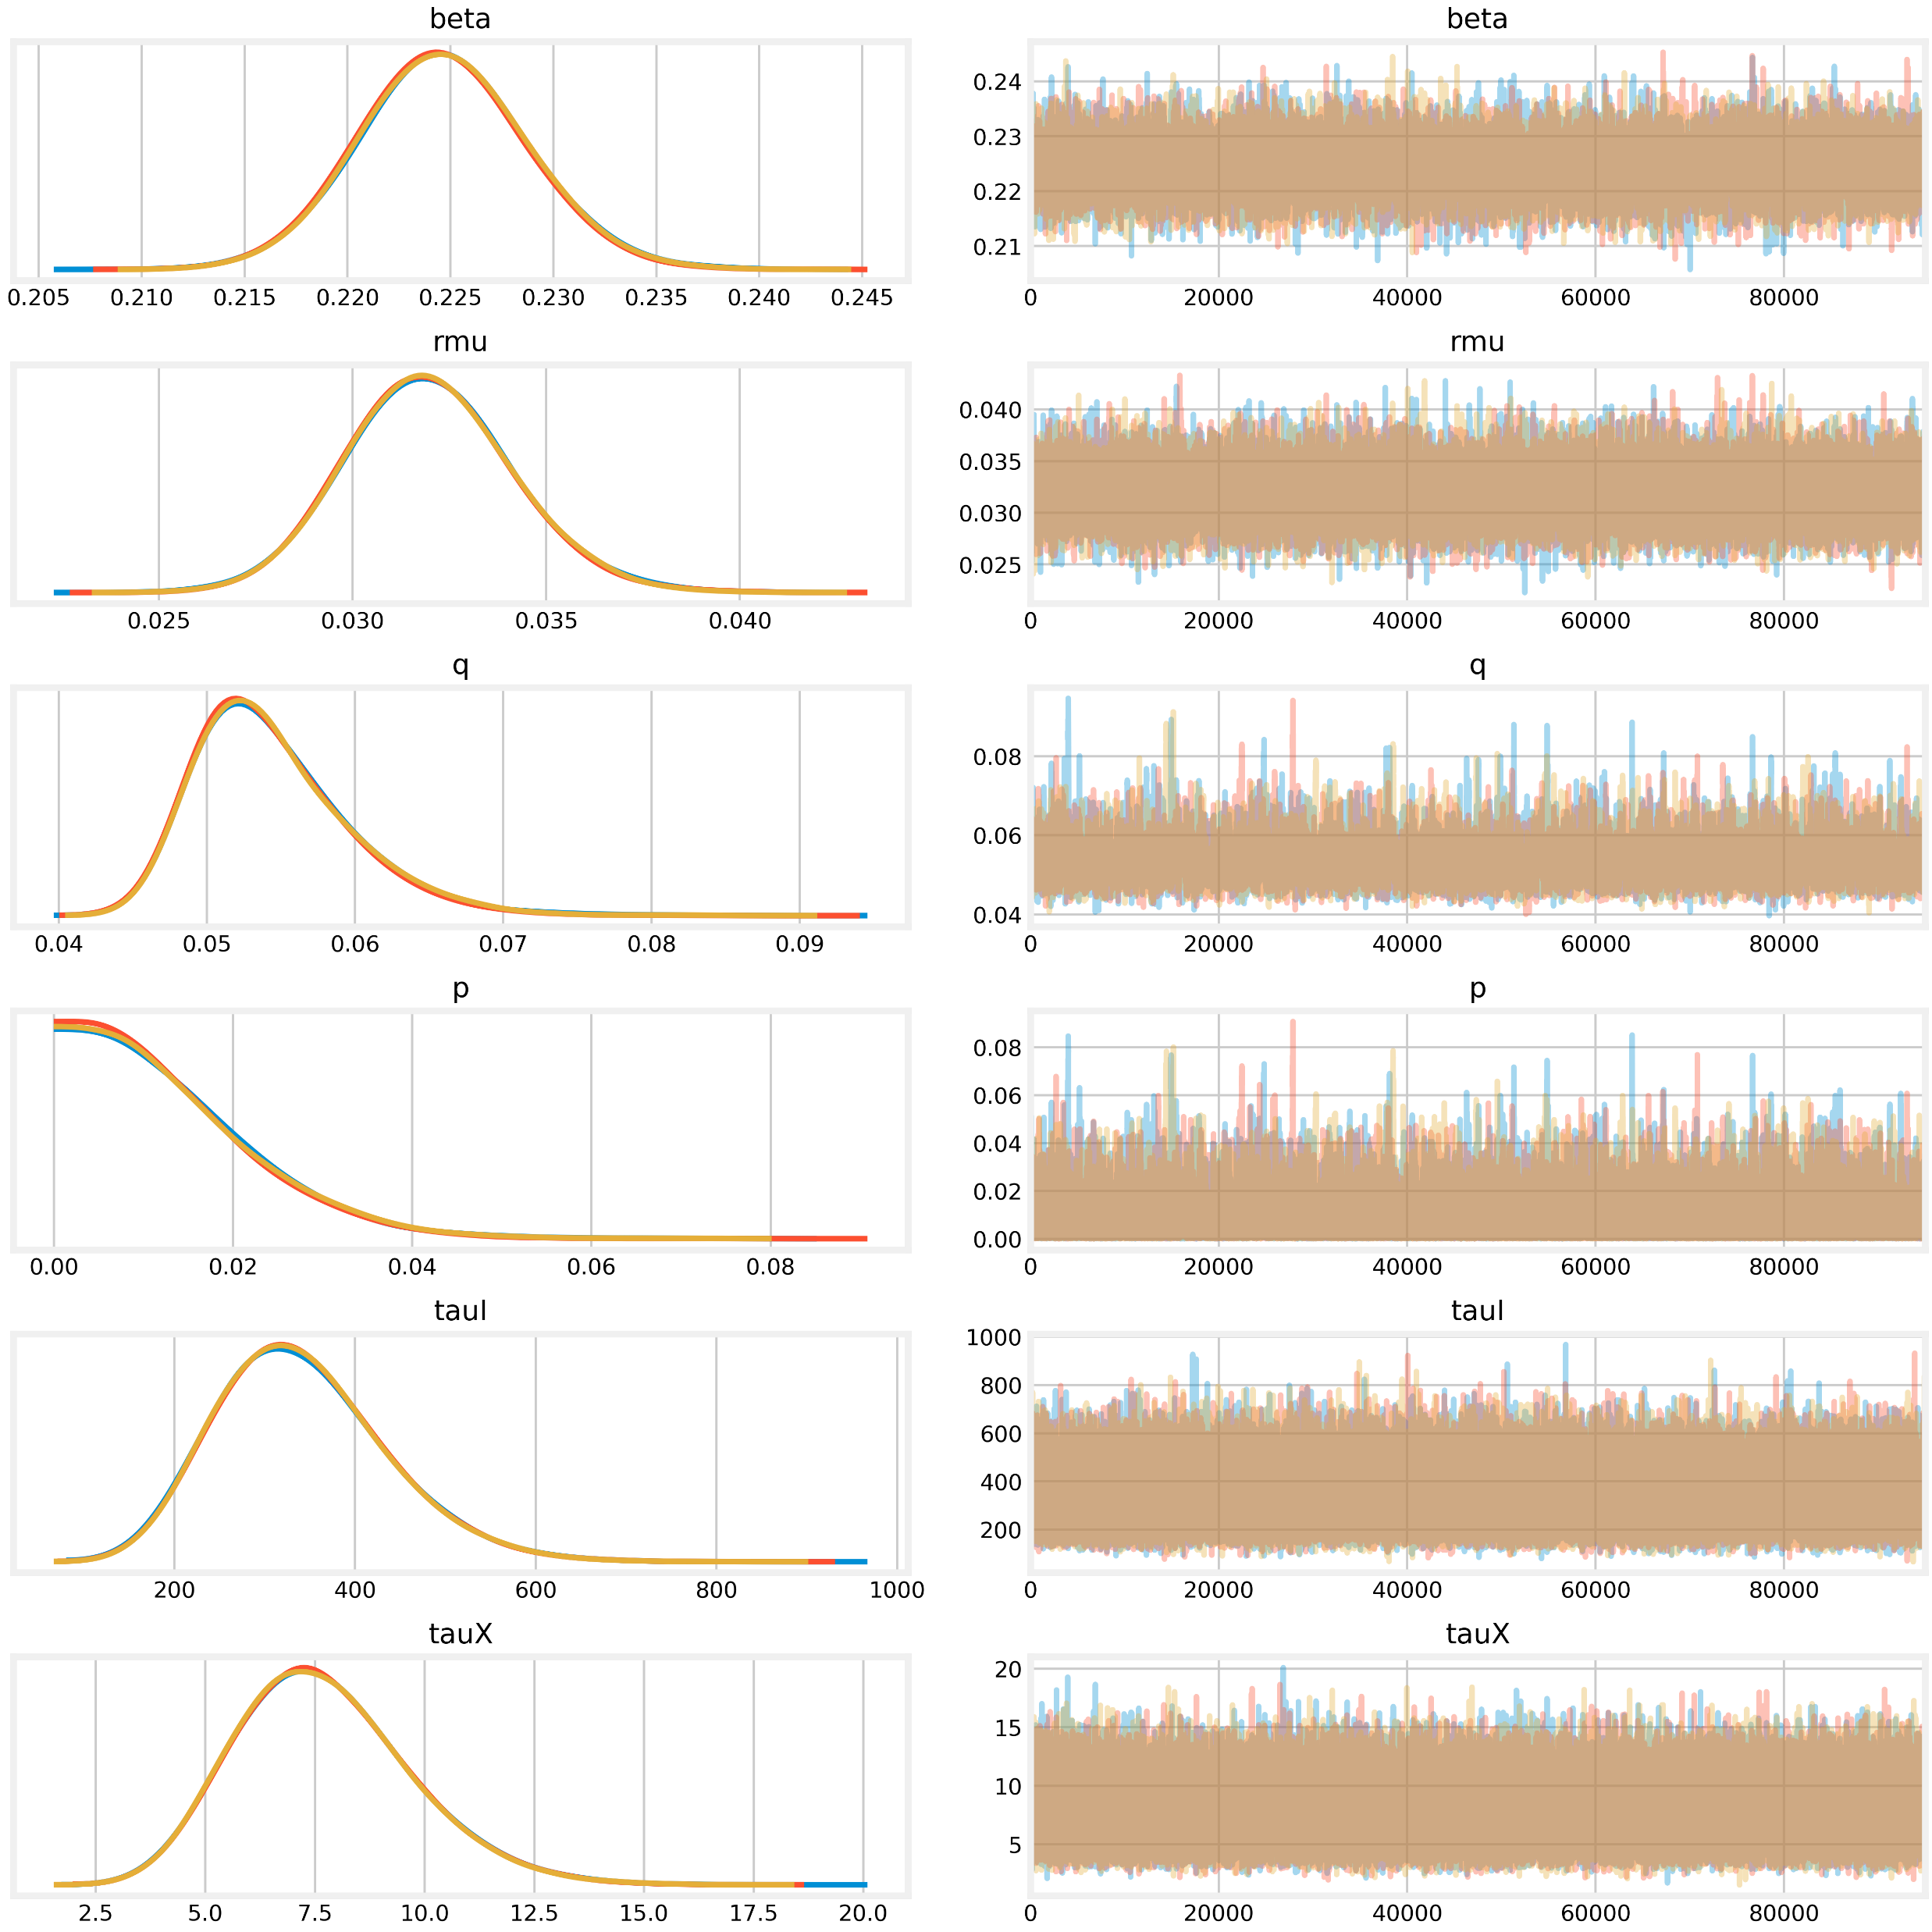
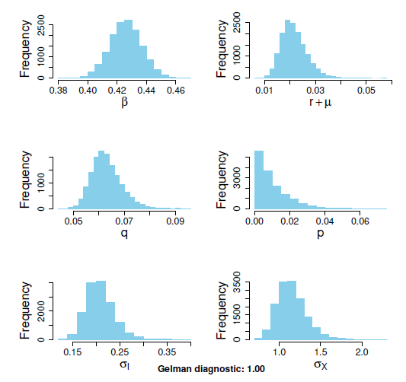
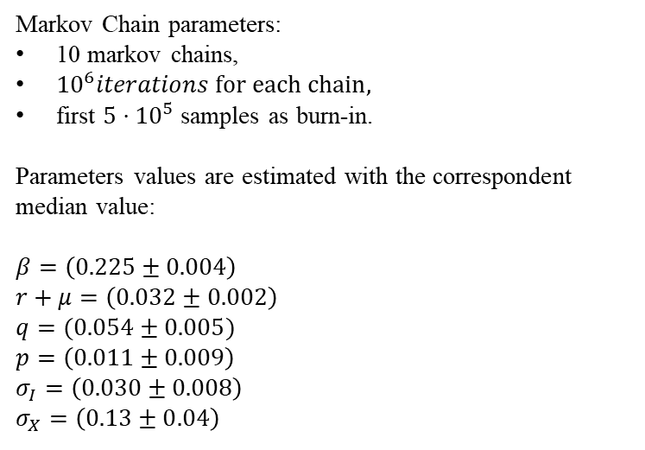
Results
Markov Chain parameters:
10 markov chains,
${10}^{6}iterations for each chain,$
first ${5⋅10}^{5}$ samples as burn-in.
Parameters values are estimated with the correspondent median value:
$β=\left(0.225±0.004\right)$
$r+μ=\left(0.032±0.002\right)$
$q=(0.054±0.005)$
$p=\left(0.011±0.009\right)$
$σ_{I}=\left(0.030±0.008\right)$
$σ_{X}=\left(0.13±0.04\right)$
Parameter distribution
Parameter trace

Slide 10
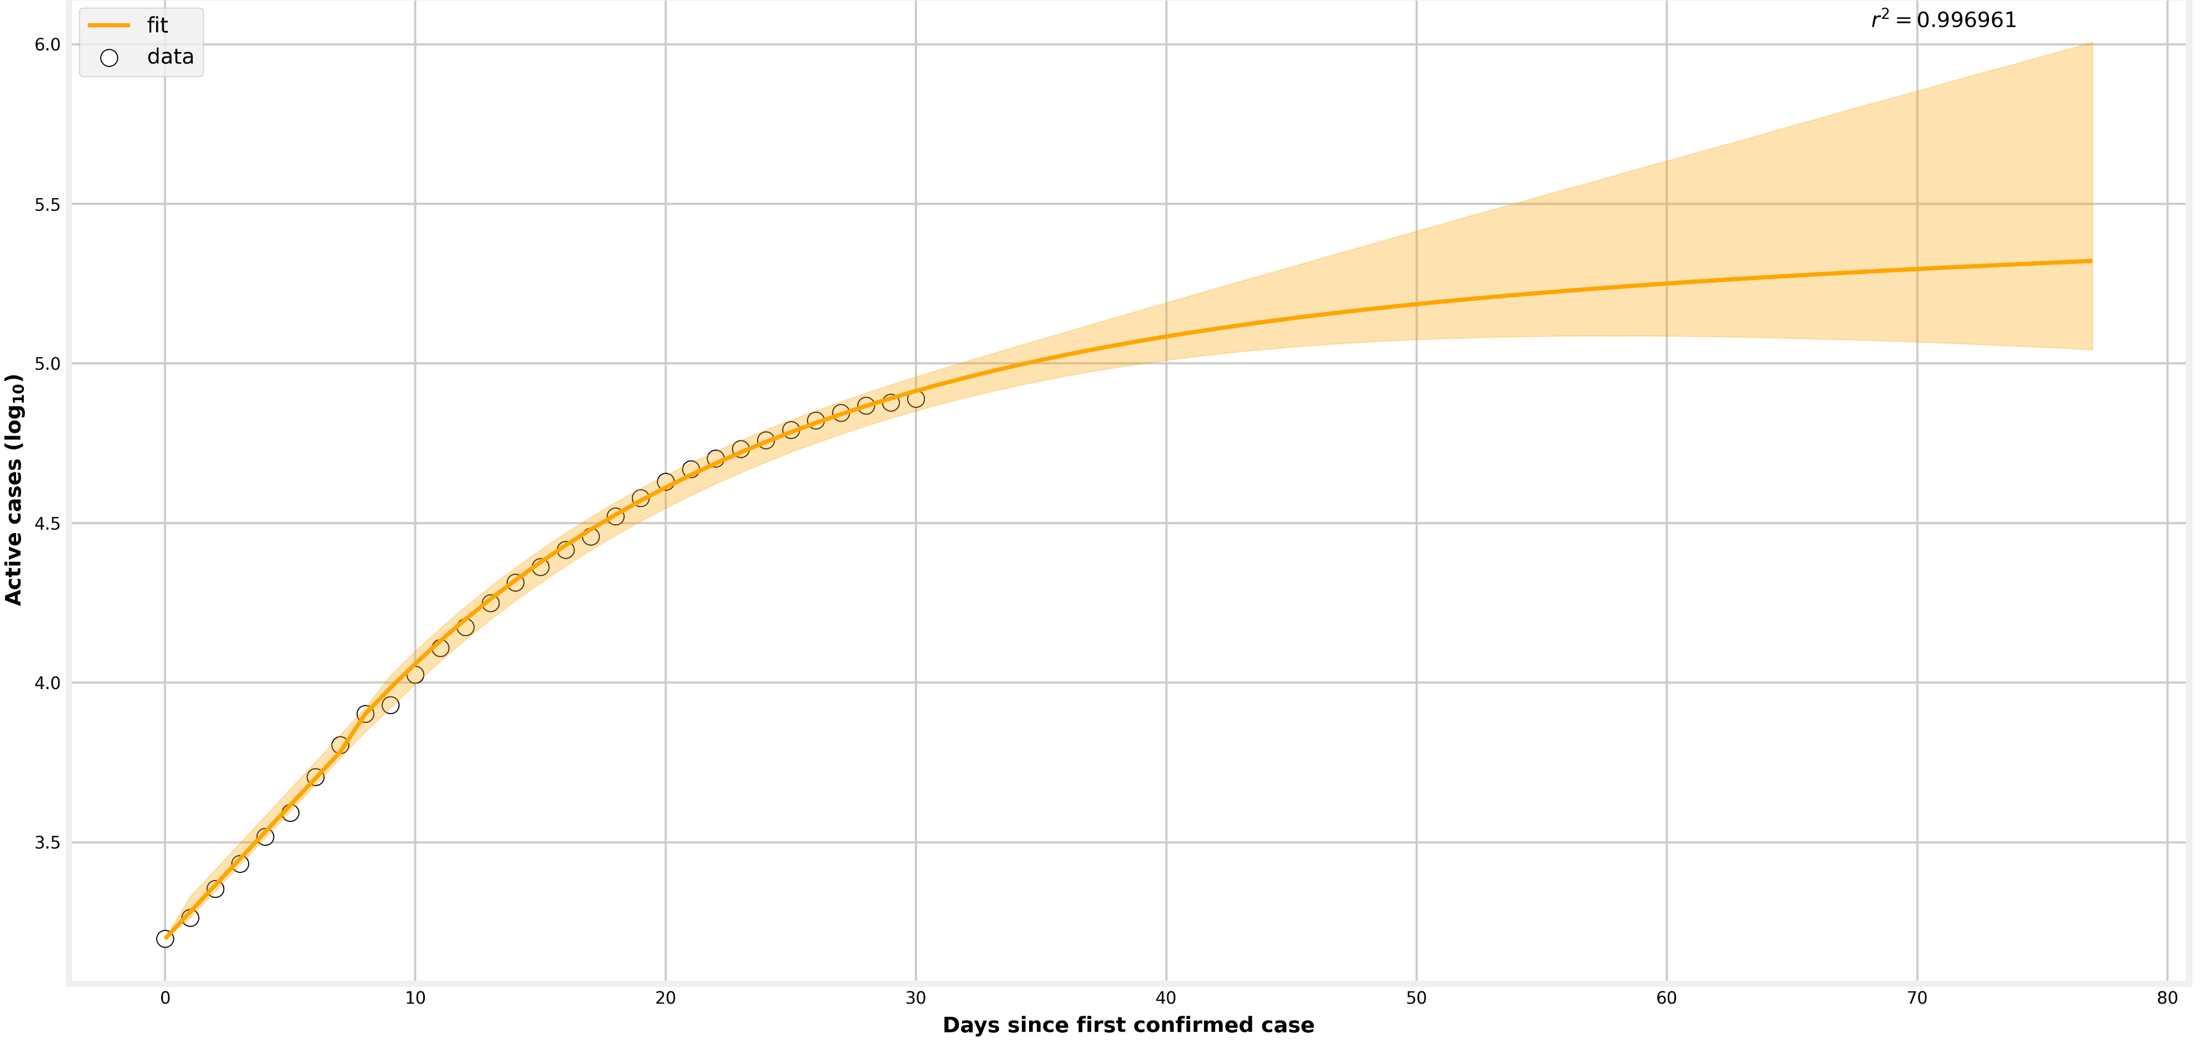
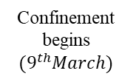


The solid line represents the expression for I(t) using the median parameters for each posterior
Exponential growth
95% posterior density
Controlled epidemic
Confinement begins
$${(9}^{th}March)$$
$${31}^{th}March$$
$$1^{th}March$$

Slide 11
Conclusion

Slide 12

References
Dataset protezione civile at: https://raw.githubusercontent.com/pcm-dpc/COVID-19/master/dati-andamento-nazionale/dpc-covid19-ita-andamento-nazionale.csv

