Slide 1
Chapter 11
Pointers
*
Copyright © 2008 W. W. Norton & Company.
All rights reserved.

Slide 2
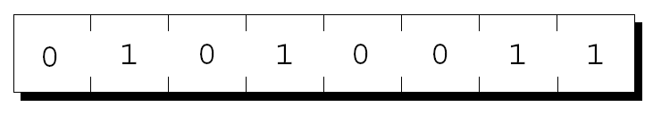
Pointer Variables
The first step in understanding pointers is visualizing what they represent at the machine level (i.e., low level or memory level).
In most modern computers, main memory is divided into bytes, with each byte capable of storing eight bits of information:
Each byte has a unique address.
*
Copyright © 2008 W. W. Norton & Company.
All rights reserved.

Slide 3
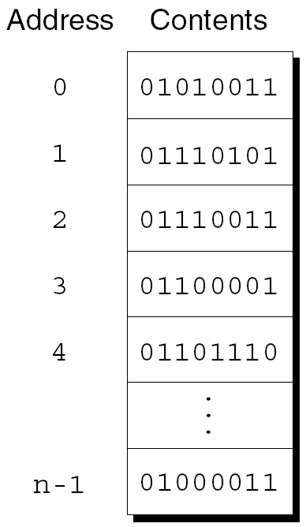
Pointer Variables
If there are n bytes in memory, we can think of addresses as numbers that range from 0 to n – 1:
*
Copyright © 2008 W. W. Norton & Company.
All rights reserved.

Slide 4
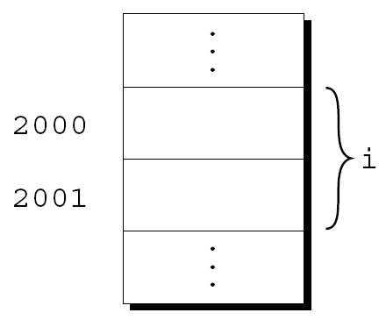
Pointer Variables
Each variable in a program occupies one or more bytes of memory.
The address of the first byte is said to be the address of the variable.
In the following figure, the address of the variable i is 2000:
*
Copyright © 2008 W. W. Norton & Company.
All rights reserved.

Slide 5
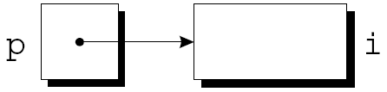
Pointer Variables
Addresses can be stored in special pointer variables.
When we store the address of a variable i in the pointer variable p, we say that p “points to” i.
A graphical representation:
*
Copyright © 2008 W. W. Norton & Company.
All rights reserved.

Slide 6
Declaring Pointer Variables
When a pointer variable is declared, its name must be preceded by an asterisk:
int *p;
p is a pointer variable capable of pointing to objects of type int.
We use the term object instead of variable since p might point to an area of memory that doesn’t belong to a variable.
*
Copyright © 2008 W. W. Norton & Company.
All rights reserved.

Slide 7
Declaring Pointer Variables
Pointer variables can appear in declarations along with other variables:
int i, j, a[10], b[20], *p, *q;
C requires that every pointer variable point only to objects of a particular type (the referenced type):
int *p; /* points only to integers */
double *q; /* points only to doubles */
char *r; /* points only to characters */
There are no restrictions on what the referenced type may be.
*
Copyright © 2008 W. W. Norton & Company.
All rights reserved.

Slide 8
The Address and Indirection Operators
C provides a pair of operators designed specifically for use with pointers.
To find the address of a variable, we use the & (address) operator. & is ampersand
To gain access to the object that a pointer points to, we use the * (indirection) operator.
*
Copyright © 2008 W. W. Norton & Company.
All rights reserved.

Slide 9
The Address Operator
Declaring a pointer variable sets aside space for a pointer but doesn’t make it point to an object:
int *p; /* points nowhere in particular */
It’s crucial to initialize p before we use it.
*
Copyright © 2008 W. W. Norton & Company.
All rights reserved.

Slide 10
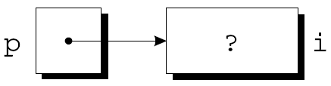
The Address Operator
One way to initialize a pointer variable is to assign it the address of a variable:
int i, *p;
…
p = &i;
Assigning the address of i to the variable p makes p point to i:
*
Copyright © 2008 W. W. Norton & Company.
All rights reserved.

Slide 11
The Address Operator
It’s also possible to initialize a pointer variable at the time it’s declared:
int i;
int *p = &i;
The declaration of i can even be combined with the declaration of p:
int i, *p = &i;
*
Copyright © 2008 W. W. Norton & Company.
All rights reserved.

Slide 12
The Indirection Operator
Once a pointer variable points to an object, we can use the * (indirection) operator to access what’s stored in the object.
If p points to i, we can print the value of i as follows:
printf("%d\n", *p);
Applying & to a variable produces a pointer to the variable. Applying * to the pointer takes us back to the original variable:
j = *&i; /* same as j = i; */
*
Copyright © 2008 W. W. Norton & Company.
All rights reserved.

Slide 13
The Indirection Operator
As long as p points to i, *p is an alias for i.
*p has the same value as i.
Changing the value of *p changes the value of i.
The example on the next slide illustrates the equivalence of *p and i.
*
Copyright © 2008 W. W. Norton & Company.
All rights reserved.

Slide 14
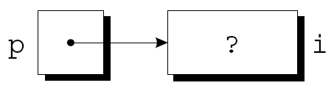
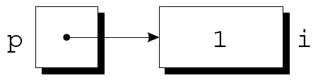
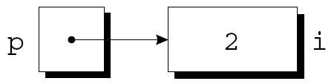
The Indirection Operator
p = &i;
i = 1;
printf("%d\n", i); /* prints 1 */
printf("%d\n", *p); /* prints 1 */
*p = 2;
printf("%d\n", i); /* prints 2 */
printf("%d\n", *p); /* prints 2 */
*
Copyright © 2008 W. W. Norton & Company.
All rights reserved.

Slide 15
The Indirection Operator
Applying the indirection operator to an uninitialized pointer variable causes undefined behavior:
int *p;
printf("%d", *p); /*** WRONG ***/
Assigning a value to *p is particularly dangerous:
int *p;
*p = 1; /*** WRONG ***/
*
Copyright © 2008 W. W. Norton & Company.
All rights reserved.

Slide 16
Pointer Assignment
C allows the use of the assignment operator to copy pointers of the same type.
Assume that the following declaration is in effect:
int i, j, *p, *q;
Example of pointer assignment:
p = &i;
*
Copyright © 2008 W. W. Norton & Company.
All rights reserved.

Slide 17
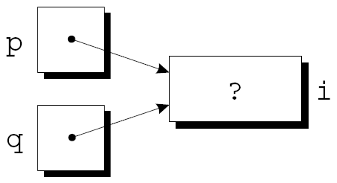
Pointer Assignment
Another example of pointer assignment:
q = p;
q now points to the same place as p:
*
Copyright © 2008 W. W. Norton & Company.
All rights reserved.

Slide 18

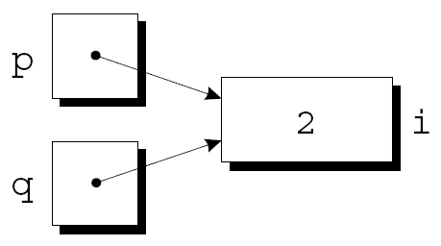
Pointer Assignment
If p and q both point to i, we can change i by assigning a new value to either *p or *q:
*p = 1;
*q = 2;
Any number of pointer variables may point to the same object.
*
Copyright © 2008 W. W. Norton & Company.
All rights reserved.

Slide 19
Pointer Assignment
Be careful not to confuse
q = p;
with
*q = *p;
The first statement is a pointer assignment, but the second is not.
The example on the next slide shows the effect of the second statement.
*
Copyright © 2008 W. W. Norton & Company.
All rights reserved.

Slide 20
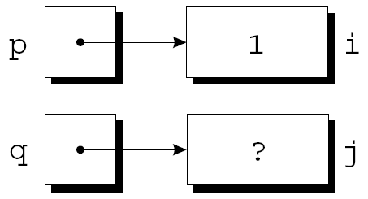
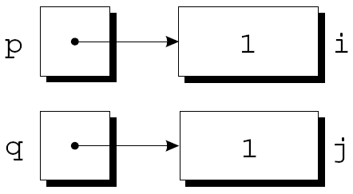
Pointer Assignment
p = &i;
q = &j;
i = 1;
*q = *p;
*
Copyright © 2008 W. W. Norton & Company.
All rights reserved.

Slide 21
Pointers as Arguments
In Chapter 9, we tried—and failed—to write a decompose function that could modify its arguments.
By passing a pointer to a variable instead of the value of the variable, decompose can be fixed.
*
Copyright © 2008 W. W. Norton & Company.
All rights reserved.

Slide 22
Pointers as Arguments
New definition of decompose:
void decompose(double x, long *int_part,
double *frac_part)
{
*int_part = (long) x;
*frac_part = x - *int_part;
}
Possible prototypes for decompose:
void decompose(double x, long *int_part,
double *frac_part);
void decompose(double, long *, double *);
*
Copyright © 2008 W. W. Norton & Company.
All rights reserved.

Slide 23
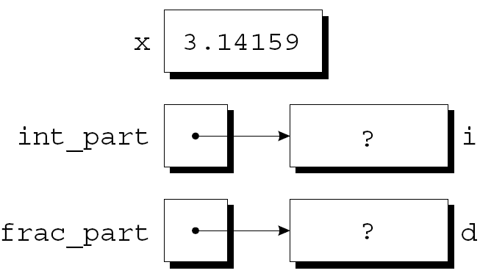
Pointers as Arguments
A call of decompose:
decompose(3.14159, &i, &d);
As a result of the call, int_part points to i and frac_part points to d:
*
Copyright © 2008 W. W. Norton & Company.
All rights reserved.

Slide 24
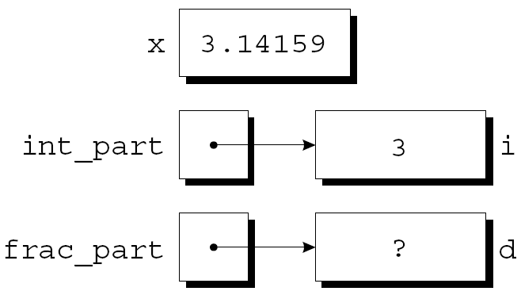
Pointers as Arguments
The first assignment in the body of decompose converts the value of x to type long and stores it in the object pointed to by int_part:
*
Copyright © 2008 W. W. Norton & Company.
All rights reserved.

Slide 25
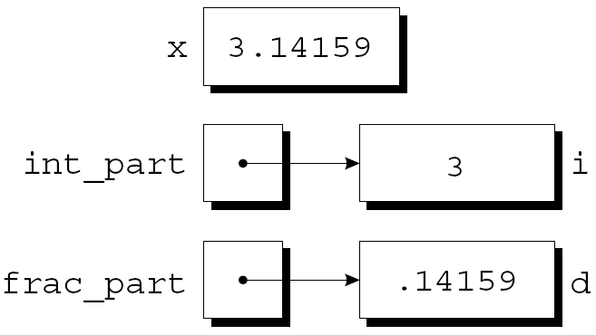
Pointers as Arguments
The second assignment stores x - *int_part into the object that frac_part points to:
*
Copyright © 2008 W. W. Norton & Company.
All rights reserved.

Slide 26
Pointers as Arguments
Arguments in calls of scanf are pointers:
int i;
…
scanf("%d", &i);
Without the &, scanf would be supplied with the value of i.
*
Copyright © 2008 W. W. Norton & Company.
All rights reserved.

Slide 27
Pointers as Arguments
Although scanf’s arguments must be pointers, it’s not always true that every argument needs the & operator:
int i, *p;
…
p = &i;
scanf("%d", p);
Using the & operator in the call would be wrong:
scanf("%d", &p); /*** WRONG ***/
*
Copyright © 2008 W. W. Norton & Company.
All rights reserved.

Slide 28
Pointers as Arguments
Failing to pass a pointer to a function when one is expected can have disastrous results.
A call of decompose in which the & operator is missing:
decompose(3.14159, i, d);
When decompose stores values in *int_part and *frac_part, it will attempt to change unknown memory locations instead of modifying i and d.
If we’ve provided a prototype for decompose, the compiler will detect the error.
In the case of scanf, however, failing to pass pointers may go undetected.
*
Copyright © 2008 W. W. Norton & Company.
All rights reserved.

Slide 29
Program: Finding the Largest and Smallest Elements in an Array
The max_min.c program uses a function named max_min to find the largest and smallest elements in an array.
Prototype for max_min:
void max_min(int a[], int n, int *max, int *min);
Example call of max_min:
max_min(b, N, &big, &small);
When max_min finds the largest element in b, it stores the value in big by assigning it to *max.
max_min stores the smallest element of b in small by assigning it to *min.
*
Copyright © 2008 W. W. Norton & Company.
All rights reserved.

Slide 30
Program: Finding the Largest and Smallest Elements in an Array
max_min.c will read 10 numbers into an array, pass it to the max_min function, and print the results:
Enter 10 numbers: 34 82 49 102 7 94 23 11 50 31
Largest: 102
Smallest: 7
*
Copyright © 2008 W. W. Norton & Company.
All rights reserved.

Slide 31
maxmin.c
/* Finds the largest and smallest elements in an array */
#include <stdio.h>
#define N 10
void max_min(int a[], int n, int *max, int *min);
int main(void)
{
int b[N], i, big, small;
printf("Enter %d numbers: ", N);
for (i = 0; i < N; i++)
scanf("%d", &b[i]);
*
Copyright © 2008 W. W. Norton & Company.
All rights reserved.

Slide 32
max_min(b, N, &big, &small);
printf("Largest: %d\n", big);
printf("Smallest: %d\n", small);
return 0;
}
void max_min(int a[], int n, int *max, int *min)
{
int i;
*max = *min = a[0];
for (i = 1; i < n; i++) {
if (a[i] > *max)
*max = a[i];
else if (a[i] < *min)
*min = a[i];
}
}
*
Copyright © 2008 W. W. Norton & Company.
All rights reserved.

Slide 33
Using const to Protect Arguments
When an argument is a pointer to a variable x, we normally assume that x will be modified:
f(&x);
It’s possible, though, that f merely needs to examine the value of x, not change it.
The reason for the pointer might be efficiency: passing the value of a variable can waste time and space if the variable requires a large amount of storage.
*
Copyright © 2008 W. W. Norton & Company.
All rights reserved.

Slide 34
Using const to Protect Arguments
We can use const to document that a function won’t change an object whose address is passed to the function.
void f(const int *p)
{
*p = 0; /* error: assignment of
read-only location ‘*p’ */
}
Attempting to modify *p is an error that the compiler will detect.
*
Copyright © 2008 W. W. Norton & Company.
All rights reserved.

Slide 35
Using const to Protect Arguments
We can use const to document that a function won’t change an object whose address is passed to the function.
void f(int * const p)
{
p = 0; /* error: assignment of
read-only parameter ‘p’ */
}
Attempting to modify *p is an error that the compiler will detect.
*
Copyright © 2008 W. W. Norton & Company.
All rights reserved.

Slide 36
Pointers as Return Values
Functions are allowed to return pointers:
int *max(int *a, int *b)
{
if (*a > *b)
return a;
else
return b;
}
A call of the max function:
int *p, i, j;
…
p = max(&i, &j);
After the call, p points to either i or j.
*
Copyright © 2008 W. W. Norton & Company.
All rights reserved.

Slide 37
Pointers as Return Values
Although max returns one of the pointers passed to it as an argument, that’s not the only possibility.
A function could also return a pointer to an external variable or to a static local variable.
Never return a pointer to an automatic local variable:
int *f(void)
{
int i;
…
return &i;
}
The variable i won’t exist after f returns.
*
Copyright © 2008 W. W. Norton & Company.
All rights reserved.

Slide 38
Pointers as Return Values
Pointers can point to array elements.
If a is an array, then &a[i] is a pointer to element i of a.
It’s sometimes useful for a function to return a pointer to one of the elements in an array.
A function that returns a pointer to the middle element of a, assuming that a has n elements:
int *find_middle(int a[], int n) {
return &a[n/2];
}
*
Copyright © 2008 W. W. Norton & Company.
All rights reserved.

