Slide 1
Chapter 18
Declarations
*
Copyright © 2008 W. W. Norton & Company.
All rights reserved.

Slide 2
Declaration Syntax
Declarations furnish information to the compiler about the meaning of identifiers.
Examples:
int i;
float f(float);
General form of a declaration:
declaration-specifiers declarators ;
Declaration specifiers describe the properties of the variables or functions being declared.
Declarators give their names and may provide additional information about their properties.
*
Copyright © 2008 W. W. Norton & Company.
All rights reserved.

Slide 3
Declaration Syntax
Declaration specifiers fall into three categories:
Storage classes
Type qualifiers
Type specifiers
C99 has a fourth category, function specifiers, which are used only in function declarations.
This category has one member, the keyword inline.
Type qualifiers and type specifiers should follow the storage class, but there are no other restrictions on their order.
*
Copyright © 2008 W. W. Norton & Company.
All rights reserved.

Slide 4
Declaration Syntax
There are four storage classes: auto, static, extern, and register.
At most one storage class may appear in a declaration; if present, it should come first.
In C89, there are only two type qualifiers: const and volatile.
C99 has a third type qualifier, restrict.
A declaration may contain zero or more type qualifiers.
*
Copyright © 2008 W. W. Norton & Company.
All rights reserved.

Slide 5
Declaration Syntax
The keywords void, char, short, int, long, float, double, signed, and unsigned are all type specifiers.
The order in which they are combined doesn’t matter.
int unsigned long is the same as long unsigned int.
Type specifiers also include specifications of structures, unions, and enumerations.
Examples: struct point { int x, y; }, struct { int x, y; }, struct point.
typedef names are also type specifiers.
*
Copyright © 2008 W. W. Norton & Company.
All rights reserved.

Slide 6
Declaration Syntax
Declarators include:
Identifiers (names of simple variables)
Identifiers followed by [] (array names)
Identifiers preceded by * (pointer names)
Identifiers followed by () (function names)
Declarators are separated by commas.
A declarator that represents a variable may be followed by an initializer.
*
Copyright © 2008 W. W. Norton & Company.
All rights reserved.

Slide 7
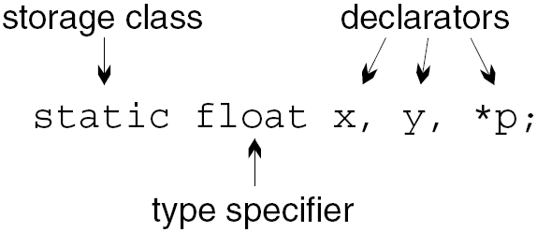
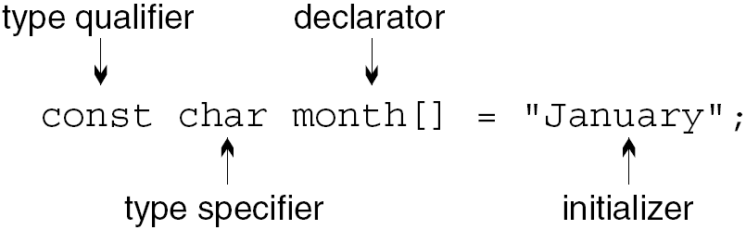
Declaration Syntax
A declaration with a storage class and three declarators:
A declaration with a type qualifier and initializer but no storage class:
*
Copyright © 2008 W. W. Norton & Company.
All rights reserved.

Slide 8
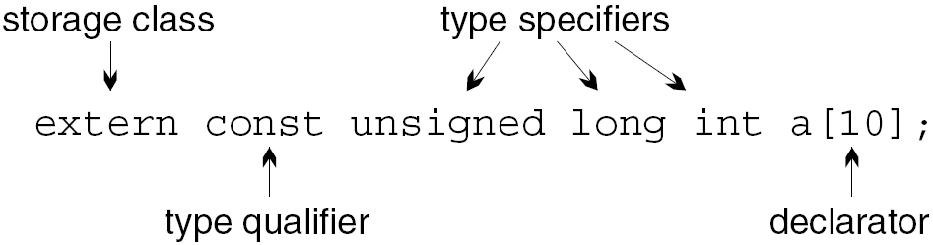
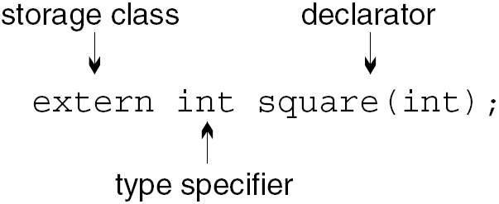
Declaration Syntax
A declaration with a storage class, a type qualifier, and three type specifiers:
Function declarations may have a storage class, type qualifiers, and type specifiers:
*
Copyright © 2008 W. W. Norton & Company.
All rights reserved.

Slide 9
Storage Classes
Storage classes can be specified for variables and—to a lesser extent—functions and parameters.
Recall that the term block refers to the body of a function (the part in braces) or a compound statement, possibly containing declarations.
*
Copyright © 2008 W. W. Norton & Company.
All rights reserved.

Slide 10
Properties of Variables
Every variable in a C program has three properties:
Storage duration
Scope
Linkage
*
Copyright © 2008 W. W. Norton & Company.
All rights reserved.

Slide 11
Properties of Variables
The storage duration of a variable determines when memory is set aside for the variable and when that memory is released.
Automatic storage duration: Memory for variable is allocated when the surrounding block is executed and deallocated when the block terminates.
Static storage duration: Variable stays at the same storage location as long as the program is running, allowing it to retain its value indefinitely.
*
Copyright © 2008 W. W. Norton & Company.
All rights reserved.

Slide 12
Properties of Variables
The scope of a variable is the portion of the program text in which the variable can be referenced.
Block scope: Variable is visible from its point of declaration to the end of the enclosing block.
File scope: Variable is visible from its point of declaration to the end of the enclosing file.
*
Copyright © 2008 W. W. Norton & Company.
All rights reserved.

Slide 13
Properties of Variables
The linkage of a variable determines the extent to which it can be shared.
External linkage: Variable may be shared by several (perhaps all) files in a program.
Internal linkage: Variable is restricted to a single file but may be shared by the functions in that file.
No linkage: Variable belongs to a single function and can’t be shared at all.
*
Copyright © 2008 W. W. Norton & Company.
All rights reserved.

Slide 14
Properties of Variables
The default storage duration, scope, and linkage of a variable depend on where it’s declared:
Variables declared inside a block (including a function body) have automatic storage duration, block scope, and no linkage.
Variables declared outside any block, at the outermost level of a program, have static storage duration, file scope, and external linkage.
*
Copyright © 2008 W. W. Norton & Company.
All rights reserved.

Slide 15
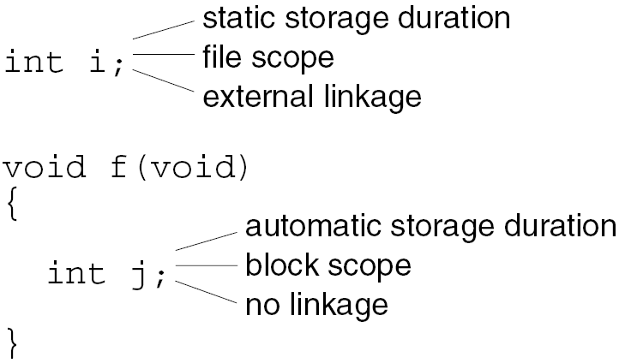
Properties of Variables
Example:
We can alter these properties by specifying an explicit storage class: auto, static, extern, or register.
*
Copyright © 2008 W. W. Norton & Company.
All rights reserved.

Slide 16
The auto Storage Class
The auto storage class is legal only for variables that belong to a block.
An auto variable has automatic storage duration, block scope, and no linkage.
The auto storage class is almost never specified explicitly.
*
Copyright © 2008 W. W. Norton & Company.
All rights reserved.

Slide 17
The static Storage Class
The static storage class can be used with all variables, regardless of where they’re declared.
When used outside a block, static specifies that a variable has internal linkage.
When used inside a block, static changes the variable’s storage duration from automatic to static.
*
Copyright © 2008 W. W. Norton & Company.
All rights reserved.

Slide 18
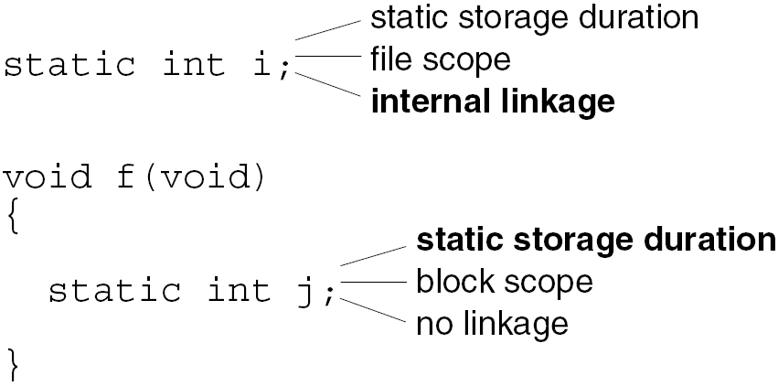
The static Storage Class
Example:
*
Copyright © 2008 W. W. Norton & Company.
All rights reserved.

Slide 19
The static Storage Class
When used outside a block, static hides a variable within a file:
static int i; /* no access to i in other files */
void f1(void)
{
/* has access to i */
}
void f2(void)
{
/* has access to i */
}
This use of static is helpful for implementing information hiding.
*
Copyright © 2008 W. W. Norton & Company.
All rights reserved.

Slide 20
The static Storage Class
A static variable declared within a block resides at the same storage location throughout program execution.
A static variable retains its value indefinitely.
Properties of static variables:
A static variable is initialized only once, prior to program execution.
A static variable declared inside a function is shared by all calls of the function, including recursive calls.
A function may return a pointer to a static variable.
*
Copyright © 2008 W. W. Norton & Company.
All rights reserved.

Slide 21
The static Storage Class
Declaring a local variable to be static allows a function to retain information between calls.
More often, we’ll use static for reasons of efficiency:
char digit_to_hex_char(int digit)
{
static const char hex_chars[16] =
"0123456789ABCDEF";
return hex_chars[digit];
}
Declaring hex_chars to be static saves time, because static variables are initialized only once.
*
Copyright © 2008 W. W. Norton & Company.
All rights reserved.

Slide 22
The extern Storage Class
The extern storage class enables several source files to share the same variable.
A variable declaration that uses extern doesn’t cause memory to be allocated for the variable:
extern int i;
In C terminology, this is not a definition of i.
An extern declaration tells the compiler that we need access to a variable that’s defined elsewhere.
A variable can have many declarations in a program but should have only one definition.
*
Copyright © 2008 W. W. Norton & Company.
All rights reserved.

Slide 23
The extern Storage Class
There’s one exception to the rule that an extern declaration of a variable isn’t a definition.
An extern declaration that initializes a variable serves as a definition of the variable.
For example, the declaration
extern int i = 0;
is effectively the same as
int i = 0;
This rule prevents multiple extern declarations from initializing a variable in different ways.
*
Copyright © 2008 W. W. Norton & Company.
All rights reserved.

Slide 24
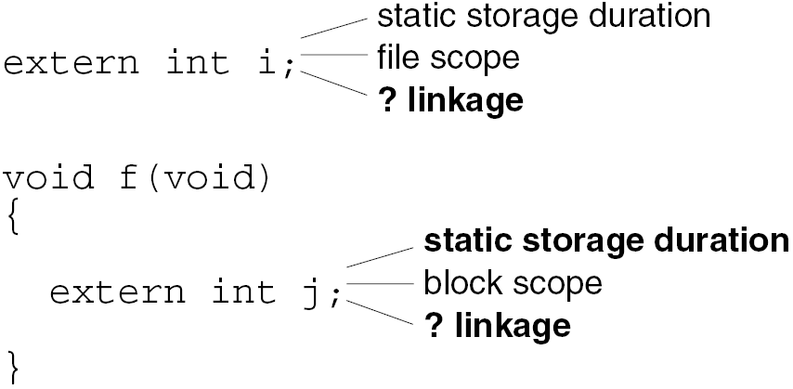
The extern Storage Class
A variable in an extern declaration always has static storage duration.
If the declaration is inside a block, the variable has block scope; otherwise, it has file scope:
*
Copyright © 2008 W. W. Norton & Company.
All rights reserved.

Slide 25
The extern Storage Class
Determining the linkage of an extern variable is a bit harder.
If the variable was declared static earlier in the file (outside of any function definition), then it has internal linkage.
Otherwise (the normal case), the variable has external linkage.
*
Copyright © 2008 W. W. Norton & Company.
All rights reserved.

Slide 26
The register Storage Class
Using the register storage class in the declaration of a variable asks the compiler to store the variable in a register.
A register is a high-speed storage area located in a computer’s CPU.
Specifying the storage class of a variable to be register is a request, not a command.
The compiler is free to store a register variable in memory if it chooses.
*
Copyright © 2008 W. W. Norton & Company.
All rights reserved.

Slide 27
The register Storage Class
The register storage class is legal only for variables declared in a block.
A register variable has the same storage duration, scope, and linkage as an auto variable.
Since registers don’t have addresses, it’s illegal to use the & operator to take the address of a register variable.
This restriction applies even if the compiler has elected to store the variable in memory.
*
Copyright © 2008 W. W. Norton & Company.
All rights reserved.

Slide 28
The register Storage Class
register is best used for variables that are accessed and/or updated frequently.
The loop control variable in a for statement is a good candidate for register treatment:
int sum_array(int a[], int n)
{
register int i;
int sum = 0;
for (i = 0; i < n; i++)
sum += a[i];
return sum;
}
*
Copyright © 2008 W. W. Norton & Company.
All rights reserved.

Slide 29
The register Storage Class
register isn’t as popular as it once was.
Many of today’s compilers can determine automatically which variables would benefit from being kept in registers.
Still, using register provides useful information that can help the compiler optimize the performance of a program.
In particular, the compiler knows that a register variable can’t have its address taken, and therefore can’t be modified through a pointer.
*
Copyright © 2008 W. W. Norton & Company.
All rights reserved.

Slide 30
The Storage Class of a Function
Function declarations (and definitions) may include a storage class.
The only options are extern and static:
extern specifies that the function has external linkage, allowing it to be called from other files.
static indicates internal linkage, limiting use of the function’s name to the file in which it’s defined.
If no storage class is specified, the function is assumed to have external linkage.
*
Copyright © 2008 W. W. Norton & Company.
All rights reserved.

Slide 31
The Storage Class of a Function
Examples:
extern int f(int i);
static int g(int i);
int h(int i);
Using extern is unnecessary, but static has benefits:
Easier maintenance. A static function isn’t visible outside the file in which its definition appears, so future modifications to the function won’t affect other files.
Reduced “name space pollution.” Names of static functions don’t conflict with names used in other files.
*
Copyright © 2008 W. W. Norton & Company.
All rights reserved.

Slide 32
The Storage Class of a Function
Function parameters have the same properties as auto variables: automatic storage duration, block scope, and no linkage.
The only storage class that can be specified for parameters is register.
*
Copyright © 2008 W. W. Norton & Company.
All rights reserved.

Slide 33
Summary
A program fragment that shows all possible ways to include—or omit—storage classes in declarations of variables and parameters:
int a;
extern int b;
static int c;
void f(int d, register int e)
{
auto int g;
int h;
static int i;
extern int j;
register int k;
}
*
Copyright © 2008 W. W. Norton & Company.
All rights reserved.

Slide 34
Summary
Name Storage Duration Scope Linkage
a static file external
b static file †
c static file internal
d automatic block none
e automatic block none
g automatic block none
h automatic block none
i static block none
j static block †
k automatic block none
†In most cases, b and j will be defined in another file and will have external linkage.
*
Copyright © 2008 W. W. Norton & Company.
All rights reserved.

Slide 35
Summary
Of the four storage classes, the most important are static and extern.
auto has no effect, and modern compilers have made register less important.
*
Copyright © 2008 W. W. Norton & Company.
All rights reserved.

Slide 36
Type Qualifiers
There are two type qualifiers: const and volatile.
C99 has a third type qualifier, restrict, which is used only with pointers.
volatile is discussed in Chapter 20.
const is used to declare “read-only” objects.
Examples:
const int n = 10;
const int tax_brackets[] =
{750, 2250, 3750, 5250, 7000};
*
Copyright © 2008 W. W. Norton & Company.
All rights reserved.

Slide 37
Type Qualifiers
Advantages of declaring an object to be const:
Serves as a form of documentation.
Allows the compiler to check that the value of the object isn’t changed.
Alerts the compiler that the object can be stored in ROM (read-only memory).
*
Copyright © 2008 W. W. Norton & Company.
All rights reserved.

Slide 38
Type Qualifiers
It might appear that const serves the same role as the #define directive, but there are significant differences between the two features.
#define can be used to create a name for a numerical, character, or string constant, but const can create read-only objects of any type.
const objects are subject to the same scope rules as variables; constants created using #define aren’t.
*
Copyright © 2008 W. W. Norton & Company.
All rights reserved.

Slide 39
Type Qualifiers
The value of a const object, unlike the value of a macro, can be viewed in a debugger.
Unlike macros, const objects can’t be used in constant expressions:
const int n = 10;
int a[n]; /*** WRONG ***/
It’s legal to apply the address operator (&) to a const object, since it has an address; a macro doesn’t have an address.
*
Copyright © 2008 W. W. Norton & Company.
All rights reserved.

Slide 40
Type Qualifiers
There are no absolute rules that dictate when to use #define and when to use const.
#define is good for constants that represent numbers or characters.
*
Copyright © 2008 W. W. Norton & Company.
All rights reserved.

Slide 41
Declarators
In the simplest case, a declarator is just an identifier:
int i;
Declarators may also contain the symbols *, [], and ().
A declarator that begins with * represents a pointer:
int *p;
*
Copyright © 2008 W. W. Norton & Company.
All rights reserved.

Slide 42
Declarators
A declarator that ends with [] represents an array:
int a[10];
The brackets may be left empty if the array is a parameter, if it has an initializer, or if its storage class is extern:
extern int a[];
In the case of a multidimensional array, only the first set of brackets can be empty.
*
Copyright © 2008 W. W. Norton & Company.
All rights reserved.

Slide 43
Declarators
C99 provides two additional options for what goes between the brackets in the declaration of an array parameter:
The keyword static, followed by an expression that specifies the array’s minimum length.
The * symbol, which can be used in a function prototype to indicate a variable-length array argument.
Chapter 9 discusses both features.
*
Copyright © 2008 W. W. Norton & Company.
All rights reserved.

Slide 44
Declarators
A declarator that ends with () represents a function:
int abs(int i);
void swap(int *a, int *b);
int find_largest(int a[], int n);
C allows parameter names to be omitted in a function declaration:
int abs(int);
void swap(int *, int *);
int find_largest(int [], int);
*
Copyright © 2008 W. W. Norton & Company.
All rights reserved.

Slide 45
Declarators
The parentheses can even be left empty:
int abs();
void swap();
int find_largest();
This provides no information about the arguments.
Putting the word void between the parentheses is different: it indicates that there are no arguments.
The empty-parentheses style doesn’t let the compiler check whether function calls have the right arguments.
*
Copyright © 2008 W. W. Norton & Company.
All rights reserved.

Slide 46
Declarators
Declarators in actual programs often combine the *, [], and () notations.
An array of 10 pointers to integers:
int *ap[10];
A function that has a float argument and returns a pointer to a float:
float *fp(float);
A pointer to a function with an int argument and a void return type:
void (*pf)(int);
*
Copyright © 2008 W. W. Norton & Company.
All rights reserved.

Slide 47
Deciphering Complex Declarations
But what about declarators like the one in the following declaration?
int *(*x[10])(void);
It’s not obvious whether x is a pointer, an array, or a function.
*
Copyright © 2008 W. W. Norton & Company.
All rights reserved.

Slide 48
Deciphering Complex Declarations
Rules for understanding declarations:
Always read declarators from the inside out. Locate the identifier that’s being declared, and start deciphering the declaration from there.
When there’s a choice, always favor [] and () over *. Parentheses can be used to override the normal priority of [] and () over *.
*
Copyright © 2008 W. W. Norton & Company.
All rights reserved.

Slide 49
Deciphering Complex Declarations
Example 1:
int *ap[10];
ap is an array of pointers.
Example 2:
float *fp(float);
fp is a function that returns a pointer.
*
Copyright © 2008 W. W. Norton & Company.
All rights reserved.

Slide 50
Deciphering Complex Declarations
Example 3:
void (*pf)(int);
Since *pf is enclosed in parentheses, pf must be a pointer.
But (*pf) is followed by (int), so pf must point to a function with an int argument.
The word void represents the return type of this function.
*
Copyright © 2008 W. W. Norton & Company.
All rights reserved.

Slide 51
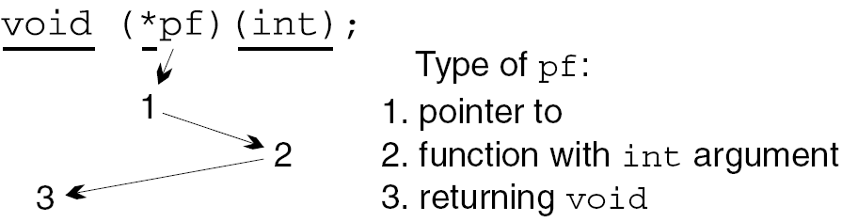
Deciphering Complex Declarations
Understanding a complex declarator often involves zigzagging from one side of the identifier to the other:
*
Copyright © 2008 W. W. Norton & Company.
All rights reserved.

Slide 52
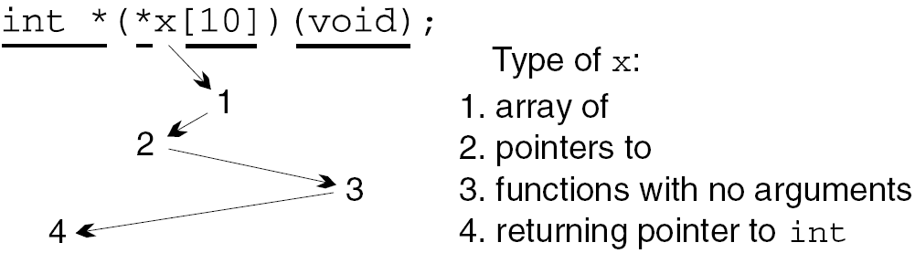
Deciphering Complex Declarations
A second example of “zigzagging”:
typedef int *(*pfdd)(void); / define type pfdd
pfdd x[10] = {NULL, f1, f2, f3};
*
Copyright © 2008 W. W. Norton & Company.
All rights reserved.

Slide 53
Deciphering Complex Declarations
Certain things can’t be declared in C.
Functions can’t return arrays:
int f(int)[]; /*** WRONG ***/
Functions can’t return functions:
int g(int)(int); /*** WRONG ***/
Arrays of functions aren’t possible, either:
int a[10](int); /*** WRONG ***/
In each case, pointers can be used to get the desired effect.
For example, a function can’t return an array, but it can return a pointer to an array.
*
Copyright © 2008 W. W. Norton & Company.
All rights reserved.

Slide 54
Using Type Definitions to Simplify Declarations
Some programmers use type definitions to help simplify complex declarations.
Suppose that x is declared as follows:
int *(*x[10])(void);
The following type definitions make x’s type easier to understand:
typedef int *Fcn(void);
typedef Fcn *Fcn_ptr;
typedef Fcn_ptr Fcn_ptr_array[10];
Fcn_ptr_array x;
*
Copyright © 2008 W. W. Norton & Company.
All rights reserved.

Slide 55
Initializers
For convenience, C allows us to specify initial values for variables as we’re declaring them.
To initialize a variable, we write the = symbol after its declarator, then follow that with an initializer.
*
Copyright © 2008 W. W. Norton & Company.
All rights reserved.

Slide 56
Initializers
The initializer for a simple variable is an expression of the same type as the variable:
int i = 5 / 2; /* i is initially 2 */
If the types don’t match, C converts the initializer using the same rules as for assignment:
int j = 5.5; /* converted to 5 */
The initializer for a pointer variable must be an expression of the same type or of type void *:
int *p = &i;
*
Copyright © 2008 W. W. Norton & Company.
All rights reserved.

Slide 57
Initializers
The initializer for an array, structure, or union is usually a series of values enclosed in braces:
int a[5] = {1, 2, 3, 4, 5};
In C99, brace-enclosed initializers can have other forms, thanks to designated initializers.
*
Copyright © 2008 W. W. Norton & Company.
All rights reserved.

Slide 58
Initializers
An initializer for a variable with static storage duration must be constant:
#define FIRST 1
#define LAST 100
static int i = LAST - FIRST + 1;
If LAST and FIRST had been variables, the initializer would be illegal.
*
Copyright © 2008 W. W. Norton & Company.
All rights reserved.

Slide 59
Initializers
If a variable has automatic storage duration, its initializer need not be constant:
int f(int n)
{
int last = n - 1;
…
}
*
Copyright © 2008 W. W. Norton & Company.
All rights reserved.

Slide 60
Initializers
A brace-enclosed initializer for an array, structure, or union must contain only constant expressions:
#define N 2
int powers[5] =
{1, N, N * N, N * N * N, N * N * N * N};
If N were a variable, the initializer would be illegal.
In C99, this restriction applies only if the variable has static storage duration.
*
Copyright © 2008 W. W. Norton & Company.
All rights reserved.

Slide 61
Initializers
The initializer for an automatic structure or union can be another structure or union:
void g(struct part part1)
{
struct part part2 = part1;
…
}
The initializer doesn’t have to be a variable or parameter name, although it does need to be an expression of the proper type.
*
Copyright © 2008 W. W. Norton & Company.
All rights reserved.

Slide 62
Uninitialized Variables
The initial value of a variable depends on its storage duration:
Variables with automatic storage duration have no default initial value.
Variables with static storage duration have the value zero by default.
A static variable is correctly initialized based on its type, not simply set to zero bits.
It’s better to provide initializers for static variables rather than rely on the fact that they’re guaranteed to be zero.
*
Copyright © 2008 W. W. Norton & Company.
All rights reserved.

Slide 63
Inline Functions (C99)
C99 function declarations may contain the keyword inline.
inline is related to the concept of the “overhead” of a function call—the work required to call a function and later return from it.
Although the overhead of a function call slows the program by only a tiny amount, it may add up in certain situations.
*
Copyright © 2008 W. W. Norton & Company.
All rights reserved.

Slide 64
Inline Functions (C99)
In C89, the only way to avoid the overhead of a function call is to use a parameterized macro.
C99 offers a better solution to this problem: create an inline function.
The word “inline” suggests that the compiler replaces each call of the function by the machine instructions for the function.
This technique may cause a minor increase in the size of the compiled program.
*
Copyright © 2008 W. W. Norton & Company.
All rights reserved.

Slide 65
Inline Functions (C99)
Declaring a function to be inline doesn’t actually force the compiler to “inline” the function.
It suggests that the compiler should try to make calls of the function as fast as possible, but the compiler is free to ignore the suggestion.
*
Copyright © 2008 W. W. Norton & Company.
All rights reserved.

Slide 66
Inline Definitions (C99)
An inline function has the keyword inline as one of its declaration specifiers:
inline double average(double a, double b)
{
return (a + b) / 2;
}
average has external linkage, so other source files may contain calls of average.
However, the definition of average isn’t an external definition (it’s an inline definition instead).
Attempting to call average from another file will be considered an error.
*
Copyright © 2008 W. W. Norton & Company.
All rights reserved.

Slide 67
Inline Definitions (C99)
There are two ways to avoid this error.
One option is to add the word static to the function definition:
static inline double average(double a, double b)
{
return (a + b) / 2;
}
average now has internal linkage, so it can’t be called from other files.
Other files may contain their own definitions of average, which might be the same or different.
*
Copyright © 2008 W. W. Norton & Company.
All rights reserved.

Slide 68
Inline Definitions (C99)
The other option is to provide an external definition for average so that calls are permitted from other files.
One way to do this is to write the average function a second time (without using inline) and put this definition in a different source file.
However, it’s not a good idea to have two versions of a function: we can’t guarantee that they’ll remain consistent when the program is modified.
*
Copyright © 2008 W. W. Norton & Company.
All rights reserved.

Slide 69
Inline Definitions (C99)
A better approach is to put the inline definition of average in a header file:
#ifndef AVERAGE_H
#define AVERAGE_H
inline double average(double a, double b)
{
return (a + b) / 2;
}
#endif
Let’s name this file average.h.
*
Copyright © 2008 W. W. Norton & Company.
All rights reserved.

Slide 70
Inline Definitions (C99)
Next, we’ll create a matching source file, average.c:
#include "average.h"
extern double average(double a, double b);
Any file that needs to call the average function can include average.h.
The definition of average included from average.h will be treated as an external definition in average.c.
*
Copyright © 2008 W. W. Norton & Company.
All rights reserved.

Slide 71
Inline Definitions (C99)
A general rule: If all top-level declarations of a function in a file include inline but not extern, then the definition of the function in that file is inline.
If the function is used anywhere in the program, an external definition of the function will need to be provided by some other file.
*
Copyright © 2008 W. W. Norton & Company.
All rights reserved.

Slide 72
Inline Definitions (C99)
When an inline function is called, the compiler has a choice:
Perform an ordinary call (using the function’s external definition).
Perform inline expansion (using the function’s inline definition).
Because the choice is left to the compiler, it’s crucial that the two definitions be consistent.
The technique just discussed (using the average.h and average.c files) guarantees that the definitions are the same.
*
Copyright © 2008 W. W. Norton & Company.
All rights reserved.

Slide 73
Restrictions on Inline Functions (C99)
Restrictions on inline functions with external linkage:
May not define a modifiable static variable.
May not contain references to variables with internal linkage.
Such a function is allowed to define a variable that is both static and const.
However, each inline definition of the function may create its own copy of the variable.
*
Copyright © 2008 W. W. Norton & Company.
All rights reserved.

Slide 74
Using Inline Functions with GCC (C99)
Some compilers, including GCC, supported inline functions prior to the C99 standard.
Their rules for using inline functions may vary from the standard.
The scheme described earlier (using the average.h and average.c files) may not work with these compilers.
Version 4.3 of GCC is expected to support inline functions in the way described in the C99 standard.
*
Copyright © 2008 W. W. Norton & Company.
All rights reserved.

Slide 75
Using Inline Functions with GCC (C99)
Functions that are specified to be both static and inline should work fine, regardless of the version of GCC.
This strategy is legal in C99 as well, so it’s the safest bet.
A static inline function can be used within a single file or placed in a header file and included into any source file that needs to call the function.
*
Copyright © 2008 W. W. Norton & Company.
All rights reserved.

Slide 76
Using Inline Functions with GCC (C99)
A technique for sharing an inline function among multiple files that works with older versions of GCC but conflicts with C99:
Put a definition of the function in a header file.
Specify that the function is both extern and inline.
Include the header file into any source file that contains a call of the function.
Put a second copy of the definition—without the words extern and inline—in one of the source files.
A final note about GCC: Functions are “inlined” only when the -O command-line option is used.
*
Copyright © 2008 W. W. Norton & Company.
All rights reserved.

