Slide 1
Case 5
Matthew Thomas Prescher

Slide 2
Intro: Data Mining
Data Mining is the analysis of raw data to extract useful information.
For Classification purposes a Variable with only two possibilities is preferred.
Approximately 1750 row and 80 variables(columns) are in this data set.
Tasked to find a variable with only two possible values and 6 explanatory variables that will prove to contain useful applications for a certain business

Slide 3
Analysis
Several variables have only 2 options such as Gender, do you have close friends who are a certain race, do you trust the government.
Many of those have missing values or do not hold much value for a company.
Thus the variable chosen is VOLUNT1 . It represents whether the individual has done any volunteer activities in the past 12 months. The relevance of the variable is for Non-Profit Organizations which rely on volunteers to keep going and achieve outreach.
The explanatory variables chosen were Education level, Gender, Marriage_Status, Own_State(how healthy you feel), Christian, and US Born
Among these variables there is few blank fields and very few “Refused to answer” “Didn’t Know” responses (RF/DK). This can lead to less accurate results in Classification Methods that may be undesirable.

Slide 4
Solving Procedure
First to make best use of the data chosen, data clean up is to be done.
Eliminate blank fields and RF/DK responses.
Convert Categorical variables into Dummies
Minimize the number of Dummies possible to get accurate readings.
Second is to make sure overfitting is not occurring in correlation tables where one variable influences the rest.
Third: to make this applicable to Organizations I chose to use Logistic Regression and Naïve Bayes as my Classification Methods. As they both result in a probability where you are closer to a Yes or No result

Slide 5
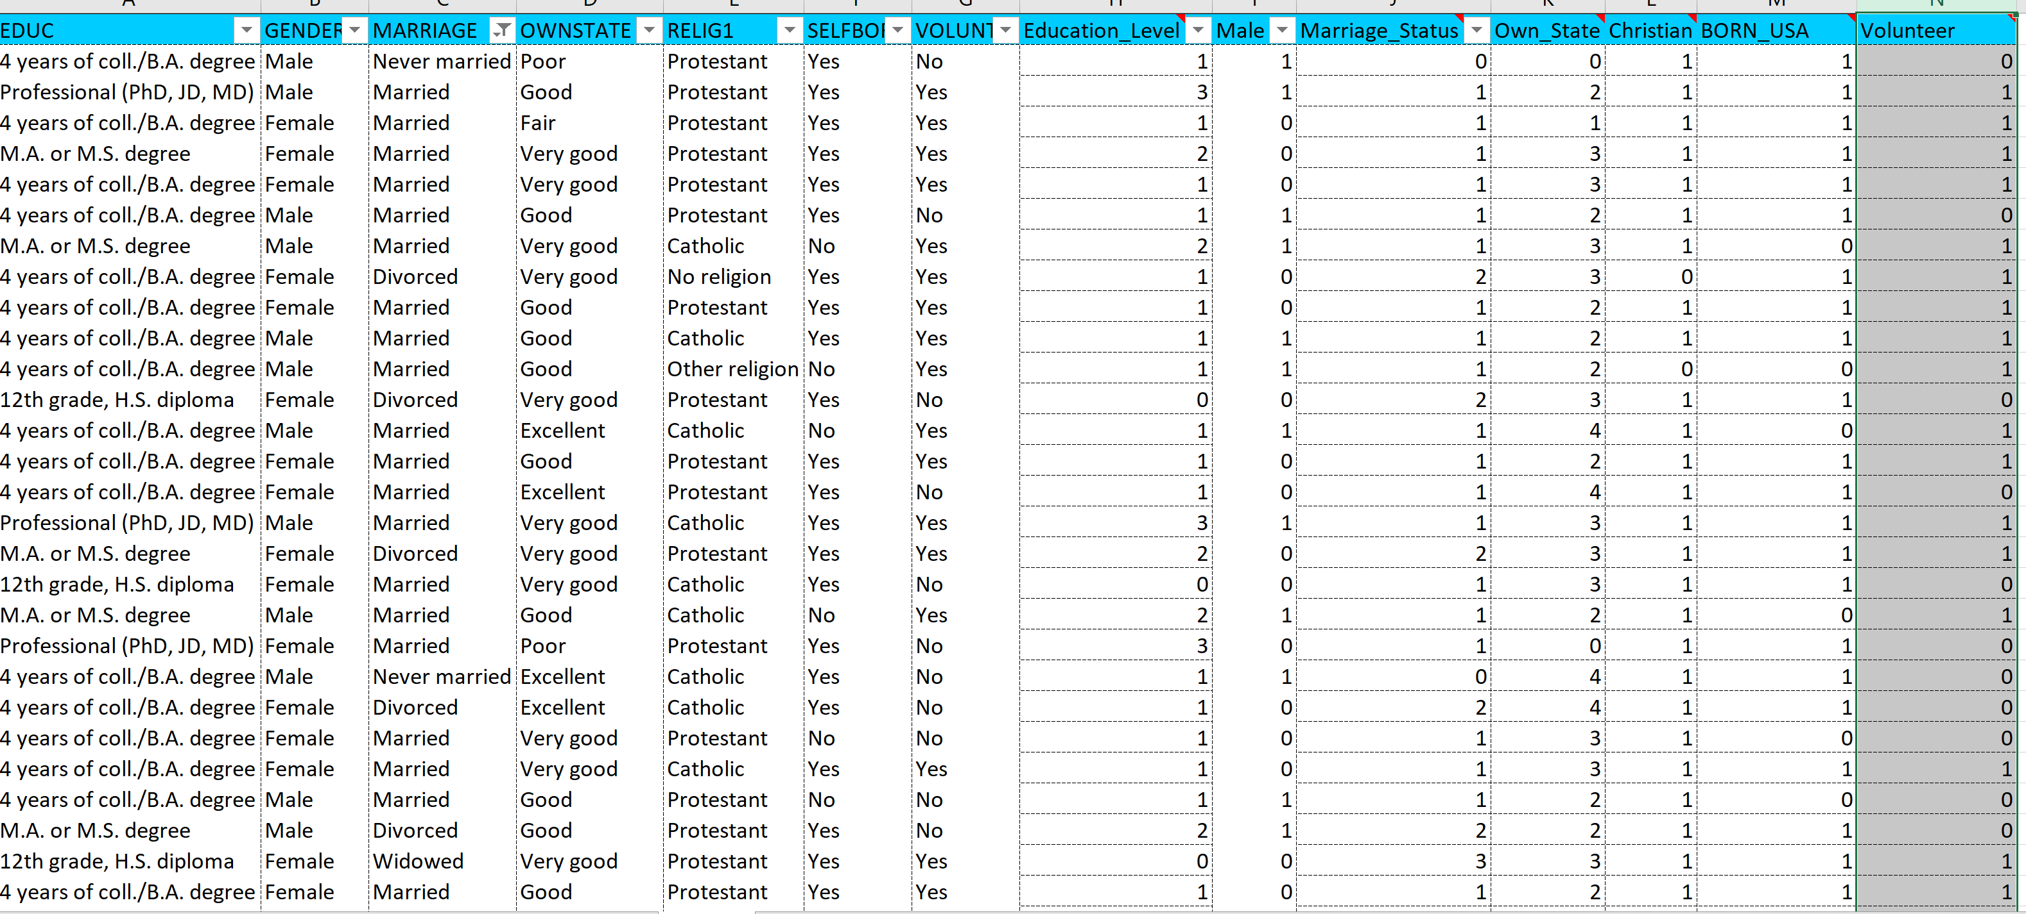
Solving Procedure Cont.
Breakdown of the variables and conversion into Dummy Variables.
This is essential in order to later input the dummies to both the logistic Regression and Naïve Bayes.

Slide 6
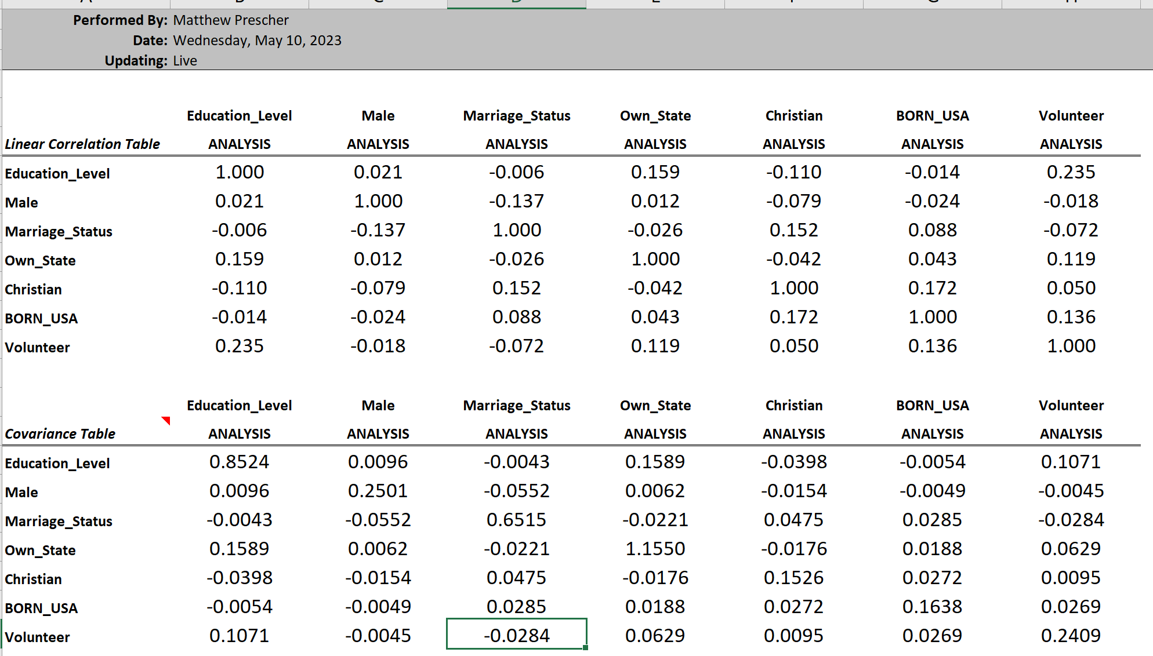
Solving Procedure Cont.
Covariance and Correlation Table.
The table is important for us to make certain that our variables are reasonable and will not affect each other strongly which may produce erroneous results.

Slide 7
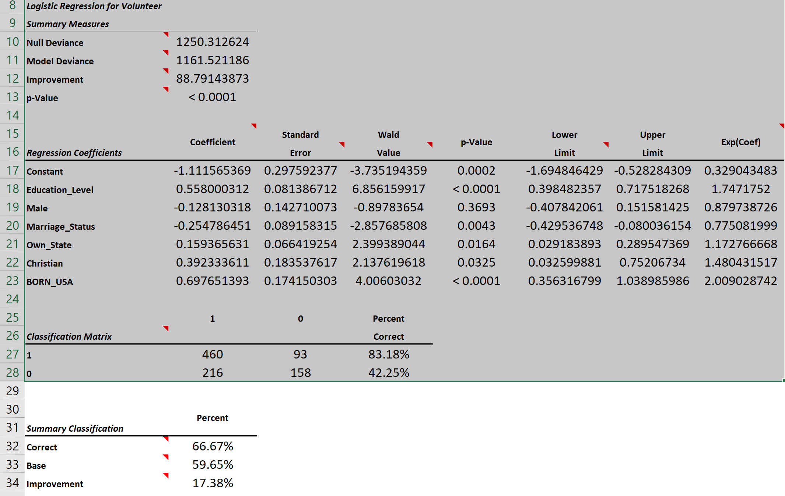
Interpretation of Logistic Regression
The logistic Regression Coefficients show us the weight each variable carries and effects the probability of whether the individual is a likely volunteer candidate or not.
The p-value show us that all are significant except for Male for it is not below the .05 mark.
In the Classification Matrix it shows that the model has an 83% correct rate of choosing individuals who would be likely to volunteer. However, it does poorly when determining the individuals who would not be likely to volunteer.
The model can then be said to have a high Sensitivity or True Positive Rate. Meaning it is likely to classify those likely to volunteer in addition to a few that would not. This serves our purpose well because it does not hurt to try to recruit individuals that would typically say no to volunteering but it does hurt when you miss those that would be willing to volunteer.

Slide 8
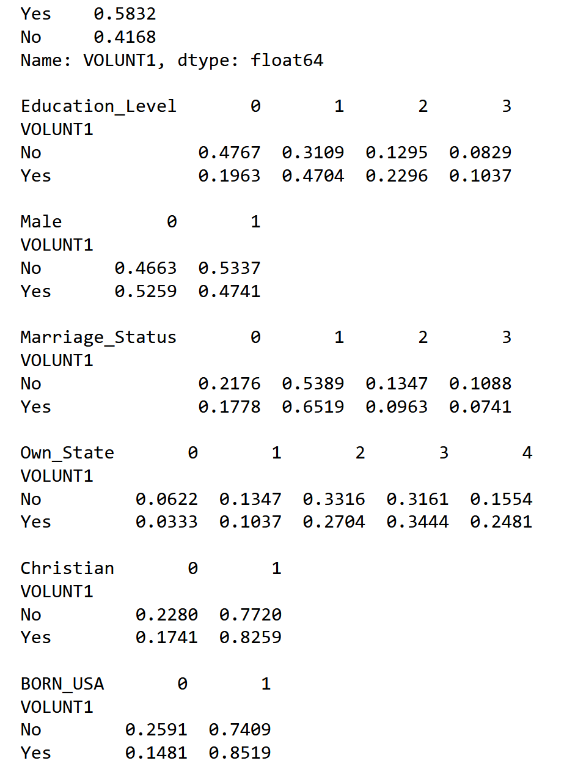
Interpretation of Naïve Bayes Classifier
Naïve Bayes Classifier is a supervised machine learning algorithm. It creates probabilities for all variables given. In this case every dummy is calculated in correlation with Yes or No to volunteering. Using this type of approach an organization can deduce which types of individuals are most likely to say yes or no and who to target to increase efficiency and reduce cost.
In this instance the variable being if an individual will volunteer or not the most likely to volunteer is one that meets the following requirements in the YES row:
Bachelors degree (1 in education), Female(0 in Male), Married (1 in Marriage_Status), Very Good Health (3 in Own_State), Christian (1 in Christian), and Born in USA(1, in USA)
This individual is 89% likely to be willing to Volunteer.

