Slide 1



Early detection of Autism spectrum disorder using EEG Techniques (ML)
FYP Proposal
Mujtaba Khan | (1802-2021)
Nuha Amir | (1611-2021)
Rubbaishe | (2192-2021)
Supervisor Saad Akbar
Hamdard University

Slide 2
Outline
Group Introduction
Introduction
Problem Statement
Project Objectives
Project Scope
Architecture Big Picture
Project Methodology
Project Role & Responsibilities
Project Milestones
Project Plan
Project Tools
Project Deliverables
References

Slide 3
Group Introduction
Group Members
Mujtaba Khan
Nuha Amir
Rubbaishe
Supervisor: Saad Akbar
Why we selected him as supervisor?
We selected him as our supervisor because we believe he is a professional person who can help us throughout the project resolving our issues in most convenient way.
Relevant Expertise
He have relevant expertise and experience in different areas of technology.
Relevant Experience
He has 15+ years of prolific experience in academia and IT industry.

Slide 4
Introduction
One of the most well researched developmental impairments is autism spectrum disorder (ASD). In addition to showing signs of constrained and repetitive patterns of behavior, interests, or hobbies, those with ASD’s must also have chronic difficulties in social communication and social interaction. It denotes intricate, long-lasting neurodevelopmental abnormalities that are usually diagnosable prior to the child becoming three years old. ASD's etiology is still being investigated, but a growing body of research indicates that a complex interplay between hereditary and environmental variables is the likely culprit. There are hundreds of genes that have been connected to autistic problems, and the heritability of ASD is thought to be between 40 and 80%.

Slide 5
Problem Statement
Signal processing: In order to identify significant characteristics associated with ASD from the complex and noisy EEG recordings, advanced signal processing techniques are needed.
Feature extraction: is the process of extracting pertinent characteristics from EEG data that are correlated with characteristics of ASD, such as trouble interacting with others, trouble communicating, or repetitive activities.
Data Quality: Because noise and artifacts can seriously impair analysis and interpretation, it is imperative to ensure the accuracy and consistency of EEG data.
Machine Learning: The process of creating and refining machine learning models that can reliably divide people into ASD and non-ASD categories using EEG data.
Ethical Consideration: Participant permission, data anonymization, and potential biases in the dataset are among the ethical issues that must be taken into account while handling sensitive data pertaining to neurological diseases.

Slide 6
Project Objectives
To provide an accurate EEG signal diagnostic technique for autism spectrum disorder. This entails examining EEG data to find patterns and biomarkers linked to ASD, allowing people with and without the illness to be distinguished from one another.
Effective intervention and assistance depend on an accurate and timely diagnosis. Behavioral evaluations, which may be subjective and time-consuming, are a common component of traditional diagnostic techniques for ASD. Electroencephalography (EEG) signals have attracted increasing attention in the past several years as a possible diagnostic and comprehension tool for ASD.

Slide 7
Project Scope
The goal of this research is to use electroencephalography (EEG) data to build a trustworthy, non-invasive diagnostic tool for autism spectrum disorder (ASD). We want to find distinguishing patterns and biomarkers that set apart neurotypical and ASD people through the analysis of EEG data. Improving early diagnosis will allow for prompt treatments and assistance for people with ASD.

Slide 8
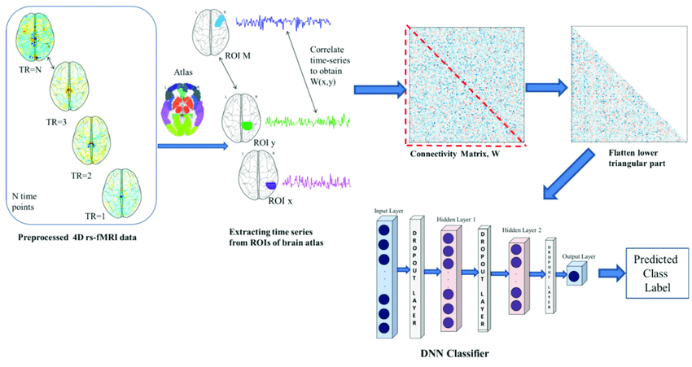
Architecture Big Picture
Architecture Flow:

Slide 9
Project Methodology
Data preprocessing: Modifying and labeling data into binary and 1DLBP forms.
Model selection: Choosing GCNs for EEG data's graph structure.
Graph representation: Representing EEG electrodes as nodes and functional connectivity as edges.
Spatial relationships: Capturing spatial relationships and connectivity patterns.
Feature learning: Learning meaningful representations from raw EEG features.
Interpretability: Providing more interpretable results.
GCNs: Using the formula H^(l+1) = σ(D^(-1/2)AD^(1/2)H^(l)W^(l)).

Slide 10
Project Role & Responsibilities
RACI Chart
TASK | MUJTABA | NUHA | RUBBAISHE
Project Planning | A | R | I
Data Collection | C | I | R
Data Preprocessing | I | A | R
Noise Reduction | R | I | A
Model Development | I | R | C
Model Training | R | C | I
Model Evaluation | R | I | A
Interpretation of Results | C | R | I
Validation | A | I | R
Report Preparation | I | A | R
Dissemination of Findings | R | I | A

Slide 11
Project Milestones
Project Initiation and Planning
Obtain and preprocess EEG data
Create time-frequency representations
Extract unique patterns and textures
Train and optimize models
Compare and validate models
Develop and deploy the diagnostic tool
Future Planning
Dissemination and Knowledge Sharing

Slide 12
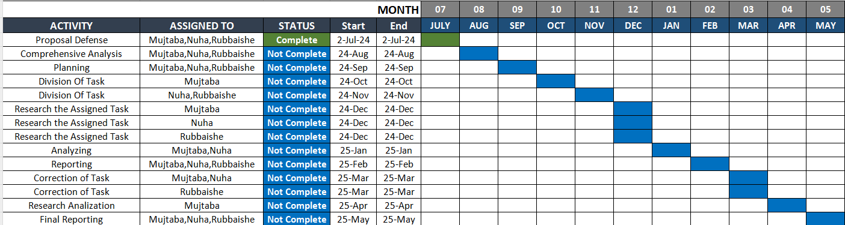
Project Plan
Division Of Task:

Slide 13
Project Tools
Software Requirements
Hardware Requirements
Python
Scikit-learn
TensorFlow / Keras
MNE Python
Jupyter Notebook
Intel Core i5 Laptop with 8GB RAM
EEG dataset obtained from online research

Slide 14
Project Deliverables
FYP-I Evaluation
FYP-II Evaluation
Project Plan
Review of Literature and Assessment of Needs
Data Collection and Analysis
Research Design and Method
Published Review Paper
Project Report-I
- Literature Review & Methodology
- Preprocessed EEG dataset
- Trained ML/DL models
- Diagnostic tool (prototype)
- Final Report and Research Paper

Slide 15
References
Automated ASD detection using hybrid deep lightweight features extracted from EEG signals
https://www.sciencedirect.com/science/article/abs/pii/S0010482521003425
Multi-View Separable Residual convolution neural Network for detecting Alzheimer’s disease progression
https://www.sciencedirect.com/science/article/abs/pii/S1746809424004336
Deep learning for neurodegenerative disorder (2016 to 2022): A systematic review
https://www.sciencedirect.com/science/article/abs/pii/S1746809422006772

Slide 16
THANK YOU!

