Slide 1
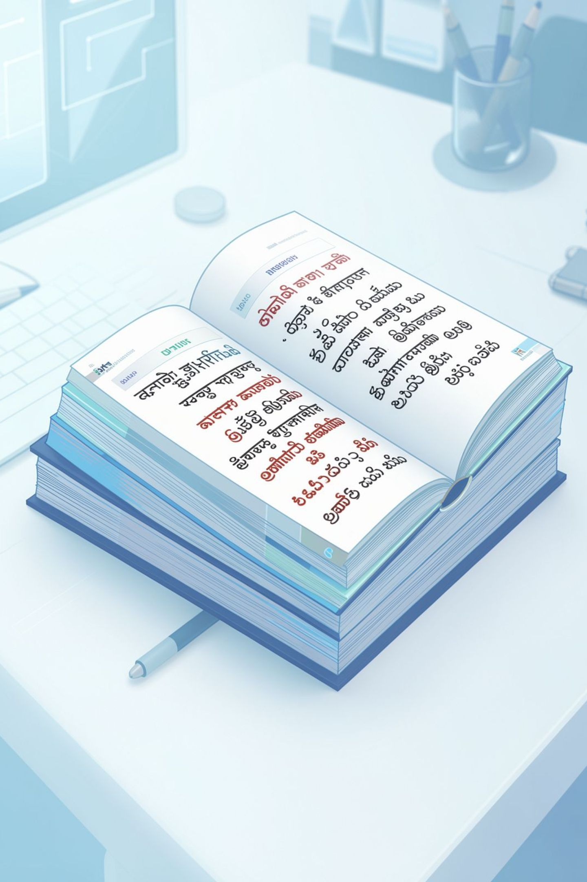
Morphological Analysis for Indian Languages
Short guide to morphology in Indian languages — why it matters, core challenges, practical approaches, and a focused case study. Designed for NLP researchers, engineers, and linguistic product teams.
Shaik Nuha
192472242

Slide 2

What is Morphology?
Morphology studies the internal structure of words and how morphemes (roots, prefixes, suffixes, infixes) combine to form meaning. It sits between phonology and syntax, and drives form-to-meaning mapping critical for NLP tasks like tagging, lemmatization, and parsing.
Core concepts
Root/stem, inflection (tense, number, gender), derivation (creating new words).
Morpheme types
Free vs bound morphemes; clitics; compound formation.
NLP outputs
Segmentation, morphological tags, lemmas, and feature-value pairs.

Slide 3
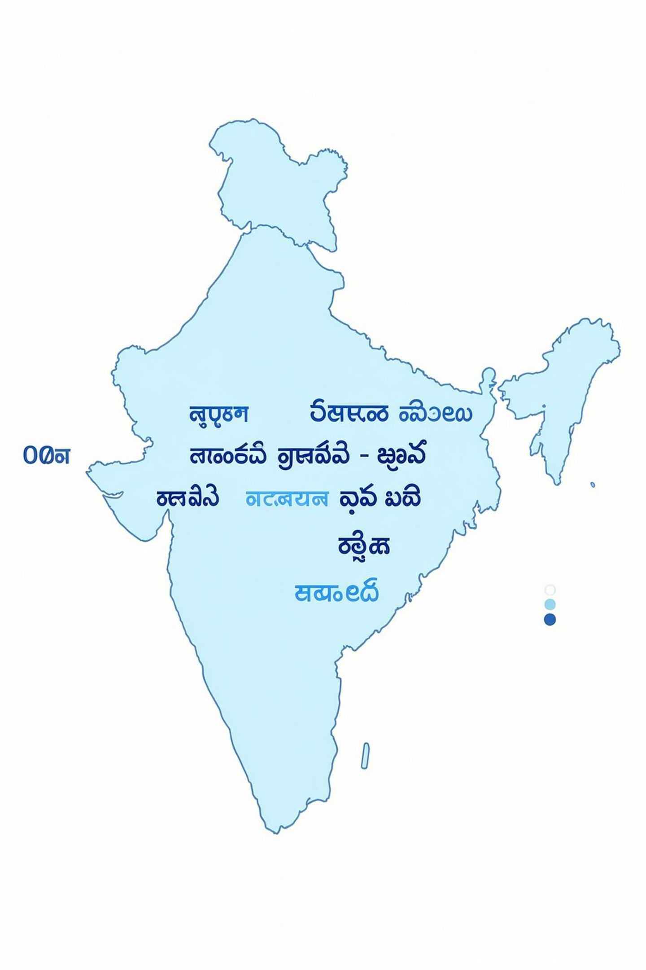
The Uniqueness of Indian Languages
Indian languages show rich morphology: agglutinative patterns (Telugu, Tamil), fusional and inflectional behavior (Hindi, Marathi), and extensive case/ergativity contrasts. Script diversity and sandhi (phonological alternations) further complicate analysis.
High morpheme density
Orthographic variation
Long suffix chains encode tense, aspect, politeness, and honorifics.
Multiple scripts and non-standard spellings in social text.
Morphophonemic changes
Sandhi and vowel harmony change surface forms of morphemes.

Slide 4
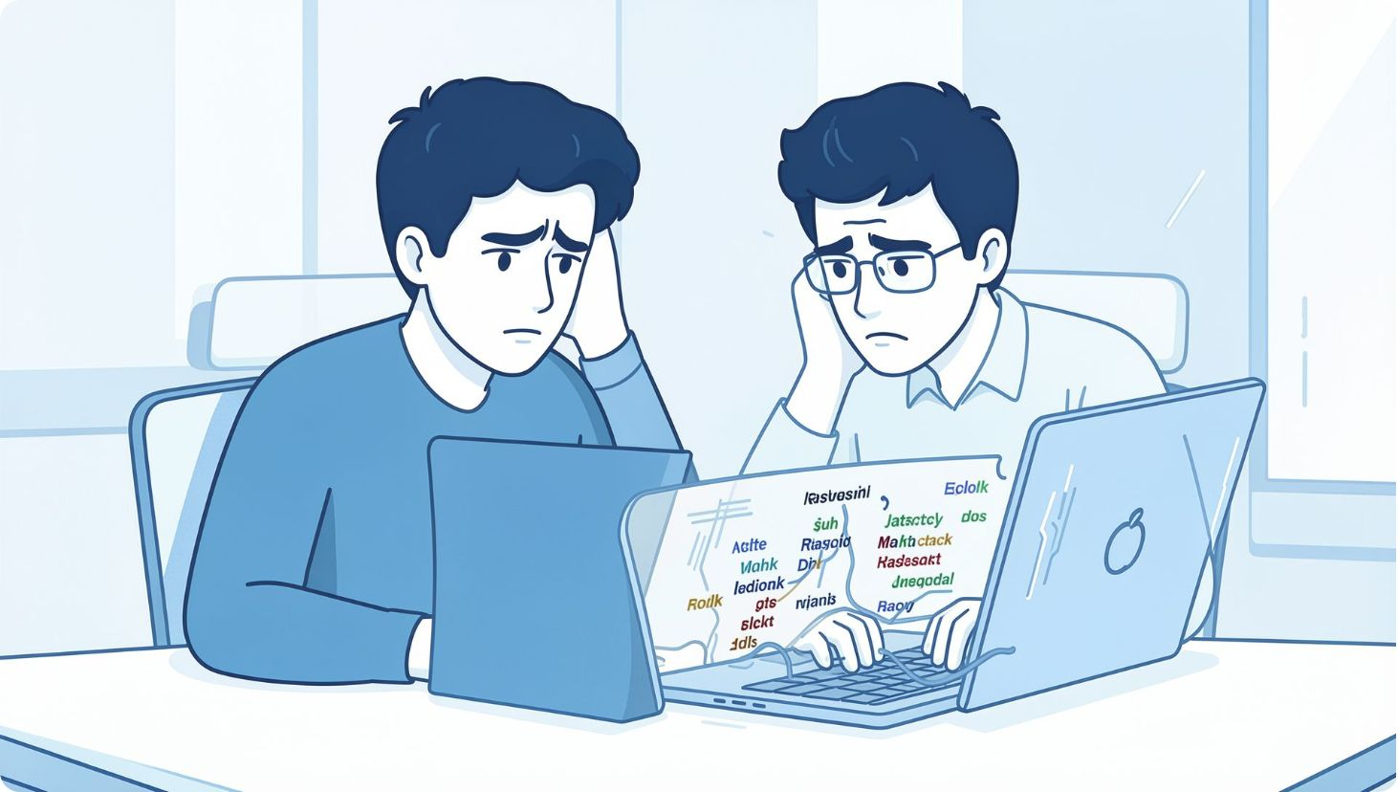
Challenges in Morphological Analysis for Indian Languages
Data scarcity for low-resource languages and dialects.
Complex inflectional paradigms and long agglutinative suffixes.
Ambiguity: same surface form can map to multiple analyses.
Script conversion and romanization inconsistencies in user-generated content.
Domain shift: formal vs colloquial usage impacts analyzer accuracy.

Slide 5
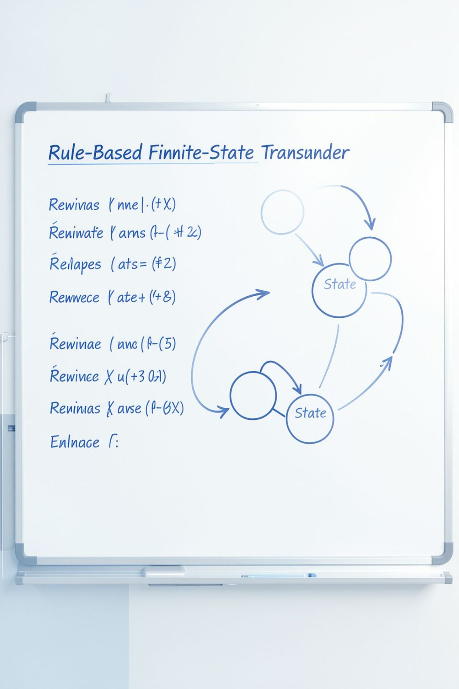
Rule-Based Approaches: Pros and Cons
Rule-based systems (finite-state transducers, hand-crafted lexicons, morphological grammars) encode linguistic knowledge explicitly. They remain valuable where data is scarce and linguistic transparency is required.
Advantages
Deterministic outputs and interpretable errors.
Works well with small lexicons and expert knowledge.
Efficient runtime (FSTs are fast).
Limitations
High initial engineering cost to cover variants.
Hard to scale across dialects or noisy orthography.
Poor handling of unseen or borrowed forms.

Slide 6
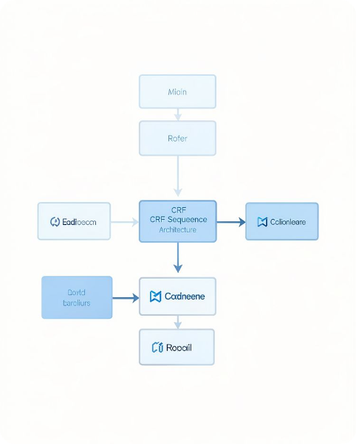
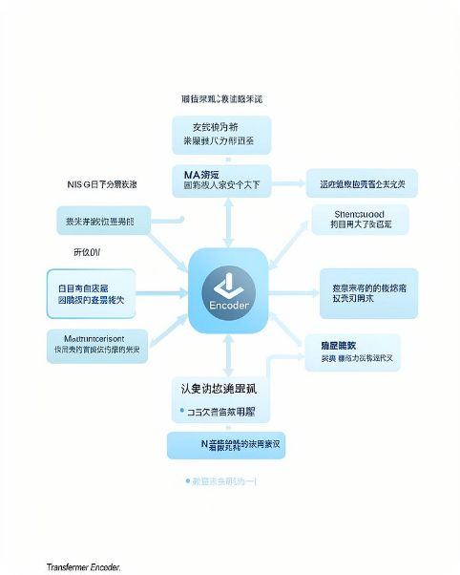
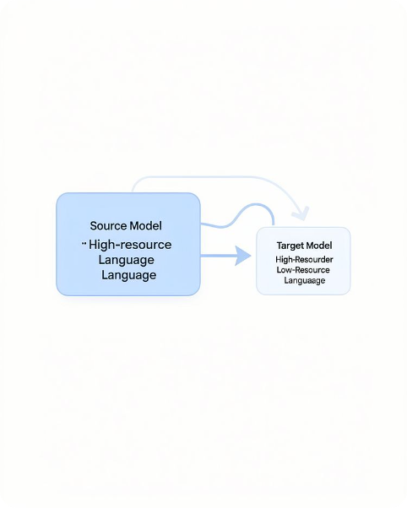
Statistical & Machine Learning Methods: Data-Driven Rise
Statistical taggers, CRFs, and modern neural models (BiLSTM-CRF, Transformer-based encoders) learn morphological patterns from annotated data and raw corpora via transfer learning and subword models.
Sequence models
Pretrained transformers
Transfer & augmentation
CRFs and BiLSTMs produce high-quality tagging with moderate data.
Multilingual BERT / IndicBERT capture subword regularities and context.
Cross-lingual transfer, synthetic data, and back-translation improve coverage.

Slide 7
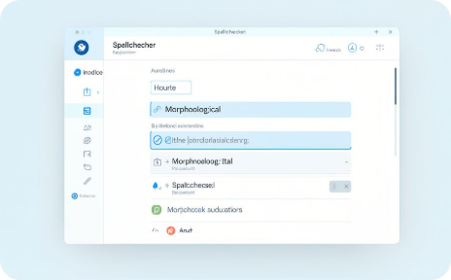
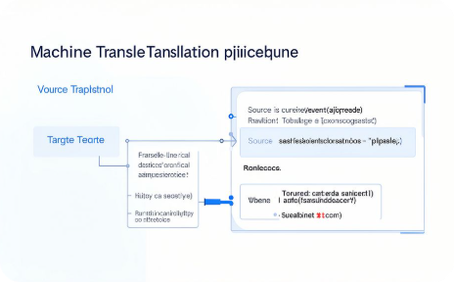
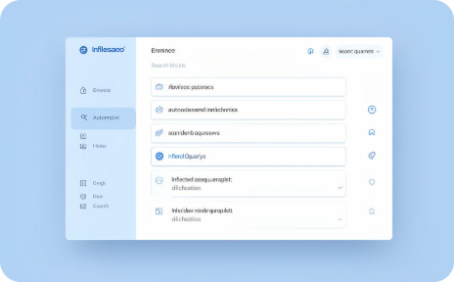
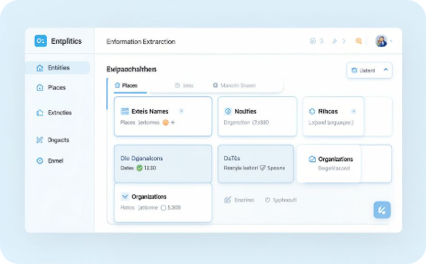
Applications: From Spell Check to Machine Translation
Spell & grammar checking
Machine translation
Search & retrieval
Information extraction
Morphology-aware models produce grammatically correct target forms.
Lemma normalization and morphological expansion increase recall.
Better segmentation reduces false positives and improves suggestions.
Accurate morphological analysis improves entity recognition and relation extraction.

Slide 8

The Future of Morphological Analysis in Indian NLP
Synergy of linguistics and large-scale pretraining, better tools for low-resource languages, community-driven annotated corpora, and interpretable hybrid systems will shape next-generation morphological analyzers. Focus areas:
Open resources
Explainable models
Shared lexica, paradigms, and evaluation suites for regional languages.
Hybrid pipelines that provide human-understandable analyses and error signals.
Cross-lingual transfer
Leveraging typological similarity to bootstrap analyzers for related languages.

