Slide 1
DA 2009 | Data Collection Methods II | Assignment 2
Collecting data from the Colombo Stock Exchange
Share prices, company details and announcements - collected ethically, with Python
Pasindu 25ada072
Sasini 25ada073
Salaama 25ada141
Nuhan 24ada076
University of Colombo
Notes:
PRESENTED BY: 24ada076 - Nuhan (opening)
Good morning. I'm Nuhan, and this is our DA 2009 group project: collecting data from the Colombo Stock Exchange website. Our group is Pasindu, Sasini, Salaama and me. I'll open, and my teammates will explain how it works.

Slide 2
What we collect
Three kinds of public data from www.cse.lk - no logins, nothing personal
1
2
3
Share prices
Company details
Announcements
Today's price, change and turnover for every listed company - about 284 of them.
Facts about one company: its market value, and its highest and lowest price this year.
Notices companies publish - many of them as PDF files, and some of those are scans.
Then we clean it, check it, chart it and save it - in an app with a tab for every step, labelled with the member who built it.
2
Notes:
PRESENTED BY: 24ada076 - Nuhan (opening)
We collect three kinds of public data: today's share prices for every listed company, details about individual companies, and company announcements, many of them as PDF files. No logins, and nothing personal.
But our first attempt found almost nothing - and that's where the story starts.
(Hand over to the next speaker.)

Slide 3
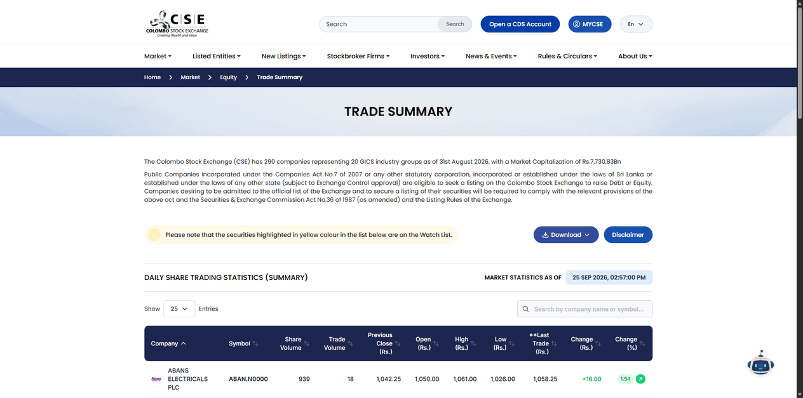
The surprise: the page is built by JavaScript
The page arrives almost empty. JavaScript in the browser fills in the prices afterwards.
A real browser
A plain download
Selenium driving Microsoft Edge
requests + BeautifulSoup
24
characters of text
0 tables, out of 17,898 bytes of HTML. The prices are simply not in the file.
4,121 characters and 1 table - but only after waiting 5.3 seconds for one page
3
Notes:
(From here, any member can present.)
We started the way the course taught us, with requests and BeautifulSoup. The trade summary page gave us just 24 characters of text and no tables.
CSE builds its pages with JavaScript, and requests never runs it. Selenium, a real browser, did see the table - but it took over five seconds for one page.

Slide 4
The answer: read the data the page itself uses
Found with the browser's developer tools - no guessing
1
2
3
4
Open the site
Watch the requests
It answers in JSON
pandas makes a table
Press F12 and choose the Network tab
The page asks /api/tradeSummary for its prices
Tidy names and values - no HTML to dig through
One row per company, ready to use
284
One company, as CSE sends it
{
"symbol": "SAMP.N0000",
"name": "SAMPATH BANK PLC",
"price": 141.0, "change": 1.0
}
companies from a single request
Most of these addresses only answer POST requests
4
Notes:
So we pressed F12 and watched the Network tab. The page fetches its prices from addresses like api/tradeSummary, which answer in JSON.
We ask those addresses directly - most of them only answer POST requests - and pandas turns the JSON into a table. One request gives us all 284 companies.

Slide 5
Ethics: every request goes through one function
The rules are written once, so no part of the project can skip them
1
Check robots.txt
CSE's robots.txt
CSE blocks one folder, /cgi-bin/ - we never go there
User-agent: *
Disallow:
Disallow: /cgi-bin/
Sitemap: https://www.cse.lk/sitemap.xml
2
Wait 1.5 seconds
Between every request, even though CSE does not ask us to
3
Say who we are
Our university, course and an email address in the User-Agent
Public data only
Nothing personal is collected
CSE is credited inside every file we save
4
Log it
Every request is written to logs/request_log.csv
5
Keep a copy
So we never ask CSE for the same thing twice
5
Notes:
Ethical scraping is a main part of the marks, so every request goes through one function.
It checks robots.txt - CSE only blocks cgi-bin, which we never use. It waits 1.5 seconds, even though CSE doesn't ask us to. It says who we are, logs every request, and keeps a copy so we never ask twice.

Slide 6
Announcements: finding and reading the PDFs
A crawler finds the documents, then we read the text out of each one
1
2
3
Read the list
Build each address
Download politely
of circulars CSE has published
The PDFs live on a separate server, cdn.cse.lk
A few at a time, no copies, and only real PDFs
Text-based
Scanned
Hybrid
896
0
0 127 1,129 274
characters
characters
characters on pages 1 to 4
pdfplumber reads the text straight out of the file
A photo of a printed page - there is no text inside
Only page 1 is a scan
6
Notes:
For announcements, our crawler reads the list of circulars, finds each PDF on CSE's file server, and downloads a few at a time - skipping copies, and checking each one really is a PDF.
pdfplumber reads most of them. But one was a scan - a photo of a page, with no text inside.

Slide 7
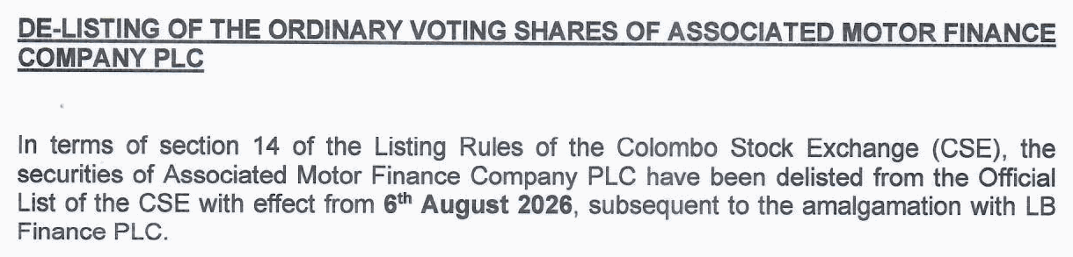
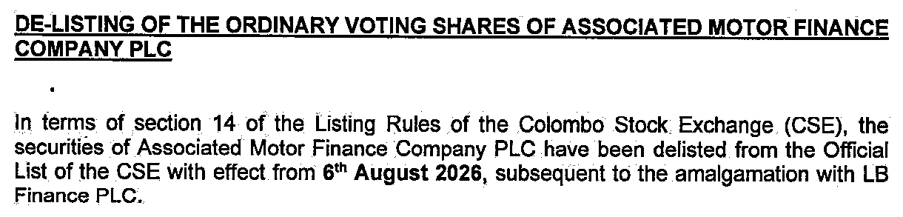
OCR: reading a scanned page
The four steps of the OCR pipeline, one tool for each
1
2
3
4
Make an image
Clean it
Read it
Tidy it
pdfplumber, at 200 dpi
OpenCV: grey, then pure black and white
pytesseract and Tesseract
pandas: one row per line of text
The scanned page
After cleaning - ready to read
Tesseract gives every word a confidence score, so we know which words to check by hand.
7
Notes:
For scans we use OCR, in the four steps from the lecture. pdfplumber makes an image. OpenCV turns it grey, then pure black and white - you can see the difference here. pytesseract reads the letters, and pandas tidies the result.
Every word gets a confidence score, so we know which words to check by hand.

Slide 8
Clean, check, chart and save
Data from a website is never ready to use straight away
1
Clean
Dates arrive as huge numbers - we turn them back into dates, in Sri Lanka time. Text that is really numbers becomes numbers.
2
Check
All 6 checks passed: no negative prices, no company twice, and 99.8% of cells have a value.
3
Save
CSV, Excel and JSON - with the Colombo Stock Exchange credited inside every file.
8
Notes:
Website data is never ready to use. We turn dates from huge numbers into Sri Lanka time, and check the values make sense - all six checks passed.
On this day, 96 companies rose, 113 fell and 75 didn't move. We save CSV, Excel and JSON, crediting the Colombo Stock Exchange in every file.

Slide 9
Who did what
Each tab in the app is labelled with the member whose part it shows
1
Nuhan 24ada076
2
Pasindu 25ada072
Ethical scraping and robots.txt, BeautifulSoup, and reading PDFs
Getting the data from the site, and Selenium
3
Sasini 25ada073
4
Salaama 25ada141
Crawling for documents, and cleaning the data
OCR, saving the files, and the charts
The app itself was put together by all four of us.
Thank you - questions?
9
Notes:
This is who built each part. Every tab in the app is labelled with its member, and we put the app together as a team.
Thank you. We're happy to take your questions, and we can show any part of it running in the app.

