Slide 1




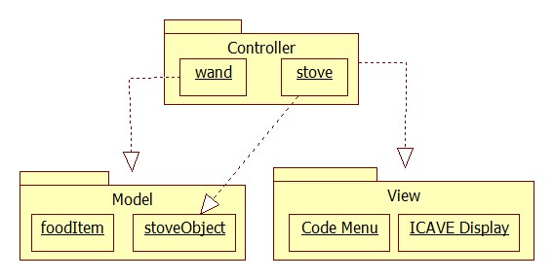
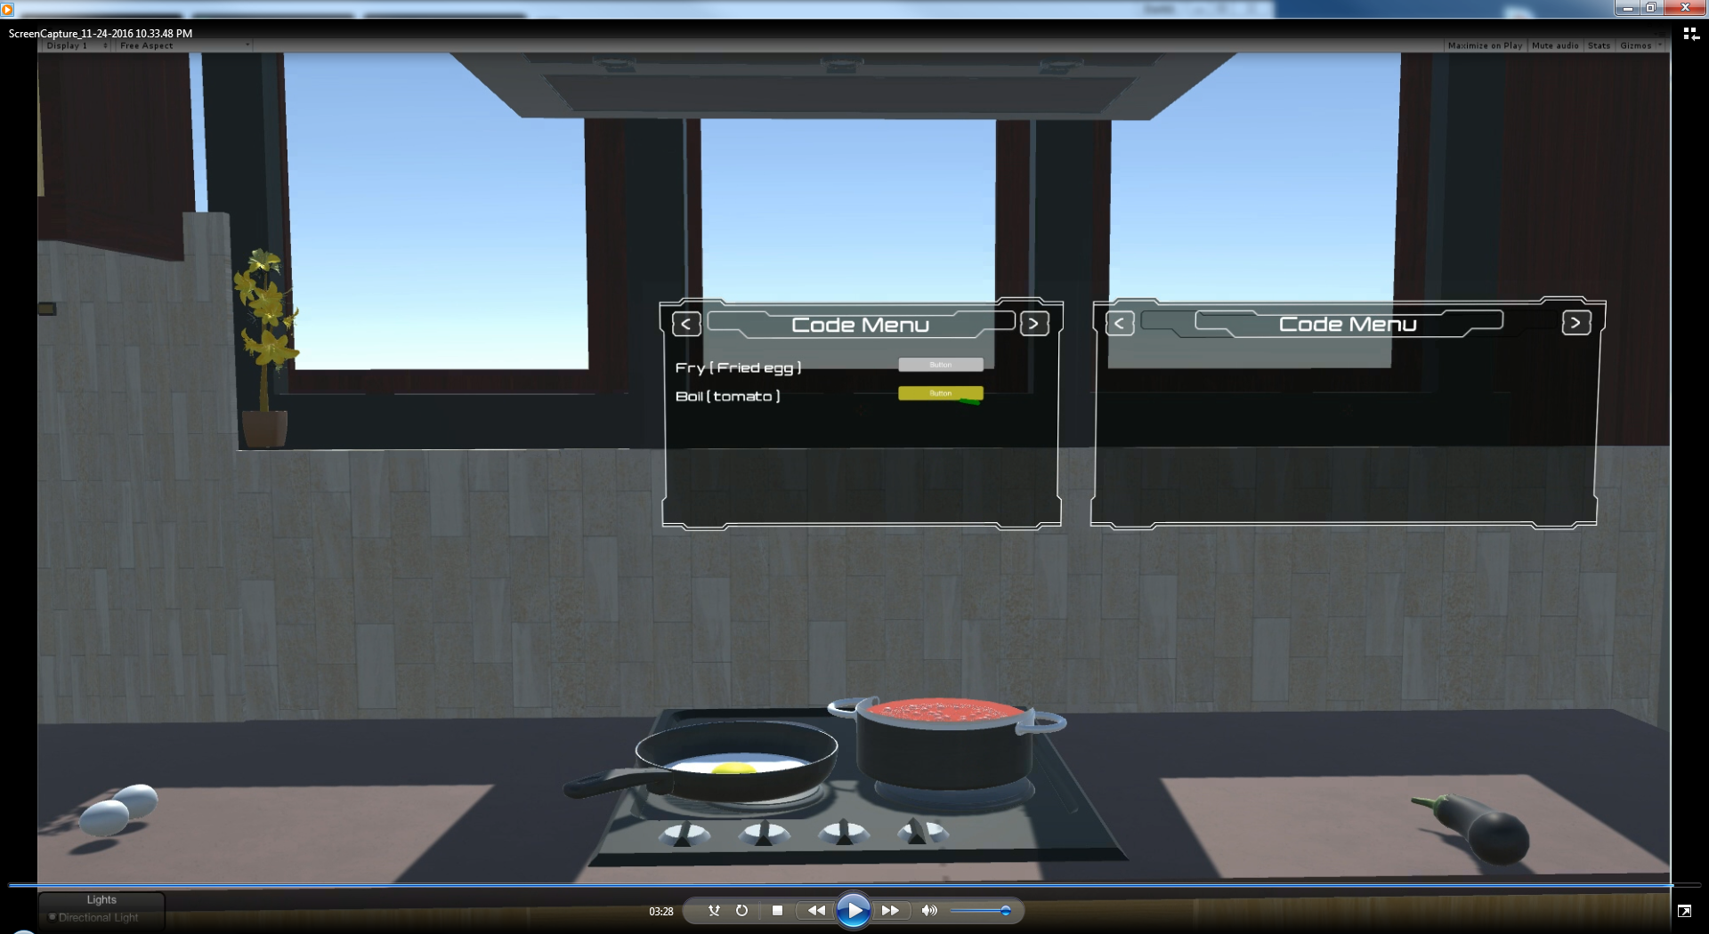
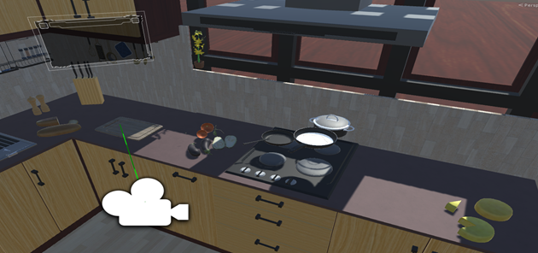
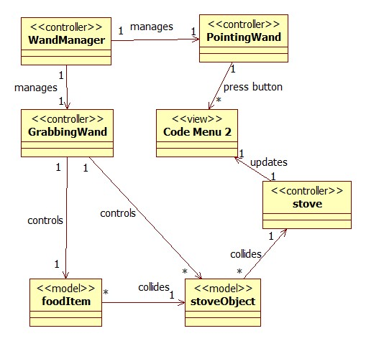
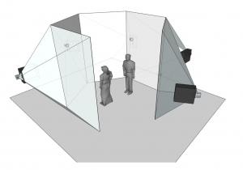
School of Computing & Information Sciences
Senior Project, 2016, Fall
Code by Cooking 0.0
Student: Derrick Serbia, Florida International University
Mentors: Dr. Franciso Ortega, Mr. Mohsen Taheri
Instructor: Masoud Sadjadi, Florida International University
Problem
Students new to programming cannot easily understand basic concepts.
Current teaching methods are not interactive enough.
Typing is the only method to build code.
Current System
Lectures
Videos
Examples
Interactive but fail at comparing programming with a familiar activity
Requirements
The application should allow the student to:
Interact with various cooking tools in the virtual environment
Make a connection between programming and cooking
Create and execute functions that have been predefined in the system
See the output of the functions
Solution
Connect programming concepts with familiar activities such as cooking.
Create virtual reality environment where students can engage in interactive learning.
Have students build code by moving objects in the virtual world.
Implementation
Unity 5.3.2 used for application development.
Mechdyne’s getReal3D 3.2.5 used to connect and utilize input devices.
Microsoft Visual Studio used develop scripts in C#.
System Design
Model-View-Controller
Screenshots
(Top) Code menu that lets students see the functions that can be executed. (Bottom) Virtual kitchen with cooking objects.
Object Design
The GrabbingWand controller is used to move objects around in the environment. The interactions between these allows the student to view and execute code in the Code Menu
I-CAVE
Summary
Code by Cooking immerses students in a virtual reality environment and attempts to simplify programming concepts. The application’s purpose is to educate while staying away from traditional teaching methods.
Acknowledgement
The material presented in this poster is based upon the work supported by Leonardo Guibert, Mohsen Taheri, Francisco Ortega and Masoud Sadjadi. I am thankful to the help that I received from my teammate, Dhrumel Shah.
Notes:
‹#›

