Slide 1
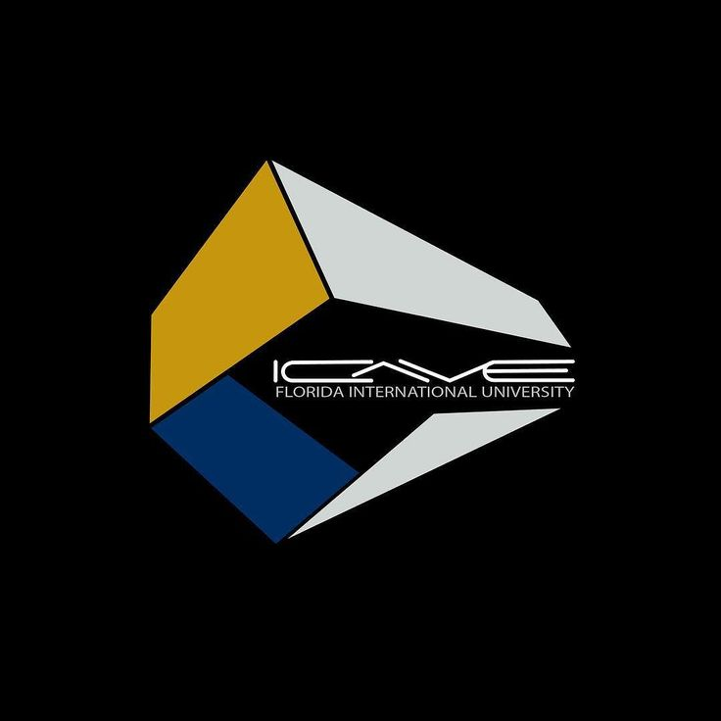


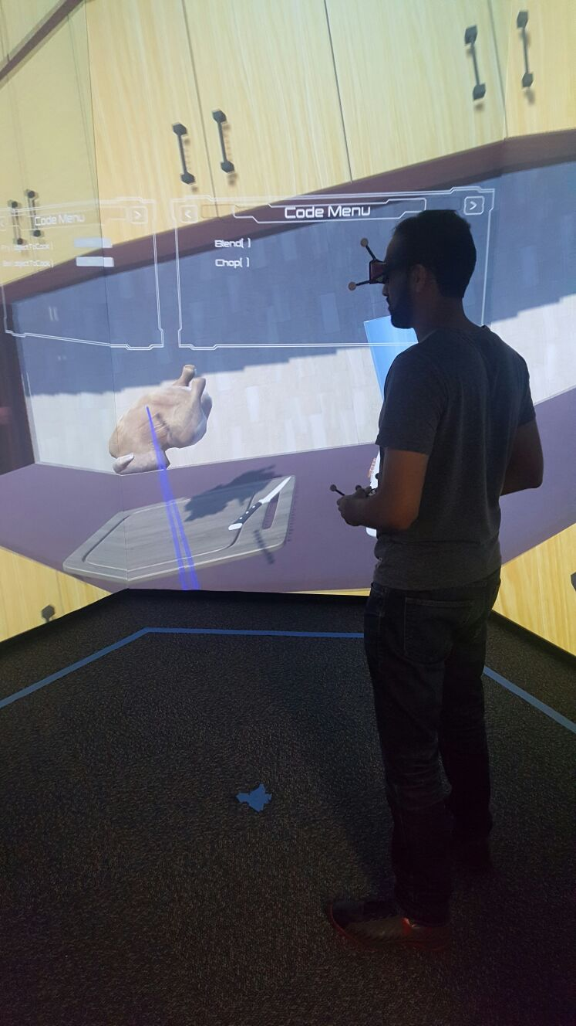

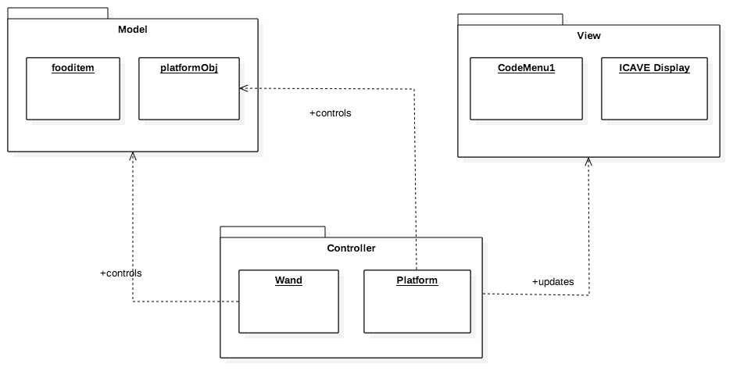
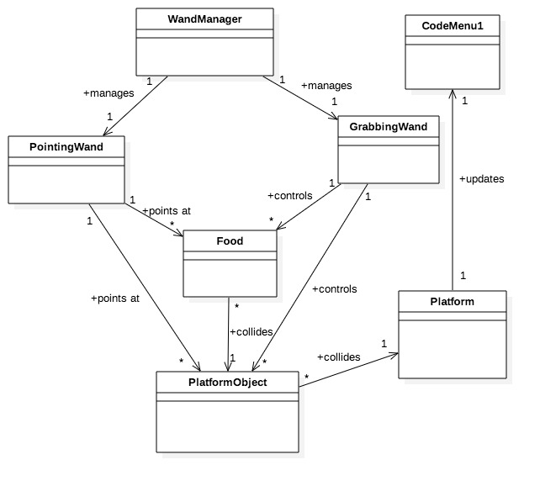
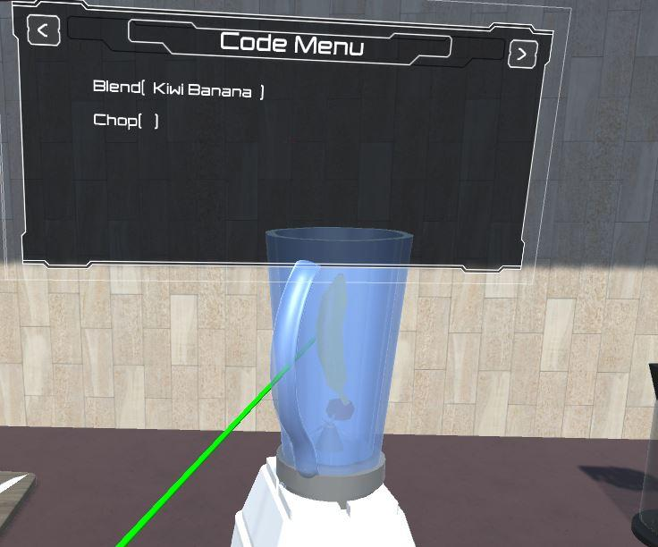
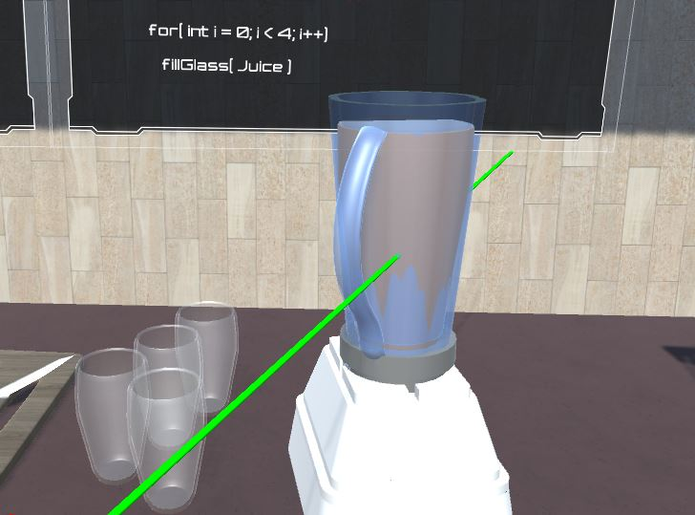
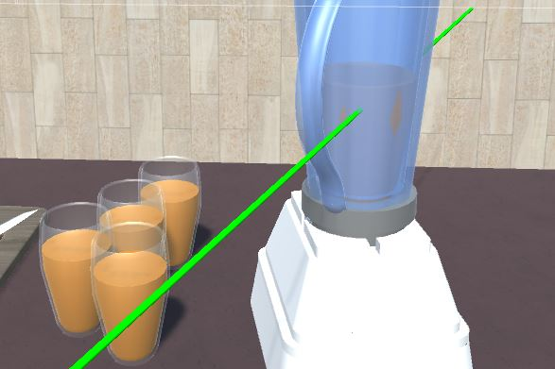
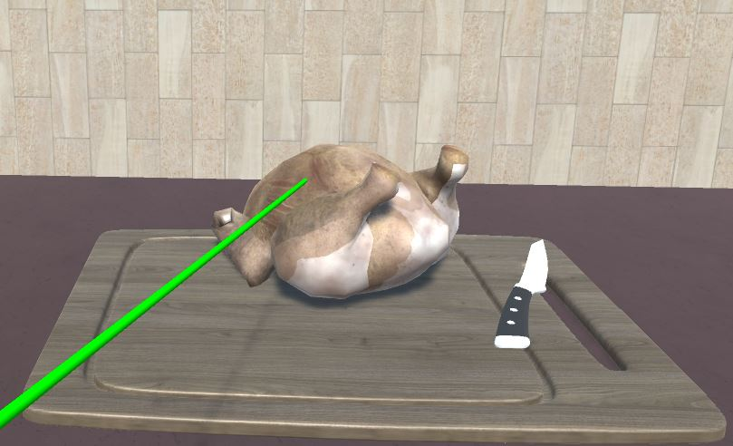
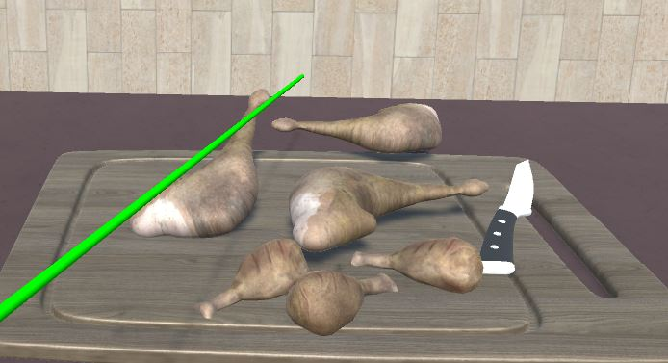
School of Computing & Information Sciences
Senior Project, Fall, 2016
Code by Cooking 0.0
Student: Dhrumel Shah, Florida International University
Mentor: Dr. Francisco Ortega, Mr. Mohsen Taheri
Instructor: Dr. Masoud Sadjadi, Florida International University
Problem
Students learning programming for the first time cannot relate to concepts
Current teaching methods are not interactive enough
Typing in letters on a keyboard is the only way to code, requiring students to know the exact syntax before they start coding
Requirements
The system should allow student users to:
Operate with various kitchen equipment such as a blender and chopping board
Enter a function on a display by activating the kitchen tool
Pass parameters to the function by placing ingredients in the tool
Execute the function by starting the cooking process
Define and execute a loop
Implementation
We used Unity 5.3.2 to develop our application
We implemented our code in C# using Visual Studio
We used Mechdyne’s GetReal3D 3.2.5 plugin to use the different devices in the I-CAVE
Solution
Relate programming concepts to a daily activity such as cooking
Develop a virtual reality environment where students can engage in interactive learning
Allow students to code by carrying out cooking activities
Current System
Lectures
Tutorial videos
Code-building websites that do not relate programming concepts to real life activities
System Design
Object Design
Summary
CodebyCooking lays a foundation for introductory programming courses in virtual reality. We hope that this application encourages education systems to incorporate advanced technology into teaching.
Acknowledgement
The material presented in this poster is based on the work supported by Francisco Ortega, Mohsen Taheri, Masoud Sadjadi and Leonardo Guibert. I am also thankful to the help I have received from my teammate Derrick Serbia.
Notes:
1

