Slide 1


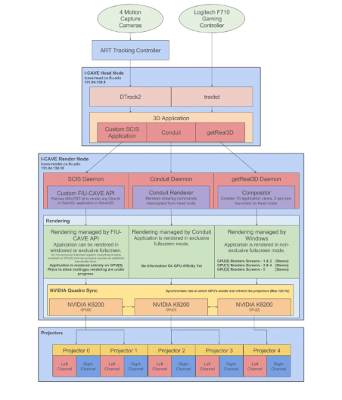
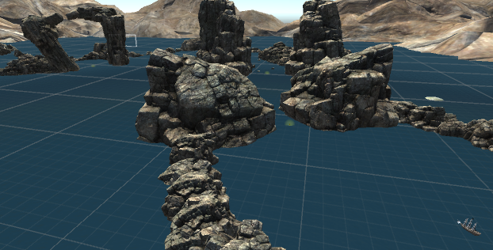
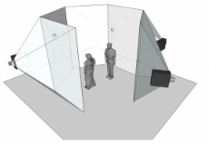
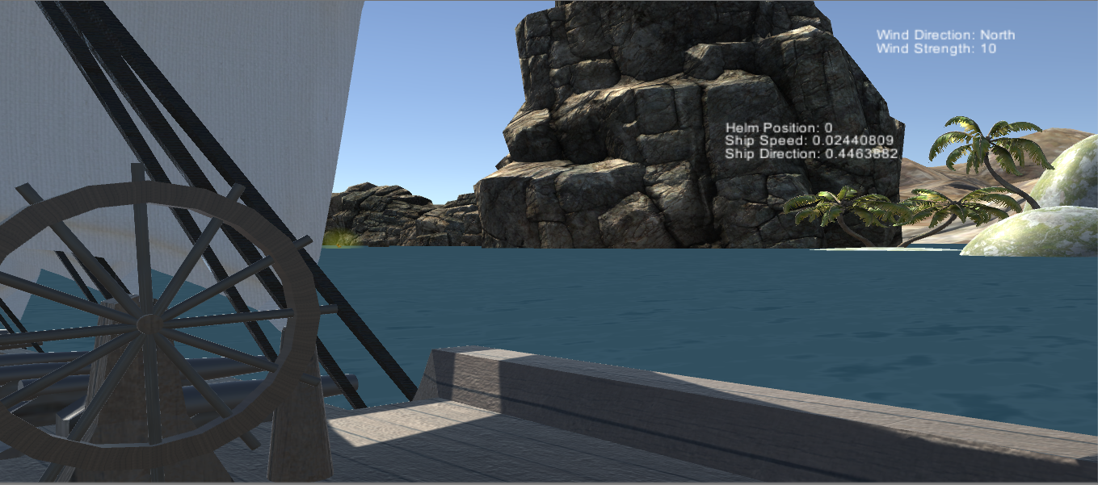
VIP, Spring 2017
TAM: Multi-Touch, Mid-Air, and Motion for Virtual and Augmented Reality – ICAVE – Learning with Virtual Reality
Student: Michael Quiros, Florida International University
Mentor: Francisco Ortega, Florida International University
Instructor: Masoud Sadjadi, Florida International University
Problem
Implement learning using 3D/VR aspects of ICAVE
Should take advantage of the 3D/VR environment for a learning experience unique to the ICAVE
Solution
The learning should be implemented in a fun and interactive design
Suggested solution: Design a virtual room to do “Coding by blocks” for Computer Science education use
End outcome: Design a sailing simulator to teach sailing and explore features of the ICAVE
Current Version
Users begin aboard a ship
Users must take advantage of wind direction, navigation, and their natural wayfinding skills to find all objects throughout the map
Many features can be added in the future to increase user experience
Screenshots
Problems Encountered
Little to no experience with 3D Unity
No previous VR/ICAVE experience
Many bugs and setbacks including improper ship movement, 3D modeling interruptions, and Unity Physics engine incompliance
ICAVE System
Motion Tracking 3D Glasses
Motion Tracking Controller (“Wand”)
System Head Node
System Render Node
Projectors & Displays
Implementation
Unity 5.3.2 – 3D Game Engine
GetReal3D – ICAVE supported motion tracking/VR plug-in
Visual Studio – IDE used for scripting in C#
Maya – Modeling software to edit/customize preset 3D models
User Objective
Pick-up objects are spread through the map for the user to collect
The user must use their sailing and navigation skills to find and collect these objects
Unique landforms and islands give a sense of direction to the user
Pick up objects spread in a breadcrumb trail to find
Map is open space to encourage exploration/sailing while providing an obstacle course-like challenge
Future Design
Lots of room for features to be added
More maps with larger selection of sailing environments to learn
Dynamic random pick up positioning for an exploratory experience
Multiplayer integration with multiple users piloting one or more ships
More features such as compasses, telescopes, and sail manipulation
Direct information on navigation and wayfinding within the contents of the game (pop-ups, virtual instructions)
Use of GetReal3D’s “Wand” tools to mimic hands manipulating objects
Summary
Users will be able to explore sailing through the ICAVE using a small sailing simulator
The ICAVE will enhance the user experience by having them sail in a fun and safe, yet educational and interactive environment.
This will promote their knowledge of factors affecting sailing such as wind direction and speed
The simulator will also test the users navigation and wayfinding skills in finding the preset pick ups
Acknowledgement
The material presented in this poster is based upon the work supported by Francisco Ortega.
I am thankful to the help that I received from my group member, Noel Gonzalez.
Notes:
1

