Slide 1



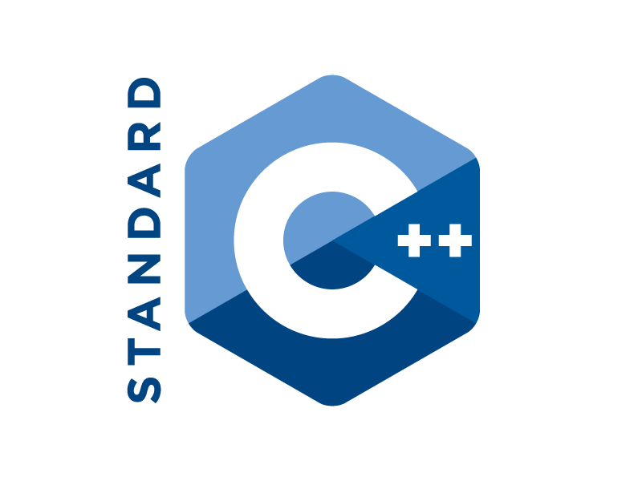
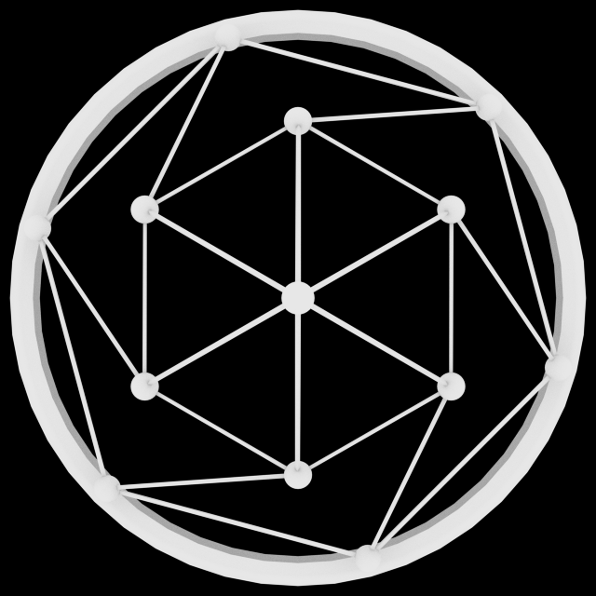



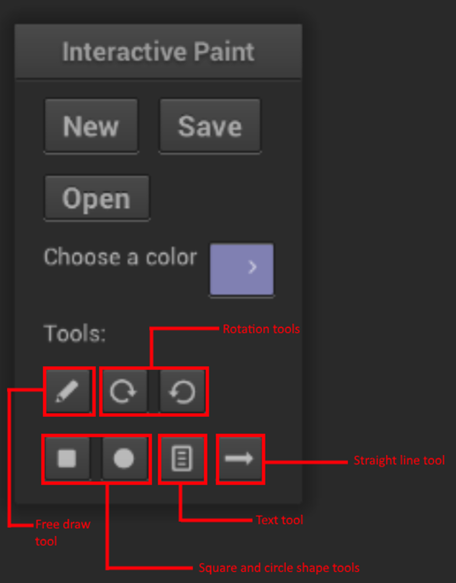
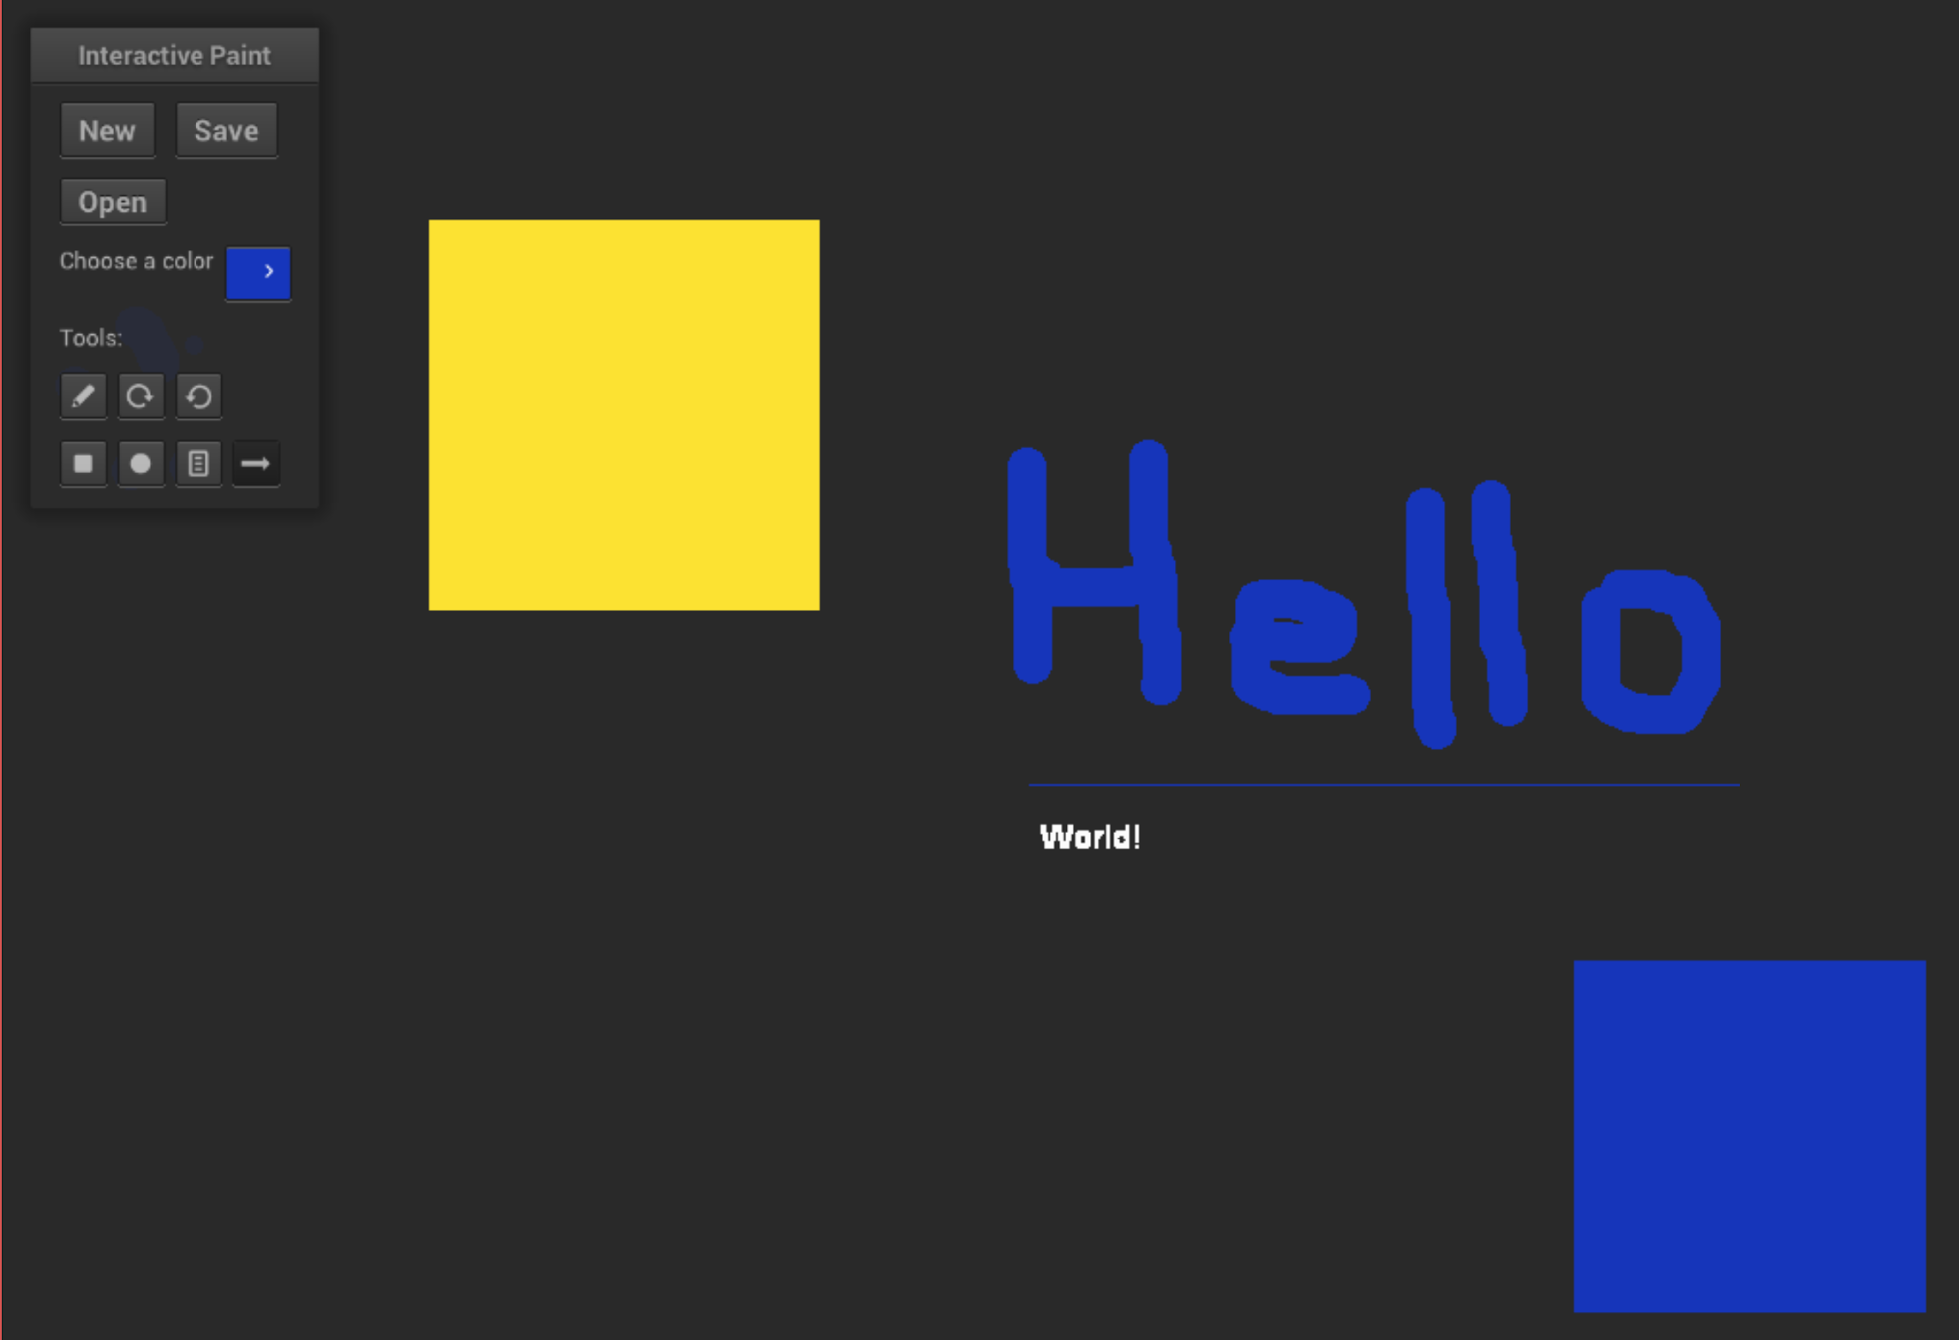
School of Computing & Information Sciences
Senior Project, 2016, Fall
OpenHID Lab
Multi-Modal Interactive Paint, Version 3
Student: Justin Alvarez, Florida International University
Mentor: Dr. Francisco Ortega, Florida International University
Instructor: Masoud Sadjadi, Florida International University
Problem
Currently on PCs, input is usually limited to the keyboard, mouse, and maybe a joystick or camera.
There are many alternate interactive input devices available, and with this project we aim to showcase some of their uses and future possibilities, particularly when multiple input devices are used in conjunction.
This project is a complete rewrite, from scratch, of the iteration last semester.
Current System
Status:
Support for many easy to use tools
Ability to directly change program state using an input device (leap motion)
My core contributions:
Cinder based GL context
User interface, using NanoGUI
All drawing tools (square, circle, etc.)
Resizable elements
Requirements
Our job was to rewrite the previous version of the of the paint app in a way that it would be a maintainable project for the future.
As a developer, I want to use NanoGUI for controls and Cinder as a GL abstraction so I can be more efficient
As a user, I want to be able to use some basic tools (New, Save, Line, Rotate, and Color Select).
As a user, I would like to have an endpoint select line tool, a text tool, and an open button.
System Design
Object Design
Implementation
We used a few key technologies:
Coded in modern C++
OpenGL abstraction layer
NanoGUI
UI elements
SDKs for input devices
Screenshots
Verification
Test case: Draw circle
Purpose: Test to see if a circle is drawn properly
Preconditions: Color is set to a value c
Action: with circle tool active, press an initial position, O, and drag out a distance, r, from the center and release mouse
Expected result: Value of pixel at point r away from O should be the preset color c
Verification
Summary
Interactive Paint showcases the possible features that new input devices can add to an application
Future iterations will be able to add more input devices to provide innovative features
The use of VR as an input device will greatly enhance the features of Interactive Paint and provide an entirely novel experience
Acknowledgement
The material presented in this poster is based upon the work supported by Dr. Francisco Ortega. I am thankful to the help that I received from my group member, Jose Morgan.Special thanks to the OpenHID lab for providing the hardware that made this project possible and Alain Galvan for helping out with some OpenGL questions..
Notes:
1

