Slide 1





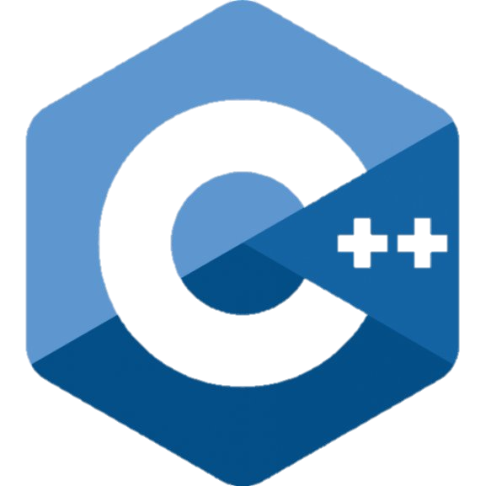

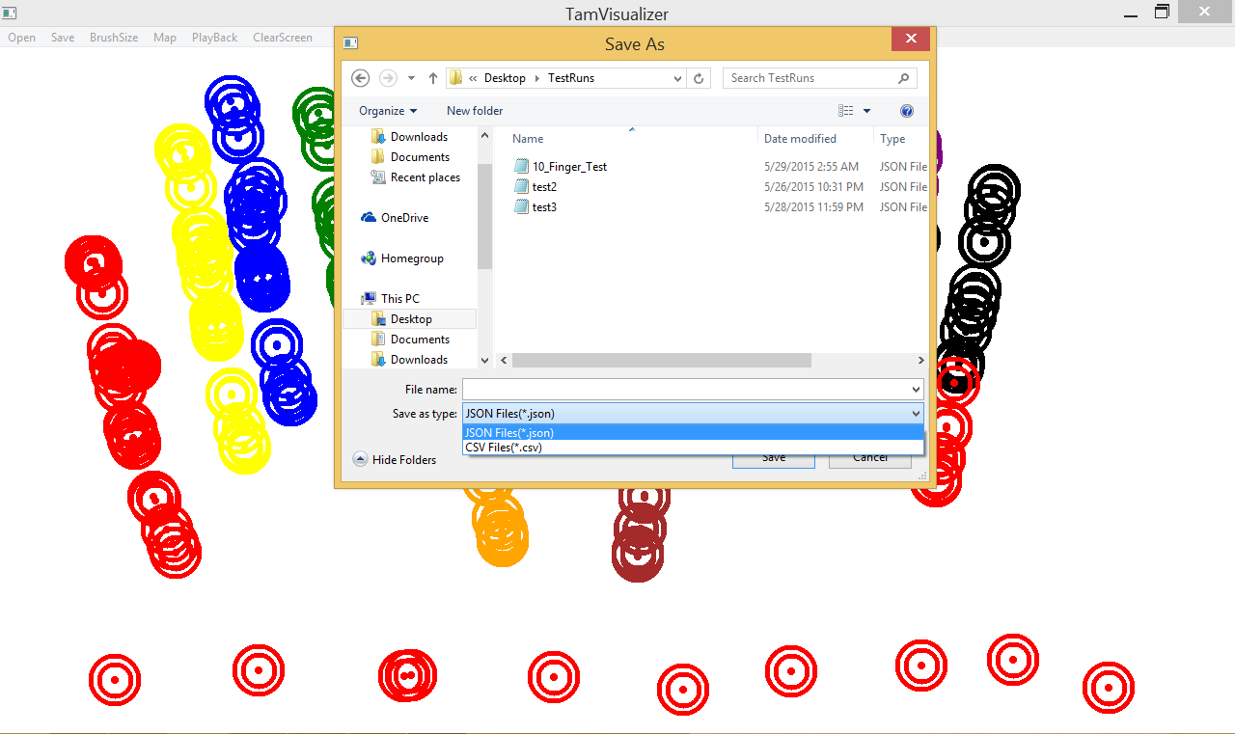
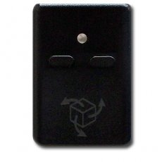
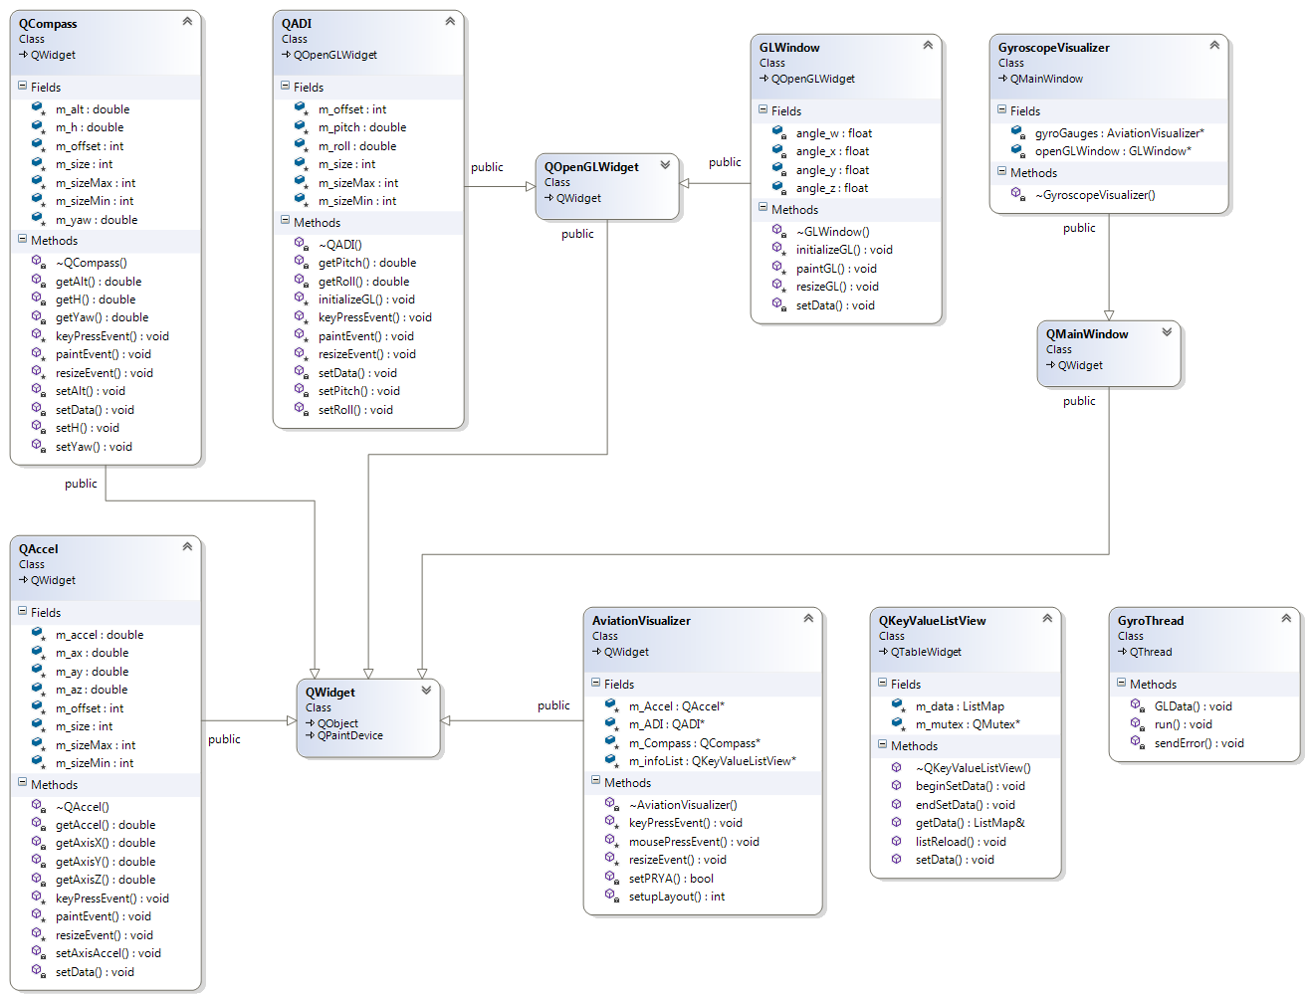
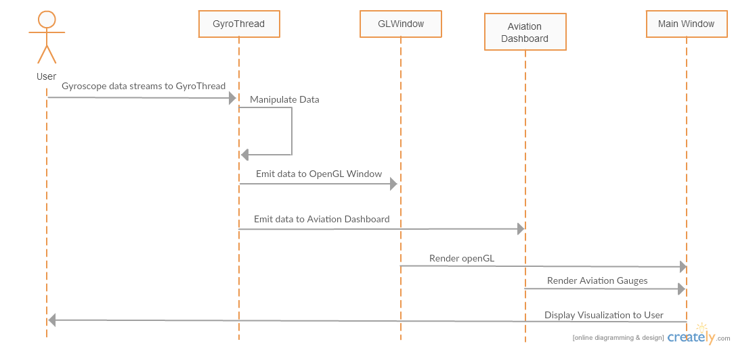
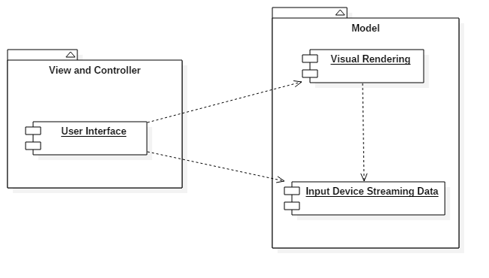
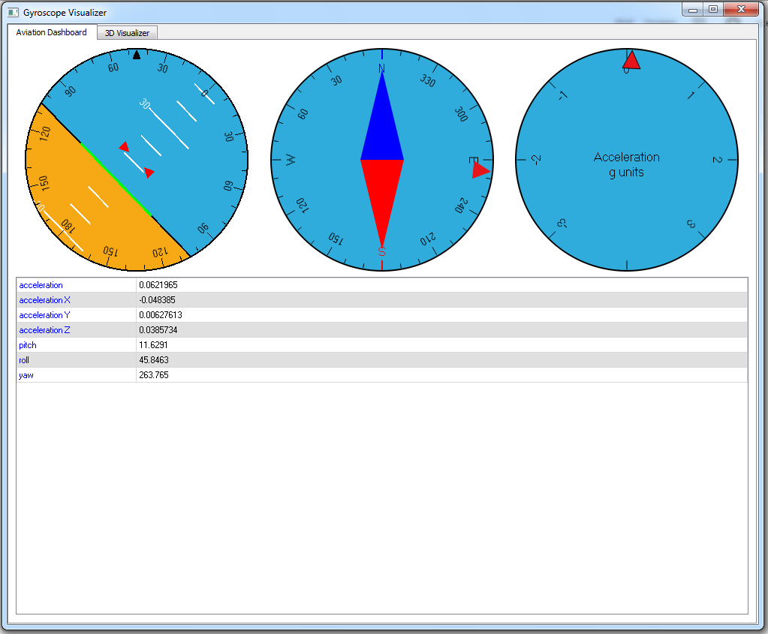
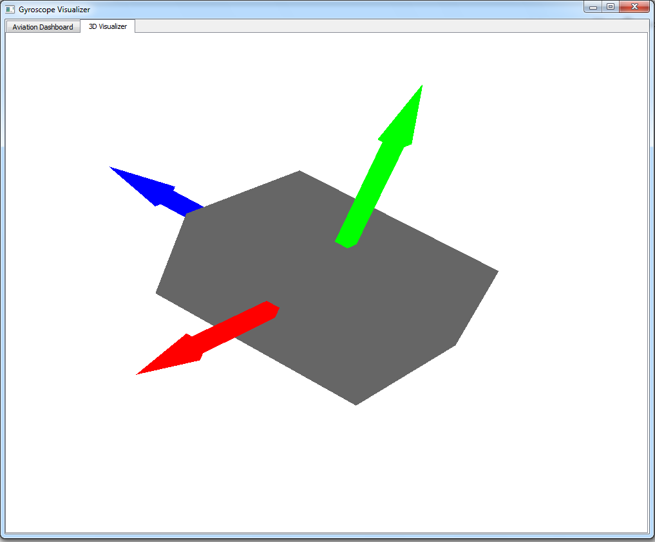
School of Computing & Information Sciences
Senior Project, 2015, Summer
TAM: Touch and Mid-Air Framework
Student: Alfredo Zellek, Florida International University
Mentor: Francisco Ortega, Ph.D., Florida International University
Sponsored By: Naphtalie Rishe, Ph.D., and Francisco Ortega, Ph.D.
Instructor: Masoud Sadjadi, Ph.D., Florida International University
Problem
Current System
Requirements
Many developers are constrained to programming for point and click or touch-screen interfaces. Developing an application that does not use these types of input devices can be very challenging, since there are very few frameworks available.
Our goal is to produce a framework that can help developers easily work with various input devices. There will be two main parts to the framework: The API and the Visualizers. Currently, the visualizers are the priority of the project.
The current TAM system provides the developer with a simple “finger-painting” touch-screen visualizer along with playback functionality. This limits the developer to very simple debugging and visualization.
The new system will have an expanded touch-screen visualizer with algorithmic visualization and introduce a new visualizer to deal with both 2D and 3D gyroscope visualization.
To expand the system to include a gyroscope visualizer.
Visualize gyroscope rotations in 2D through an Aviation-style Dashboard
Visualize gyroscope rotations in 3D using an on-screen representation of the gyroscope.
Display gyroscope data in textual form for analysis (Pitch, Roll, Yaw, and Acceleration)
System Design
Object Design
Implementation
The system uses the Model-View-Controller architecture pattern. The user can view and change the visualization data through the user interface, while the gyroscope data is streamed into the model portion of the code, which will render the visual display to the user interface.
Verification
Screenshots
Summary
Bottom-up integration was used for this project. First, classes were developed separately from the rest of the system. These classes were then tested, and then paired with each of the already tested classes to ensure that no new bugs were introduced. After this, the classes were integrated into the project.
Unit tests were also developed to test the complex algorithmic or data manipulation tasks such as creating the rotation matrices from the quaternions given by the gyroscope’s API.
The TAM Visualization system needed to be improved in order to pave a path towards a generalized input-device framework.
This work extends the visualization system to gyroscopes. For this particular project, the YEI 3-Space Sensor/API was used. It introduces an Aviation-style Dashboard for 2D visualization, and an on-screen 3D representation of the gyroscope.
This expansion to the visualizers allows developers to have a greater range of devices to deal with, and will ease the abstraction of input-devices in future iterations.
Future work may include merging the visualizers, and adding more visualization methods such as a 3D Gimbal model.
Acknowledgement
The material presented in this poster is based upon the work supported by Alfredo Zellek. I am thankful to the help that I received from my group member Steven Ignetti, my mentor Dr. Francisco Ortega, and the support of Dr. NaphtalieRishe.

