Slide 1
VIP/Senior Project Final Presentation Fall 2017
AR-VR-VE for Computer Science Education 1.0
Team Member(s):
Francisco Lozada, Hamilton Chevez, Filip Klepsa, Nicollete Celli, Cristian Cabrera, Lukas Borges, Santiago Bolivar, Bernardo Blum
Product Owner(s):
Francisco Ortega
Instructor:
Francisco Ortega & Masoud Sadjadi
School of Computing and Information Sciences Florida International University
Notes:
Greet your audience, thank them for attending your presentation, introduce yourself, introduce your project, introduce your team members, and quickly indicate what each of you did in a high-level manner, and put more emphasis on your part/contribution.

Slide 2
Problem definition
The objective of the project is to present to increase the retention of Computer Science students in introductory courses through the use of augmented and virtual reality technologies.
The Leap Motion Controller (LMC) is a commercialized, palm-sized, infrared sensor designed to make capturing hand and finger movements in 3D space affordable. Applying machine learning methods, this project hopes to extend the usefulness to, or re-validate use of the LMC device for single-frame gesture recording and recognition. As the backbone of the American deaf culture, gesture recognition on American Sign Language (ASL) could potentially become an educational tool for children and adults.
Alas, the LEAP-Trainer was built! A single-frame gesture recording and recognition system utilizing the compact and affordable Leap Motion Controller. The English alphabet in American Sign Language is the set of gestures recorded, and recognition tested on. Applying K-nearest neighbor on recorded and trained frame vector data, experimental results obtained in this study show an average recognition rate of approximately 78% versus a test trained sample of 300 recorded frames per letter with accuracy increasing as the set of trained recorded frames grows.
Notes:
Introduce the problem that the whole project tackles and stay focused on the parts that you have been working. Indicate if there is an existing previous system, enumerate its problems/limitations, etc.

Slide 3
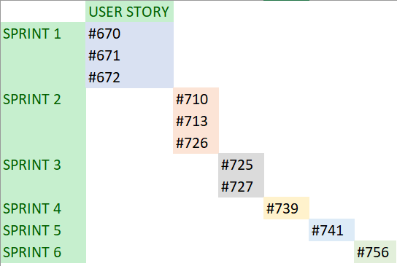
Project Management
Notes:
Project Management (schedule for entire semester) (one slide; Gantt Chart).

Slide 4
Requirements: User Stories
#670 Learn Leap API
#671 Learn Real Sense API
#672 Build a mini Leap enabled program
#710 Design- Gesture Process
#713 Research - Template Matching
#726 Build - Database of ASL Alphabet
#725 Improve - Output of JSON file
#727 Evaluate - Machine Learning Algorithms using Weka & Constructed database
#739 Begin to Implement - A Machine Learning Algorithm
#741 Continue To Implement - A Machine Learning Algorithm
#756 Finish Implementing - A Machine Learning Algorithm
Notes:
4. Requirements:
4.1. User stories implemented (one or more slides).
4.2. UML use cases and the use case diagram for the implemented use cases (one or more slides).
4.3. UML sequence diagrams for the implemented use cases.

Slide 5
Requirements: User Stories
#739 Begin to Implement - A Machine Learning Algorithm
#741 Continue To Implement - A Machine Learning Algorithm
#756 Finish Implementing - A Machine Learning Algorithm
These three user stories were the most crucial and time consuming part of the project. Holding the most weight, three sprints were dedicated solely to their completion. As a result, the project was a success with an average classification rate of 78% across all ASL letters.
Notes:
4. Requirements:
4.1. User stories implemented (one or more slides).
4.2. UML use cases and the use case diagram for the implemented use cases (one or more slides).
4.3. UML sequence diagrams for the implemented use cases.

Slide 6
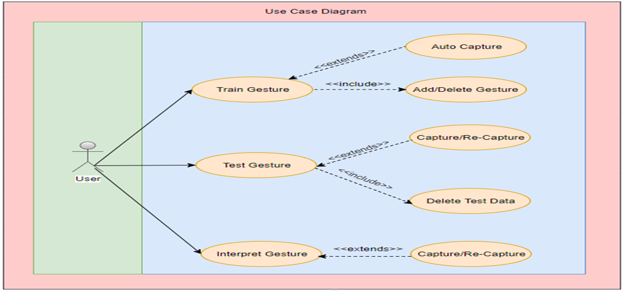
Requirements: Use Cases
Notes:
4. Requirements:
4.1. User stories implemented (one or more slides).
4.2. UML use cases and the use case diagram for the implemented use cases (one or more slides).
4.3. UML sequence diagrams for the implemented use cases.

Slide 7
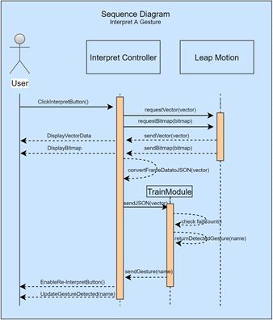
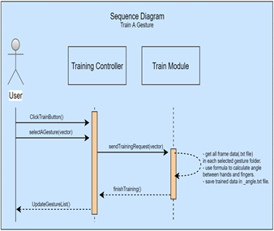
Requirements: Sequence Diagrams
These two sequence diagrams represent the bulk of the programming done to implement the K-Nearest Neighbor machine learning algorithm. They satisfy the goal of the project to train and recognize gestures.
Notes:
4. Requirements:
4.1. User stories implemented (one or more slides).
4.2. UML use cases and the use case diagram for the implemented use cases (one or more slides).
4.3. UML sequence diagrams for the implemented use cases.

Slide 8
System Design: Architecture
The LEAP-Trainer’s framework is a bit untraditional in the sense that the usual Model-View-Controller architecture representation needed to be modified to fit this application. This system connects to an external device through the USB in which all data is collected from, adding an additional layer. To compensate, sequence diagrams were drawn to show the controller in use, the connection to the Leap Motion Device, File Helper, Training Module, or a combination. However, the overall structure of the project remains modular, partitioned by data gathering, training/interpretation logic, and the user interface.
Notes:
5. System design:
5.1. System decomposition; identify the architecture patterns used (one slide).
5.2. System deployment – h/w and s/w requirements (one slide).
5.3. Persistent data design (one slide).
5.4. Security/Privacy (one slide).

Slide 9
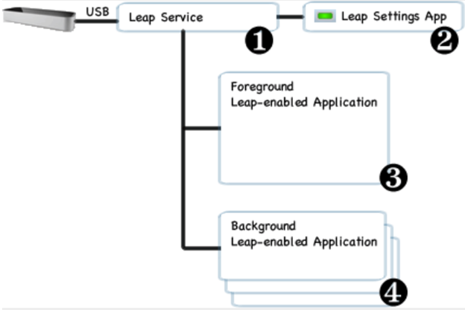
System Design: Deployment
The native application interface is provided through a dynamically loaded library. This library connects to the Leap Motion service and provides tracking data to the LEAP-Trainer application.
Notes:
5. System design:
5.1. System decomposition; identify the architecture patterns used (one slide).
5.2. System deployment – h/w and s/w requirements (one slide).
5.3. Persistent data design (one slide).
5.4. Security/Privacy (one slide).

Slide 10
System Design
Models: o LeapConstants: Contains constants used in angle conversion. o LMBone: Contains bone type, start, end, and direction. o LMFinger: Contains finger ID, type, width, length. o LMFrame: Contains frame ID, hand type, pitch/yaw/roll, wrist/elbow position, time stamp, hands, fingers. o LMHand: Contains palm position, palm direction, palm normal, arm direction, arm elbow, fingers. o LMSingleton: Contains the limits used in interpretation.
Controllers o Capture: Handles capturing a frame. o Test: Handles testing a captured frame. o Interpret: Handles interpreting a captured frame.
Module o TrainModule: Performs the train function which converts frame vector data into classifiable angles. Additionally, it contains the logic used to interpret trained gestures.
Views: o Training Form: Main view of the LEAP-Trainer, used to capture and train gestures. o Testing Form: Sub view of the LEAP-Trainer, used to test a captured gesture. o Interpreter Form: Secondary view of the LEAP-Trainer, used to interpret trained gestures.
Notes:
5. System design:
5.1. System decomposition; identify the architecture patterns used (one slide).
5.2. System deployment – h/w and s/w requirements (one slide).
5.3. Persistent data design (one slide).
5.4. Security/Privacy (one slide).

Slide 11
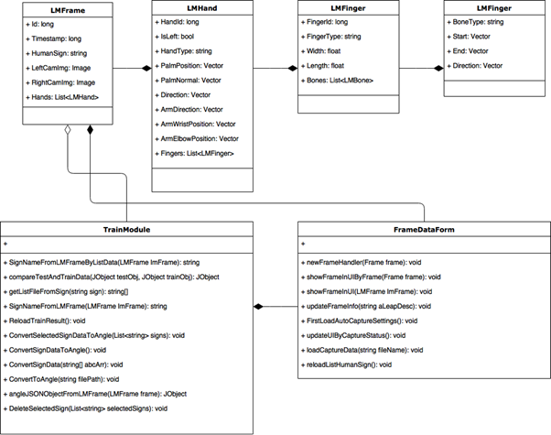
Minimal Class Diagram
This diagram represents the interactions with respect to the input device and the software when dealing with training gestures
Notes:
6. Detailed design:
6.1. Minimal class diagram. Identify the design patterns used (one or more slides).
6.2. State machine for the main control object or the most important object of the implemented uses cases (one or more slides).
6.3. Main algorithm used related to an implemented use case described above (one or more slides).

Slide 12
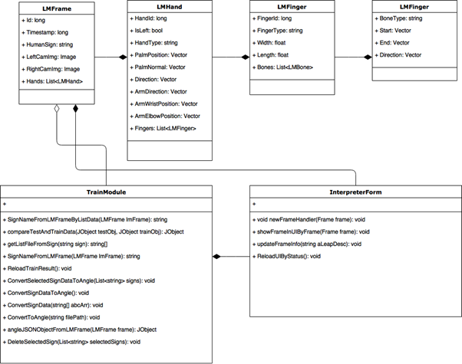
Minimal Class Diagram
This diagram represents the interactions with respect to the input device and the software when dealing with interpreting gestures.
Notes:
6. Detailed design:
6.1. Minimal class diagram. Identify the design patterns used (one or more slides).
6.2. State machine for the main control object or the most important object of the implemented uses cases (one or more slides).
6.3. Main algorithm used related to an implemented use case described above (one or more slides).

Slide 13
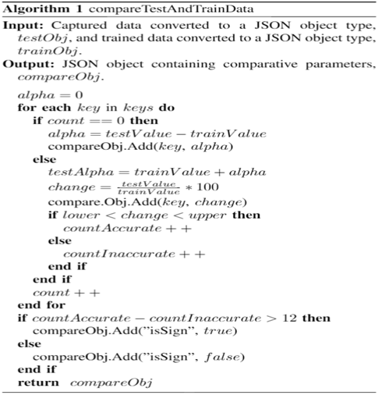
Main algorithm 1
Post-training, when the angles have been calculated and stored, the user will want an interpretation. Classification is achieved by comparing the angles collected and its implementation is shown in Algorithm 1. When data is captured for the interpreter, it will get frame data (called frame A). It will convert frame A to an angle by using the methods in the previous section. Next, it is time to compare angle, theta, with each angle file for all trained gestures. To perform the classification, the LEAP-Trainer needs the upper and lower limit value of the perceived finger variation within each capture, upper and lower respectively.
Notes:
6. Detailed design:
6.1. Minimal class diagram. Identify the design patterns used (one or more slides).
6.2. State machine for the main control object or the most important object of the implemented uses cases (one or more slides).
6.3. Main algorithm used related to an implemented use case described above (one or more slides).

Slide 14
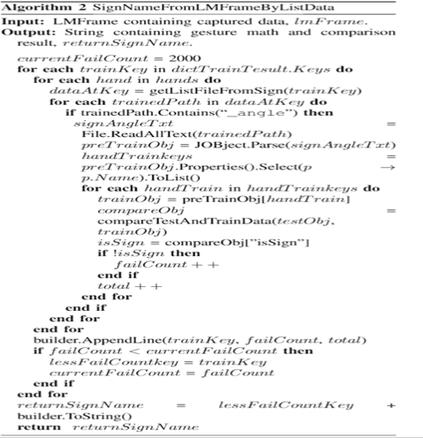
Main algorithm 2
The correct gesture name is returned by Algorithm 2. First, Algorithm 2 retrieves the locations where the angle data is stored, signAngleTxt. Then it parses the data in signAngleTxt for all the files containing angle within their name. For all data, the training object, trainObj, and the comparison Object, compareObj, is loaded which was created by Algorithm 1. Then, it finds all the occurrences where the data is false for all values in the training set verses the comparison set and chooses the gesture which has the least amount of fail counts stored in failCount.
Notes:
6. Detailed design:
6.1. Minimal class diagram. Identify the design patterns used (one or more slides).
6.2. State machine for the main control object or the most important object of the implemented uses cases (one or more slides).
6.3. Main algorithm used related to an implemented use case described above (one or more slides).

Slide 15
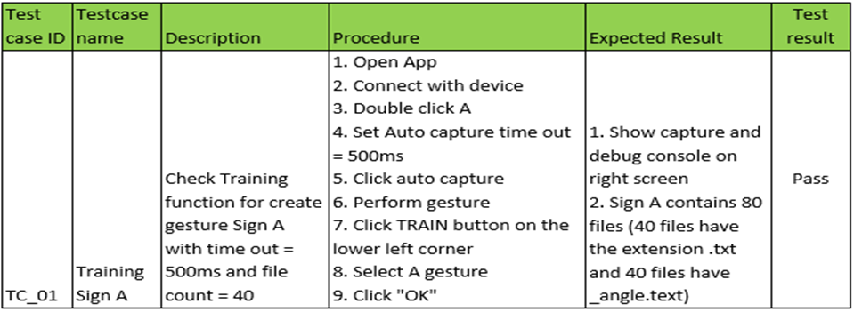
Test Suites and Test Cases
Notes:
7. Test Suites and Test Cases (one sunny day and one rainy day) for the use case represented in part (5) above (2 slides).
7.1 One sunny day and one rainy day for the implemented use cases (one or more slides).
7.2 Automated test scripts for the implemented use cases (one or more slides).

Slide 16
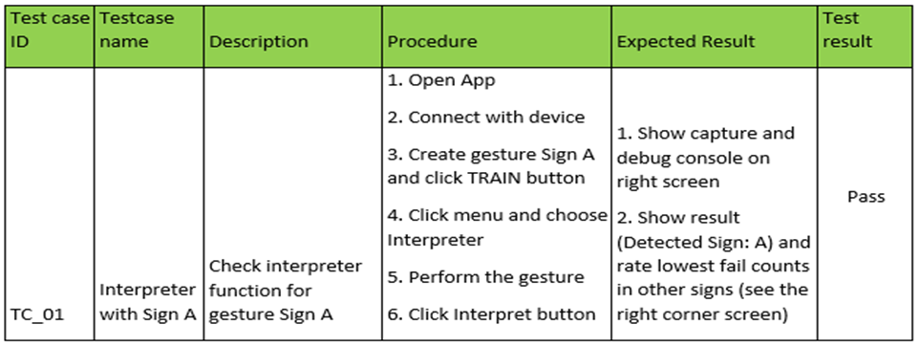
Test Suites and Test Cases
Notes:
7. Test Suites and Test Cases (one sunny day and one rainy day) for the use case represented in part (5) above (2 slides).
7.1 One sunny day and one rainy day for the implemented use cases (one or more slides).
7.2 Automated test scripts for the implemented use cases (one or more slides).

Slide 17
Summary
The LEAP-Trainer, a single-frame gesture recording and recognition software that utilizes the Leap Motion Controller optical, infrared sensor, designed by Leap Motion to perform detection and tracking of the human hand and its features. The LEAP-Trainer paired with the Leap Motion Controller, the right environment and application settings can accurately classify single-frame gestures in American Sign Language in real-time with an average accuracy of 78% per letter. Future work includes the possibility of extending the software to utilize more than one controller and to introduce a system that can support multi-framed gestures.
Contact: fklep001@fiu.edu
Questions?
Thank You!
Notes:
Summarize your contribution
Include your contact information
Ask if anyone has any questions for you.
Thank your audience

