Slide 1
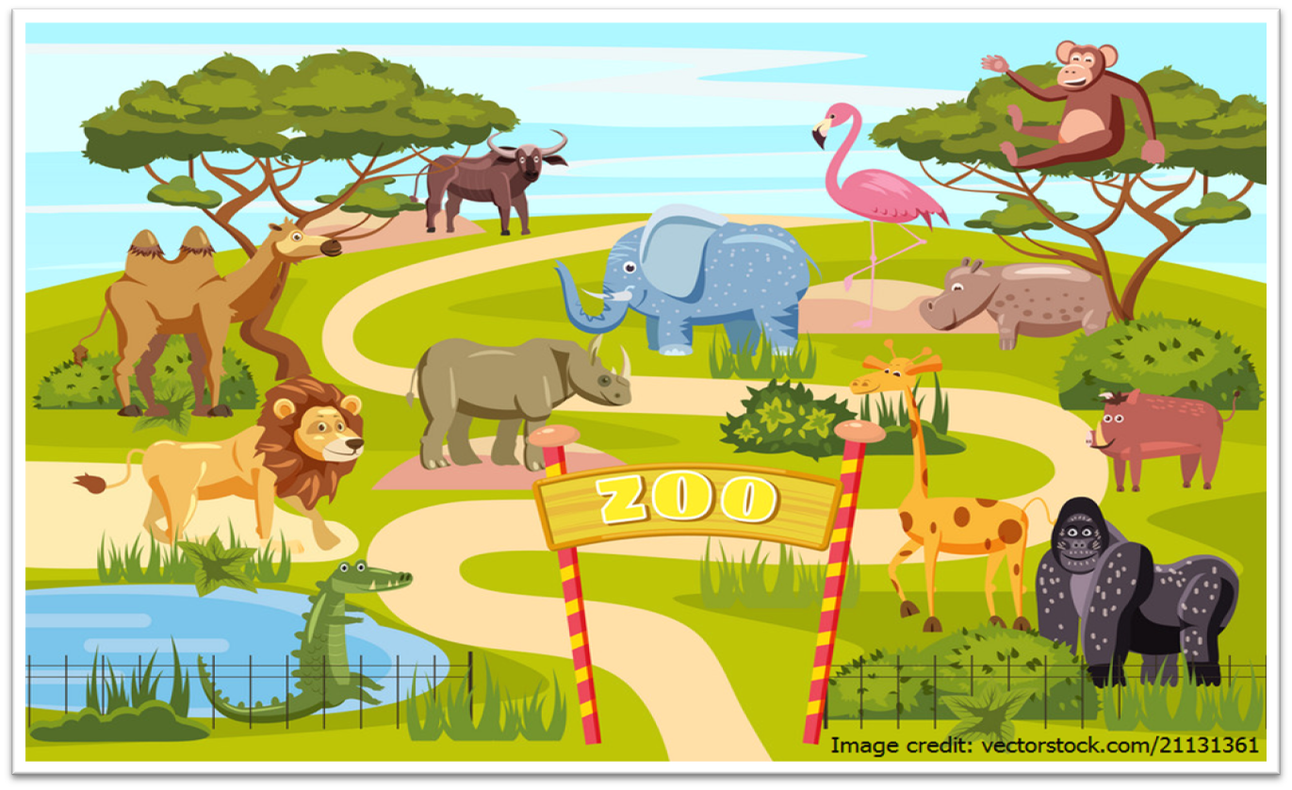
Zoo Certificate
This is to certify that
{{full name}}
{{other identifier}}
successfully completed the zoo quiz
with score of {{percent}} on {{date}}
Issued by Mr. Seksun Suwanmanee - CoE - PRINCE OF SONGKLA UNIVERSITY

