Slide 1


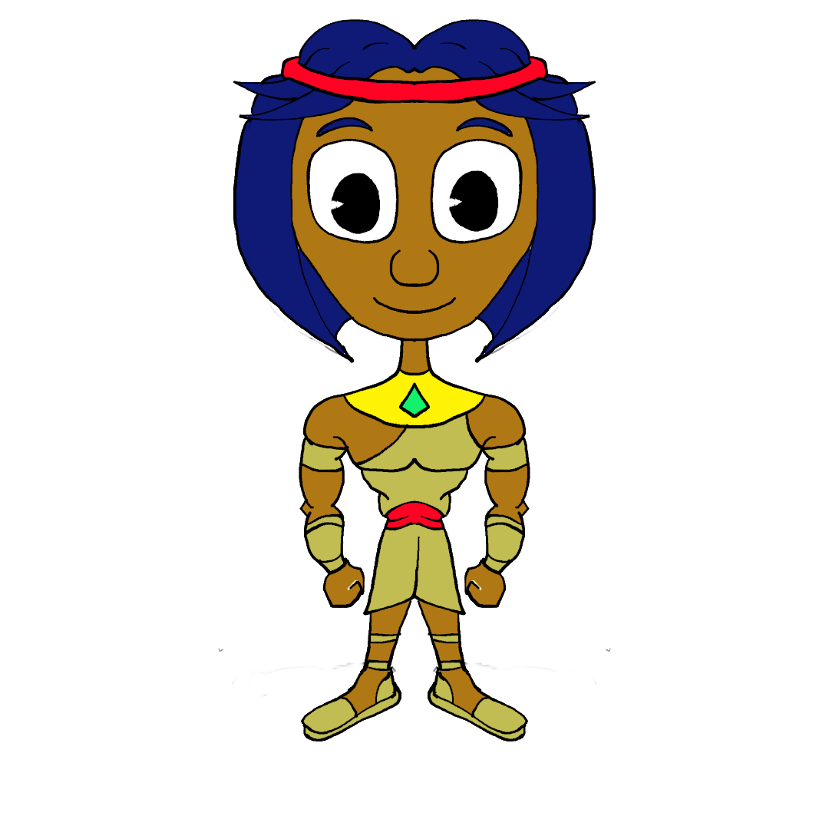
Welcome to the podcast challenge
Introduction
Zimny [hilo]
Word games
Mini-challenge No 1
Mini-challenge No 2
redes sociales
®Copyright
contacto

Slide 2

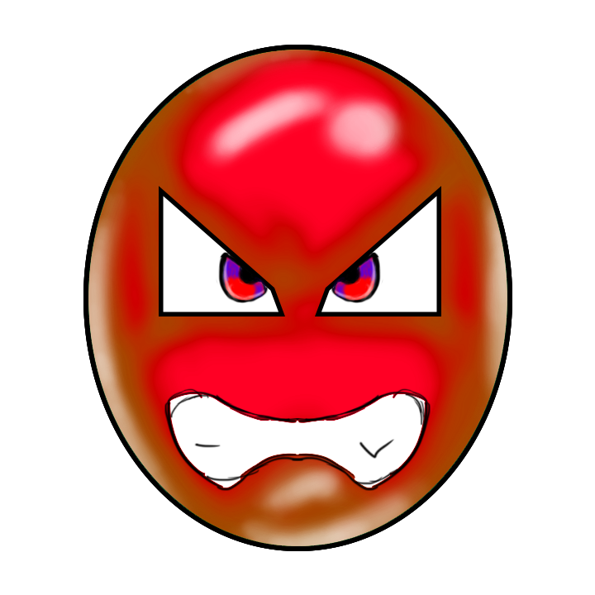

Word games
Word games
Narrative verbs
Narrative tenses
connectives
Description
Description
Description
redes sociales
®Copyright
contacto

Slide 3
Mini challenge no 1
Writing a script
A hero’s journey
examples
Task hand in
Description
Embeded form
Item 1
Item 2
Item 3
Description
Description
Description
redes sociales
®Copyright
contacto

Slide 4
Mini challenge no 2
¨producing your podcast
How to
Sound libraries
Task hand in
Video
Embeded form
Item 1
Item 2
Item 3
Description
Description
Description
redes sociales
®Copyright
contacto

Slide 5
About your tutor
About your tutor
evidence
Evidence 1
Description
redes sociales
®Copyright
contacto

