Slide 1
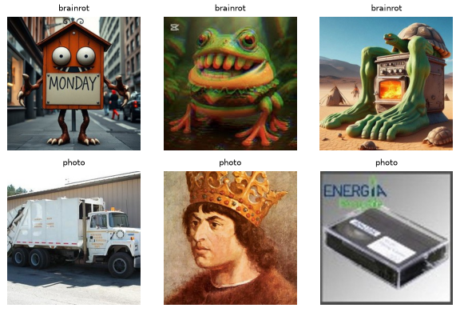
Brainrot
Detector
MACHINE LEARNING · NAUKMA · MINI-PROJECT
Is this image an Italian brainrot character? A binary image classifier — and an honest look at what it actually learnt.
Team
Stack
Partner A [name] · Partner B [name]
TensorFlow / Keras · scikit-learn · Streamlit
Code, notebook and model: ML_Brainrot repository
Notes:
Brainrot Detector: a binary image classifier for Italian brainrot memes, built for the Machine Learning course at NaUKMA. The interesting part is not the accuracy but what the model actually learnt.

Slide 2
The project, step by step
WHAT WE DID
01
Question & data sources
06
Cross-validation & metrics
Chose the task; ordinary AI images as hard negatives
5-fold CV; ROC-AUC, PR-AUC, F1, balanced accuracy
02
Data pipeline
07
Fine-tuned MobileNetV2
prepare_data.py: download, standardise, deduplicate
Keras, two stages: head first, then top 30 layers
03
Exploratory analysis
08
Decision threshold
Class balance, pixel stats per source, duplicates
Chosen on validation, then fixed for test and app
04
Train / val / test split
09
Error analysis
70 / 15 / 15, stratified by source
Per-source errors, border & occlusion tests, hard-neg. curve
05
Baselines
10
Streamlit demo app
Majority class; colour histogram + logistic regression
Upload an image, get the brainrot probability
AI assistance: Claude Code was used as a coding assistant (first drafts of code, debugging, README). Methodology choices were checked and the notebook re-run by the team.
Notes:
Ten steps in order, from formulating the question to the demo app.

Slide 3
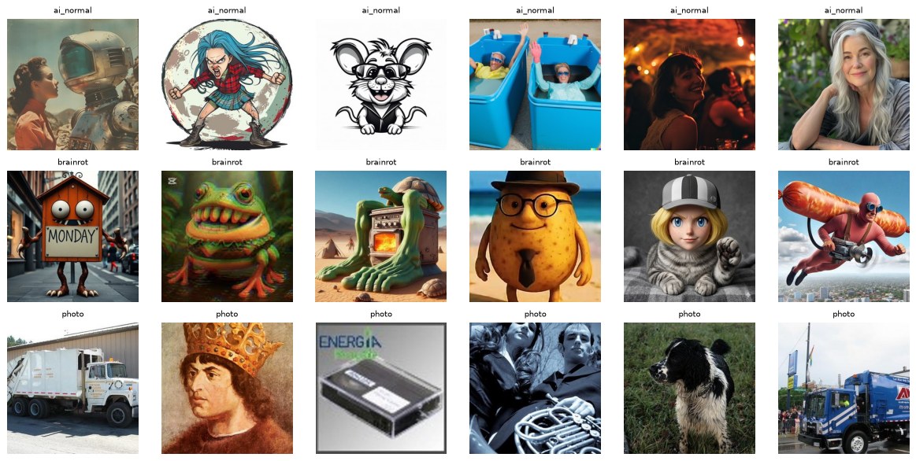
Every brainrot image is AI-generated — so we added ordinary AI images as hard negatives
THE QUESTION
If the "not brainrot" class were only real photos, a model could score well by simply detecting AI images. To test what it really learns, class 0 mixes photos with Midjourney / DALL·E / SD images, and every result is reported per source.
Source | Label | Images
brainrot | 1 | 4 982
photo | 0 | 4 500
ai_normal | 0 | 500
Total · split 70 / 15 / 15 |  | 9 982
Examples from each source: ai_normal (top), brainrot (middle), photo (bottom).
Kaggle Italian Brainrot dataset · HF midjourney-dalle-sd · Imagenette. All images → RGB, centre crop, 256², JPEG q90; 18 duplicates removed before splitting.
Notes:
Hard negatives are the key design decision: without them, 'AI-generated vs real' would be enough to score high.

Slide 4
An end-to-end study: from raw downloads to a working demo app
WORK DONE
01
02
03
04
05
06
Data pipeline
Baselines
Transfer learning
Validation
Error analysis
Demo app
Download 3 public sources (~700 MB), standardise every image identically, hash-dedupe, split stratified by source.
Majority class (floor) and HSV colour histogram + logistic regression to measure "style only".
Frozen MobileNetV2 embeddings + logreg; then MobileNetV2 fine-tuned in Keras with augmentation.
5-fold stratified CV for sklearn models; early stopping + threshold on val for Keras; test used once.
Errors per source, confident mistakes, border test, occlusion maps, hard-negative curve.
Streamlit app: upload an image, get brainrot probability with adjustable threshold.
PARTNER A
PARTNER A
A · B
PARTNER A
PARTNER B
PARTNER B
Reproducible: seed 42, deterministic TF ops, pinned versions; full notebook runs in ~15 min on a laptop CPU.

Slide 5
Each model beats the last; fine-tuned MobileNetV2 reaches ROC-AUC 0.986
RESULTS · HELD-OUT TEST SET (1 498 IMAGES)
Model | ROC-AUC | Bal. acc. | F1 | brainrot missed | photo false alarm | ai_normal false alarm
Majority class | 0.500 | 0.500 | 0.000 | 100 % | 0 % | 0 %
Colour histogram + logreg | 0.773 | 0.717 | 0.725 | 25.3 % | 28.9 % | 53.3 %
MobileNetV2 embeddings + logreg | 0.972 | 0.931 | 0.931 | 7.2 % | 3.0 % | 38.7 %
Fine-tuned MobileNetV2 | 0.986 | 0.951 | 0.951 | 4.7 % | 1.5 % | 38.7 %
0.77
1.5 %
38.7 %
ROC-AUC from colour alone — brainrot has a recognisable visual style.
of everyday photos wrongly flagged — a usable "brainrot vs photo" filter.
of ordinary AI images wrongly flagged — the weak spot (next slide).
ROC-AUC 95% CI for fine-tuned model: 0.981–0.991 · threshold 0.35 chosen on validation · 5-fold CV agrees (embeddings: 0.978 ± 0.002)
Notes:
Every step of the ladder matters; most of the gain comes from pretrained ImageNet features. Photos are handled well, ordinary AI images are not.

Slide 6
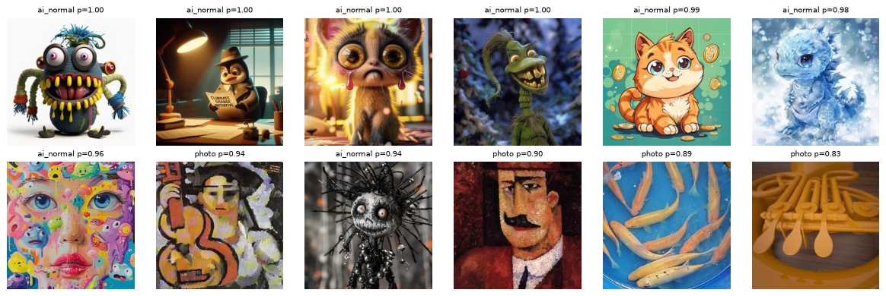
The model partly learnt "AI-generated cartoon character ⇒ brainrot"
KEY FINDING
29 / 75
ordinary AI test images flagged as brainrot
38.7 % · Wilson 95% CI 28–50 %
The false alarms are mostly cute or creepy creatures with big eyes and saturated colours — visually close to the meme genre, but not brainrot.
Most confident false positives on the test set (label · predicted brainrot probability).
A few painterly photos (cubist portraits, a fish tank) are also caught by the "AI style" cue.
Notes:
The model learnt a mix of 'brainrot' and 'AI-generated character'. 29 of 75 ordinary AI images are flagged.

Slide 7
Not a watermark shortcut — and more hard negatives keep helping
DIAGNOSTICS
Hard-negative learning curve · embeddings, 5-fold CV
Border-removal test · keep only central 60 %
Source | Full image | Centre only
brainrot | 4.7 % | 9.1 %
photo | 1.5 % | 3.4 %
ai_normal | 38.7 % | 32.0 %
Cropping hurts brainrot and photos about equally → no sign the model relies on TikTok watermarks or captions.
Occlusion maps
Important regions sit on the character (faces, eyes, hybrid body parts), not on the background — qualitative only.
False alarms on AI images fall from 58 % to 32 % and have not levelled off — at a small cost in brainrot recall.
Notes:
Two checks: the border test rules out a watermark shortcut; the learning curve shows more hard negatives would help further.

Slide 8
Usable as a "brainrot vs photos" filter — not yet as "brainrot vs any AI picture"
CONCLUSIONS
Supported
Not supported
Next steps
Reliable separation from photos: ROC-AUC 0.986, 1.5 % false alarms
Most gain comes from pretrained ImageNet features
No watermark / caption shortcut
That the model understands "brainrot" as a concept
39 % of ordinary AI images flagged
Limitations
Only 75 hard negatives in test
One meme wave, one wiki; 10 photo classes
Keras model trained with one seed
Collect more hard negatives — the curve says this is the biggest lever
Add other meme styles and non-ImageNet photos
Repeat fine-tuning over several seeds
Demo
streamlit run app.py — upload an image, get the brainrot probability.
Notes:
Bottom line: works as a brainrot-vs-photos filter; collecting more ordinary AI images is the most promising next step.

