Slide 1

Stock Price Prediction of BEXIMCO
Using Statistical Tests,Single stock prediction using OLS,Random Forest,XGBOSST, LSTM,
and a Multi-Stock XGBoost Framework
Md. Takbir Al Tanim | 2331694
Nujat-E- Hasnat | 2330201
Tahura Anzum Toa | 2230230

Slide 2

Introduction
Stock markets are influenced by news, investor sentiment, economic conditions, and global events.
Predicting prices is challenging due to noise, volatility, and sudden market shocks.
This study predicts next-day closing prices of BEXIMCO using:
Statistical tests
Machine Learning models
Deep learning (LSTM)
A multi-stock XGBoost model
Data spans 1999–2025, covering major market events.

Slide 3
Research Objectives
Analyze BEXIMCO’s price behavior using statistical methods.
Test for stationarity and structural breaks.
Compare prediction performance of:
OLS
Random Forest
XGBoost
LSTM
Build a multi-stock learning model using XGBoost.
Evaluate which model performs best for short-term forecasting.

Slide 4
Literature Review (1)
- LSTM & GRU capture long patterns.
- Hybrid CNN–GRU improves accuracy.
- Transformers strong in volatile markets.
- ARIMA struggles with nonlinear patterns.

Slide 5
Literature Review (2)
- XGBoost strong for directional forecasting.
- ARIMA + XGBoost hybrids stable.
- Cross-stock learning effective.
- LSTM/RNN models overfit noisy data.

Slide 6
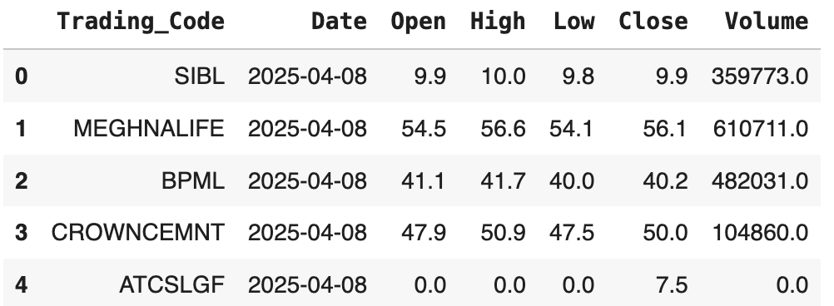
Data Source
- DSE daily OHLC data (1999–2025).
- Includes price, volume, trading code.
- Covers 2010 crash, pandemic, reforms.

Slide 7
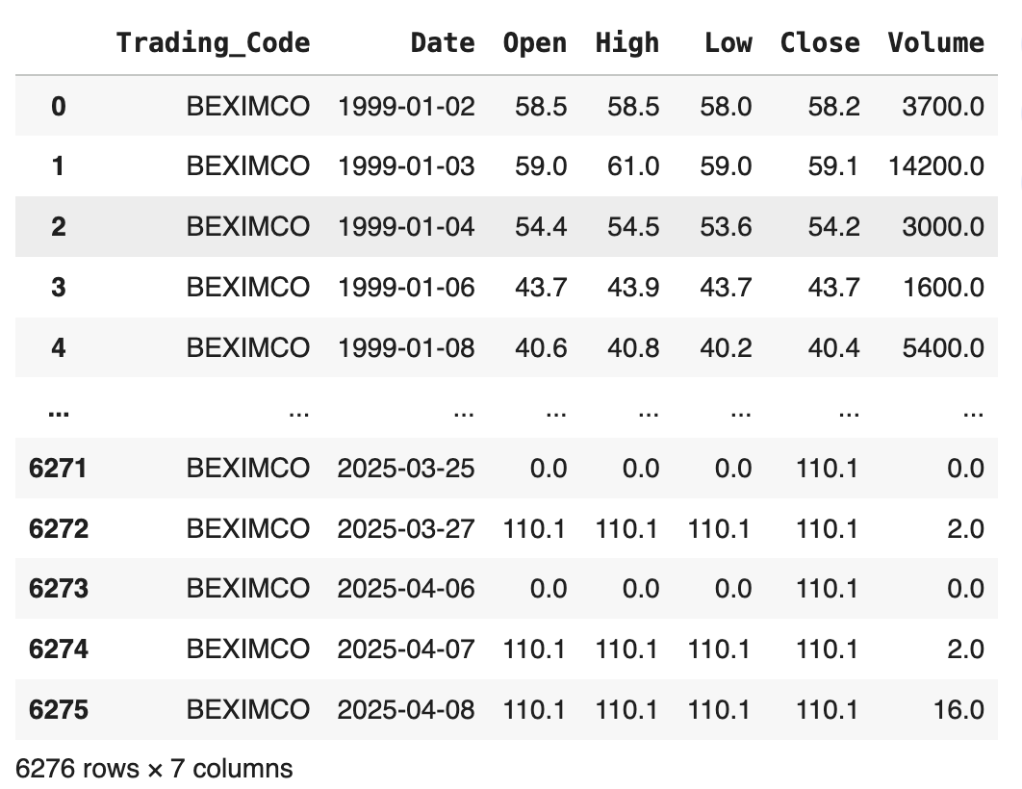
Data Cleaning
- Date sorting & formatting.
- Remove missing/zero-price rows.
- Remove duplicates.
- Clip outliers.
- Final dataset: 6,179 rows.

Slide 8
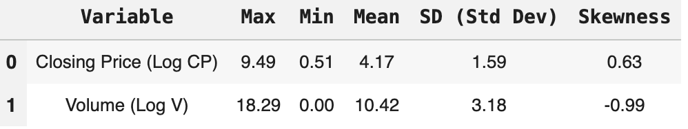
Summary Statistics
- Log transform reduces skew.
- Log Close mean = 4.17, SD = 1.59.
- Log Vol mean = 10.42.
- Strong price correlations (>0.95).

Slide 9
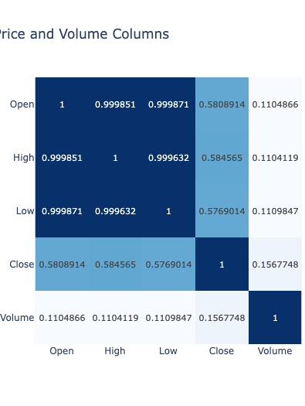
Correlation Analysis
- Open/High/Low/Close highly correlated.
- Volume weakly correlated.
- Engineered features required.

Slide 10
Statistical Tests Overview
- ADF test for stationarity.
- PP test for unit root.
- CUSUM/Chow for structural breaks.

Slide 11
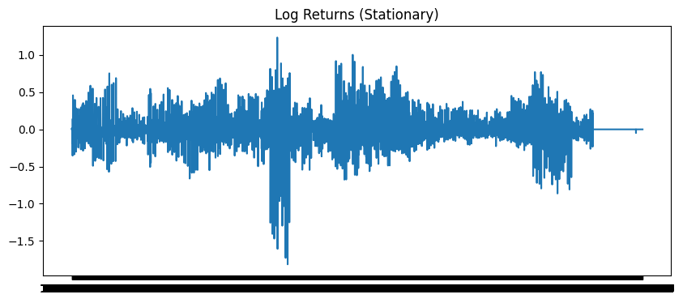
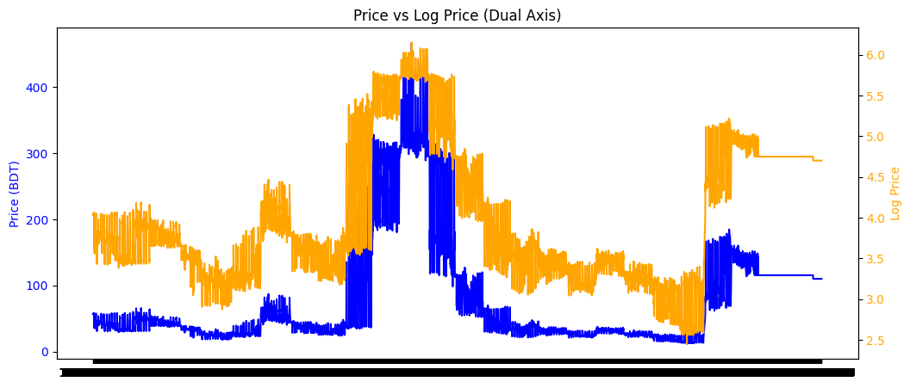
Stationarity Results
- Raw price non-stationary.
- Log-differencing → stationary.
- ADF p = 2.6e-30.

Slide 12

Structural Break Test
CUSUM results:
Statistic ≈ 7.29
p-value → 1.38 × 10⁻⁴⁶
Strong evidence of instability Interpretation:
Market crashes and policy shifts created structural breaks
Models must handle changing relationships over time

Slide 13

Feature Engineering
Engineered features include:
SMA7, SMA14
EMA14
Daily returns
Volume change
Lagged features (Lag1, Lag3, Lag7) Purpose: Improve predictive power and capture market behavior.

Slide 14

Models Used
Baseline + ML + DL:
OLS Regression → tests linearity
Random Forest → handles nonlinear patterns
XGBoost → gradient boosting, powerful for tabular data
LSTM → captures temporal sequences
Each model predicts next-day closing price.

Slide 15
Training Setup
Train-test split: 70% train, 30% test
StandardScaler applied
Evaluation metrics:
R²
RMSE
LSTM uses rolling windows of previous 30 days

Slide 16
Model Results
Method | Training R² | Training RMSE | Testing R² | Testing RMSE
OLS | 0.965868 | 17.082000 | 0.964192 | 9.345098
Random Forest | 0.995592 | 6.138985 | 0.899617 | 15.646742
XGBoost | 0.998406 | 3.692045 | 0.748851 | 24.749057
LSTM | 0.941047 | 22.502635 | 0.787535 | 22.782882
OLS: R²=0.9642, RMSE=9.35 (best)
RF: Overfits mildly
XGB: Overfits strongly
LSTM: Moderate accuracy

Slide 17
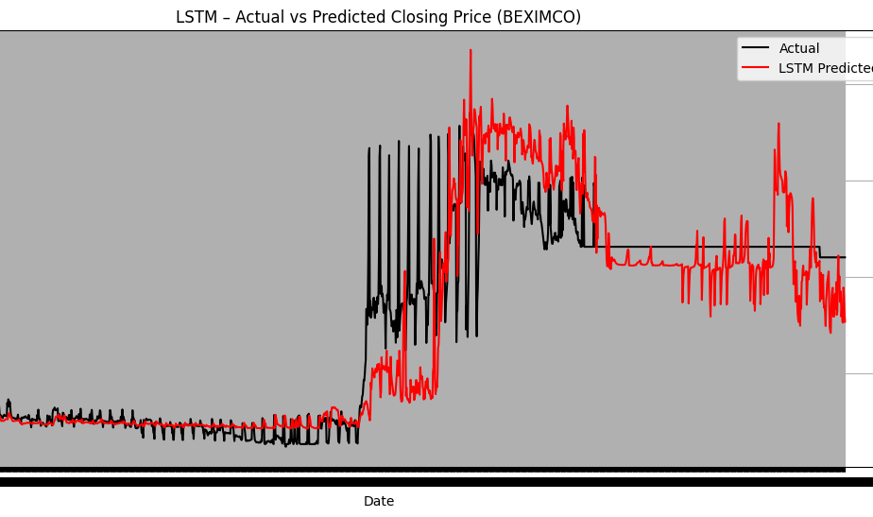
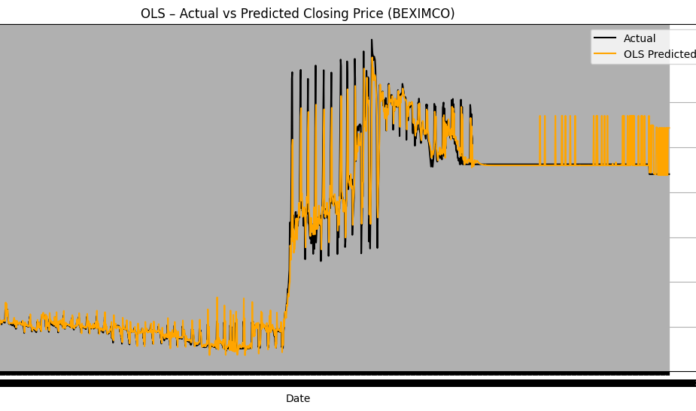
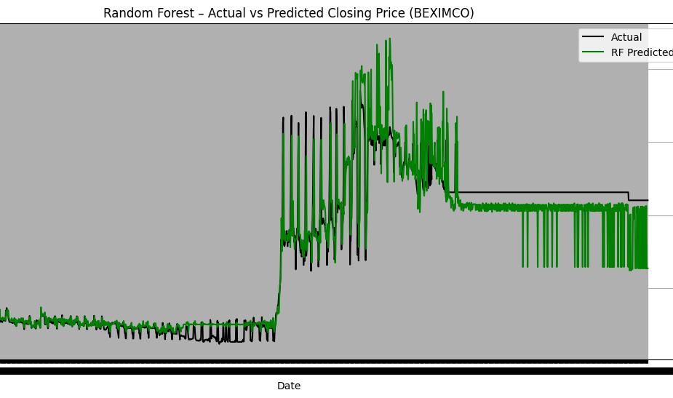
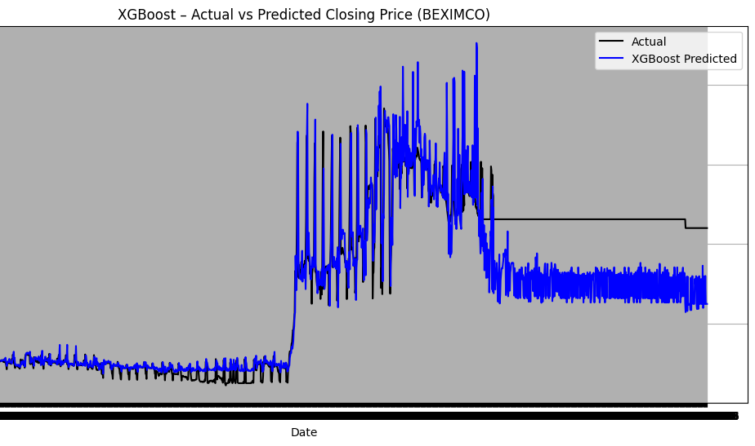
Prediction Visualization
OLS:
Follows actual values closely
Smooth and accurate
RF:
Captures nonlinearity
Noisy predictions
XGBoost:
Overreacts to volatility
LSTM:
Tracks long-term trend
Struggles with sudden changes

Slide 18
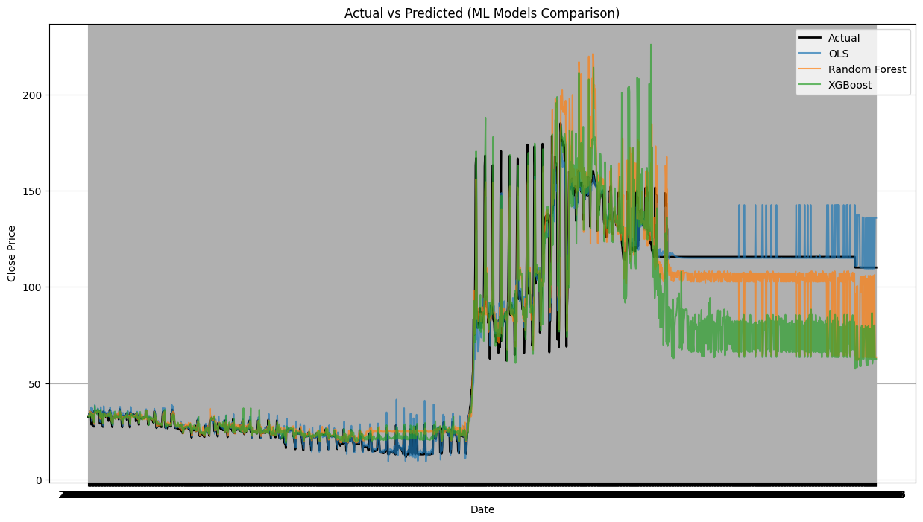
Combined Comparison
OLS most accurate
RF moderate accuracy
XGBoost unstable
LSTM lagging turns

Slide 19
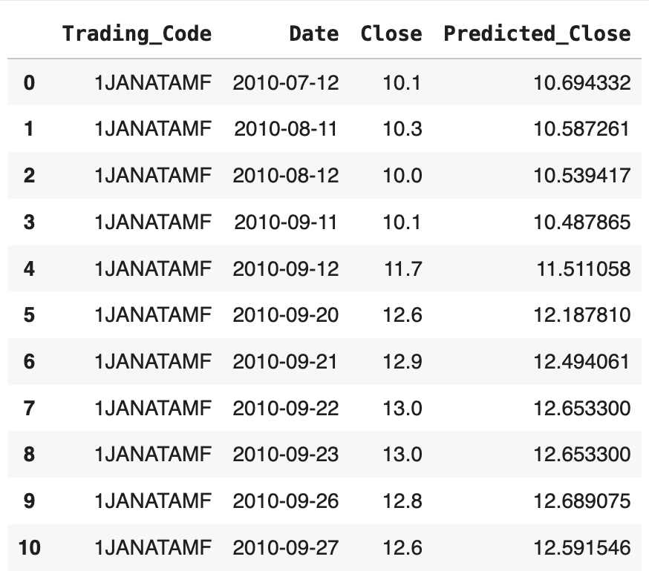
Multi-Stock XGBoost
- Trained on ALL DSE stocks.
- Features: SMA, EMA, MACD, RSI, lags, volume.
- R² = 0.9571, RMSE = 113.97.

Slide 20
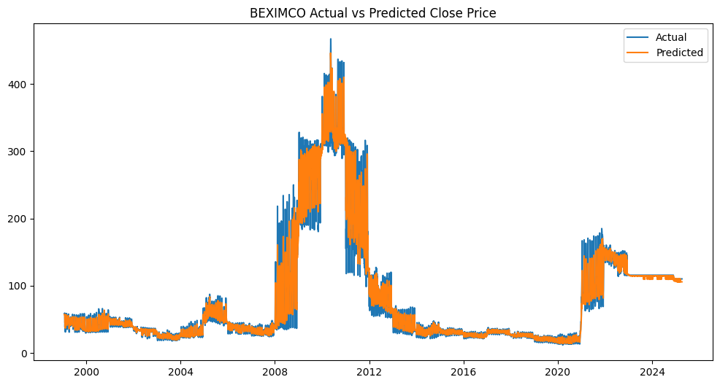
BEXIMCO Multi-Stock Results
- Tracks long-term movement.
- Captures trends.
- Short-term movements harder.

Slide 21
Conclusion
- Raw data non-stationary with structural breaks.
- OLS best model for next-day prediction.
- RF & XGB overfit.
- Multi-stock XGBoost improves generalization.

Slide 22
Future Work
Future improvements:
Use Transformers, GRU, hybrid DL models
Multi-step forecasting (1–10 days ahead)
Add macroeconomic and sentiment indicators
Explore regime-switching models for structural breaks
Tune LSTM with attention mechanisms

Slide 23
Thank You
Reference:
[1] A. Bhavani, A. V. Ramana, and A. S. N. Chakravarthy, “Comparative
analysis between LSTM and GRU in stock price prediction,” in Proc.
2022 Int. Conf. Edge Comput. Appl. (ICECAA), 2022, pp. 532–537.
[2] B. Nagendra and G. Singh, “Comparing ARIMA, linear regression,
random forest, and LSTM for time series forecasting: A study on item
stock predictions,” in Proc. 2023 4th IEEE Global Conf. Advancement
in Technology (GCAT), 2023, pp. 1–8.
[3] C. Umezuruike, D. Olaniyan, J. Olaniyan, A. E. Adeniyi, A. Oyebade,
and D. Abaneme, “Comparative analysis of long short-term memory
(LSTM), gated recurrent unit (GRU) and transformer models in predict-
ing stock prices,” in Proc. 2024 IEEE 5th Int. Conf. Electro-Computing
Technol. for Humanity (NIGERCON), 2024, pp. 1–6.
[4] M. R. Hasan, F. Sultana, H. O. Rashid, T. K. Abdulwasea, and S. Raza,
“Bridging stock price data and technical features for stock forecasting:
A comparative study of BiLSTM, CNN & GRU models,” in Proc. 2025
9th Int. Symp. Innovative Approaches in Smart Technol. (ISAS), 2025,
pp. 1–6.
[5] S. Deng, X. Huang, Y. Zhu, Z. Su, Z. Fu, and T. Shimada, “Stock index
direction forecasting using an explainable eXtreme Gradient Boosting
and investor sentiments,” North Am. J. Econ. Finance, vol. 64, p. 101848,
2023.

