Slide 1
CI/CD: Automating the Software Development Lifecycle
BMS Institute of Technology and Management
(An Autonomous Institution, Affiliated to VTU Belagavi)
Department of MCA
VAIBHAV KARBHANTNAL – 1BY23MC097

Slide 2
What is CI/CD?
CI: Continuous Integration — Code changes are integrated frequently and tested
CD: Continuous Delivery/Deployment — Code is released frequently (manually or automatically)
Goal: Deliver code frequently, reliably, and quickly

Slide 3
What is Continuous Integration (CI)?
Developers merge code into shared repo
Automatic testing (unit tests, builds)
Benefits: Catch bugs early, improve code quality, reduce integration pain
Tools: Jenkins, GitHub Actions, Travis CI

Slide 4
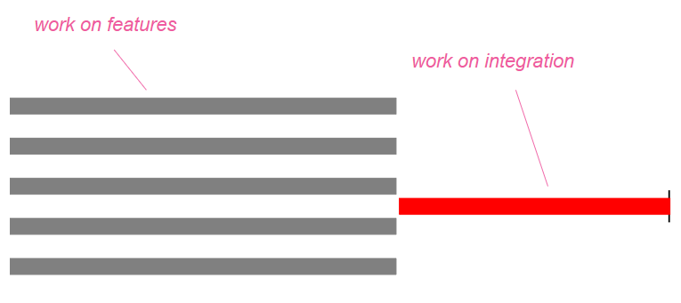

Slide 5
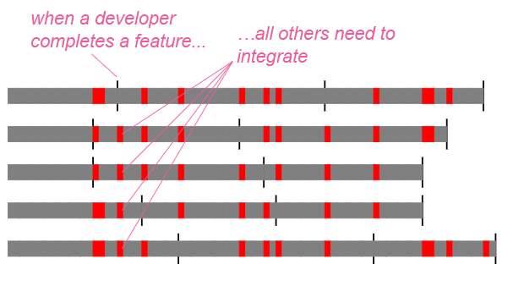
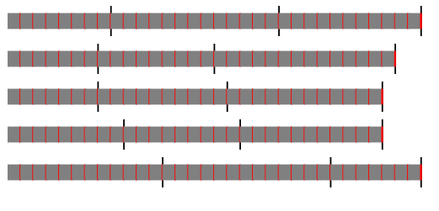
Contineous Integration

Slide 6



Delivery
What is Continuous Delivery/Deployment (CD)?
Deployment
Tools
Ready to deploy any time (manual release)
Auto-release after tests pass
GitLab CI/CD, ArgoCD, Spinnaker

Slide 7
CI/CD Pipeline Stages
Code Commit
Build
Test
Developers push changes to a shared repository like GitHub or GitLab. This triggers the CI pipeline to begin automatically.
Automated tests (unit, integration) are run on the built code. Helps detect bugs early before deploying further.
Source code is compiled and dependencies are resolved. Creates an executable or deployable artifact (e.g., Docker image, JAR file).

Slide 8
CI/CD Pipeline Stages
Deploy
Approval (Optional)
A manual step for code review or stakeholder sign-off. Often used in Continuous Delivery models.
Test
Monitor
Automated tests (unit, integration) are run on the built code. Helps detect bugs early before deploying further.
Logs, metrics, and alerts are collected post-deployment. Ensures performance and error tracking in real time.
Code is deployed to staging or production environments. Happens automatically in Continuous Deployment.

Slide 9
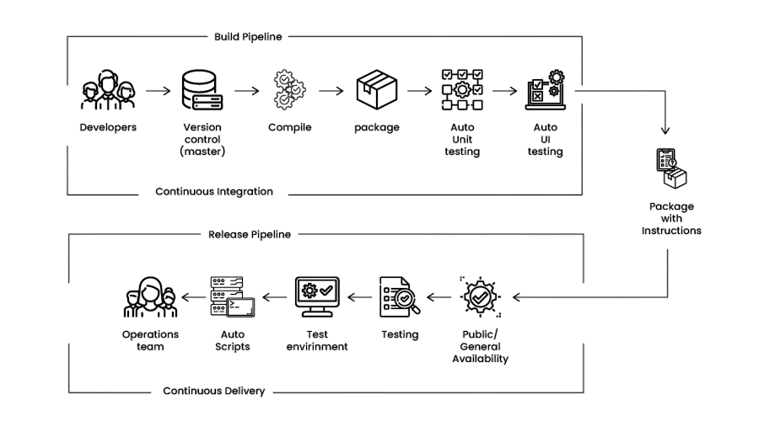

Slide 10
Benefits of CI/CD
Faster, safer releases
Less manual work
Quick feedback
Improved team productivity

Slide 11
Challenges in CI/CD
Complex tool integration
Setup costs
Rollbacks and test reliability
Security in pipelines

Slide 12
Popular Tools (Visual Table)
Tool | Type | Highlights
Jenkins | CI/CD | Open-source, customizable
GitHub Actions | CI/CD | Native to GitHub, easy to use
GitLab CI | CI/CD | Integrated in GitLab
ArgoCD | CD | Kubernetes-native deployment

Slide 13



Real-world Use Cases
AMAZON
NETFLIX
START-UP
Thousands of daily deployments
Uses Spinnaker for fully automated CD
Fast testing and delivery using GitHub Actions and Docker

Slide 14
Conclusion
CI/CD is a key part of modern DevOps
It improves
With the right setup, it can transform development processes
Speed
Reliability
software quality

Slide 15
Thank You
Do you have any questions?
vaibuk1234@gmail.com
+91 83108 97169

