Slide 1
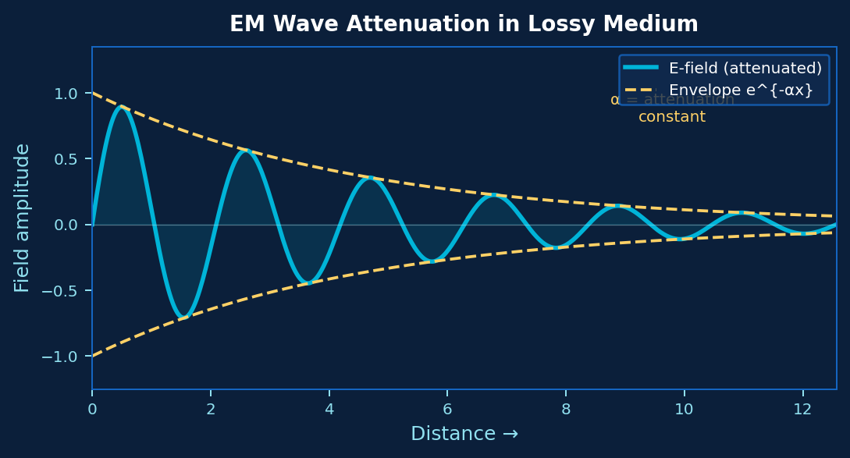
Electromagnetic Waves & Transmission Lines
AI-Based Prediction of
Electromagnetic Wave Attenuation
in Lossy Media
Group 7
Problem-Based Learning | Engineering

Slide 2
Agenda
01
Problem Statement
Why predict EM wave attenuation using AI?
02
Theory Background
Lossy media, attenuation constant α, propagation
03
Proposed Methodology
Dataset generation, AI model design, validation
04
Applications
Prediction accuracy
05
05
Conclusion
05
Key takeaways and project significance

Slide 3
Problem Statement
The Challenge
Our Solution
Analytical formula for α requires complex calculations at each frequency & medium
Train an AI model (ANN) on simulated attenuation data across media
Real-world media (soil, tissue, seawater) have varying σ, ε, μ — hard to generalize
Inputs: frequency, conductivity, permittivity, permeability, distance
Engineers need quick attenuation estimates without re-deriving formulae
Output: predicted attenuation in dB/m — instant, no formula needed
No flexible tool exists that works across multiple lossy media types simultaneously
Validate against analytical results and published datasets

Slide 4
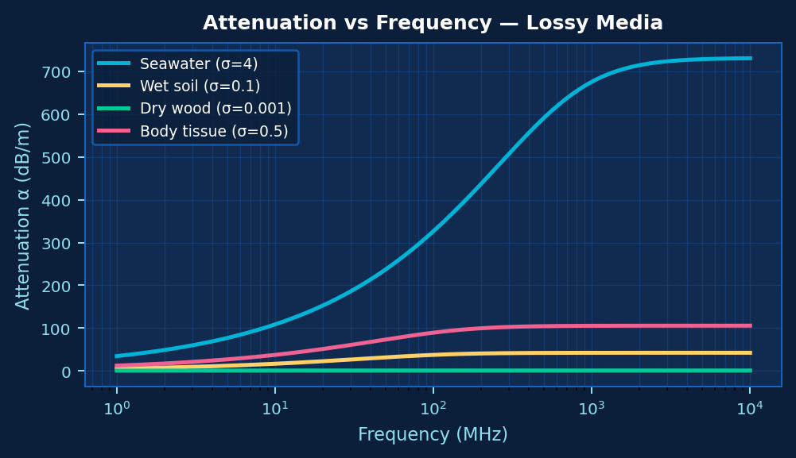
Theory Background
Attenuation Constant:
α = ω√(με/2) · √[ √(1 + (σ/ωε)²) − 1 ] (Np/m)
Decaying E-field in lossy medium
α vs Frequency for different lossy media

Slide 5
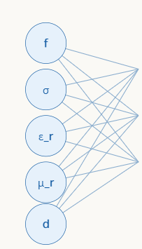
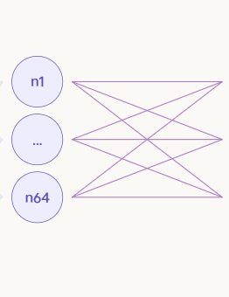
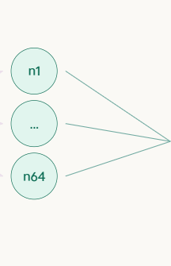

Proposed Methodology
1
Data Generation
Compute α for 10,000+ combinations of σ, ε_r, μ_r, f, distance across media types.
2
Preprocessing
Normalize inputs, 80/20 train-test split, log-scale frequency for stability.
3
ANN Model
Input(5) → Dense(64,ReLU) → Dense(64,ReLU) → Output(1). Adam optimizer, MSE loss.
4
Training
Train on TensorFlow/Keras. Monitor loss curves, tune hyperparameters.
ANN Architecture
5
Validation
Plot predicted vs actual α. Compute RMSE, R² score. Test on unseen media.

Slide 6
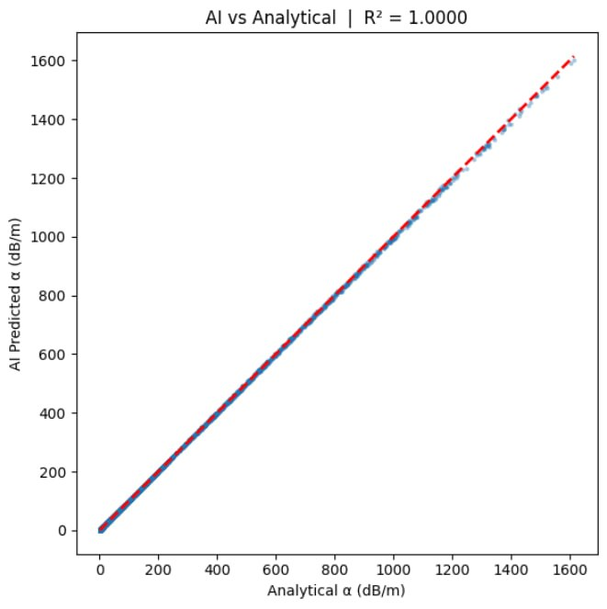
Applications
R² > 0.98
10,000+
5 Media
< 1%
Model accuracy
expected
Training samples
generated
Soil, water, tissue,
concrete, air
Error vs analytical
formula (target)
Radar systems — predicting signal loss through rain/soil
Submarine communication — seawater heavily attenuates EM waves
Medical imaging (MRI/microwave) — waves through human tissue
Underground mining comms — signals through rock/soil
5G network planning — attenuation through building materials

Slide 7
Conclusion
We are not replacing the formula — we are making it intelligent.
Gap
ANN
Use
Real research gap
Principled AI choice
Real-world impact
No existing tool predicts α directly from raw material properties (σ, ε_r, μ_r, f) across arbitrary lossy media — our project fills this exactly.
ANN is chosen over CNN deliberately — tabular physical inputs have no spatial structure. The model learns the nonlinear α relationship through backpropagation.
Applications in underwater comms, 5G through walls, medical imaging, and radar design — any domain requiring fast EM attenuation estimation in lossy media.
What this project demonstrates:
AI can encode physics — trained on Maxwell's equations outputs, the ANN generalizes to new media without ever seeing the formula explicitly.

Slide 8
Thank You
AI-Based Prediction of EM Wave Attenuation in Lossy Media
EMW & Transmission Lines
Problem-Based Learning | Engineering | 2025–26

