Slide 1
Recruitment Bot
HIREWISE

Slide 2
PROBLEM STATEMENT
Recruiting junior-level candidates is a time-consuming task with a high rejection rate. Traditional methods often involve repetitive screening of unqualified applicants, leading to wasted resources.
PRESENT SCENARIO
Recruiters spend significant time screening resumes and conducting initial interviews.
Traditional methods lack personalization and may fail to accurately assess soft skills and cultural fit.
Inconsistent interview styles can lead to bias and an unfair candidate experience.

Slide 3
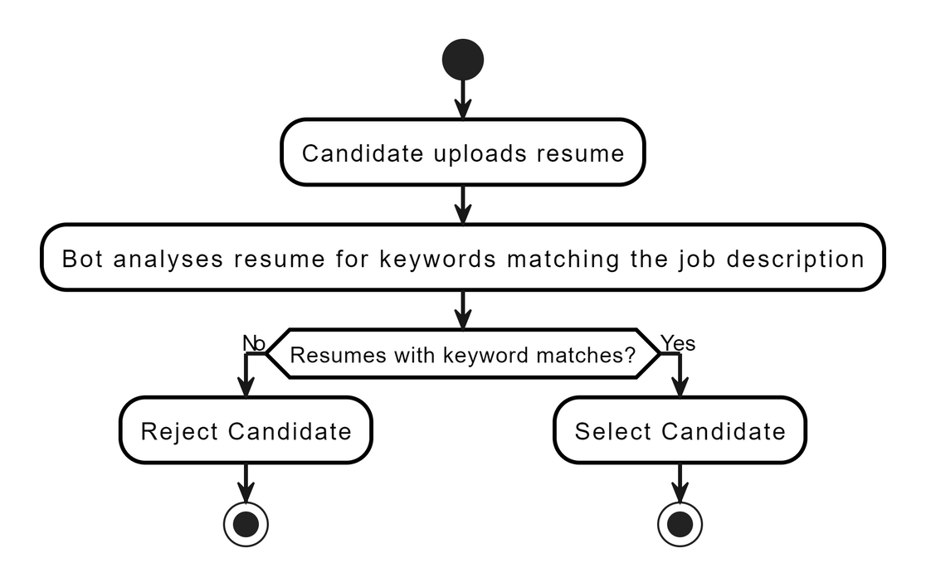
PROPOSED SOLUTION:
This solution presents a hybrid recruitment process with an AI Interview Bot built using GenAI:
Resume Screening
Reviewing job applicants resumes and ranking them based on the percentage of matching keywords and relevant qualifications with the job description.

Slide 4
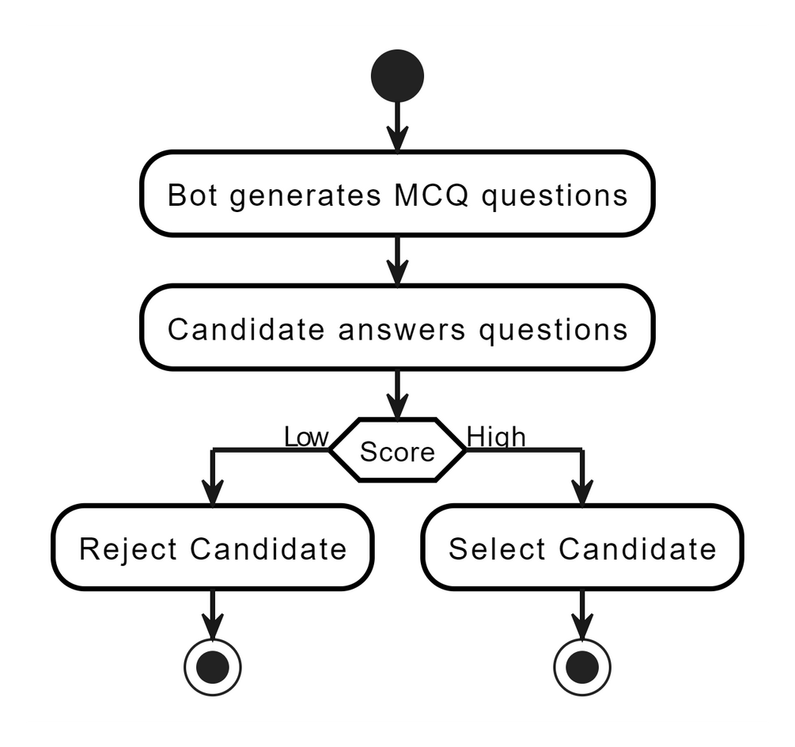
PROPOSED SOLUTION
Pre-Screening Methods
Pre-Screening with MCQs
Automated flashcard generation for candidate assessment during job applications. It involves creating MCQs based on required skills to filter out low-scoring candidates early in the recruitment process.

Slide 5
PROPOSED SOLUTION
Comprehensive Job Applicant Assessment System
Voice Modulation Analysis
This system assesses candidate confidence by analyzing voice modulation, tone, and speech patterns.
It assigns scores (ranging from 0 to 100) based on confidence and clarity.
Variations in tone, pitch, and volume are considered to gauge expressiveness and emotional range.
Text Collection and Speaker Diarization
During video interviews, the system collects text from both questions and answers.
Speaker diarization segments audio or video into individual speaker segments.
It enables tracking of “who spoke when” during the interview.

Slide 6
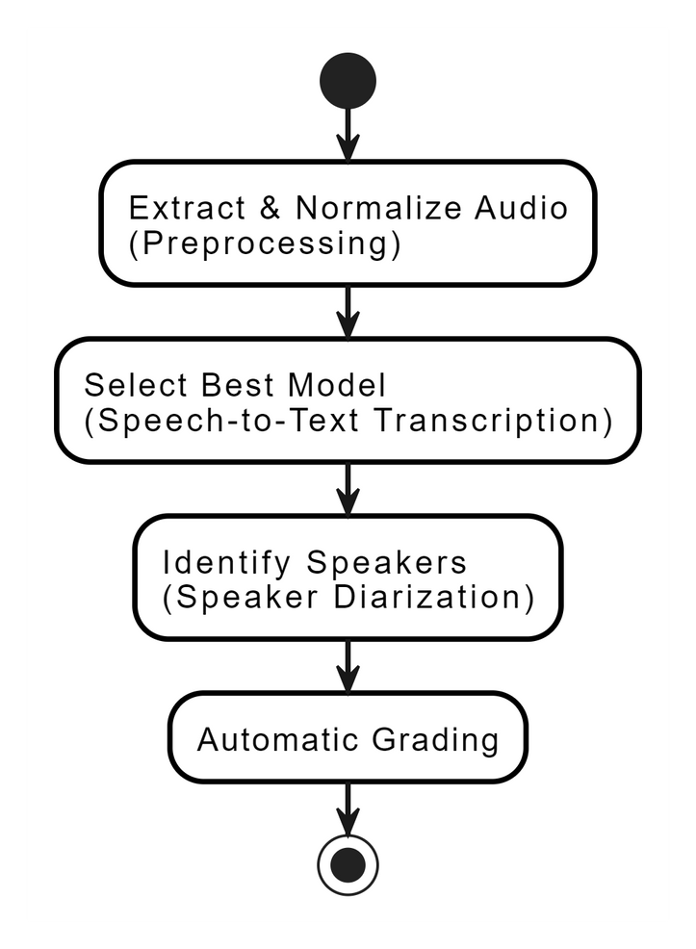
PROPOSED SOLUTION
Comprehensive Job Applicant Assessment System
Grading Using OpenAI Models
OpenAI models (such as GPT-4) evaluate response quality.
Factors considered include fluency, domain knowledge, and logical reasoning.
Scores are assigned based on the quality of each candidate’s answers.

Slide 7
PROPOSED SOLUTION
Comprehensive Job Applicant Assessment System
Facial Analysis for Confidence and Suspicious Activities:
Facial expressions are analyzed to determine confidence levels (e.g., smiles, eye contact).
Suspicious behavior (e.g., nervousness, evasiveness) is flagged.
Non-verbal cues enhance the overall assessment.

Slide 8
CONCLUSION
This hybrid recruitment process using an AI Interview Bot offers a time-saving and efficient solution for screening and assessing junior-level candidates. By leveraging AI technology, recruiters can focus on the final interview stage with better-qualified applicants, leading to a more successful hiring outcome
Refer this:
https://github.com/Nukaraju2003/Recruitment_Bot

