Slide 1
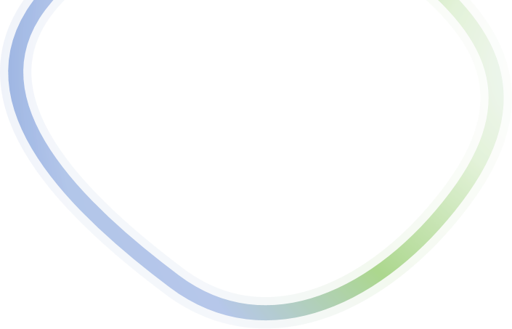

Fed-MS: Fault Tolerant Federated Edge Learning
with Multiple Byzantine Servers
$Senmao Qi^{†}, Hao Ma^{†}, Yifei Zou^{†∗}, Yuan Yuan^{†}, Peng Li^{‡}, and Dongxiao Yu^{†}$
${}_{ }^{†}{School of Computer Science and Technology, Shandong University, China}$
$${}_{ }^{‡}{School of Computer Science and Engineering,University of Aizu, Jinan, Japan}$$
44th IEEE International Conference on Distributed Computing Systems
23 July - 26 July Jersey City, New Jersey, USA
Notes:
Good [morning/afternoon], everyone. My name is xx, and today I am excited to present our work titled "Fed-MS: Fault Tolerant Federated Edge Learning with Multiple Byzantine Servers." This research was conducted in collaboration with [Senmao Qi, Hao Ma, Yifei Zou, Yuan Yuan, Peng Li, and Dongxiao Yu].

Slide 2
Contents
Background and Motivation
Model and Problem Definition
Fault Tolerant Federated Edge Learning with Multiple Byzantine Servers
Theoretical Guarantee
Experimental Results
Conclusion and Future Work
Notes:
In this presentation, I will first introduce the background and motivation of our work.

Slide 3




Background and Motivation
Federated Edge Learning
Local Dataset
...
End Client-K
Local Model
Local Dataset
Global Aggregation
Edge Server
End Client-2
Local Model
Local Dataset
End Client-1
Local Model
Federated edge learning (FEEL) is a promising paradigm
that combines edge computing and distributed machine learning.
Notes:
Federated Edge Learning is an emerging paradigm that combines federated learning and edge computing. It enables large-scale, privacy-preserving machine learning on edge devices, which is crucial for applications in the Industrial Internet of Things. Unlike traditional centralized ML, where data is aggregated and processed in a central server, FEEL allows edge devices to collaboratively train a shared ML model without sharing their raw data. Therefore, federated edge learning can achieve efficient model training with low latency while protecting user data privacy.

Slide 4


Background and Motivation
Byzantine Attack on FEEL
Local Dataset
...
End Client-K
Local Model
Local Dataset
Global Aggregation
Edge Server
End Client-2
Local Model
Local Dataset
End Client-1
Local Model
Byzantine clients significantly degrade learning performance！
Notes:
Although FEEL has advantageous for privacy and efficiency, its distributed nature also introduces significant security challenges. As shown on this slide, malicious participants that can corrupt their local models before sending them for aggregation. For example, they can arbitrarily modify the parameters of the model or apply a certain amount of Gaussian noise. During the aggregation process of the global model, noise can cause a large degree of deviation in the correct parameter results, resulting in a decrease in model prediction accuracy or even failure to converge. This malicious behavior significantly degrads the overall learning performance and poses a severe threat to the integrity of the entire federated learning process.

Slide 5


Background and Motivation
Byzantine-resilient FEEL
Local Dataset
...
End Client-K
Local Model
Local Dataset
Byzantine Defense
Edge Server
End Client-2
Local Model
Local Dataset
End Client-1
Local Model
a trustworthy server
Existing work needs to rely on a trustworthy parameter server.
Notes:
Previous research works rely on a trusted parameter server to find and filter possible malicious models. Specifically, the server will reject possible malicious models before aggregating the global model by comparing their similarity or testing on a specific validation set.

Slide 6
Background and Motivation
Byzantine Attack on Server
Local Dataset
...
End Client-K
Local Model
Local Dataset
Byzantine Defense
Edge Server
End Client-2
Local Model
Local Dataset
End Client-1
Local Model
a byzantine server
A malicious global model will be broadcast if server is untrustworthy!
Notes:
However, the assumption that the server is trustworthy is not always true, especially in edge scenarios. The edge server is likely to be a base station deployed outdoors, which is often an easy target for attackers. Previous work only considered Byzantine behavior from clients. Once the trusted parameter server is lost, all clients will receive malicious aggregation results. This problem becomes more serious in open edge scenarios. Therefore, how to achieve secure model training under Byzantine servers will be the focus of this study.

Slide 7
Contents
Background and Motivation
Model and Problem Definition
Fault Tolerant Federated Edge Learning with Multiple Byzantine Servers
Theoretical Guarantee
Experimental Results
Conclusion and Future Work
Notes:
Next, we introduce our federated edge learning model with multi-parameter servers and our defense goals.

Slide 8
Model and Problem Definition
FEEL with Byzantine Servers
Local Dataset
...
Edge Server-1
Edge Server-2
End Client-K
Local Model
Local Dataset
End Client-2
Local Model
Local Dataset
End Client-1
Local Model
...
Edge Server-P
There are some Byzantine parameter servers among multiple servers.
Notes:
Drawing from the concept of redundant backups, we consider a federated edge learning scenario with multiple parameter servers and assume that some of these servers may be Byzantine. By distributing the aggregation task across multiple servers, we can mitigate the impact of any single Byzantine server, enhancing the robustness and security of the learning process. For an honest parameter server, it will broadcast the correct aggregation results to all clients. However, a malicious parameter server can modify the real aggregation results.

Slide 9

Model and Problem Definition
Byzantine Server
Threat Model
*Unknown Distribution: The distribution of the Byzantine PSs can be arbitrary and unknown for the clients.
*Arbitrary Tampering: A Byzantine PS can add arbitrary noise to aggregated results.
*Adaptive Knowledge: The Byzantine PSs can have a full knowledge on the FEEL system.
Byzantine Server
Limitation: The proportion of Byzantine servers cannot exceed 50%!
Notes:
Now, let's discuss our threat model in detail. Specifically, the distribution of Byzantine servers is arbitrary and unknown, which means we cannot distinguish between honest and malicious parameter servers. Moreover, a Byzantine server can arbitrarily modify the aggregation results, such as adding arbitrarily large noise or providing outdated aggregation results to the clients. Finally, we assume that Byzantine servers have adaptive knowledge, meaning they can obtain dynamic information about the entire network system.

Slide 10
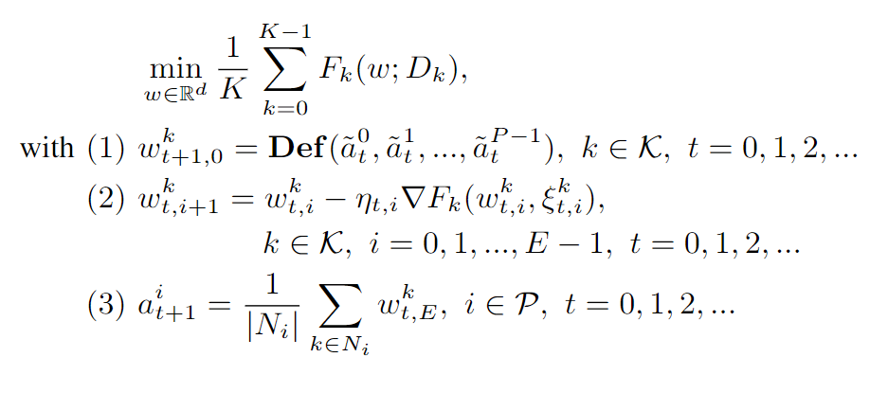
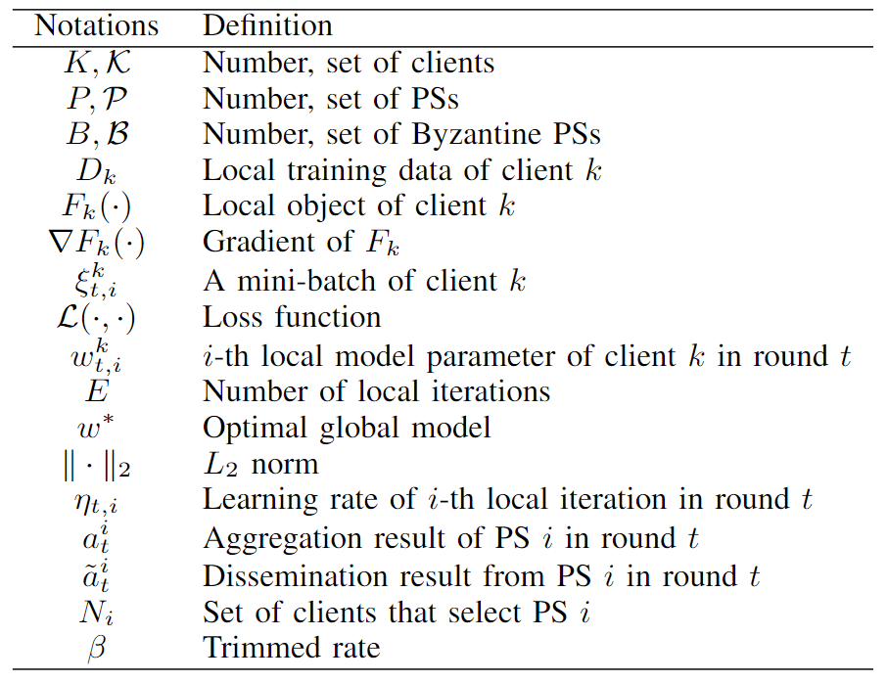
Model and Problem Definition
Problem Definition and Capability of Clients
The clients know the number of Byzantine parameter servers
and have equal computation and communication capabilities.
Notes:
Our optimization goal is to learn a high-quality global model that performs well on the local datasets of all clients, which means minimizing the local loss of all clients. In the presence of Byzantine parameter servers, we need to find an appropriate defense strategy, represented as Def(), to obtain a robust global model, as described in constraint (1). Constraints (2) and (3) respectively reflect the process of local training using SGD and the model aggregation process. To achieve the above goal, we assume all clients to have same device capabilities and know the number of Byzantine parameter servers.

Slide 11
Contents
Background and Motivation
Model and Problem Definition
Fault Tolerant Federated Edge Learning with Multiple Byzantine Servers
Theoretical Guarantee
Experimental Results
Conclusion and Future Work
Notes:
Next, we introduce our Fault Tolerant Federated Edge Learning methods.

Slide 12
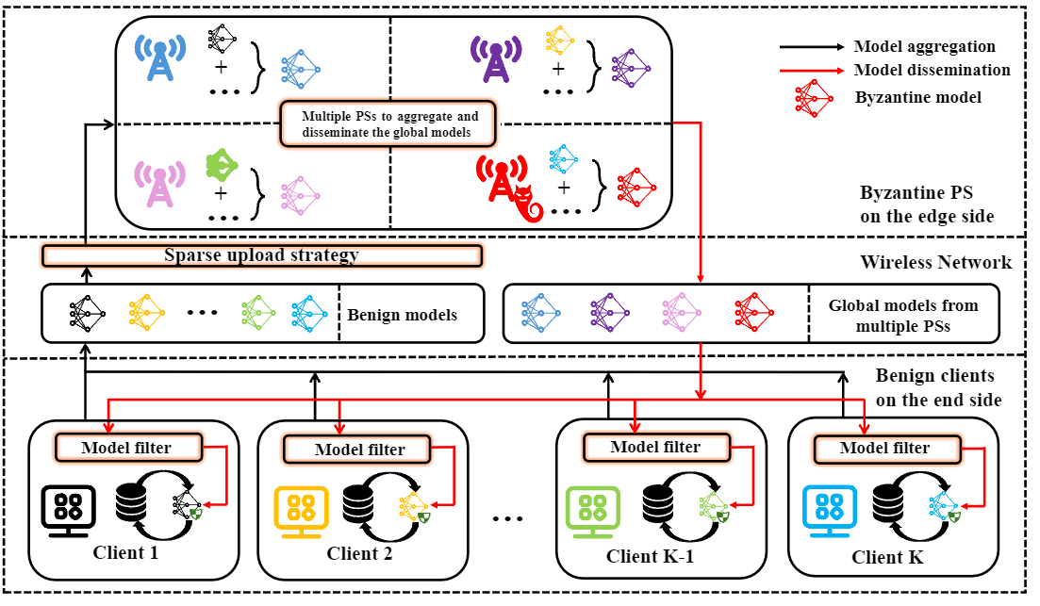
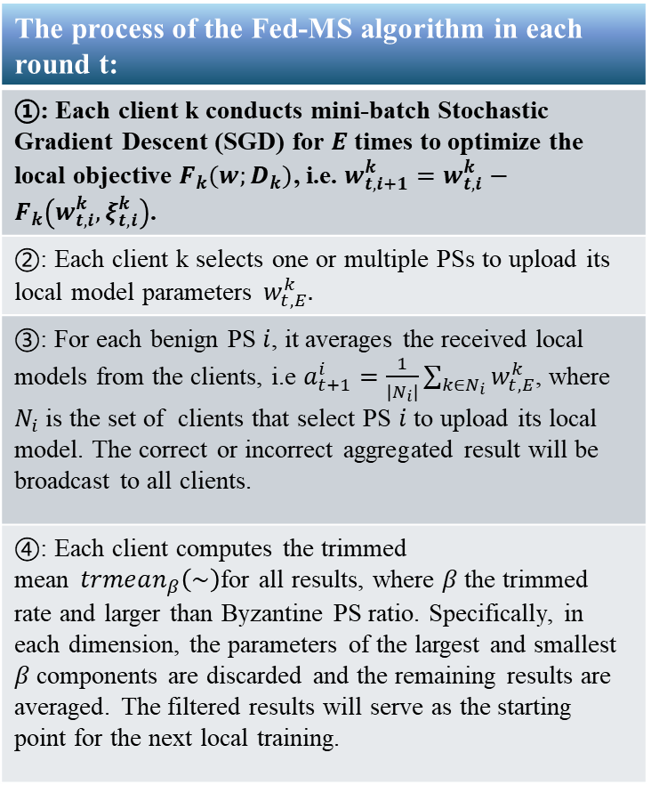
Fault Tolerant Federated Edge Learning with Multiple Byzantine Servers (Fed-MS)
The process of the Fed-MS algorithm in each round t:
①: Each client k conducts mini-batch Stochastic Gradient Descent (SGD) for $E$ times to optimize the local objective $F_{k}(w;D_{k})$, i.e. $w_{t,i+1}^{k}=w_{t,i}^{k}−F_{k}\left(w_{t,i}^{k},ξ_{t,i}^{k}\right)$.
②: Each client k selects one or multiple PSs to upload its local model parameters $w_{t,E}^{k}.$
③: For each benign PS $i$, it averages the received local models from the clients, i.e $a_{t+1}^{i}=\frac{1}{\left|N_{i}\right|}\sum_{k∈N_{i}}{w_{t,E}^{k}}$, where $N_{i}$ is the set of clients that select PS $i$ to upload its local model. The correct or incorrect aggregated result will be broadcast to all clients.
④: Each client computes the trimmed mean$trmean_{β}\left(\sim \right)$for all results, where $β$the trimmed rate and larger than Byzantine PS ratio. Specifically, in each dimension, the parameters of the largest and smallest $β$components are discarded and the remaining results are averaged. The filtered results will serve as the starting point for the next local training.
① Local Update Phase
Notes:
The first stage is the local training phase, as indicated by the purple lines in the figure. During local training, each client randomly selects a mini-batch from its local training data, computes the local loss, and performs a gradient descent step. This process is repeated for E iterations.

Slide 13
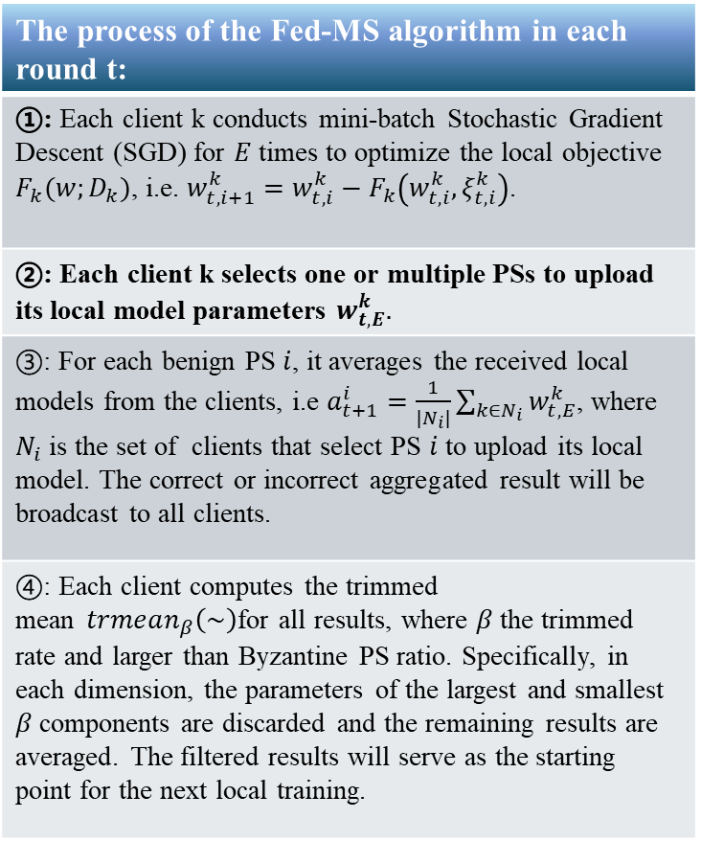
Fault Tolerant Federated Edge Learning with Multiple Byzantine Servers (Fed-MS)
The process of the Fed-MS algorithm in each round t:
①: Each client k conducts mini-batch Stochastic Gradient Descent (SGD) for $E$ times to optimize the local objective $F_{k}(w;D_{k})$, i.e. $w_{t,i+1}^{k}=w_{t,i}^{k}−F_{k}\left(w_{t,i}^{k},ξ_{t,i}^{k}\right)$.
②: Each client k selects one or multiple PSs to upload its local model parameters $w_{t,E}^{k}.$
③: For each benign PS $i$, it averages the received local models from the clients, i.e $a_{t+1}^{i}=\frac{1}{\left|N_{i}\right|}\sum_{k∈N_{i}}{w_{t,E}^{k}}$, where $N_{i}$ is the set of clients that select PS $i$ to upload its local model. The correct or incorrect aggregated result will be broadcast to all clients.
④: Each client computes the trimmed mean$trmean_{β}\left(\sim \right)$for all results, where $β$the trimmed rate and larger than Byzantine PS ratio. Specifically, in each dimension, the parameters of the largest and smallest $β$components are discarded and the remaining results are averaged. The filtered results will serve as the starting point for the next local training.
② Sparse Model Upload
Notes:
The second stage is the sparse uploading phase. If there are some Byzantine parameter servers among multiple servers, the most intuitive approach is to have each client upload its parameter information to all the parameter servers, and the parameter servers reach a consensus to achieve Byzantine fault tolerance. However, for N clients and P servers, this requires a communication complexity of N*P. Therefore, in our Fed-MS, we require each client to randomly select one parameter server to upload its parameter information. Therefore, communication complexity is only proportional to the number of clients N. Hence, we call this method as the sparse uploading strategy.

Slide 14
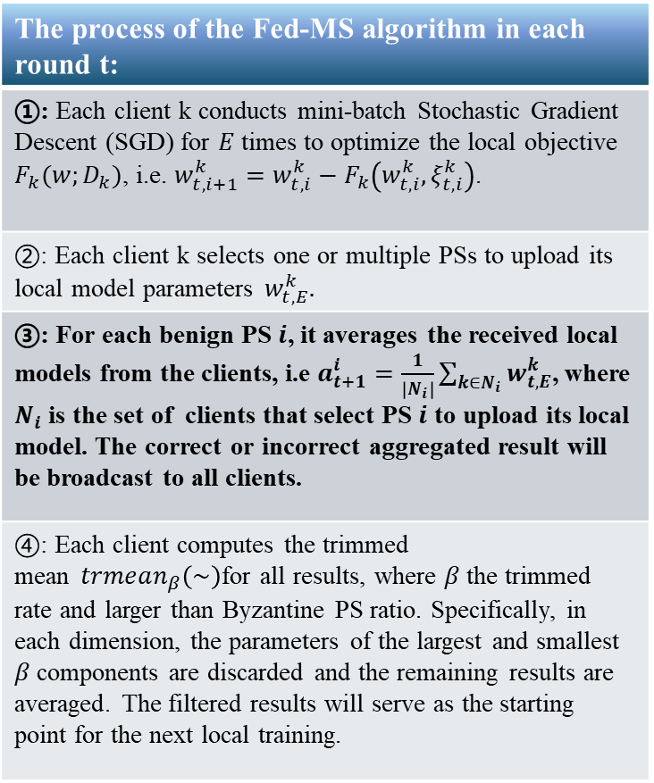
Fault Tolerant Federated Edge Learning with Multiple Byzantine Servers (Fed-MS)
The process of the Fed-MS algorithm in each round t:
①: Each client k conducts mini-batch Stochastic Gradient Descent (SGD) for $E$ times to optimize the local objective $F_{k}(w;D_{k})$, i.e. $w_{t,i+1}^{k}=w_{t,i}^{k}−F_{k}\left(w_{t,i}^{k},ξ_{t,i}^{k}\right)$.
②: Each client k selects one or multiple PSs to upload its local model parameters $w_{t,E}^{k}.$
③: For each benign PS $i$, it averages the received local models from the clients, i.e $a_{t+1}^{i}=\frac{1}{\left|N_{i}\right|}\sum_{k∈N_{i}}{w_{t,E}^{k}}$, where $N_{i}$ is the set of clients that select PS $i$ to upload its local model. The correct or incorrect aggregated result will be broadcast to all clients.
④: Each client computes the trimmed mean$trmean_{β}\left(\sim \right)$for all results, where $β$the trimmed rate and larger than Byzantine PS ratio. Specifically, in each dimension, the parameters of the largest and smallest $β$components are discarded and the remaining results are averaged. The filtered results will serve as the starting point for the next local training.
③ Aggregation and Broadcast
Notes:
The third stage is aggregation and broadcasting. For benign parameter servers, they aggregate the receive model parameters. For Byzantine parameter servers, they may tamper with the true results using the methods we mentioned earlier. Then, all parameter servers need to broadcast the results to all clients. It is worth noting that our downlink is not sparse.

Slide 15
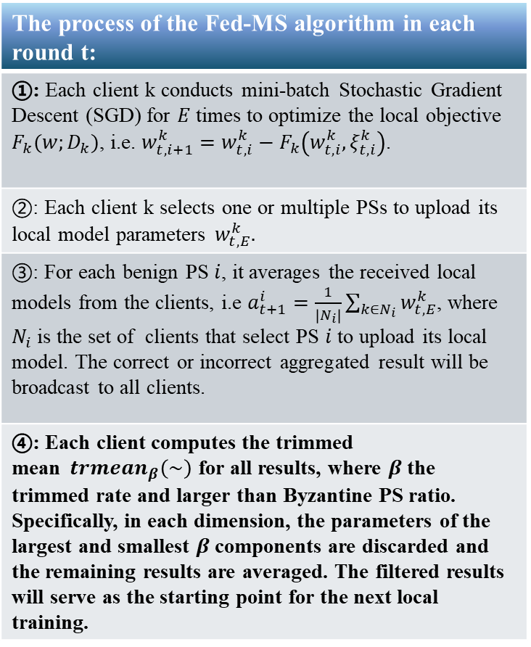
Fault Tolerant Federated Edge Learning with Multiple Byzantine Servers (Fed-MS)
The process of the Fed-MS algorithm in each round t:
①: Each client k conducts mini-batch Stochastic Gradient Descent (SGD) for $E$ times to optimize the local objective $F_{k}(w;D_{k})$, i.e. $w_{t,i+1}^{k}=w_{t,i}^{k}−F_{k}\left(w_{t,i}^{k},ξ_{t,i}^{k}\right)$.
②: Each client k selects one or multiple PSs to upload its local model parameters $w_{t,E}^{k}.$
③: For each benign PS $i$, it averages the received local models from the clients, i.e $a_{t+1}^{i}=\frac{1}{\left|N_{i}\right|}\sum_{k∈N_{i}}{w_{t,E}^{k}}$, where $N_{i}$ is the set of clients that select PS $i$ to upload its local model. The correct or incorrect aggregated result will be broadcast to all clients.
④: Each client computes the trimmed mean$trmean_{β}\left(\sim \right)$ for all results, where $β$the trimmed rate and larger than Byzantine PS ratio. Specifically, in each dimension, the parameters of the largest and smallest $β$components are discarded and the remaining results are averaged. The filtered results will serve as the starting point for the next local training.
④ Local Model Filter
Example: $trmean_{0.2}\{1,2,3,4,5\}$ will remove 20% of the smallest and largest values, i.e. 1 and 5, and then average the remaining results, i.e. $(2+3+4)/3=3$.
Notes:
The final stage is the local model filtering. Each client uses the trimmed mean method to filter the received aggregation results. Specifically, for each dimension of the model parameters, the largest and smallest β proportion of the parameters are removed. β represents the proportion of Byzantine servers and will not exceed 50%. For example, when β is 20%, applying trimmed mean to the set {1, 2, 3, 4, 5} will remove smallest 1 and largest 5, and then average the remaining numbers, resulting in 3.

Slide 16
Contents
Background and Motivation
Model and Problem Definition
Fault Tolerant Federated Edge Learning with Multiple Byzantine Servers
Theoretical Guarantee
Experimental Results
Conclusion and Future Work
Notes:
Next, we briefly introduce the convergence analysis of our algorithm.

Slide 17
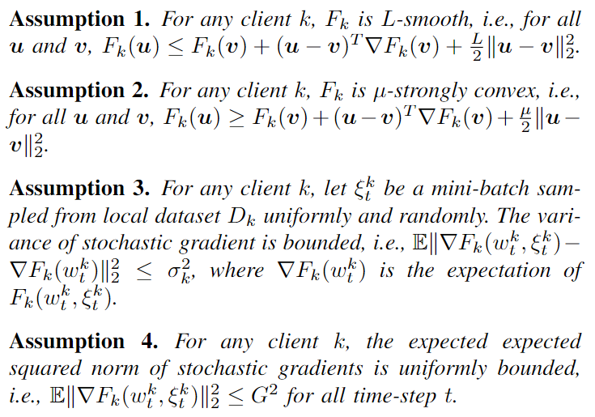
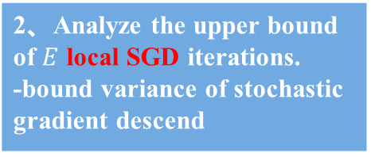
Theoretical Analysis of Fed-MS
Assumptions and Proof Sketch
1、Bound the estimation error in model aggregation and local filter. -bound sparse upload error -bound trimmed mean error
2、Analyze the upper bound of $E$ local SGD iterations. -bound variance of stochastic gradient descend
3、Establish a recursive relationship for model parameters and prove its convergence.
Notes:
We make four basic assumptions: L-smoothness, μ-strong convexity, bounded variance of stochastic gradients, and bounded stochastic gradients. Our analysis begins with the estimation of errors. In our framework, errors come from several sources. The first is the sparse uploading error, where the parameter server only receives aggregated results from a subset of clients, leading to variance compared to the aggregation results from all clients. The second source of error comes from the trimmed mean method used by clients, which introduces variance between the filtered result and the correct aggregated result. In the first phase, we bound these two types of errors. Next, we analyze the parameter changes during local training, focusing on the SGD process. Building on these two steps, we establish the recursive relationship between models across different rounds and analyze the convergence of the algorithm.

Slide 18
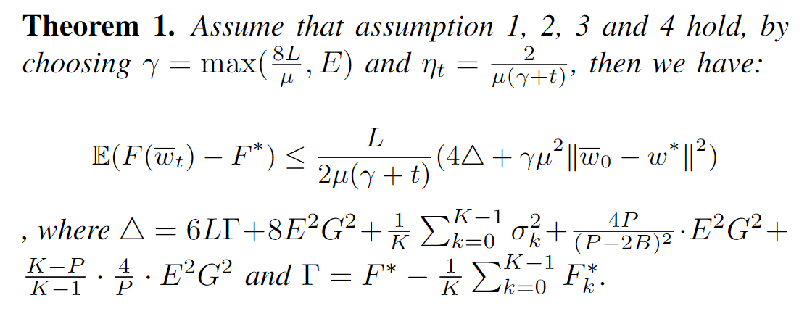
Theoretical Analysis of BR-DeFedRL
Main Theorem
*Initialize Gap
*Non-IID Data *Gradient Bound *Parameter Variance *Trimmed Mean Error *Sparse Upload Error
Notes:
Here we present our main theorem. It demonstrates that our Fed-MS algorithm continuously approaches the global optimum as the number of training rounds increases. This conclusion also reflects the influence of several key factors in the federated learning scenario. We can observe that Fed-MS converges at a rate of O(one over t) in expectation, where t is the number of training rounds.

Slide 19
Contents
Background and Motivation
Model and Problem Definition
Fault Tolerant Federated Edge Learning with Multiple Byzantine Servers
Theoretical Guarantee
Experimental Results
Conclusion and Future Work
Notes:
Next, we demonstrate the main experimental performance of Fed-MS.

Slide 20
Experimental Results
Settings of Experiment
We employ 50 clients, 10 Parameter servers, 20% of them are Byzantine. Dirichlet function is used to set different degrees of data heterogeneous distribution. The model uses MobileNetV2, and the dataset uses CIFAR-10. The Byzantine attacks include:
Noise Attack: Each Byzantine PS adds a random noise to the true aggregation results;
Random Attack: Each Byzantine PS sends a random parameters sampled from the interval [-10, 10];
Safeguard: Each Byzantine PS computes accurate gradients but transmits scaled (*0.6) negative gradients to simulate adversarial attacks and manipulate true results;
Backward: Each Byzantine PS sends the stale aggregation results (aggregation results two rounds ago).
Notes:
We considered a scenario with fifty clients and ten parameter servers, of which 20% were Byzantine parameter servers. We used the Dirichlet | function to partition the data to reflect the impact of data heterogeneity. We select a widely used image classification dataset CIFAR-10 and adopt MobileNet V2 model. We considered four common Byzantine attack methods: Noise Attack, Random Attack, Safeguard, and Backward. In Noise Attack, each Byzantine parameter server adds Gaussian noise to the true aggregation results, causing perturbation in the model updates. In Random Attack, each Byzantine parameter server replaces the genuine aggregation result with a random variable. For the Safeguard attack, each Byzantine parameter server computes accurate gradients but transmits scaled negative gradients to simulate adversarial attacks and manipulate the true results. In the Backward attack, each Byzantine parameter server sends stale aggregation results. These different attack methods help us analyze the robustness and effectiveness of our proposed defense mechanisms in federated learning environments.

Slide 21
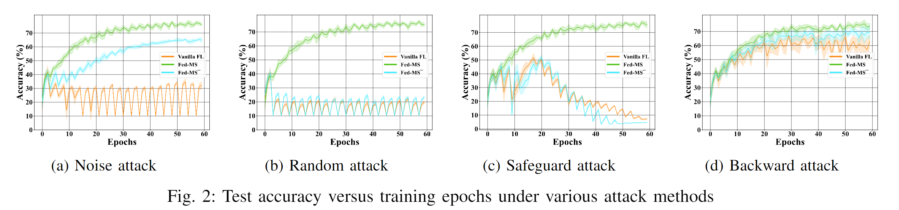
Experimental Results
Main Results
Vanilla FL: The client does not filter the aggregation results.
Fed-MS: The client uses trimmed mean for filtering, and the trimmed ratio is 0.2.
Fed-MS-: The client uses trimmed mean for filtering, but the trimmed ratio is 0.1.
Notes:
In the figure, we show the change in model accuracy with the number of training rounds. Our Fed-MS is robust under all four attack methods, while the vanilla FL method shows poor performance. If we appropriately lower the trimming rate, the performance of Fed-MS also declines, indicating that the trimming rate in Fed-MS needs to be greater than or equal to the proportion of Byzantine servers.

Slide 22
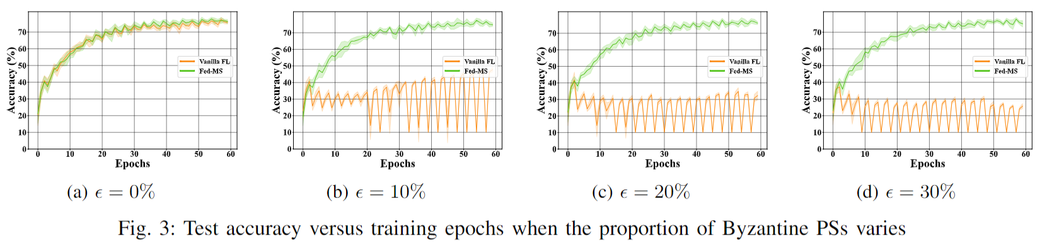
Experimental Results
Impact of the Proportion of Byzantine PSs
$ε$ is the proportion of Byzantine PSs. Fed-MS is robust to different proportions of Byzantine PSs!
Notes:
We examine how varying proportions of Byzantine PSs, affect the model's test accuracy. We use the Noise attack strategy and record the test accuracy on dataset over training epochs. Fed-MS can eventually converge under different proportions of Byzantine PSs. These results demonstrate the resilience of Fed-MS, emphasizing its robustness and ability to maintain high performance even with varying proportions of Byzantine servers.

Slide 23
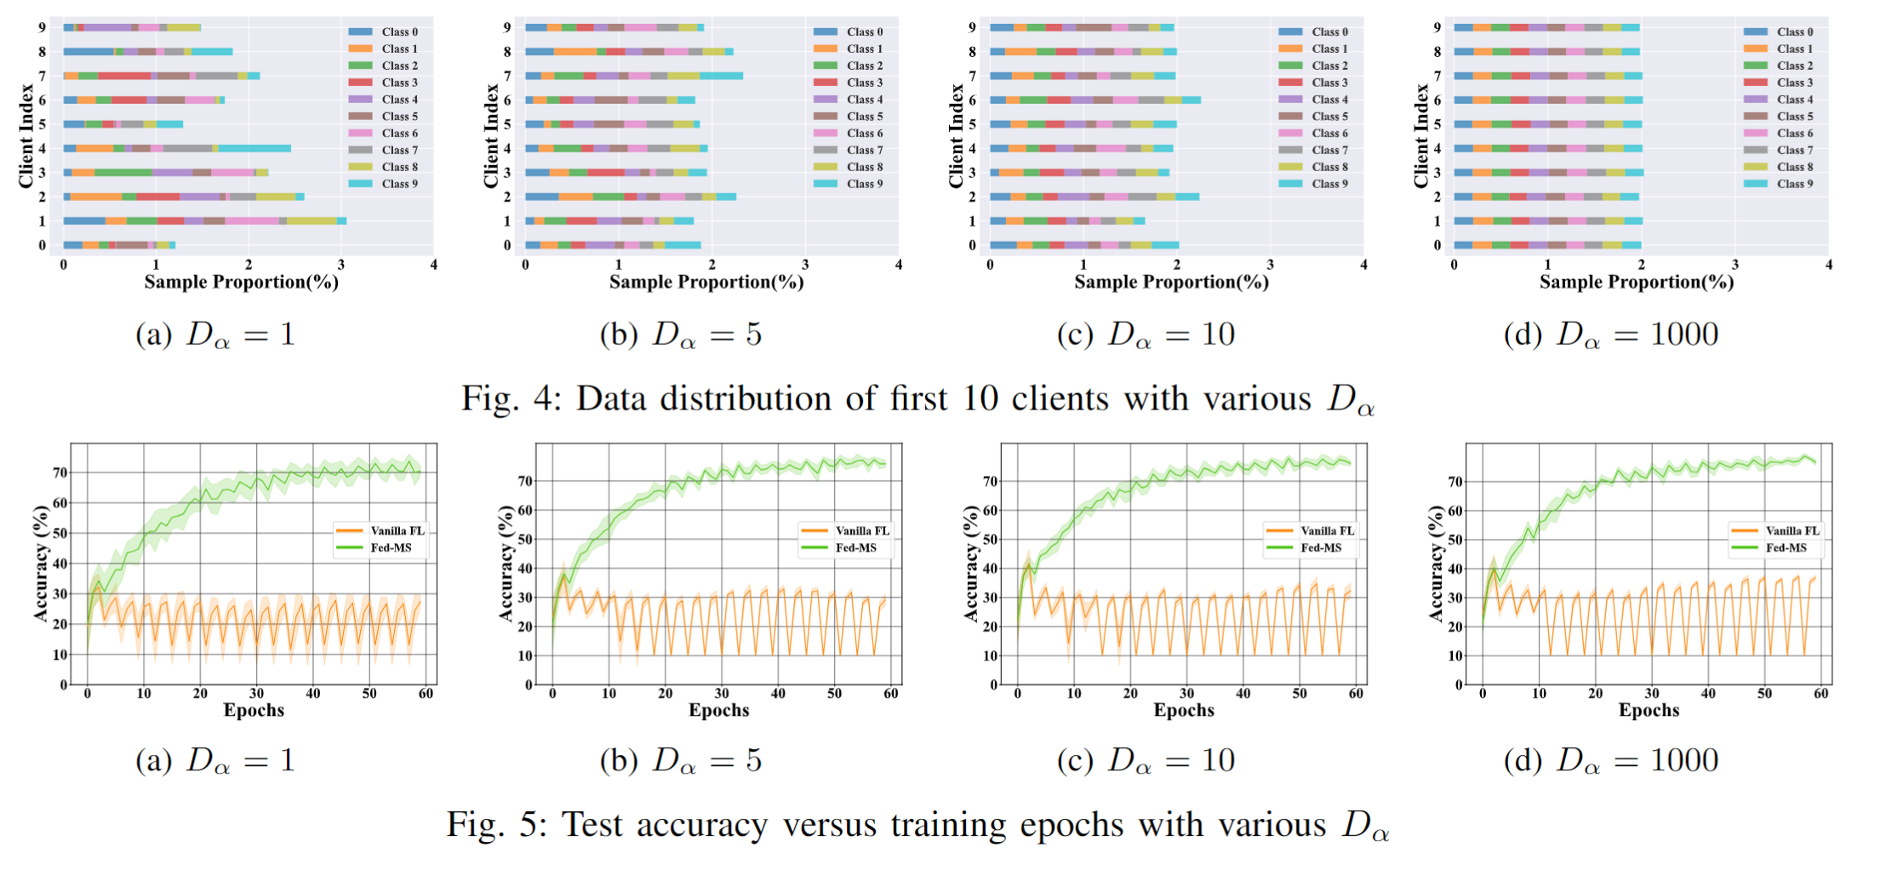
Experimental Results
Impact of Data Heterogeneity
$D_{α}$ is the Dirichlet parameter. The larger $D_{α}$ is, the more similar the data distribution is.
Notes:
We also explore how diverse data distributions impact the performance of Fed-MS. We vary the data distribution with Dirichlet parameters $D_{α}$∈{1,5,10,1000}. When $D_{α}$ is 1000, the data distribution is nearly identical across clients. We observe that as $D_{α}$​ increases, both the convergence speed and the final test accuracy improve. This demonstrates that more similar data distributions will enhance the performance of Fed-MS.

Slide 24
Contents
Background and Motivation
Model and Problem Definition
Fault Tolerant Federated Edge Learning with Multiple Byzantine Servers
Theoretical Guarantee
Experimental Results
Conclusion and Future Work
Notes:
Finally, we conclude this work and introduce future work.

Slide 25
Conclusion and Future Work
Conclusion
Future Work
The Fed-MS algorithm
Enhance parameter server-side robustness | Byzantine defense from client wise
Explore more attack methods；
Combined with privacy preservation technology;
Consider communication resource constraints；
...
Theoretical
analysis
Tackle
Tackle
Multiple PSs and Sparse Upload Strategy
Set up multiple redundant servers and reduce the communication burden of the uplink by sparse upload
Defense Strategy based on Trimmed Mean
Use trimmed mean to filter all received models
Trimmed mean error Sparse upload error Convergence rate
Notes:
In this paper, we address the fault-tolerant problem in federated edge learning with Byzantine parameter servers. Multiple parameter servers, the sparse uploading strategy, and the trimmed mean-based filtering mechanism have been proposed to enhance the robustness of clients against Byzantine attacks. In the future, we will consider more types of attacks, such as backdoor attacks and membership inference attacks. Additionally, we will address privacy concerns during communication and further optimize communication efficiency.

Slide 26
Thank You!
If you have any questions, you can contact us at:
senmao_qi@mail.sdu.edu.cn
yfzou@sdu.edu.cn
44th IEEE International Conference on Distributed Computing Systems
23 July - 26 July Jersey City, New Jersey, USA
Notes:
Thank you for your attention. If you have any questions, you can contact us via the above email address. We will be happy to answer your questions.

