Slide 1



2024 44th IEEE International Conference on Distributed Computing Systems
Dissecting the Applicability of HTTP/3 in Content Delivery Networks
Mengying Zhou, Yang Chen, Shihan Lin, Xin Wang, Bingyang Liu, Aaron Yi Ding
Fudan University, HUAWEI, TU Delft
Notes:
Hi, everyone. I‘m Mengying Zhou from Fudan University. Today, I’m excited to present our research on ‘Dissecting/dīˈsekting/ the Applicability | əplikəˈbilədē | of HTTP/3 in Content Delivery Networks.’ This is a collaborative work with Huawei and TU Delft.
And this work was finished when I was visiting Aaron Ding in TU Delft.

Slide 2





Nowadays HTTPs has fallen behind
Head-of-Line (HoL) Blocking
Connection Establishment Latency
Stream Multiplexing Efficiency
…
People wants ...
Faster response
Stable connection
H1.1 or H2
However...
HTTP/1.x or HTTP/2 hardly satisfy these demands
Notes:
Let's start with the Internet nowadays. As we all know, people want faster response and more stable connections.
However, Unfortunately, previous protocols like HTTP/1.x and HTTP/2 hardly meet these demands. They have the problems like Head-of-Line blocking and high connection latency.

Slide 3

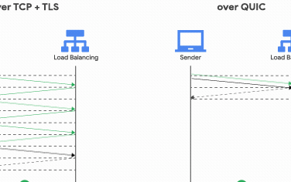
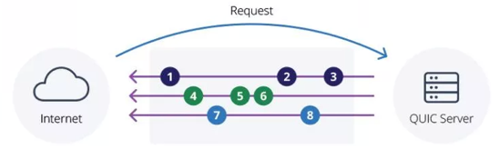

HTTP/3 comes!
HTTP/3 was designed to make HTTP traffic more secure, efficient, and faster.
Wi-Fi
Connection ID A
Mobile
The same ID
Cellular
Connection ID A
Efficient: stream multiplexing
2. Fast: quick connection establishment
3. Flexible: migration without awareness
Notes:
But there's hope. HTTP/3 comes.
H3 is designed to address these problems. It offers efficient stream multiplexing, quick connection establishment, and flexibility with seamless |ˈsēmləs | migration.
H3从2012 Google提出的QUIC开始启程，中间经历了2015年的IETF的specification，最后在2021年先后通过了QUIC的RFC和H3的RFC

Slide 4
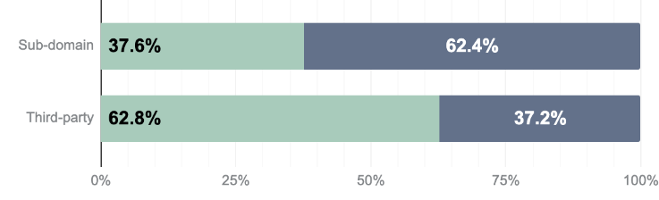
CDN: a main driver for H3
Provider | Release Year | Performance Report | H3 supported (%)
Cloudflare | 2019 [1] | H3 performs 12.4% better in TTFB, but 1-4% worse in PLT than H2. | 44.8%
Google Cloud CDN | 2021 [2] | Reduce reach latency by 2%, video rebuffer times by 9%, and improves mobile device throughput by 7%. | 95.7%
Fastly | 2021 [3] | QUIC can represent an 8% in- crease in throughput. | 8.1%
QUIC.Cloud | 2021 [4] | H3 turns TTFB from 231ms to 24ms. | /
Amazon CloudFront | 2022 [5] | N/A | 7.7%
Meta | 2022 [6] | H3 reduces tail latency by 20% and MTBR by 22%. | /
Akamai | 2023 [7] | 6.5% enhancement in users with TAT under 25ms; 12.7% improvement for requests ex-ceeding 1 Mbps. | /
HTTP/3 usage in CDN resources and
Non-CDN resources (Jan. 2024)
HTTP/3
HTTP/2
CDN
resources
38.5%
61.5%
Non-CDN
resources
20.6%
79.4%
Percentage of Requests
- H3 Adoption in Mainstream CDNs
- Higher usage of H3 in CDN resources
[1] A. Ghedini and R. Lalkaka, “HTTP/3: the past, the present, and the future,” Available: https://blog.cloudflare.com/http3-the-past-present-an d-future, 2019
[2] “HTTP/3 gets your content there QUIC, with Cloud CDN and Load Balancing,” Available: https://cloud.google.com/blog/products/network ing/cloud-cdn-and-load-balancing-support-http3, 2021
[3] “Making loveholidays 18% faster with HTTP/3,” Available: https://tech.loveholidays.com/making-loveholidays-18-faster-with-h ttp-3-1860879528a7, 2021
[4] “QUIC.cloud CDN is Production Ready!” Available: https://www.quic .cloud/quic-cloud-cdn-production-ready, 2021
[5] C. Yun, “HTTP/3 Support for Amazon CloudFront,” Available: https:// aws.amazon.com/blogs/aws/new-http-3-support-for-amazon-cloudfront, 2022
[6] T. Ingale, “Watch Meta’s engineers discuss QUIC and TCP innovations for our network,” Available: https://engineering.fb.com/2022/07/06/ne tworking-traffic/watch-metas-engineers-discuss
-quic-and-tcp-innovati ons-for-our-network, 2022
[7] “HTTP/3 is added by default to a new Ion property,” Available: https://techdocs.akamai.com/ion/changelog/may-15-2023-supportfor-http3, 2023
Notes:
One of the main drivers for H3 is CDN (Content Delivery Networks). This is a very important infrastructure for delivering web content quickly and efficiently.
In the last five years, numerous CDN providers have started supporting H3. This table summarizes the H3 Adoption in Mainstream CDN providers. Among them, Google's CDN services have almost entirely shifted to H3, and Cloudflare follows with a forty-five supported percentage.
At the same time, according to our data, Until January, the proportion of H3 used in CDN resources is almost twice that of non-CDN resources.
// And A number of reports from production environments also show significant improvements with using H3 in CDNs, like reduced latency and increased throughput.

Slide 5


Why is H3 doing so well in CDN?
Previous research:
- Analyze CDN and H3 separately
Ours:
- Study CDN and H3’s synergy
holistically
Notes:
So, why so many CDN companies start to embrace H3? Why is H3 doing so well in CDN?
Unlike previous studies that analyzed CDN and H3 separately, we aim to explore why H3 performs well in the specific environment of CDNs.
This requires considering not only H3's strengths but also the characteristics of the CDN application scenario.
// From the performance reports, we know that using H3 can bring significant improvements, such as connection time optimization. However, such enhancements not only come from H3's standout features but also from certain CDN characteristics. There is a synergistic |ˌsinərˈjistik | effect where these both work together to achieve a "1+1>2" outcome.

Slide 6



Why is H3 doing so well in CDN?
What makes these two compatible?
RQ1: What are the inherent characteristics of CDN services on webpages?
RQ2: What is the synergistic collaboration between H3’s features and these characteristics of CDN services?
“1+1>2” integration
Notes:
so, In this work, we focus on the compatibility |kəmˌpadəˈbilədē| of H3 and CDNs. our target is to study the holistic collaboration between CDNs and H3, followed by the two research questions.
|ˌsinərˈjistik |

Slide 7
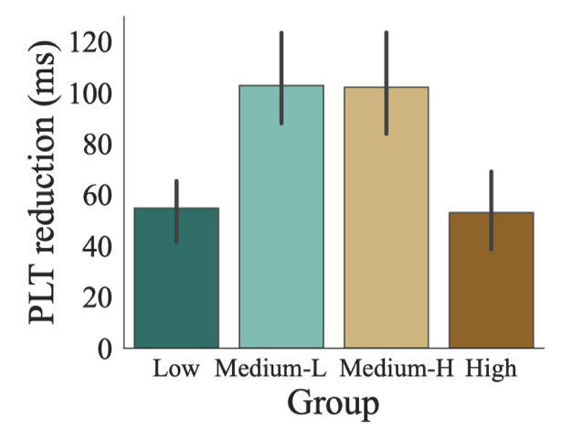
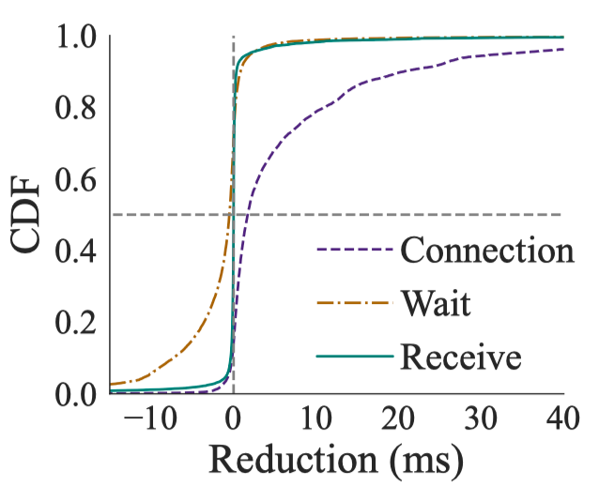
H3 adoption bring improvement
- PLT reduction for websites with different H3 adoption levels
- PLT reduction in three request stages
- connection, waiting, and receiving
Small-scale adoption
Fast connection contributes the most
Metric definition:
$X_{reduction}=X_{H2}−X_{H3}$ $X$ includes PLT, Connection time, Wait time, and Receive time
Notes:
First, let's look at an overview of the performance measurement results, that is, how much improvement can websites achieve under different H3 adoption levels. In this measurement, we use the metric called reduction, defined by comparing the performance of H2 to H3.
The left figure shows that all groups benefit from using H3 in CDNs. And, encouragingly, we find that even small-scale adoption can bring significant improvements.
HTTP requests have three main stages: connection establishment, waiting for processing, and data transfer. We further investigate which stage contributes the most to PLT reduction.
In the right-side figure, we plot the CDF of the time of each stage. We find that connection time has the most obvious improvement, indicating that H3's fast connection contributes the most.

Slide 8
Why significant: dominance of CDN
- 75% of pages’ CDN percentage are over 50% , amplifying H3's fast connection benefits.
Takeaway 1:
- Fast connection in H3 contributes to accelerating page loading
- Dominant proportion of CDN resources amplifies such acceleration
Notes:
Why does such a small optimization on connection lead to a significant improvement? The answer is the quantity. The key point is the dominance of CDN resources on webpages.
Our data shows that seventy-five percentage of pages have over 50% of their resources from CDNs, largely amplifying |ˈampləˌfī | the advantages of H3's fast connections.
So,now, we have the first takeaway on their collaboration.
for H3，xxx
for CDN service

Slide 9





A phenomenon in consecutive web browsing
Start
Page A
Page B
Page C
Cross page shared-provider phenomenon
Notes:
Ok. in the first takeaway, we have discussed the benefits of enabling H3 in CDN within the page. Now, we talk about the influence of enabling H3 CDN between pages.
Let's start with an interesting phenomenon in consecutive |kənˈse Q ədiv| web browsing. When we visit multiple pages, there is a high possibility that they share the same CDN provider, like the Cloudflare shown in this slide.

Slide 10
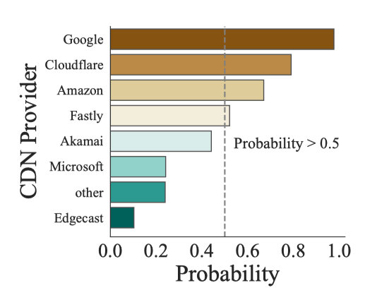
Shared-provider phenomenon
Giant CDN providers appear on almost every page
Notes:
This shared-provider phenomenon is quite prevalent, since giant CDN providers appear on almost every page. The top four CDN providers' possibilities have over 50%.

Slide 11
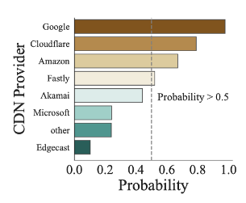
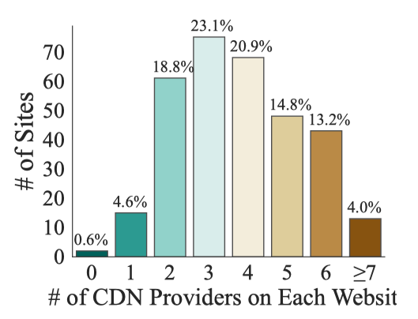





Shared-provider phenomenon
94.8%
Giant CDN providers appear on almost every webpage
Result in
# of CDN Providers on Each Website
Giant providers are shared across different webpages
Client
Can H3 connections be resumed* across pages by the same CDN provider?
Establish connection and store PSK
Resume Connection
Resume Connection
* H3 connection can be resumed cross pages owing to pre-shared keys (PSK).
Page A
Page B
Page C
Notes:
And, this, results in giant providers being shared across different webpages.
This figure also shows that the majority of pages (about ninety-five percentage) use at least two CDN providers, indicating the existing of the shared-provider phenomenon.
This phenomenon opens the opportunity for inter-page influence: Can H3 connections be resumed across pages by the same CDN provider, with using the pre-shared keys?

Slide 12
Shared-provider phenomenon reduces PLT with resumed connections*
- PLT reduction for websites with different numbers of used providers
- Number of resumed connections for different numbers of providers
- More shared-providers, more PLT reduction.
- More shared-providers, more resumed connections.
* Under consecutive visits scenario
Notes:
So, we conduct an experiment under consecutive visits scenario.
We find that the pages with more shared providers enjoy more PLT reduction. And, the core reason is exactly what we guess: the existing of resumed connections. Shared-provider can trigger the resumed H3 connections across pages, which reduces page loading time.

Slide 13
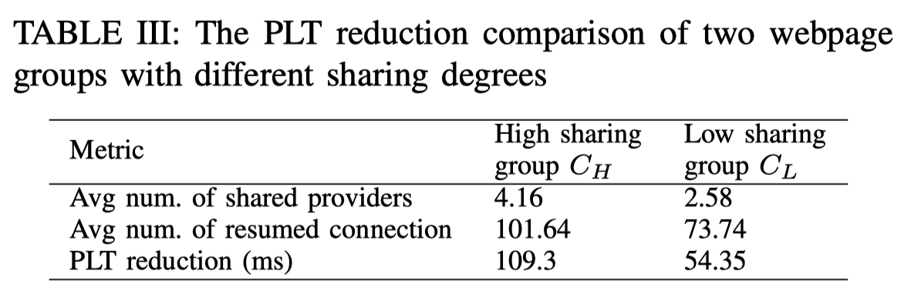
Case study: Two shared-level groups
- The higher the degree of sharing among these browsed pages, the more significant the optimization becomes.
Takeaway 2:
- There is a phenomenon of giant CDN providers being shared across different pages.
- This phenomenon accelerates page loading by triggering connection resumption of H3.
Notes:
We also conduct a case study to illustrate this influence. We divide websites into two groups based on their levels of shared providers, and compare their PLT performance. The result is clear: the higher group enjoys more optimization. This emphasizes the importance of shared-provider connections.
Here, we have the second takeaway on their collaboration.
for CDN service
for H3

Slide 14

Full transition of CDN services to H3?
Turning Point
Down
Up
Our lesson:
- Watch out optimization turning points
Notes:
So, after seeing so many benefits of using H3, should we fully transition CDN services to H3?
the answer is not exactly
The up-and-down trend shows us a clear lesson:
although H3 adoption provides great benefits, we need to watch out the optimization turning points to ensure we can always achieve the best performance.

Slide 15
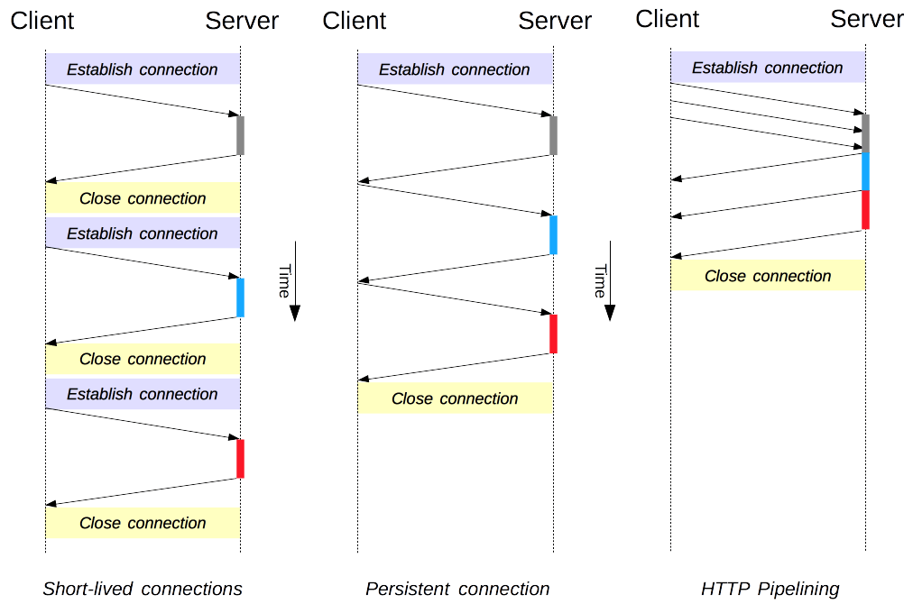
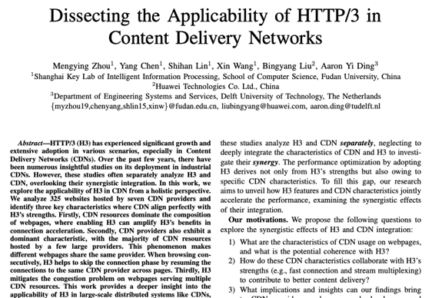
Reused HTTP connections diminish H3 benefits
Let us recall: connection time is the primary factor contributing to PLT reduction
≈ Similar to H3’s fast connection
Room
for
optimizing
Page complexity
Notes:
So, what causes this turning point? The core reason is that H2 has also made some optimizations in connection time, like HTTP reuse or called HTTP keep-alive.
and such HTTP connection reuse has a similar function as H3’s fast connection, which can also reduce the connection time. So, for pages with many reused HTTP connections, there is limited room for optimizing connection time by using H3.
I want to highlight that connection reuse and H3 resumption are two different mechanisms. Connection reuse only happens within the page, while H3 resumption can be triggered across different pages, making it keep longer.
For more details, please refer to our paper.
We only consider the difference in connection. Because both h3 and h2 have multiplexing, and we only focus on the connection time

Slide 16


Conclusions
H3 in CDN: great applicability and compatibility
Dominant proportion of CDN resources amplifies benefit of H3’s fast connection
Shared-provider phenomenon accelerates page loading by triggering connection resumption of H3.
Watch out the optimization turning points, rather than adopting H3 blindly.
CDN
HTTP/3
Thanks for your attention!
Homepage: https://mengyingzhou.github.io
Notes:
So, to conclude, our research shows that There is great applicability and compatibility between H3 and CDN.
with three key points:
And if are interested in this work, you can download the paper from my homepage.
That’s end of my talk. I will be happy to take questions.
Thank you.

Slide 17

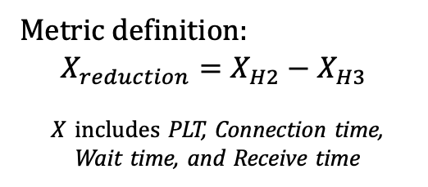
Measurement setup
Metric definition:
$$X_{reduction}=X_{H2}−X_{H3}$$
$X$ includes PLT, Connection time,
Wait time, and Receive time
（Alexa Top 500）
Notes:
here's a brief look at our measurement setup. We used probes in Utah, Wisconsin, and Clemson to compare HTTP/3 and HTTP/2 performance across top Alexa websites. We measured various metrics, including page load time, connection time, wait time, and receive time.

Slide 18

HoL problem with multiple CDN resources
The number of CDN entries per webpage for Amazon, Cloudflare, Google, and Fastly
TCP-based CDN providers are prone to HoL problem
Notes:
Finally, let's discuss the risk of head-of-line (HoL) blocking with CDN. Multiple files from the same service will easily cause HoL blocking, which is exactly a typical CDN scenario. especially, TCP-based CDN providers are more prone to the HoL problem.

Slide 19
Stream multiplexing eliminates HoL problem
Takeaway 3:
- Multiple CDN resources increase the risk of congestion.
- H3’s stream multiplexing mitigates this problem.
Notes:
Fortunately, HTTP/3's stream multiplexing can mitigate this issue. By allowing multiple streams to flow independently, it reduces congestion and improves overall performance."

