Slide 1


SocialCache: A Pervasive Social-Aware Caching Strategy for Self-Operated Content Delivery Networks of Online Social Networks
2023 International Conference on Communication (ICC)
Tiancheng Guo, Yuke Ma, Mengying Zhou, Xin Wang, Jun Wu, Yang Chen
School of Computer Science
Fudan University
Notes:
Hi, everyone. I am Mengying Zhou, from Fudan University.
Today, I am going to present our work, SocialCache: A Pervasive |pərˈvāsiv| Social-Aware Caching Strategy for Self-Operated Content Delivery Networks of Online Social Networks
This is a joint work with Tiancheng, Yuke, Xin, Jun, and Yang from Fudan University.

Slide 2




Content Delivery Network
CDNs cache content from the origin server on geographically
distributed CDN cache servers to reach users faster.
User
CDN server
Origin server
Notes:
CDN, short for Content Delivery Network, is a distributed network of servers located across various geographic locations.
CDN is a very important modern web infrastructure. Its primary function is to deliver web content, such as images, videos, and web pages, to the end-users faster.

Slide 3




Caching Strategy with Traffic Volume
Distributed CDN cache servers are easily to be fully occupied
A
B
C
Replace which content
D
New content
Metric: traffic volume for synchronization, cache hit ratio, validity period…
Full cache
Large amount of OSN data
Notes:
However, due to the limited storage, the CDN cache is easily fully occupied.
So If there is new content that needs to be cached, we need an effective caching strategy.
The current metrics for optimizing caching strategy include traffic volume, cache hit ratio, and validity period.
However, For online social media platforms, the large amount of Online Social Network data leads to a significant traffic volume for synchronization among the servers, which is a more important metric in social network scenario.

Slide 4
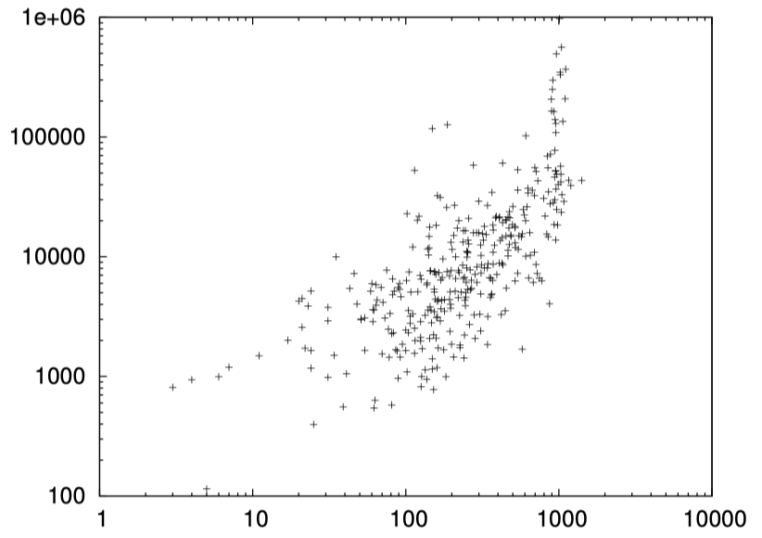
Motivation: Cache Hit and Social Influence
On YouTube, the more followers a user has,
the more views their uploaded video content receives [1]
# of video views
User’s in-degree
Motivating: Preferentially caching content from users with high social influence can increase the cache hit ratio and reduce traffic for synchronization.
[1] C. Canali, M. Colajanni, and R. Lancellotti. “Characteristics and evolution of content popularity and user relations in social networks.” In Proc. of ISCC, 2010.
Notes:
We get the motivation from Canali's work in 2010, which inspires us to propose a caching strategy to reduce the traffic volume.
They found that there is a positive correlation between the popularity of content on YouTube and the indegree of its users, which means that the more followers a user has, the higher the views of their uploaded videos.
So, preferentially caching content from users with high social influence can increase the cache hit ratio, and reduce traffic for synchronization.

Slide 5

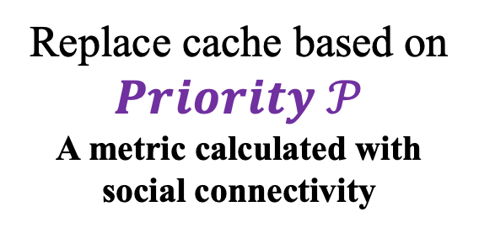
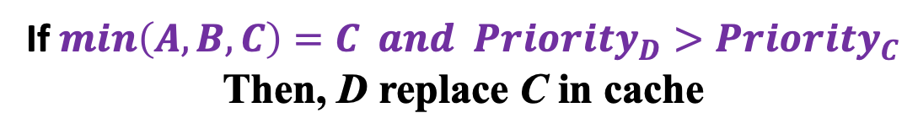
SocialCache: Social-Aware Caching Strategy
Replace cache based on $Priority 𝒫$
A metric calculated with social connectivity
A
B
C
D
New content
Full cache
If $min\left(A,B,C\right)=C and {Priority}_{D}>{Priority}_{C}$
Then, D replace C in cache
Notes:
ok， now, I will present SocialCache, a Social-Aware Caching Strategy, which considers the social influence into the caching strategy.
the principle of SocialCache is straightforward. Replace cache based on 𝑷𝒓𝒊𝒐𝒓𝒊𝒕𝒚 𝒫, A metric calculated with social connectivity. If the minimum among (A,B,C) is 𝑪 𝒂𝒏𝒅 the 𝑷𝒓𝒊𝒐𝒓𝒊𝒕𝒚 of D is higher than the 𝑷𝒓𝒊𝒐𝒓𝒊𝒕𝒚 of 𝑪 Then, D will replace C in the cache list

Slide 6
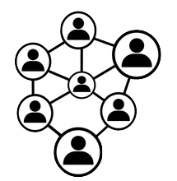





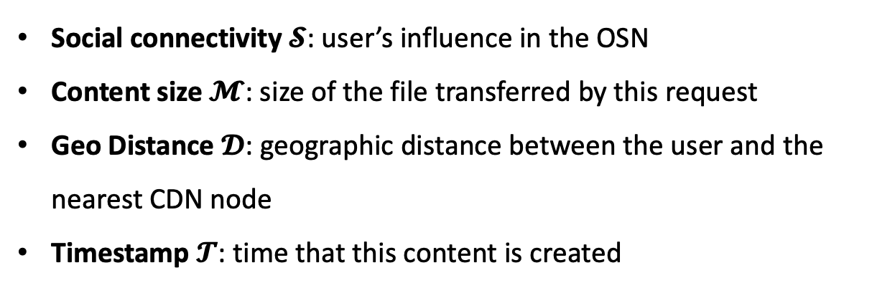



Calculation of Priority $𝒫$
Calculation of Priority $𝒫$
$$f($$
$$)$$
+
+
+
=
Social Connectivity
Content
Size
Geo
Distance
Timestamp
=
Social connectivity $𝓢$: user’s influence in the OSN
Content size $𝓜$: size of the file transferred by this request
Geo Distance $𝓓$: geographic distance between the user and the nearest CDN node
Timestamp $𝓣$: time that this content is created
*We use heuristic algorithm called hill-climbing [1] to fine-tune these weight parameters.
[1] J. Hill and K. Fu, “A learning control system using stochastic approximation for hill-climbing,” in Proc. of JACC, 1965.
Notes:
This slide displays the detailed formula for calculating the 𝑷𝒓𝒊𝒐𝒓𝒊𝒕𝒚 D.
It covers four parts:
Social connectivity 𝓢: user’s influence in the OSN
Content size 𝓜: the size of the file transferred by this request
Geo Distance 𝓓: geographic distance between the user and the nearest CDN node
Timestamp 𝓣: time that this content is created
each part has a corresponding weight parameter and we use a heuristic |hjʊərɪstɪk| algorithm called hill-climbing [1] to fine-tune these weight parameters.

Slide 7


Two Caching Situations
CDN server
A
B
C
A
B
C
Replace
D
C
Update
$$𝓟_{D}>𝓟_{C}$$
$$𝓟_{C}>𝓟_{B}$$
Cache Miss
Cache Hit
POST
(e.g. Tweet)
/
VIEW
(e.g. Browse Twitter)
Notes:
We have two cache situations. One is cache miss. At this point, new content will be inserted into the full cache list. We first calculate the priority of the new content D. If there is content with a lower priority than D, we delete the lowest priority in the list, such as C, and then sort the new cache list.
Cache hits are much easier. We only need to re-calculate the priority of each content in the queue and sort them.
Generally, the post behaviour in social networks belongs to the cache miss situation, while the view behaviour belongs to the cache hit situation.

Slide 8

Evaluation with Real-world Datasets
SocialCache is evaluated on
real-world OSN and CDN requests!
Real OSN
Twitter[1]: 11,088 nodes and 2,420,766 directed edges
Brightkite[2]: 5,773 nodes and 44,302 edges
Real CDN requests
CDN requests from Twitter users[3]: 26,952,281 media files
[1] J. J. McAuley and J. Leskovec, “Learning to discover social circles in ego networks,” in Proc. of NIPS, 2012.
[2] E. Cho, S. A. Myers, and J. Leskovec, “Friendship and Mobility: User Movement in Location-Based Social Networks,” in Proc. of KDD, 2011.
[3] Q. Gong, J. Zhang, X. Wang et al., “Identifying Structural Hole Spanners in Online Social Networks Using Machine Learning,” in Proc. of SIGCOMM, Posters and Demos, 2019.
Notes:
ok, now, I would like to introduce the Real-world Datasets used to evaluate SocialCache.
However, It is difficult to access a realistic dataset that includes a social network graph and the corresponding information on each CDN request at the same time. So, As a result, many researchers have to use synthetic |sɪnθetɪk| datasets based on randomness or other mathematical distributions, which is lack of authenticity |ˌɔθənˈtɪsəti |.
So, to better evaluate SocialCache, we use three real-world datasets:
two Real online social network datasets, come from Twitter and Brightkite. one Real CDN requests dataset, which contains the real CDN requests from Twitter users。

Slide 9
Production and SOTA Baselines
Method | Usage | Temporal info | Social info | Social-aware metric
RAND |  | × | × | /
FIFO | Production | × | × | /
LRU |  | √ | × | /
LRU-Social | State of the Art (SOTA) | √ | √ | Susceptible-Infected-Recovered (SIR) spreading model
SocialCache (ours) | / | √ | √ | Social connectivity, e.g., effective size, PageRank, Laplacian centrality
Notes:
This is the baseline we will compare with the SocialCache. Three baselines are used in the production environment, and one is the most relevant State of the Art baseline, which also considers Social-aware metrics.

Slide 10
Reduced Network Traffic within CDN
Method | Twitter | Brightkite
RAND | 135.22 GB | 306.93 GB
FIFO | 124.96 GB | 175.15 GB
LRU | 124.22 GB | 172.41 GB
LRU-Social | 124.08 GB | 236.55 GB
SocialCache | 116.14 GB (↓ 14.11%) | 167.28 GB (↓ 45.50%)
SocialCache can save significant network traffic cost within CDN
*operational costs is $0.085/GB[1]
[1] Z. Zheng, Y. Ma, Y. Liu et al., “XLINK: QoE-Driven Multi-Path QUIC Transport in Large-scale Video Services,” in Proc. of SIGCOMM, 2021.
Notes:
Here, we list the evaluation result of the Reduced Network Traffic within CDN.
We can find that, compared with the baselines, SocialCache can achieve up to 14% traffic reduction on the Twitter dataset, and even up to 45% traffic reduction on Brightkite. These results all show that SocialCache can save significant network traffic cost by considering social influence and content size.

Slide 11
Different Social Connectivity
Social Connectivity Metric | Network Traffic Volume (GB)
In-degree | 116.79
PageRank | 117.24
Laplacian centrality | 117.61
Betweenness centrality | 117.52
Effective size | 116.14
Standard deviation is 0.54
Means that different social connectivity has similar performance.
Notes:
Further, we also compare the impact of different social connectivity metrics on SocialCache. We use five metrics, and their results are similar as expected. So,In the following experiments, we adopt the Effective size metric with the best performance.

Slide 12
More Considerable Social-Aware
Method | Twitter |  |  | Brightkite
 | Network traffic (GB) | Operation Time (s) | Cache Hit Ratio (%) | Network traffic (GB) | Operation Time (s) | Cache Hit Ratio (%)
LRU-Social (SIR model) | 124.08 | 874.65 | 9.07 | 236.55 | 32463.93 | 48.99
SocialCache (Effective Size) | 116.14 | 48.38 (LRU: 38.71) | 10.36 | 167.28 | 69.53 (LRU:73.02) | 71.81
Network traffic and Cache hit ratio: SocialCache considers geographic location and content size as well, and ignores redundant connections.
Operation time: LRU-social is time-consuming with enumeration of SIR model. SocialCache performs faster and is as efficient as LRU.
Notes:
Ok, last, considering LRU-Social is the most relevant state-of-the-art work to SocialCache. So, we further compare LRU-Social and SocialCache in various aspects, including Network traffic, Operation Time, and Cache hit ratio.
In terms of Network traffic and Cache hit ratio, SocialCache outperforms better. This is because SocialCache not only considers social metrics, but also geographic location and content size.
And Regarding the Operation time, we find that LRU-Social exhibits a poor performance. LRU-Social is time-consuming because it need to operatie enumeration with SIR model. However, SocialCache can significantly reduce operation time with deleting the redundant connections. And further, SocialCache is as efficient as LRU, which is a low-time-complexity|kəmpleksɪti | algorithm.
LRU-social 计算成本比较高，effective size忽略了冗余链接（连向同一个社群的边），影响得更广泛的人群，social-aware效果更好，所以SocialCache效果更好，还有就是我们考虑了地理位置和媒体文件大小，主要评价指标是流量传输。而lru-social没有考虑这两块内容，而且主要评价指标是缓存命中率

Slide 13



SocialCache: A Pervasive Social-Aware Caching Strategy for Self-Operated Content Delivery Networks of Online Social Networks
$$f($$
$$)$$
Priority $𝒫$ of
CDN cache
+
+
+
=
Social Connectivity
Content
Size
Geo
Distance
Timestamp
A caching strategy with considering social connectivity information
Evaluating SocialCache on real-world OSN and CDN requests datasets
Achieving reduced network traffic and operation time
Thanks for your listening!
Notes:
So, to conclude, We propose SocialCache, a caching strategy to optimize self-operated CDNs with social connectivity information.
And SocialCache outperforms production and SOTA baselines on real-world OSN and CDN requests datasets, achieving reduced network traffic and operation time.
That’s end of my talk. I will be happy to take questions.

Slide 14
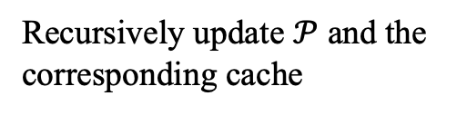


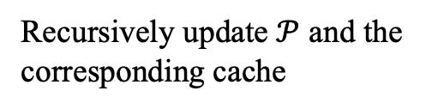
Backup Slide – POST and VIEW
L3 CDN Layer
Recursively update $𝒫$ and the corresponding cache
L2 CDN Layer
Recursively update $𝒫$ and the corresponding cache
L1 CDN Layer
A
B
C
A
B
C
Replace
D
C
Update
$$𝓟_{D}>𝓟_{C}$$
$$𝓟_{C}>𝓟_{B}$$
POST
(e.g. Tweet)
will recur to L3
Cache Miss
Cache Hit
VIEW
(e.g. Browse Twitter)
only happens within the L1
Notes:
post和view行为不一样， post会逐层上传到data center， view请求到了就返回，不再迭代，所以SocialCache会根据post和view，做不同的处理

Slide 15


Backup Slide: Combine OSN and CDN Requests
Real OSN
Twitter[1]: 11,088 nodes and 2,420,766 directed edges, 342,542 requests
Brightkite[2]: 5,773 nodes and 44,302 edges, 749,558 requests.
Real CDN requests
CDN requests from Twitter users[3]: 26,952,281 media files
For each evaluated dataset
# of requests/user: Zipf distribution(α = 1.765, β = 4.888)
Time interval between the requests: LogNormal distribution (µ = 1.789, σ = 2.366)
[1] J. J. McAuley and J. Leskovec, “Learning to discover social circles in ego networks,” in Proc. of NIPS, 2012.
[2] E. Cho, S. A. Myers, and J. Leskovec, “Friendship and Mobility: User Movement in Location-Based Social Networks,” in Proc. of KDD, 2011.
[3] Q. Gong, J. Zhang, X. Wang et al., “Identifying Structural Hole Spanners in Online Social Networks Using Machine Learning,” in Proc. of SIGCOMM, Posters and Demos, 2019.

