Slide 1
Philosophical Foundations of Cognitive Science
Connectionism
8th November 2004
PFCS

Slide 2
Overview
What are Neural Nets (/Connectionist Networks/Parallel Distributed Processing Systems)?
What have they got to do with neurons?
What can they do?
How do they do it?
What can they tell us about human cognition?
8th November 2004
PFCS

Slide 3
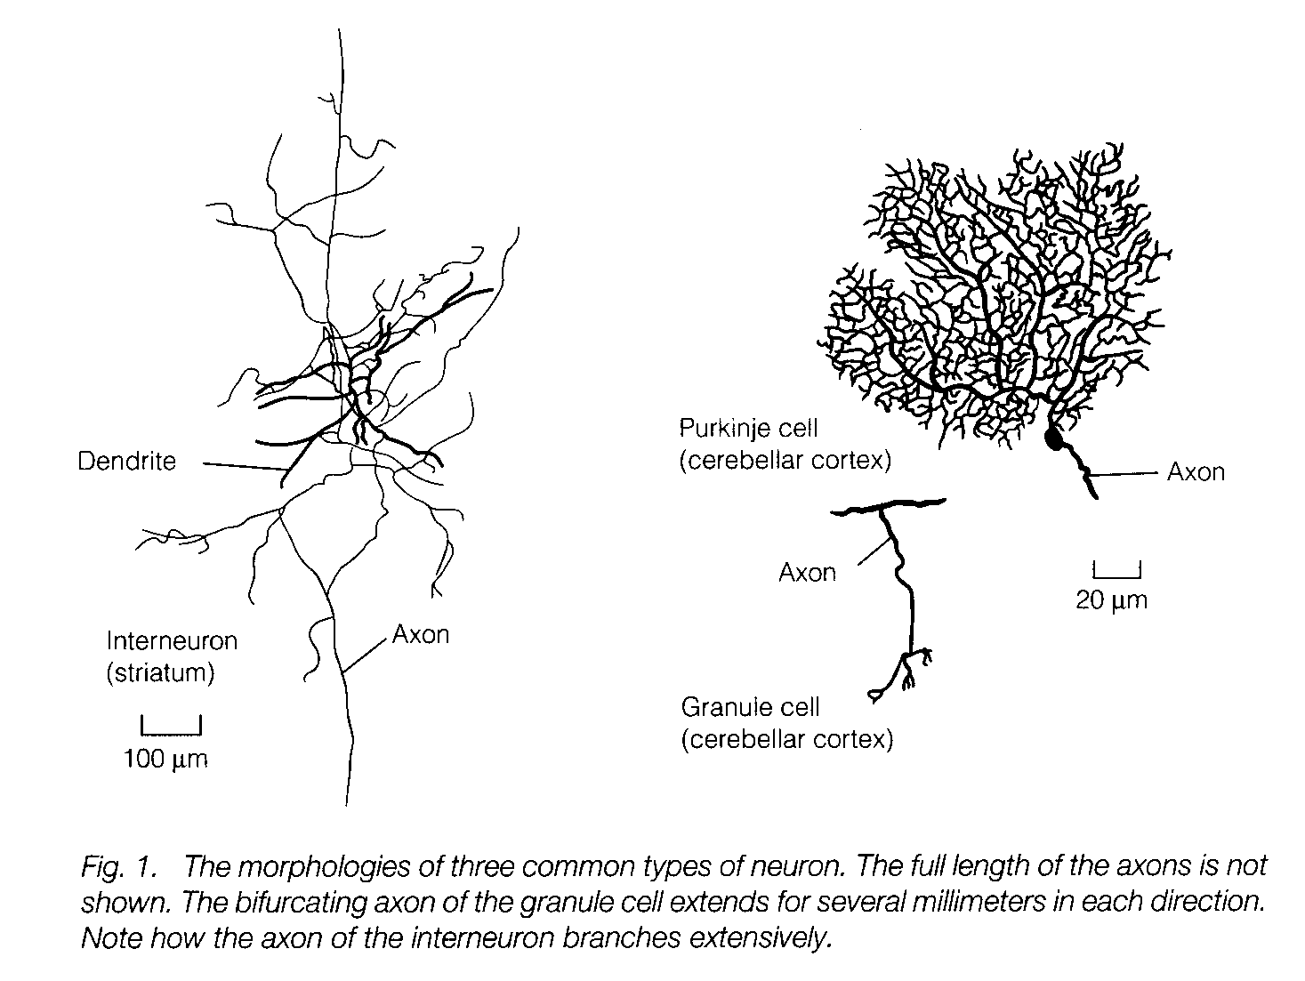
What is a neuron?
“There is no such thing as a ‘typical’ neuron”, Longstaff, 2000
8th November 2004
PFCS

Slide 4
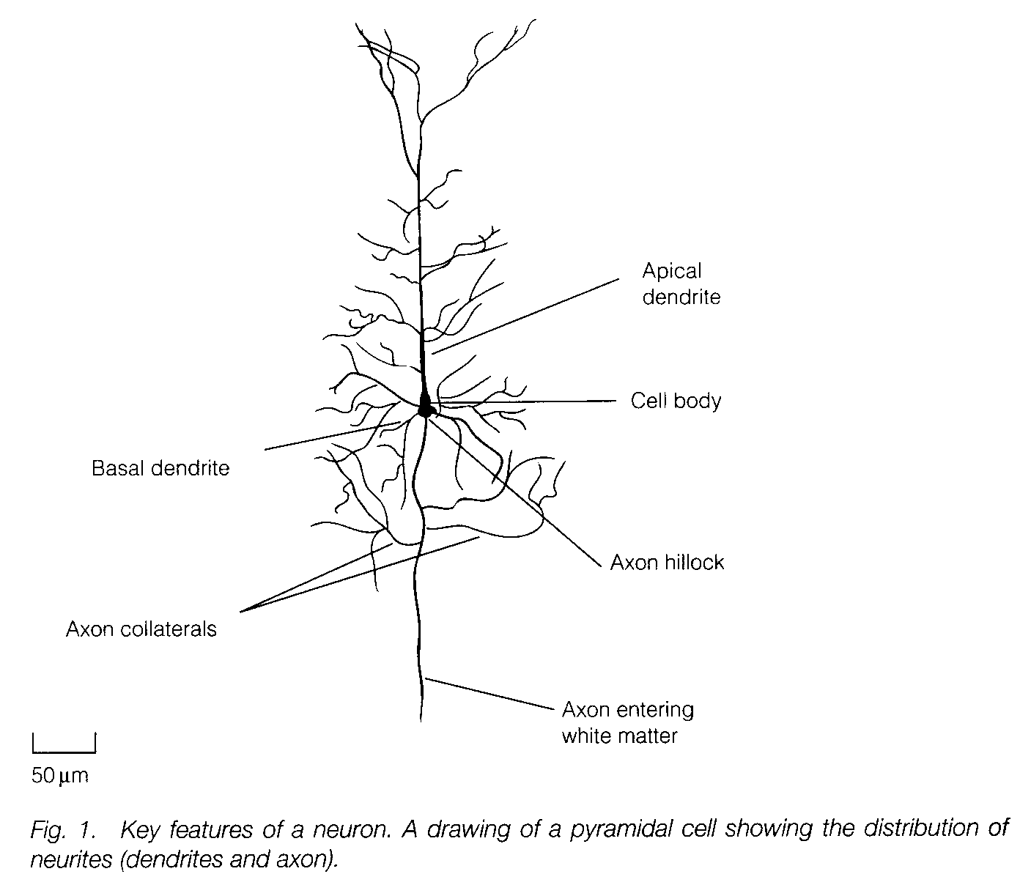
A ‘typical’(!) neuron
8th November 2004
PFCS

Slide 5
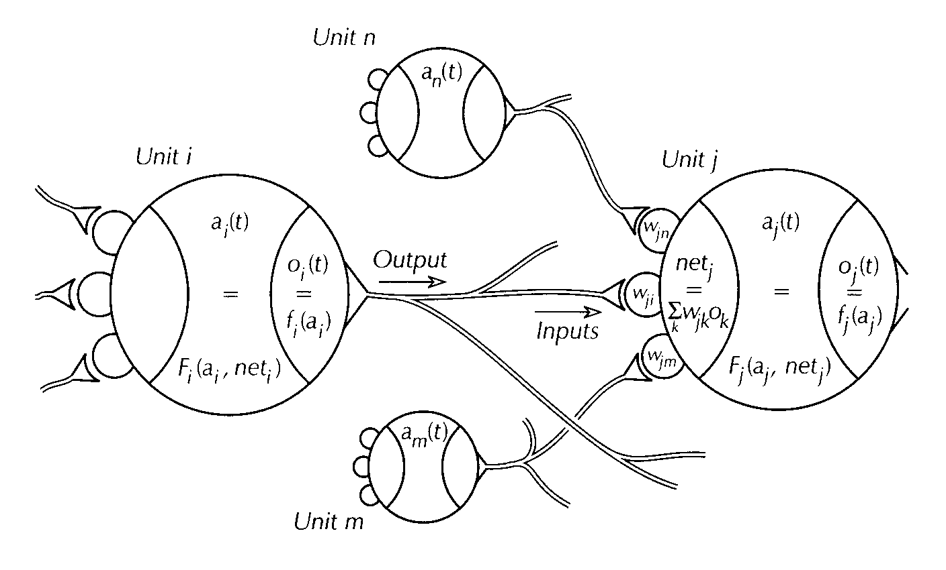
Network of Modelled Neurons
A simplified mathematical model of a network of neurons is created…
8th November 2004
PFCS

Slide 6
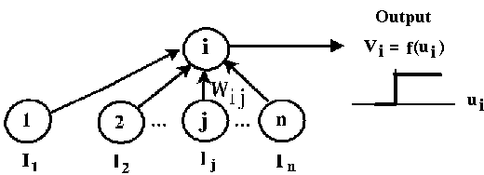
Neuron as processor
Each neuron processes its inputs according to some function
Early models used step functions (as below); current models typically use sigmoid functions (as in slide on back propagation)
8th November 2004
PFCS

Slide 7
Neurally Inspired Processing
Neural nets are neurally inspired processing models
Often massively simplified compared to what is known about the brain – though innovations are often inspired by brain research, e.g.:
  Spiking neural nets
  GAS Nets
8th November 2004
PFCS

Slide 8
Neurally Inspired Processing
Neural net models are massively parallel
  Multiple instances of (typically) very simple processors
They lend themselves to different types of processing as compared to serial symbolic systems
  Different primitives (easy-to-perform operations) are available
8th November 2004
PFCS

Slide 9

McCulloch & Pitts
Warren S. McCulloch and Walter Pitts (1943) ``A logical calculus of the ideas immanent in nervous activity'', Bulletin of Mathematical Biophysics, 5: 115-133.
A very simplified (but mathematical) model of a neuron
Showed that, if neurons are considered this way, arbitrary functions from input to output can be computed
But, how should it learn…?
8th November 2004
PFCS

Slide 10
Donald Hebb
Donald O. Hebb (1949) “The Organization of Behavior”, New York: Wiley
“What fires together, wires together”
Biologically plausible
Precise rule sometimes still used (often not), but general idea that change of weights between neurons should somehow depend on their correlated activity is still widely used.
8th November 2004
PFCS

Slide 11
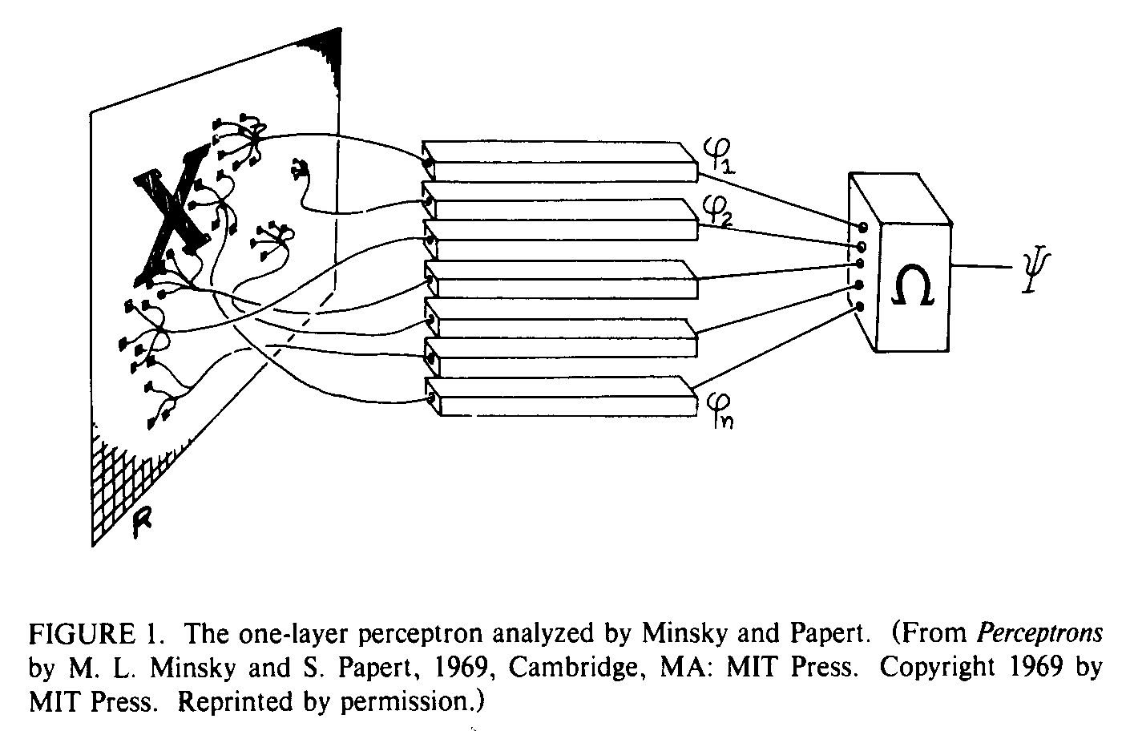
The Perceptron
Rosenblatt, F. (1957). “The perceptron: A perceiving and recognizing automaton (project PARA).”, Technical Report 85-460-1, Cornell Aeronautical Laboratory.
Rosenblatt, F. (1962). “Principles of Neurodynamics.”, Spartan Books, New York.
8th November 2004
PFCS

Slide 12
The Perceptron
What can it do?
  Recognise letters of the alphabet
  Several other interesting pattern recognition tasks (shape recognition, etc.)
  And the Perceptron Learning Rule can provably find the solution for any task that the Perceptron architecture can solve
8th November 2004
PFCS

Slide 13
The Perceptron
What can’t it do?
  Parity
  Connectedness
  XOR problem
  Non-linearly separable problems
Marvin L. Minsky and Seymour Papert (1969), “Perceptrons”, Cambridge, MA: MIT Press
A general network of McCulloch & Pitts neurons is Turing complete; but ‘so what?’:
  We don’t know how to train them
  We have a Turing complete architecture which we can train and design for
  & they speculated: maybe it’s simply not possible to find a learning algorithm for an arbitrary network?
8th November 2004
PFCS

Slide 14
PDP
This more or less killed off the field for 20 years…
Until: D.E. Rumelhart, J.L. McClelland, eds., “Parallel Distributed Processing: Explorations in the Microstructure of Cognition”, MIT Press, 1986.
  A large collection of papers, ranging from the very mathematical to the very philosophical (I recommend Volume 1, ch.4, if you’d like some very insightful extra background reading for this week)
  A lot of successful empirical work presented, but also:
  The Back Propagation learning algorithm: it was possible to have a general learning algorithm for a large class of neural nets, after all.
  [Actually, similar techniques had been discovered in the meantime (Amari 1967; Werbos, 1974, “dynamic feedback”; Parker, 1982, “learning logic”) so this was really a rediscovery. But this work was what restarted the field.]
8th November 2004
PFCS

Slide 15
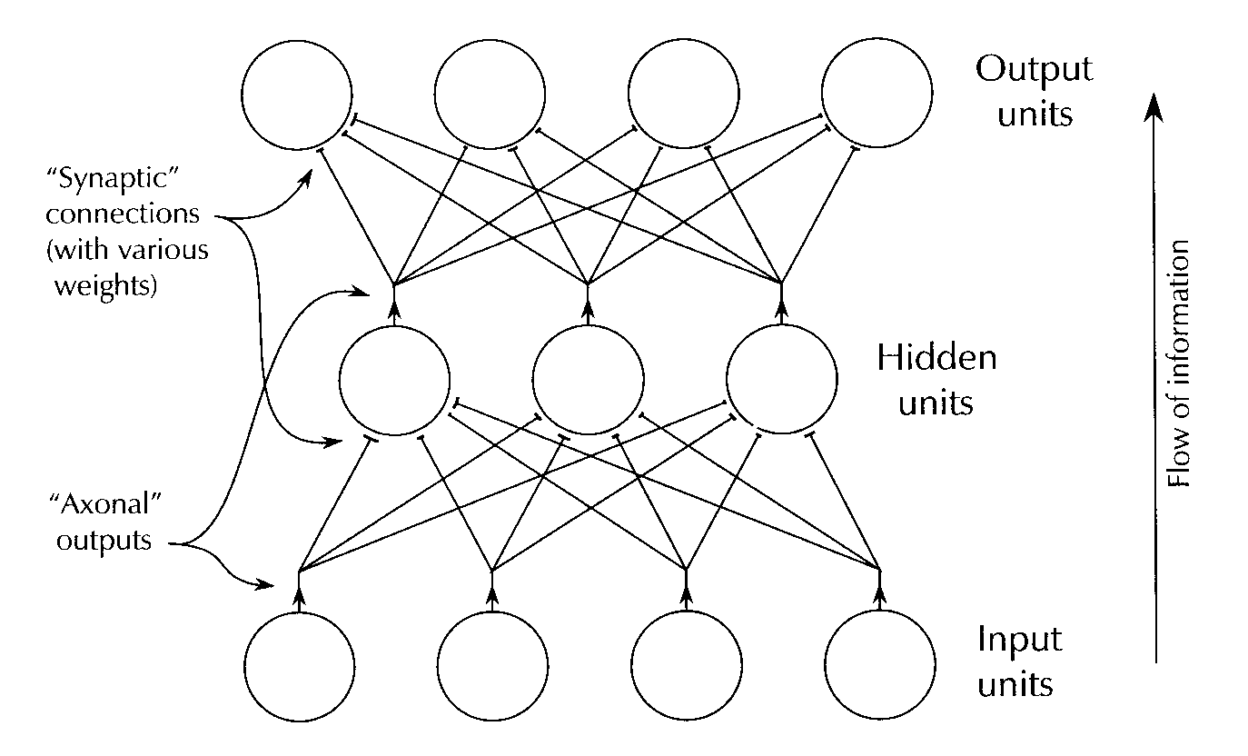
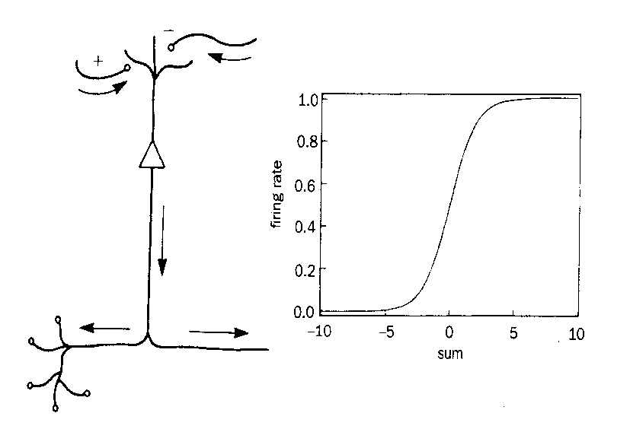
Back Propagation
Works on ‘feed-forward’ (only) but multi-layer networks:
Weights are modified by ‘backward propagation of error’…
8th November 2004
PFCS

Slide 16
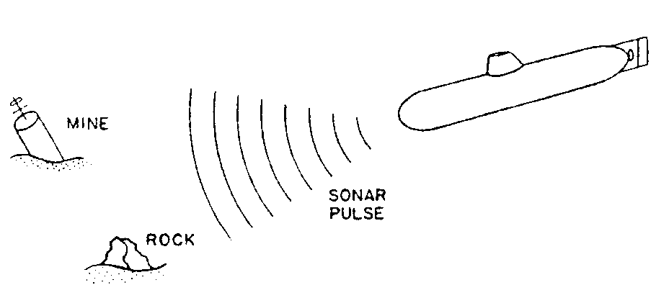
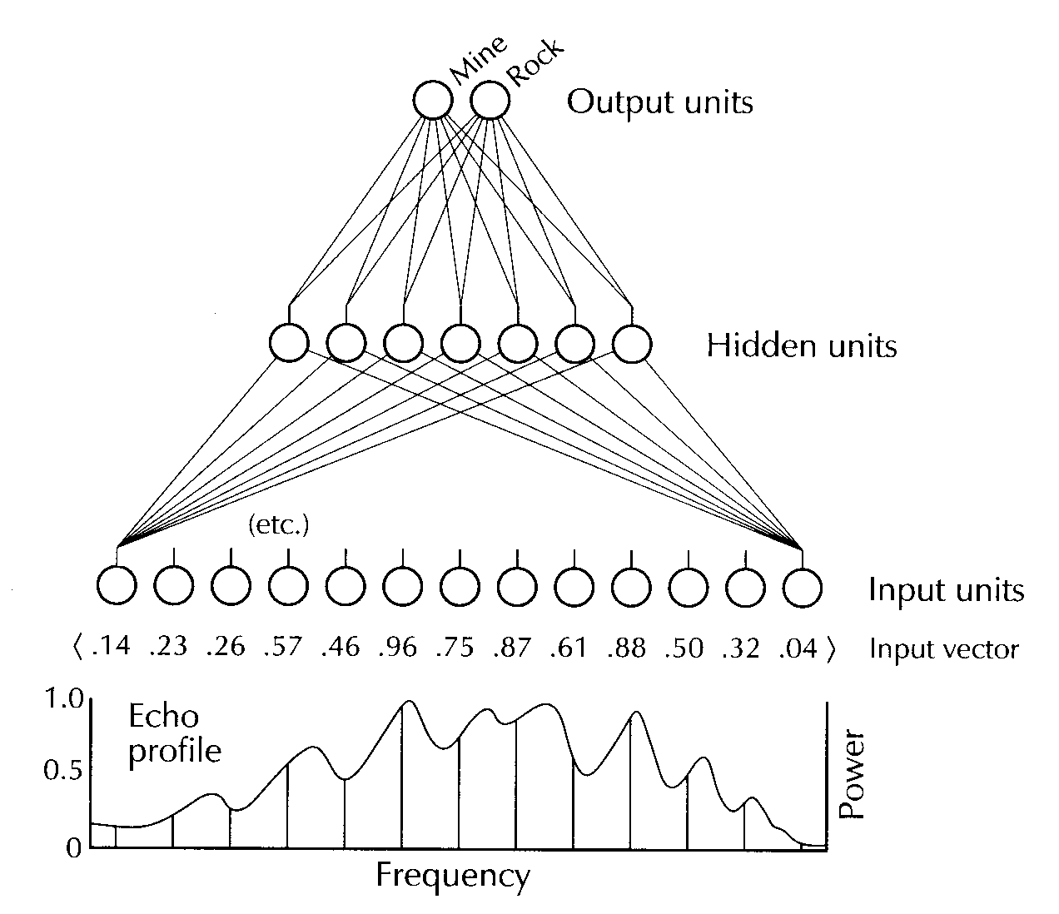
What can you do with back propagation?
(Gorman & Sejnowski, 1988)
8th November 2004
PFCS

Slide 17
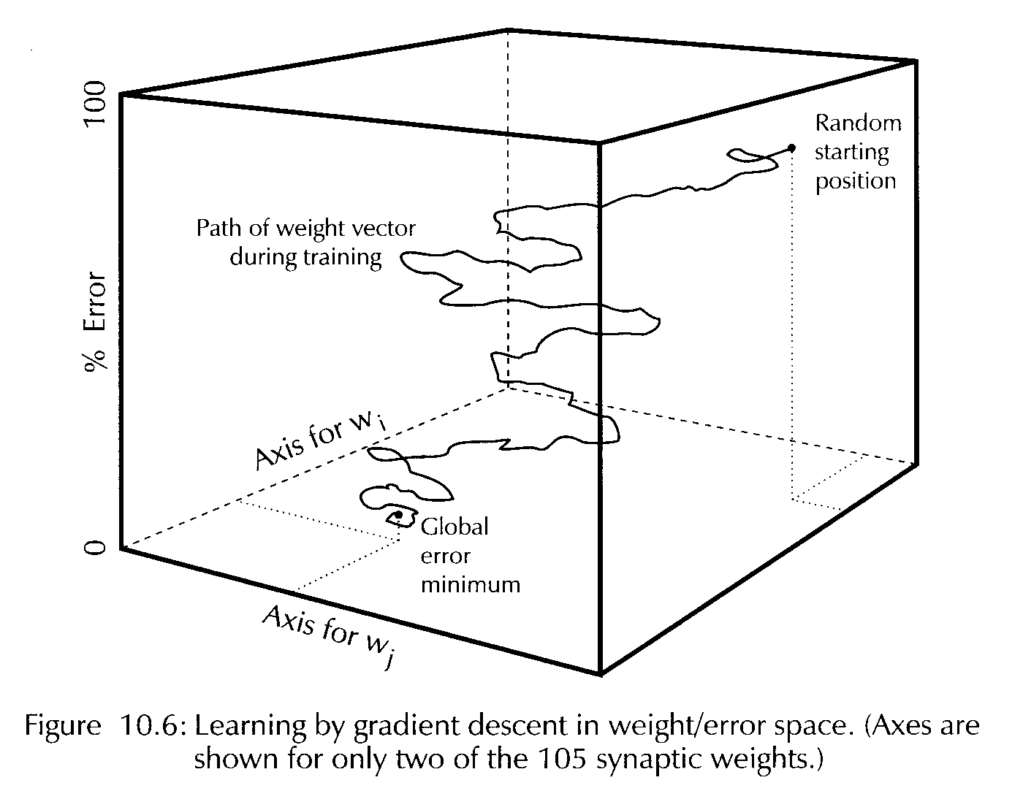
How does it work?
Gradient descent on an error landscape (walking in Snowdonia with your eyes shut…)
The detailed back prop. rules were derived mathematically in order to achieve precisely this gradient descent
8th November 2004
PFCS

Slide 18
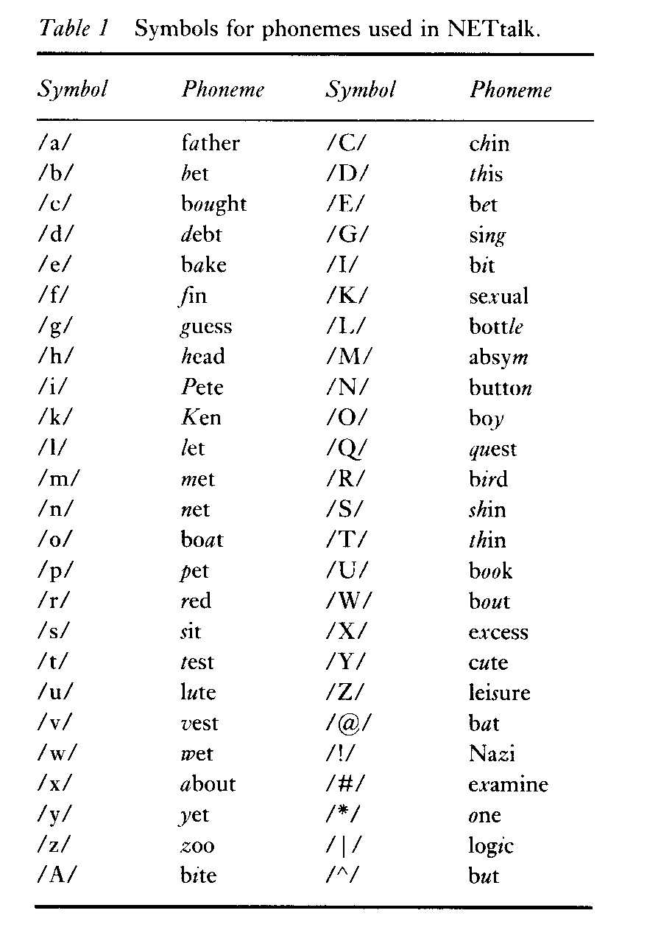
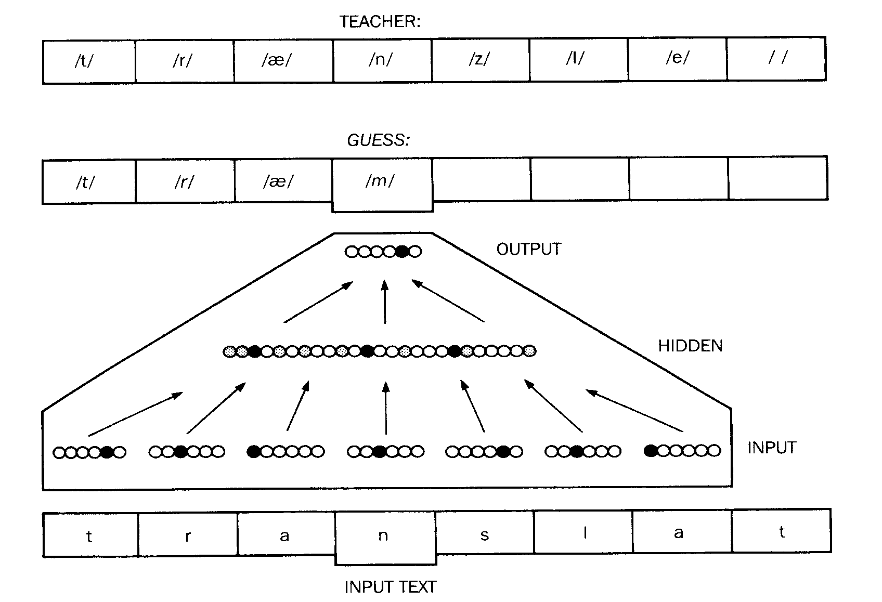
NETTalk
Now let’s look at another network, and some (statistical) tools which try to answer questions about what a network taught by back propagation has learnt
NETTalk; an interesting problem space:
  Many broadly applicable rules
  But many exceptions, too
8th November 2004
PFCS

Slide 19
NETTalk
As NETTalk learns, it shows interesting behaviour:
  First, it babbles like a child
  Then it learns the broad rules, but over-generalises
  Finally, it starts to learn the exceptions too
Achieved 98% accuracy on it’s training set
86% accuracy on new text
(cf 95% accuracy on new text for DECTalk; 10 years vs. one summer!)
8th November 2004
PFCS

Slide 20
NETTalk
No-one is claiming NETTalk is neuro-physiologically plausible, but if brains are even a little like this, we’d like to have some way of understanding what the network has learnt
In fact, various statistical techniques have been developed to try to examine the ‘representations’ that are formed by the weights and activities of neural nets
For NETTalk, one such technique, Cluster Analysis, sheds some light…
8th November 2004
PFCS

Slide 21
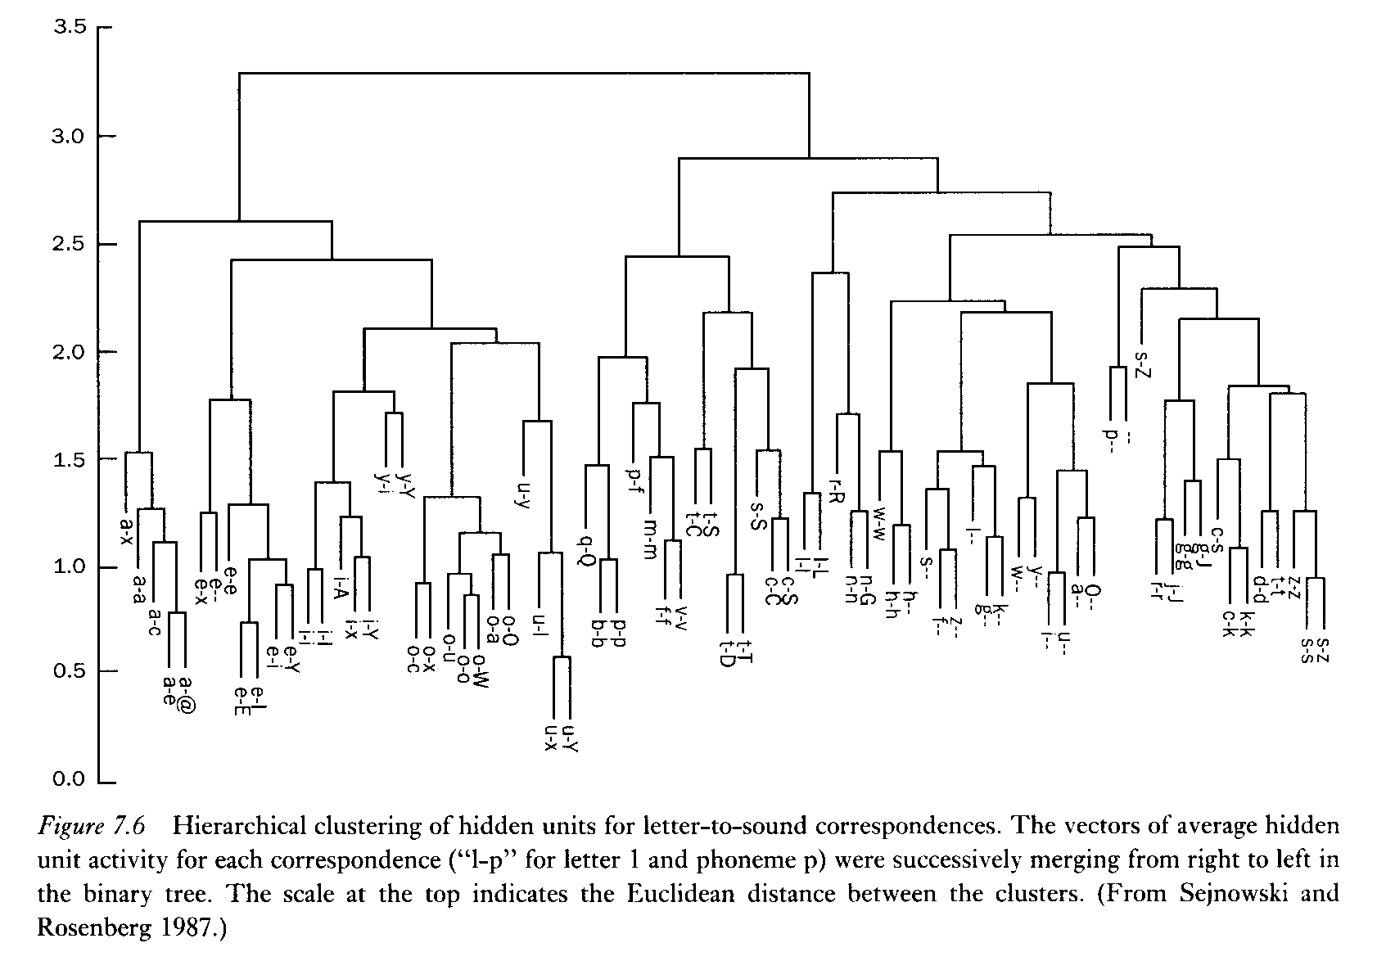
NETTalk
8th November 2004
PFCS

Slide 22
NETTalk
NETTalk wasn’t directly taught this clustering scheme, it learnt it from the data
Each time you re-run the learning task (starting from a new, random set of weights) you get completely different weights and activity vectors in the network, but the cluster analysis remains approximately the same
NOTE: When neural nets learn things, the data is not stored as facts or as rules but rather as distributed, sub-symbolic representations.
8th November 2004
PFCS

Slide 23
What does this have to do with psychology?
Broadbent (1985) argues that psychological evidence about memory or language tasks is at a completely different level of description from any facts about the way that neural nets store their information
He claims:
  Psychological investigations discover facts at the computational level (what tasks are being done)
  Neural nets are simply addressing the implementational level, and don’t tell us anything interesting about psychology at all
8th November 2004
PFCS

Slide 24
Marr’s Three Levels
David Marr, Vision, 1982
Three levels:
  Computational
  Algorithmic
  Implementational
This is a highly influential book (still entirely a GOFAI approach):
  Computational: What task needs to be done?
  Algorithmic: What is an efficient, rule based method for achieving the task?
  Implementational: Which hardware shall I run it on? (For a GOFAI approach, this last is much the least important, any Turing equivalent architecture can run any algorithm.)
8th November 2004
PFCS

Slide 25
Does the implementation matter?
Feldman (1985): The 100-step program constraint (aka ‘100-step rule’)
Neurons are slow, whatever one neuron does, you can’t have more than about 100 of that (in serial) in the time it takes us to do many day-to-day tasks
It seems neurons must achieve what they do by using massive parallelism (they certainly can in principle, there are, for instance, ~10¹⁰ neurons in the visual system, each with upwards of ~10³ connections to other neurons)
8th November 2004
PFCS

Slide 26
So what level is psychology at?
Rumelhart and McClelland argue that psychological data (about memory or language, say) are concerned with:
  “such issues as efficiency, degradation of performance under noise or other adverse conditions, whether a particular problem is easy or difficult to solve, which problems are solved quickly and which take a long time to solve, how information is represented, etc.”
But, they argue, neural net research addresses exactly the same issues. It can at least be argued that both neural net research and psychological research are addressing the same algorithmic level; not just what we do but, crucially, how we do it.
8th November 2004
PFCS

Slide 27
How many levels are there?
Marr’s three level view is probably an oversimplification, both Rumelhart and McClelland, and Churchland and Sejnowski (reading for this week), argue that in the end we have to consider multiple levels:
  Biochemical
  Membrane
  Single cell
  Neural circuit
  Brain subsystems
  Brain systems
  Brain maps
  Whole central nervous system
8th November 2004
PFCS

Slide 28
Multiple levels of description?
Rumelhart and McClelland argue that we have been seduced by dealing with a special class of systems (modern, digital computers) which are designed to implement their high-level rules exactly
They suggest that a better way of understanding psychological rules (from the rules of visual processing or speech production, all the way to beliefs and desires) is to think of them as useful levels of description
  Hardness of diamonds vs. details of Carbon atoms
  Social structure vs. details of individual behaviour
The details of the lower levels do affect the higher levels in these (perfectly normal) cases, so cannot be ignored in a complete theory
8th November 2004
PFCS

Slide 29
Emergence vs. Reduction
Phenomena like the above – & like cognition on the connectionist view – are emergent, in the sense that the high-level properties could never be understood by considering the low level units in isolation
The explanations are only weakly reductionist, in the sense that the high-level behaviour is meant to be explained in terms of the interaction of the large number of low-level elements
8th November 2004
PFCS

Slide 30
Multiple levels of description?
Have we lost compositionality and systematicity at a fundamental level?
If we go down this route, then yes.
A range of positions are possible, including:
  Eliminativisim: (Paul Churchland)
  ‘Strong connectionism’: (Rumelhart & McClelland) Neural networks really are a cognitive level of description; they explain, in terms of the interaction of multiple neurons, why higher level descriptions (such as compositional thought, etc.) work.
  ‘Cognitivism’/Symbol Systems approach: (Fodor) Neural networks must be seen as just implementation.
  A Priori approach: (~= trad. philosophy) Compositionality & systematicity define what thought is. Thought must be like that and thought, qua thought, can and must be analysed in its own terms.
8th November 2004
PFCS

Slide 31
Image Credits
A. Longstaff (2000), “Instant Notes: Neuroscience”, Oxford: BIOS Scientific
J. Haugeland (1997) ed., “Mind Design II”, Cambridge, MA: MIT Press
D. Rumelhart & J. McClelland (1986) eds., “Parallel Distributed Processing: Explorations in the Microstructure of Cognition”
W. Lycan (1999) ed., “Mind and Cognition: An Anthology”, Oxford: Blackwell
http://heart.cbl.utoronto.ca/~berj/ann.html
8th November 2004
PFCS

