Slide 1

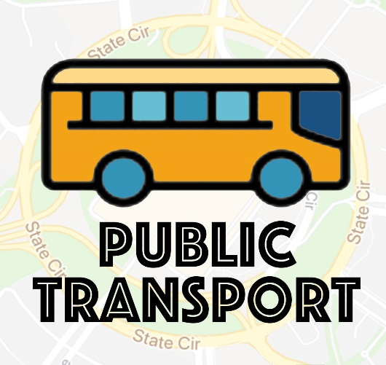
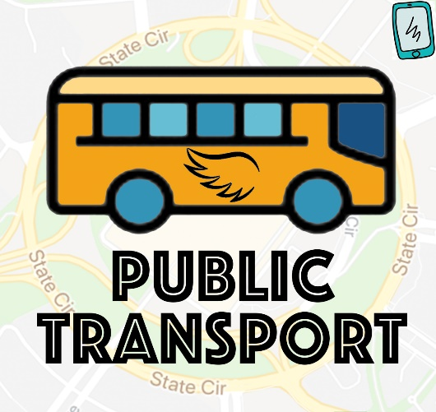
Challenge: Canberra 2029 – First Hackers: Inclusive; Progressive; Connected
Public Transport for the Future
Public Transport
Team 501
Qiuxi Shi
Hui Ren

Slide 2
01
Data Preparation
Dataset
02
Data Preprocess
03
Data Analysis
04
Result

Slide 3
Year | BIF | Construction | Design | Early Planning | Grant | ICT | Plant & Equipment | Public Private Partnership | Sum
2017 | 61,800 | 657,182 | 5,156 | 12,419 | 17,967 | 95,285 | 37,117 | 720 | 887,646
2018 | 57,419 | 500,878 | 3,442 | 41,810 | 9,345 | 65,011 | 68,501 | 0 | 746,406
2019 | 496,285 | 65,233 | 88,450 | 80,323 | 6,494 | 17,160 | 7,519 | 8,205 | 769,669
2020 | 385,388 | 67,000 | 68,585 | 32,949 | 12,403 | 3,841 | 7,714 | 1,814 | 579,694
2021 | 217,218 | 62,814 | 39,275 | 11,713 | 12,713 | 455 | 0 | 0 | 344,188
2022 | 40,809 | 64,384 | 25,408 | 7,073 | 6,000 | 0 | 0 | 0 | 143,674

Slide 4
Integrate
Idea
AI

Slide 5
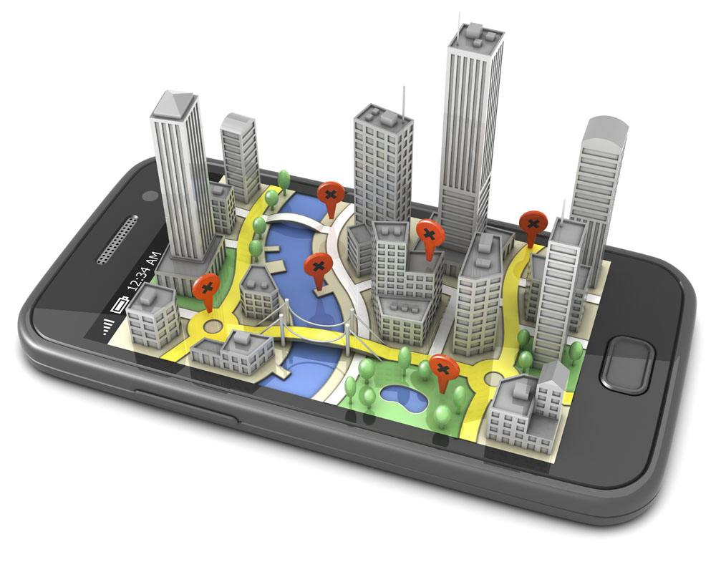
Integrate
Source from: http://www.juimg.com/tupian/201305/tongxunkeji_353394.html

Slide 6
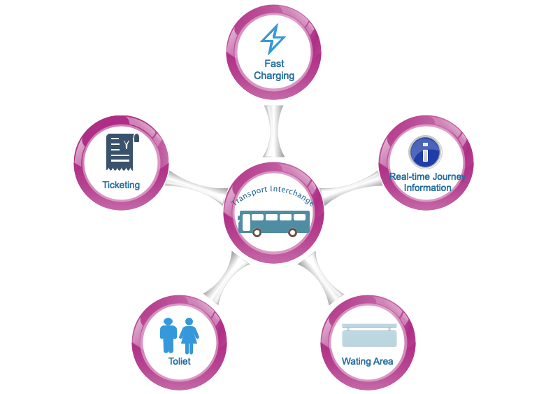
Driverless
Source from: Karen

