Slide 1
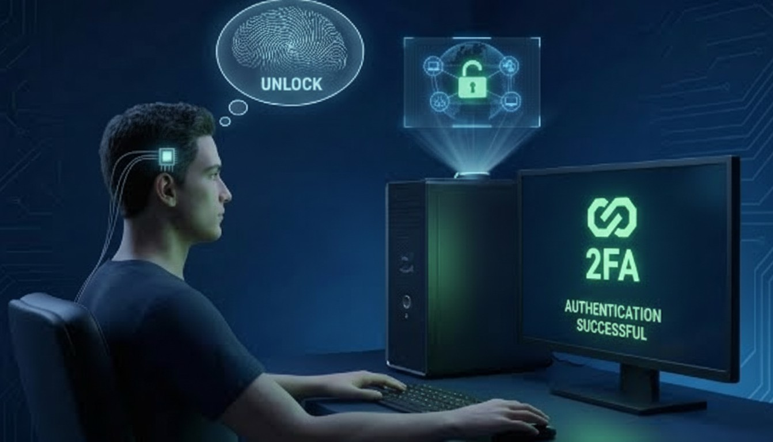
HACK YOUR PATH 7.0
Theme : Open Innovation (SDG-Alligned)
Problem Statement Title - CortexKey: Brainwave‑Backed Authentication
Team Name : BlackHats
Team Details :
Devesh CSD 2nd yr
Aditya CSD 2nd yr
Sadaf CSE 1st yr
Abhinav CSE 1st yr

Slide 2
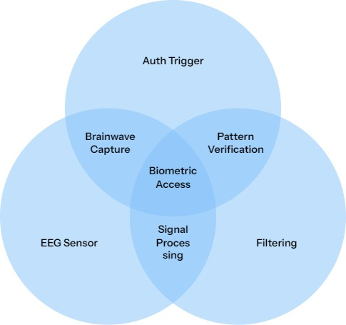
IDEA TITLE
Blackhats
Problem Statement
Current authentication methods fall short:
Passwords are reusable, guessable, and vulnerable to phishing
Biometrics like Fingerprint and FaceID rely on static physical traits
Once compromised, biometric data cannot be changed Single-factor authentication increases the risk of unauthorized access

Slide 3
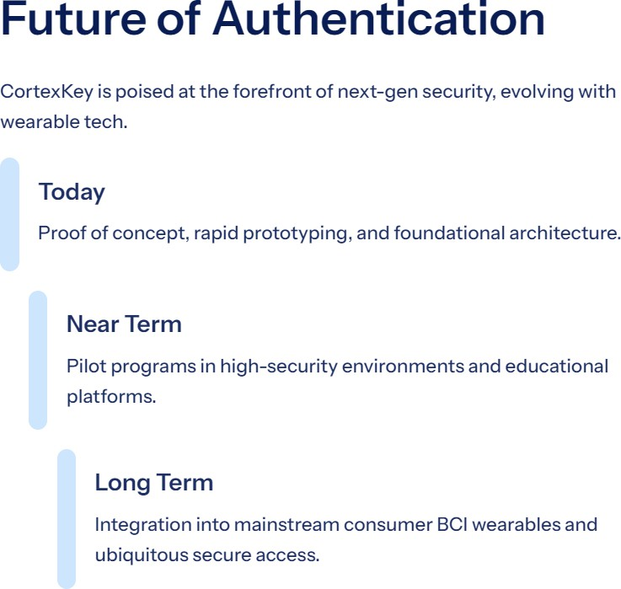



Solution: Evolution of Authentication Systems
From static credentials to brainwave-based biometric login
Blackhats
CortexKey – Secure Login Using Brainwaves Traditional biometrics authenticate using physical traits
These can be replicated or misused
CortexKey:
Uses EEG brainwave features for login authentication Acts as an add-on or alternative to FaceID/fingerprint Ensures strong liveness-based identity verification

Slide 4
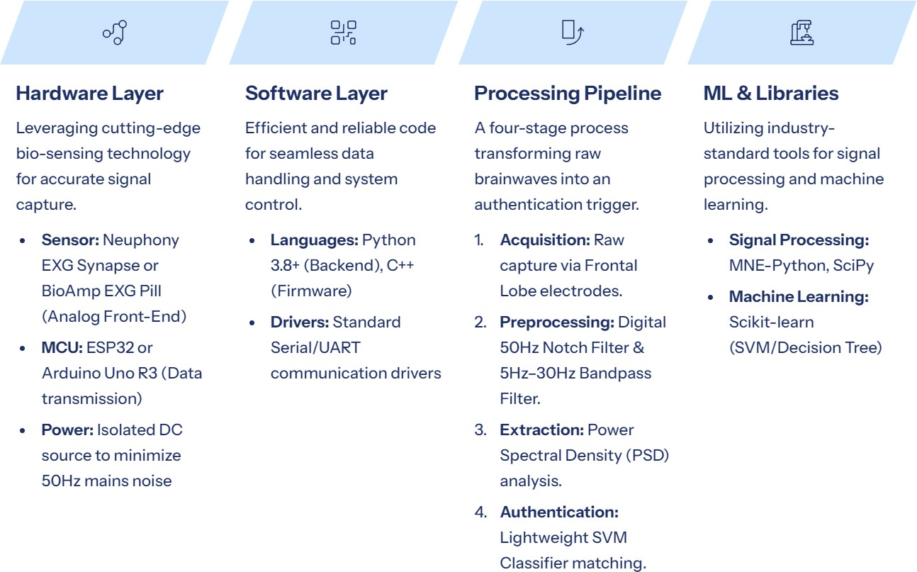
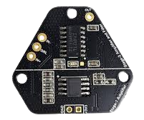
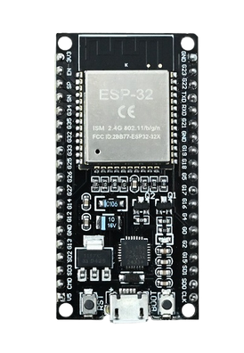
TECHNICAL APPROACH
Blackhats

Slide 5
FEASIBILITY AND VIABILITY
Blackhats
Feasibility:
Uses existing EEG signal processing methods Low‑cost, non‑medical EEG hardware Software‑driven authentication logic Prototype buildable within hackathon time No dependency on large ML models
Item
BCI Sensor Microcontroller Electrodes Cables
Power Total
Product
Neuphony EXG Synapse OR
BioAmp EXG Pill
Arduino Uno R3 (Clone) or ESP32
Gel-based disposable ECG/EEG studs
Bio-potential cables (Snap-on type)
9V Battery
Approx. Price (INR)
₹1,200 – ₹1,500
₹450 – ₹600
₹200 – ₹300
₹300 – ₹400
₹100
~₹2,500 – ₹2,900
Viability
Addresses real security gap in passkeys & biometrics Works as a second factor, not a replacement
Scales with improving wearable EEG tech
High relevance for secure systems & exams Strong future adoption in high‑security domains
NOTE:
The price range for a standard hardware passkey falls between ₹3,000 and ₹20,000.

Slide 6
RESEARCH AND REFERENCES
Blackhats
Academic Publications
Chuang, J., Nguyen, H., & Sayed, B. (2013) . "Cerebrem: A Brain-Computer Interface for User Authentication." Demonstrates the use of mental tasks (e.g., imagining movement) as a viable, secure cryptographic key.
Gui, Q., Zhan, Z., & Zhu, J. (2014) . "A Survey of EEG-based Biometrics for User Authentication." Validates brainwaves as high-entropy, non-static biometric identifiers superior to fingerprints.
Ashby, C., et al. (2011) . "Low-Cost EEG Based BCI User Identification." Proves that non-medical grade EEG sensors (like the EXG Pill) are sufficient for robust identity verification.
Palaniap p an, R. (2004) . "Method of Identifying Individuals Using Brain Electrical Activity Features." The foundational study for using Power Spectral Density (PSD) as a "Neural Signature."
Technical Frameworks & Tools
BrainFlow SDK: The industry-standard API for real-time biosensor data acquisition across open-source hardware.
MNE-Python: Primary library for scientific-grade EEG signal processing, noise filtering, and artifact removal.

Slide 7


GTM Canvas |  |  |  |  |  |  | F‘rqec Nerr+e:Correz key
 |  |  |  |  |  |  | cTM mesa: devesb{bIacÏcbaN)
 |  |  |  |  |  | {qgp¡pg tpy headband), b_{i}gb._{l}ypt tpytp "Tbe Dcatb of Static Biptpetric #”, and direct B2B ptlot progmms offering our 13,000 dev-ki1 for free testing. | High-level Conferences (DEF CON, Black Hat, Nullcon). g ^ Summits, PtÌY8te kiokedln CISO Guilds, and Deep- TecL Policy Forums.
 |  | cootent *^8! yourube Jt_{e}J- Crypto Exchange | zr•*sil
•**•• •• R aÏ-üme extraction of Alpbameta EEG neural signat8"es using a !*gfi •*&! ed8*Processin8 pipeline (SVM Classifies). Transforms mental tasks inI cryptographic keys. | Licences 2FA Continuons, d##p$J# @q¢b #»s‹ni‹ation.lt proves unequivocally tjnat a consc ions. living humen is present at the terminal neutralizing AI spooflng and static credential theft. |  |  |  | 2nd 1st |  |  | securities thèse are the specific region with speciific probleœ whicb
 |  |  |  |  | ₂ad
 | Estret o Cost-to- Precision Ratio t<13.000 BOM) Delivering enterprise- siatergiic innovation
Unlm fingcrprinrs or F•riclD
biometrie key.

