Slide 1
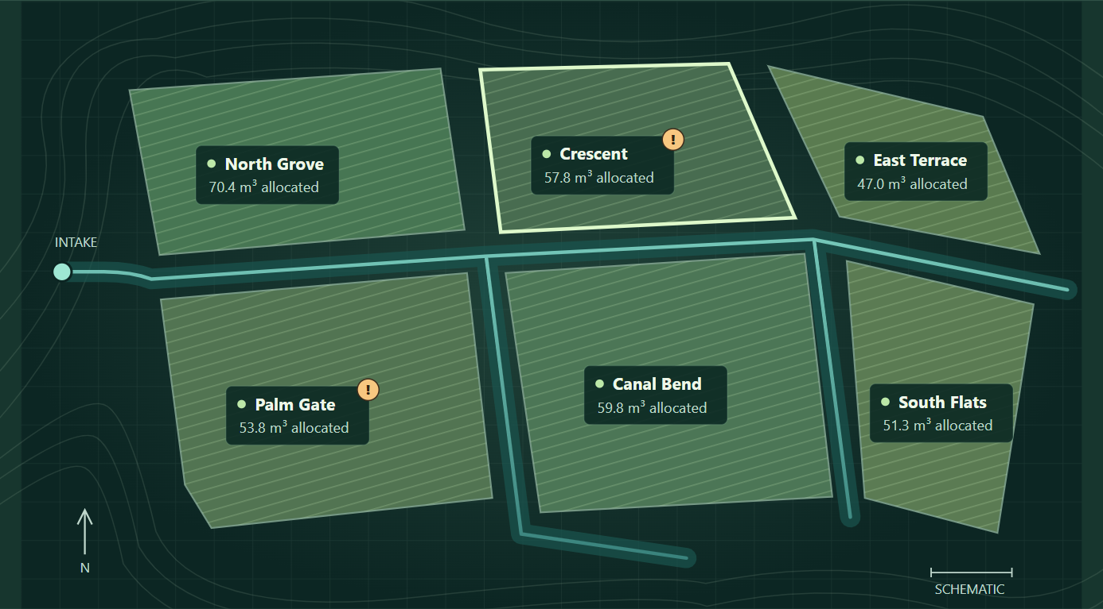
CS3081 Artificial Intelligence / Effat College of Engineering
Smart Irrigation
Decision Agent
Project question
How can a rule-based AI agent share a limited daily water supply across six farms when some soil moisture readings are wrong or missing?
Naba field map / Simulated data
Ali Ahmed • Abdulrahman Al Shalhoub
Mohammed Guail • Hamed Al Mehadar
Naba Irrigation Lab / CS3081
01 / 09
Notes:
Introduce the team and the question. Naba is a software simulation of six farms. The map is a real view from the running prototype, not a geographic map or a field result.

Slide 2
Understand the issue
Why shared irrigation matters
67%
A fixed schedule can miss what the soil needs that day.
Poor sensor placement can change how much water a controller uses.
With one shared source, extra water at one farm leaves less for the others.
of Saudi Arabia’s total water use went to agriculture in 2020
Includes regenerated agricultural water.
Sources: Odnoletkova and Patzek (2023); Neugebauer et al. (2023)
02 / 09
Notes:
The 67% figure is for 2020 total use and includes regenerated agricultural water. The study gives 62% when regenerated agricultural water is excluded. A second study simulated fuzzy control and found that a poor sensor depth reversed the water saving. This is the motivation for checking readings before acting.
Sources:
https://doi.org/10.1038/s44264-023-00006-w
https://doi.org/10.1038/s41598-023-45203-2

Slide 3
Understand the problem
The daily allocation problem
238 m³
Give each of six farms a daily dose based on its soil and crop needs.
Deal with readings that are stuck, impossible or missing.
Keep the sum of the doses within the shared daily supply.
per day after a 30% cut
320 m³
usual daily loss across six farms
Simulation inputs: normal supply is 340 m³/day
03 / 09
Notes:
The six farms have equal area but different capacities, stress levels, target moisture and typical losses. The 30% cut takes supply from 340 to 238 cubic meters per day. Typical loss adds to 320. Stored moisture helps early in the run, but the agent cannot create water.

Slide 4
Literature review
What the research shows
Seven peer-reviewed papers, 2022 to 2026
Irrigation rules
Fuzzy control used 11.5% less water at the best sensor depth in one simulation. Poor placement reversed the saving [2].
Sensor checks
A two-node lab test flagged injected faults by comparing readings with predictions [4].
Shared allocation
Daily soil water balance and equity are already part of shared irrigation models [7].
Reference numbers match Report 2
04 / 09
Notes:
The papers cover three different jobs: water control, reading checks and shared allocation. Singh showed that fuzzy rules could drive a pump. Neugebauer isolated sensor depth in simulation. Tabatabaei tested a vineyard for one season, with no replicated plots. Jihani demonstrated fault checks in a small lab. Shaikh used monthly crop plans and seven-day irrigation. Bulukazari modeled regional profit and water. Chang modeled daily movement and allocation trade-offs. The results use different measures and should not be ranked directly.
Sources:
https://doi.org/10.3390/en15197199
https://doi.org/10.1038/s41598-023-45203-2
https://doi.org/10.1038/s41598-026-56154-9
https://doi.org/10.1016/j.rineng.2023.101395
https://doi.org/10.1007/s11269-021-03054-4
https://doi.org/10.1371/journal.pone.0269663
https://doi.org/10.1016/j.jenvman.2024.123164

Slide 5
Literature review
Competitors and the gap
Existing tools
What our experiment adds
CropX: soil monitoring and irrigation planning.
WiseConn DropControl: remote schedules, monitoring and alerts.
SWAN Systems: supply budgets and scheduling without soil probes.
Show which readings were rejected and what estimate replaced them.
Replay faults and a shared shortage on the same days for all three strategies.
The product pages do not report this exact test.
Sources: official CropX, WiseConn and SWAN Systems product pages
05 / 09
Notes:
These are commercial products with working field capabilities. SWAN explicitly models crop needs without requiring probe data and tracks sources and allocations. The gap here is the evidence from one transparent, matched experiment, not the absence of these features in commercial products.
Sources:
https://cropx.com/cropx-platform/
https://wiseconn.com/our-solution/
https://www.swansystems.com/water-supply-management/
https://knowledgebase.swansystems.com/books/frequently-asked-questions/page/why-doesnt-swan-schedule-from-actual-soil-moisture-probes

Slide 6
Project idea
AI pillars in Naba
Runs in the browser with no AI API or LLM.
80 / 80
Knowledge. Use IF rules to check sensor readings.
Uncertainty. Use a moisture estimate when a reading fails.
Optimization. Give priority to the driest farms within the water limit.
Search supports optimization. Binary search finds the highest reserve level the water can cover.
injected faults flagged in 3 days or less
0
daily supply violations
Prototype: five scenarios, 20 seeds each, 30 days per run
06 / 09
Notes:
Knowledge, uncertainty handling, and optimization are the three main pillars. The IF rules reject missing, impossible, repeated, or unusually different readings. The agent predicts soil moisture from its previous estimate, water applied, and forecast loss. It uses the prediction when a reading fails and a fixed 60/40 blend when a reading passes. During shortages, binary search tries higher and lower reserve levels to find one the supply can cover. Each farm has a limit based on its soil capacity and target moisture. The 80 events were stuck and impossible readings in the fault and combined cases. There were also 20 false fault alerts across the tests.

Slide 7
System diagram
The daily decision loop
1 Simulated inputs
Readings, supply, forecast and soil limits
2 Rule-based check
Predict from the last dose, then check the reading
3 Allocation
Raise the driest reserves within the supply cap
6 Evaluation
Replay three strategies and compare outcomes
5 Farm simulator
Apply water and loss. Record soil moisture.
4 Daily output
Water per farm, alerts and reasons
Next day: updated sensor readings
Naba Irrigation Lab / CS3081
07 / 09
Notes:
The draw.io source is included. Read clockwise. The rule module predicts moisture using the previous estimate, dose and forecast loss. The simulator produces next-day readings and separately logs true moisture for evaluation. The controller never reads the true state.

Slide 8
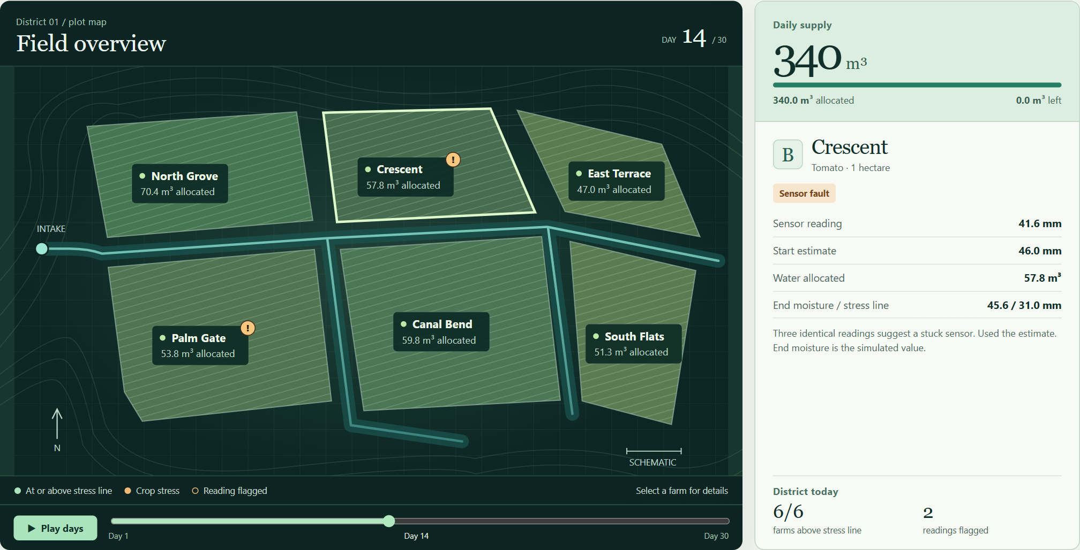
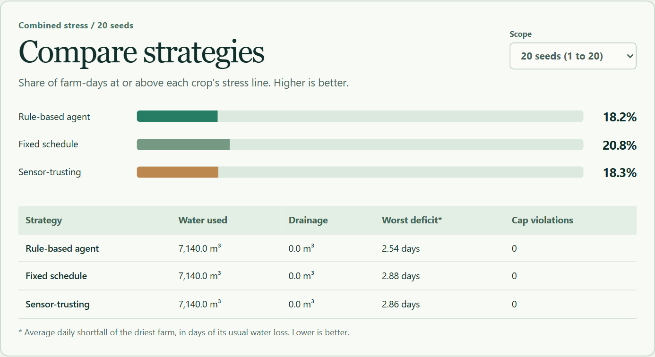
Design images
Inside the simulator
Field map
Strategy comparison
Agent vs. fixed schedule
Worst deficit: 2.54 vs. 2.88 days
Coverage: 18.2% vs. 20.8%
Day 14: a stuck reading is flagged and replaced with an estimate.
Screenshots from the working Naba prototype
08 / 09
Notes:
The field view is the sensor-fault scenario, day 14, seed 7. Crescent repeats its reading, so the agent uses its estimate. The right screenshot is the combined scenario averaged over 20 seeds. Worst deficit was 2.54 days for the agent and 2.88 for the fixed schedule. Coverage was 18.2% versus 20.8%. All strategies used the same volume. The trade-off is that sharing stress more evenly can lower the driest farm’s deficit while fewer farms stay above the threshold.

Slide 9
Naba Irrigation Lab
Thank you
Questions?
Open the Naba demo from the project folder
Ali Ahmed / Abdulrahman Al Shalhoub / Mohammed Guail / Hamed Al Mehadar
09 / 09
Notes:
Suggested demo: Open the sensor-fault scenario on day 14 and select Crescent. Show the repeated-reading flag and the fallback estimate. Then select Combined stress and Compare runs, and choose the 20-seed scope. Point out the worst-deficit and coverage trade-off.
Offline demo: extract Naba_Irrigation_Lab.zip, then open index.html.

