Slide 1

AICTE – EDUSKILLS VIRTUAL INTERNSHIP
JAVA
Java Full Stack
Development
J
MySQL
A
Spring Framework
Professional Internship Presentation
V
Spring Boot
NUMAIR NIZAMI • STU69e1f231956b81776415281
A
Core Java
B.Tech CSE | IILM University, Greater Noida
JANUARY – MARCH 2026
AICTE • EDUSKILLS • JAVA FULL STACK
01

Slide 2
01 / OVERVIEW
Candidate & Internship Snapshot
A structured overview of the Java Full Stack virtual internship
CANDIDATE
INTERNSHIP
PROGRAM
NUMAIR NIZAMI
AICTE Student ID: STU69e1f231956b81776415281
B.Tech Computer Science & Engineering
IILM University, Greater Noida
Batch: 2024–2028
AICTE – EduSkills Virtual Internship
Java Full Stack Development With Project
8 Weeks
January – March 2026
Mode: Virtual
EduSkills Academy
Mentor: Sagarabala Behera
AICTE Student ID:
STU69e1f231956b81776415281
Project-based learning
AICTE • EDUSKILLS • JAVA FULL STACK
02

Slide 3
02 / CONTEXT
Why the internship matters
The program connects web fundamentals, Java programming, enterprise frameworks and database technologies.
BUILD
CONNECT
THE SHIFT
HTML • CSS • Bootstrap
JavaScript • jQuery
From learning
individual tools
to understanding the system.
PERSIST
SECURE
Frontend + Java + enterprise frameworks + persistence + version control
Hibernate • MySQL
Spring • Spring Boot
AICTE • EDUSKILLS • JAVA FULL STACK
03

Slide 4
03 / TECHNOLOGY
JAVA Stack & Supporting Tools
The documented curriculum, presented as a connected Java Full Stack ecosystem.
FRONTEND
BACKEND
HTML • CSS • JavaScript • jQuery
J A V A
JDBC • Servlets • Multithreading
MySQL
Spring Framework
Spring Boot
Core Java
STATE & UI
DATABASE
OOP • Collections • Exception Handling • File Handling
Hibernate • MySQL
API & SECURITY
Spring Boot • Git / GitHub
AICTE • EDUSKILLS • JAVA FULL STACK
04

Slide 5
04 / ARCHITECTURE
How a JAVA request moves
A conceptual learning flow based only on the technologies documented in the internship materials.
USER / UI
HTML • CSS • JS
JDBC / APIs
SPRING
MYSQL
WEB LOGIC
ENTERPRISE
ORM
JavaScript / jQuery
Spring / Spring Boot
Hibernate
Presentation → Java Logic → Framework Layer → Persistence
AICTE • EDUSKILLS • JAVA FULL STACK
05

Slide 6
05 / LEARNING PATH
Internship learning path
A progressive journey from web fundamentals to enterprise Java and database technologies.
01–02
03–04
05–06
07–08
WEB FOUNDATIONS
SCRIPTING
JAVA DEVELOPMENT
ENTERPRISE + DATABASE
JavaScript
Spring Boot & Hooks
Context / Redux
Router + Tailwind
Node / Express
MySQL / REST / JWT
Git / Deployment
Hibernate / MySQL
AICTE • EDUSKILLS • JAVA FULL STACK
06

Slide 7
06 / LEARNING FOCUS 01
Core Java & Advanced Java
The internship curriculum covered Java programming fundamentals and advanced enterprise-oriented concepts.
LEARNING FLOW
DOCUMENTED LEARNING
OOP • Collections • Exception Handling • File Handling
JAVA BASICS
ADVANCED JAVA
JDBC / SERVLETS
MULTITHREADING
ADVANCED JAVA TOPICS
LEARNING OUTCOME
• Random short-ID generation
• URL mapping / retrieval
• Duplicate handling
• Exportable mapping data
Stronger understanding of Java programming and enterprise application fundamentals.
STACK FOCUS
Core Java • Advanced Java • JDBC • Servlets
AICTE • EDUSKILLS • JAVA FULL STACK
07

Slide 8
07 / LEARNING FOCUS 02
Spring, Spring Boot & Persistence
The major project bringing the JAVA layers together end-to-end.
DOCUMENTED TECHNOLOGIES
SPRING
SPRING BOOT
REST APIs
User Management
Product Catalog
Full-stack Integration
Database Interaction
Capstone focus: connecting the application layers.
HIBERNATE
MYSQL
ORM
DATABASE
PERSISTENCE
Java Application → ORM → Relational Data
AICTE • EDUSKILLS • JAVA FULL STACK
08

Slide 9
08 / CAPABILITIES
Technical Skills Developed
Practical capabilities documented across the Java Full Stack internship curriculum.
Frontend
Scripting
HTML • CSS • Bootstrap • responsive design
JavaScript • jQuery • DOM
Java
Persistence
Core Java • Advanced Java • JDBC • Servlets
Hibernate • MySQL
Enterprise
Workflow
Spring Framework • Spring Boot • REST APIs
Git / GitHub • branching • version control
RESULT • Stronger understanding of Java Full Stack development, enterprise frameworks, persistence and version control.
AICTE • EDUSKILLS • JAVA FULL STACK
09

Slide 10
09 / CREDENTIALS
Internship Completion
Key details from the supplied Java internship materials.
PROGRAM DETAILS
CERTIFICATE DETAILS
Java Full Stack Development With Project
EduSkills Academy
Mentor: Sagarabala Behera
Duration: 8 Weeks
Period: January – March 2026
Certificate ID: 2026-2D81EDE71F
Issued: 06 April 2026
AICTE Student ID:
STU69e1f231956b81776415281
IILM University, Greater Noida
AICTE • EDUSKILLS • JAVA FULL STACK
10

Slide 11
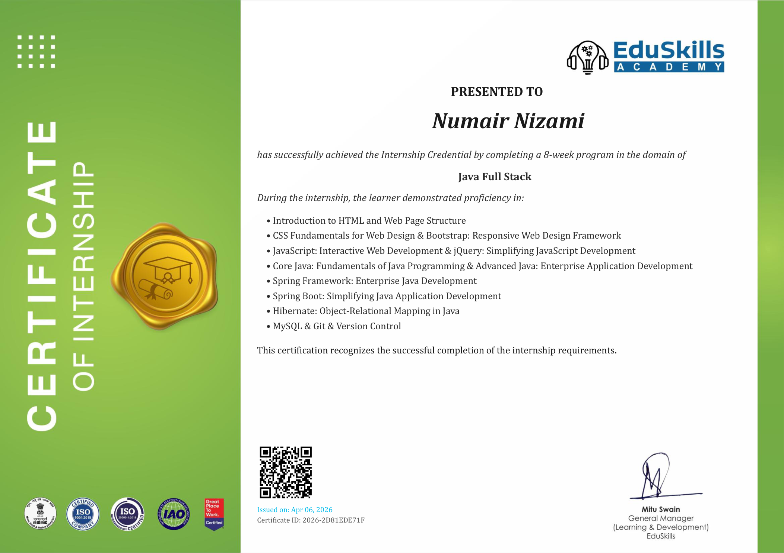
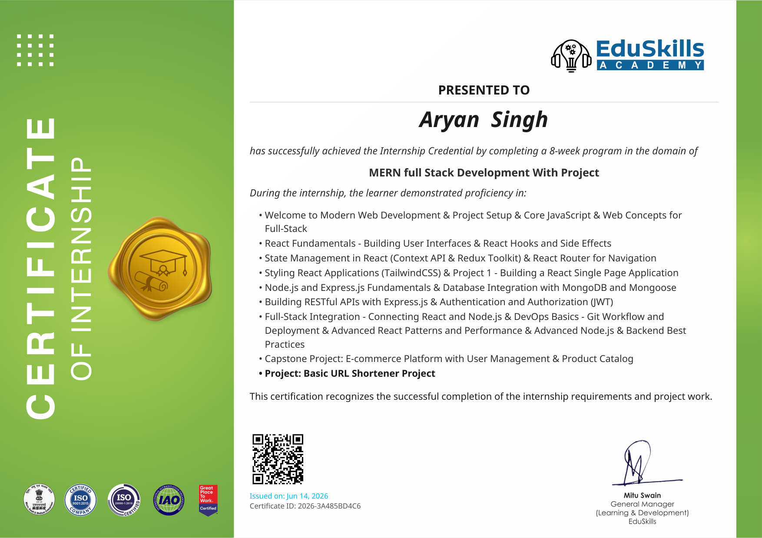

Slide 12
FINAL / TAKEAWAY
FINAL / TAKEAWAY
THANK YOU
Learn the stack.
Build the system.
NUMAIR NIZAMI
STU69e1f231956b81776415281
B.Tech CSE
The internship strengthened practical understanding of Spring Boot, Core Java, Spring Framework, MySQL, APIs, authentication and full-stack project workflow.
IILM UNIVERSITY
AICTE – EduSkills
Virtual Internship
LEARN
BUILD
APPLY
JANUARY – MARCH 2026
JAVA ecosystem
Core Java + Enterprise Java
Spring + Persistence + Git
THANK YOU
JAVA • PROJECT-BASED LEARNING • FULL-STACK INTEGRATION
Java Full Stack Development With Project
AICTE • EDUSKILLS • JAVA FULL STACK
12

