Slide 1



NoSQL Database
Chat with your PDF (OpenAI + Redis)
By: Numaira Zaib

Slide 2


Evolution of Database Systems
From File-Based Models to High-Speed Data Platforms
Key Milestones in Database Evolution
Early systems: Simple file-based storage
Progressed to Relational Databases (SQL) for structured data
Rise of NoSQL & distributed databases for flexibility and scale
Explosion of diverse and unstructured data
Storage costs dropped, but data access challenges increased
Relational DBs exposed limitations in flexibility & performance
Impact of Web 2.0
The Modern Need
Demand for real-time access, high scalability, and fault tolerance
Paved the way for NoSQL solutions like Redis

Slide 3
NoSQL Revolution & the Rise of Redis
Solving Modern Data Challenges with Speed and Simplicity
Limits of Traditional Databases
Struggled with scaling, unstructured data, and real-time needs
Built for structured, relational data with complex joins
Emergence of NoSQL (Late 2000s)
Designed for large-scale, high-performance, distributed data
Supports flexible data formats for modern applications

Slide 4

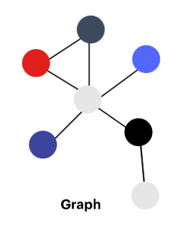

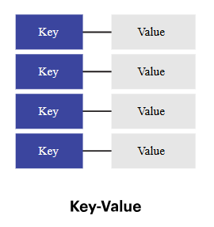
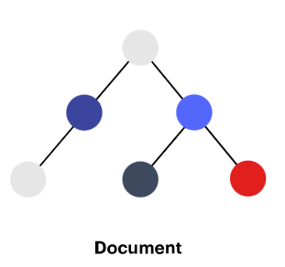
NoSQL Types
Stores data as key–value pairs; ideal for caching and session data (e.g., Redis)
Uses JSON-like documents for flexible, semi-structured data (e.g., MongoDB)
Stores data in RAM for ultra-fast read/write operations (e.g., Redis, Memcached)
Organizes data by columns for fast analytics and aggregation (e.g., Cassandra)
Represents data as nodes and edges for complex relationships (e.g., Neo4j)

Slide 5

Redis Overview
Remote Dictionary Server
Redis is a fast, in-memory NoSQL database known for its key-value structure and event-driven architecture. It’s ideal for real-time, scalable applications and integrates well with AI workflows, like PDF text retrieval and conversational interfaces. Security features include ACLs and TLS encryption, with ongoing improvements. Redis offers a strong foundation for high-performance apps, with future potential in native encryption and cross-cluster support

Slide 6

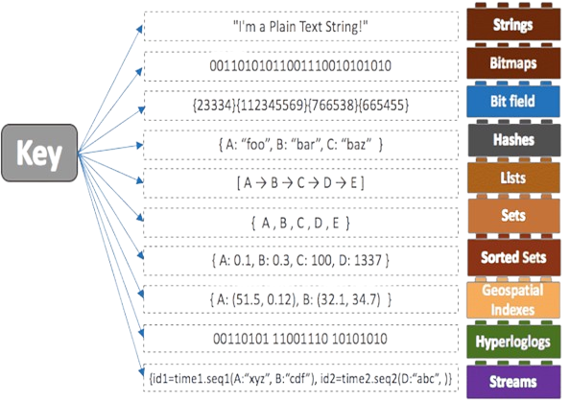

Design
Underlying Data Model
Redis is a key-value based NoSQL database
Supports rich data types: strings, lists, hashes, sets, sorted sets, streams, bitmaps, hyperloglogs, and spatial indexes
All data is stored in memory (not on disk), ensuring sub-millisecond data access
Ideal for real-time use cases due to memory-based storage and fast lookup
Figure: Shows supported data types based on application/business need

Slide 7
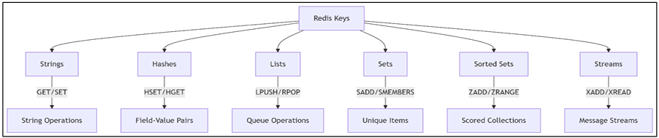
Design
Command-Based Query Language
Replaces SQL with specific commands like SET, GET, HSET, ZADD, etc
Commands are atomic, consistent, and have known time complexities
Lacks SQL’s declarative style but offers high performance and simplicity
Supports publish/subscribe, Lua scripting for complex logic, and transactions via MULTI/EXEC
Most operations complete in constant or logarithmic time

Slide 8
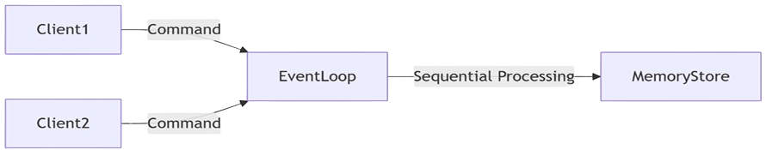
Redis Architecture, Persistence & Scalability
High-Performance Design with Built-In Fault Tolerance
Single-Threaded Architecture
Event-driven model ensures fast, atomic operations
Processes commands sequentially—no locking or thread contention
Optimized with non-blocking I/O and memory-efficient data structures

Slide 9
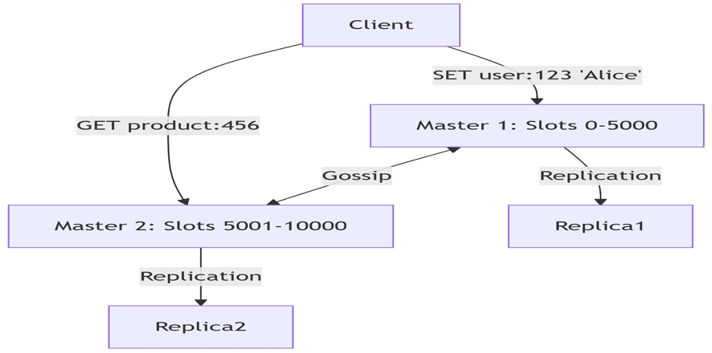
Redis Architecture, Persistence & Scalability
Persistence Mechanisms
RDB: Snapshot-based backup (faster, compact, but may lose recent data).
AOF: Logs each write (more durable, higher storage use).
Both can be combined for balanced durability and performance.
High Availability & Scalability
Replication: Asynchronous master-replica setup.
Redis Cluster: Auto-partitions data with consistent hashing.
Supports smart client routing, failover, and self-healing via gossip protocol.
Enables horizontal scaling without central coordination.

Slide 10

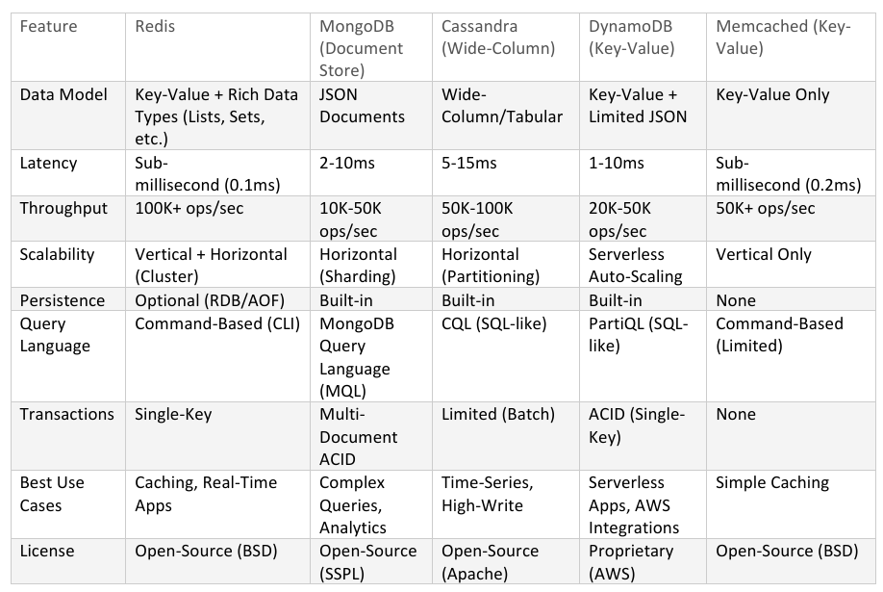
Redis vs Other NoSQL Databases

Slide 11

Redis-Powered PDF QA App
This project combines Redis with GPT-4 to build a fast, intelligent PDF-based QA system. Users upload PDFs, which are converted into embeddings and stored in Redis. When a question is asked, the system retrieves the most relevant content using vector similarity and generates accurate, context-aware answers using GPT-4, all through a user-friendly Streamlit interface

Slide 12

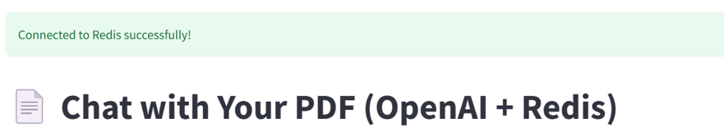
Redis-Powered PDF QA App
Setup, Embeddings & Storage Workflow
Environment Setup
Libraries: Streamlit, PyPDF2, SentenceTransformers, Redis, LangChain, OpenAI
Set OpenAI API key securely for GPT-4 access
Redis Client Initialization
Configured with host, port, password
Used ping() for connection check in Streamlit UI
Embedding Model Loading
Loaded all-MiniLM-L6-v2 using @st.cache_resource for efficiency
Converts PDF text into embeddings for semantic comparison
Conversational Memory
Used ConversationBufferWindowMemory (LangChain) to track last 5 user-chatbot exchanges
Ensures coherent multi-turn conversations

Slide 13
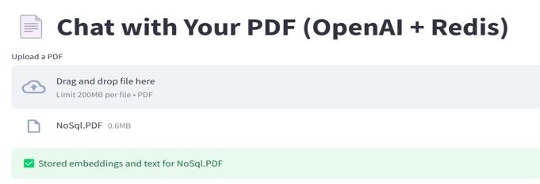
Redis-Powered PDF QA App
PDF Processing, QA Logic & User Interface
LangChain Agent Setup
GPT-4 agent with no external tools, max 5 reasoning steps, early stop
Prompted to answer based only on uploaded PDF content
PDF Text Extraction
extract_pdf_text() uses PyPDF2 to read pages
Warns user if PDF contains no readable text

Slide 14
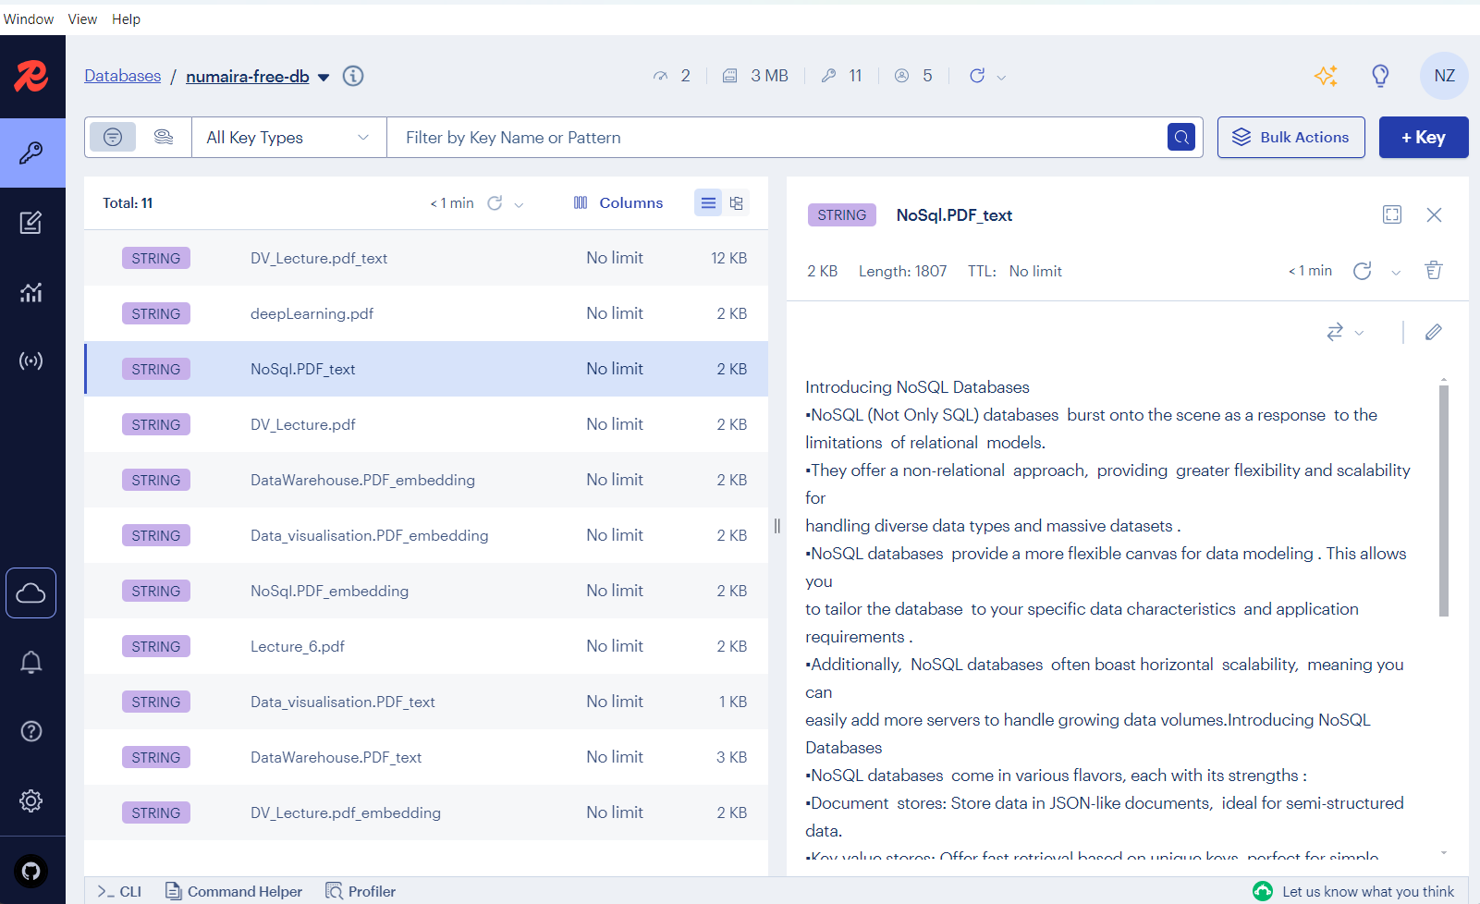
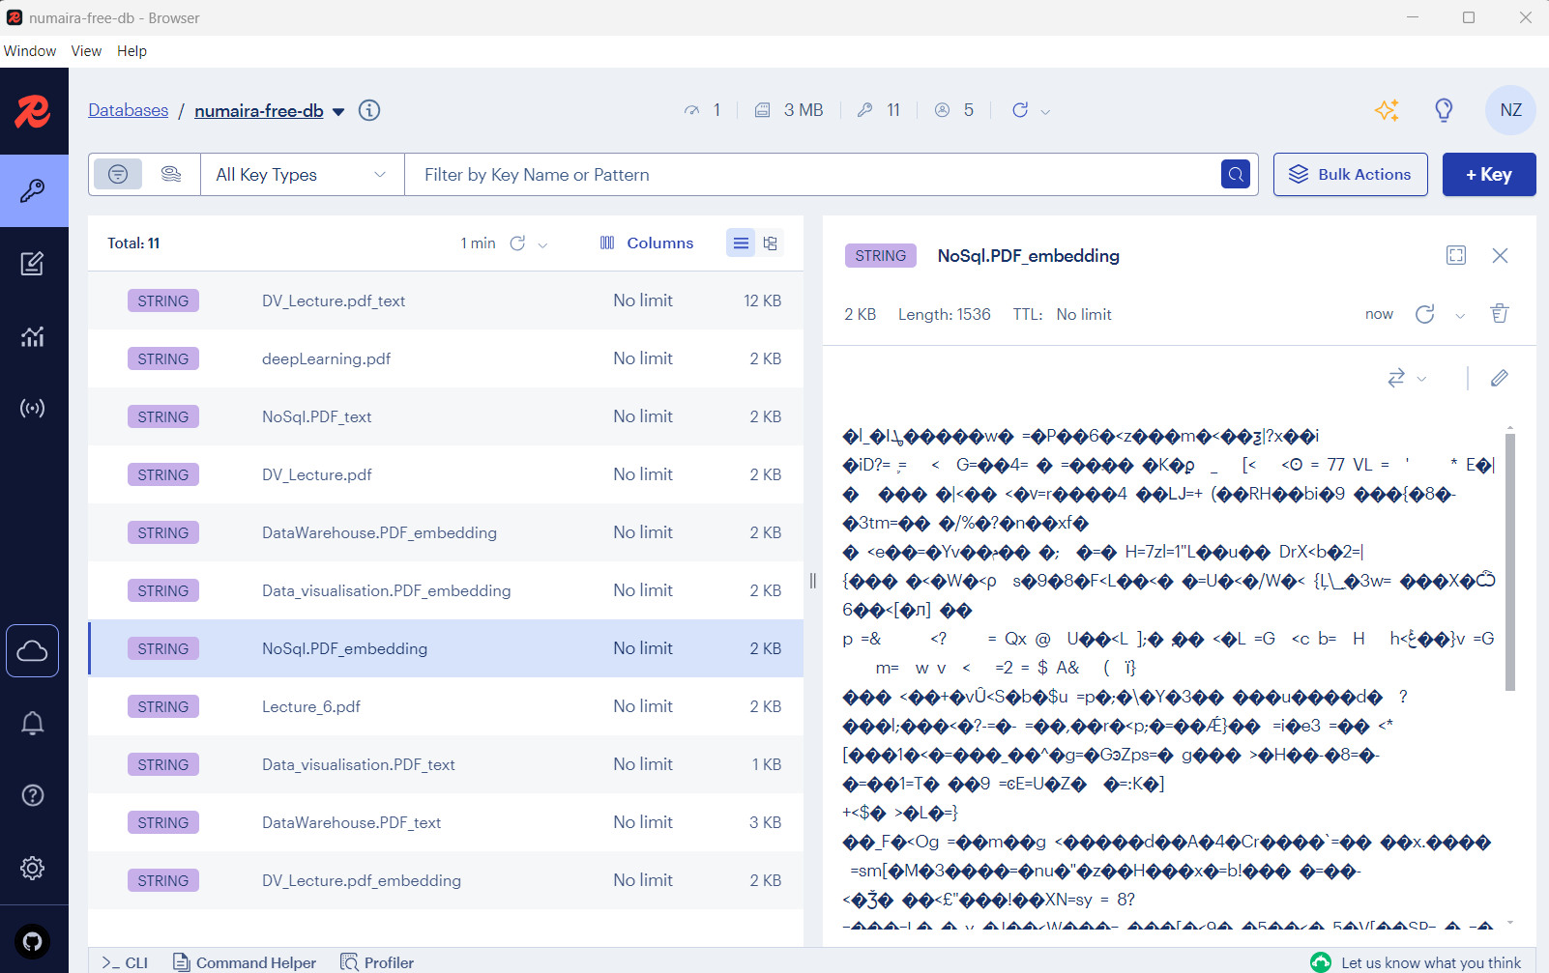
Redis-Powered PDF QA App
PDF Processing, QA Logic & User Interface
Embedding + Text storage in Redis
store_embeddings_in_redis(): → Embeds full text, stores in binary (embedding) and string (text) format

Slide 15
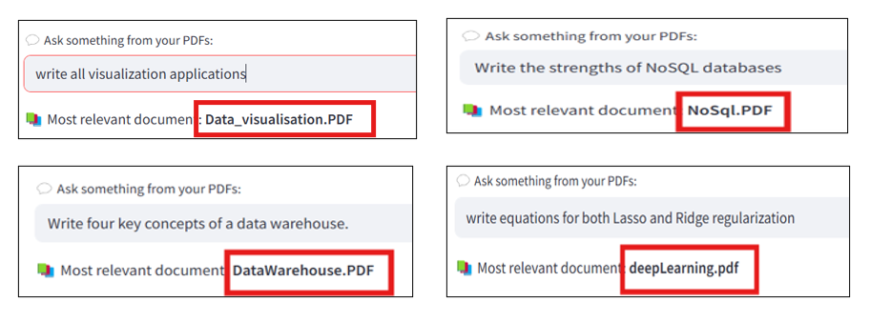
Redis-Powered PDF QA App
PDF Processing, QA Logic & User Interface
Retrieve Relevant PDF
retrieve_similar_pdf(): → Embeds question, computes cosine similarity with stored PDFs
Answer Generation via OpenAI/Streamlit App
get_answer_from_openai() prompts GPT-4 using matched PDF + user query

Slide 16
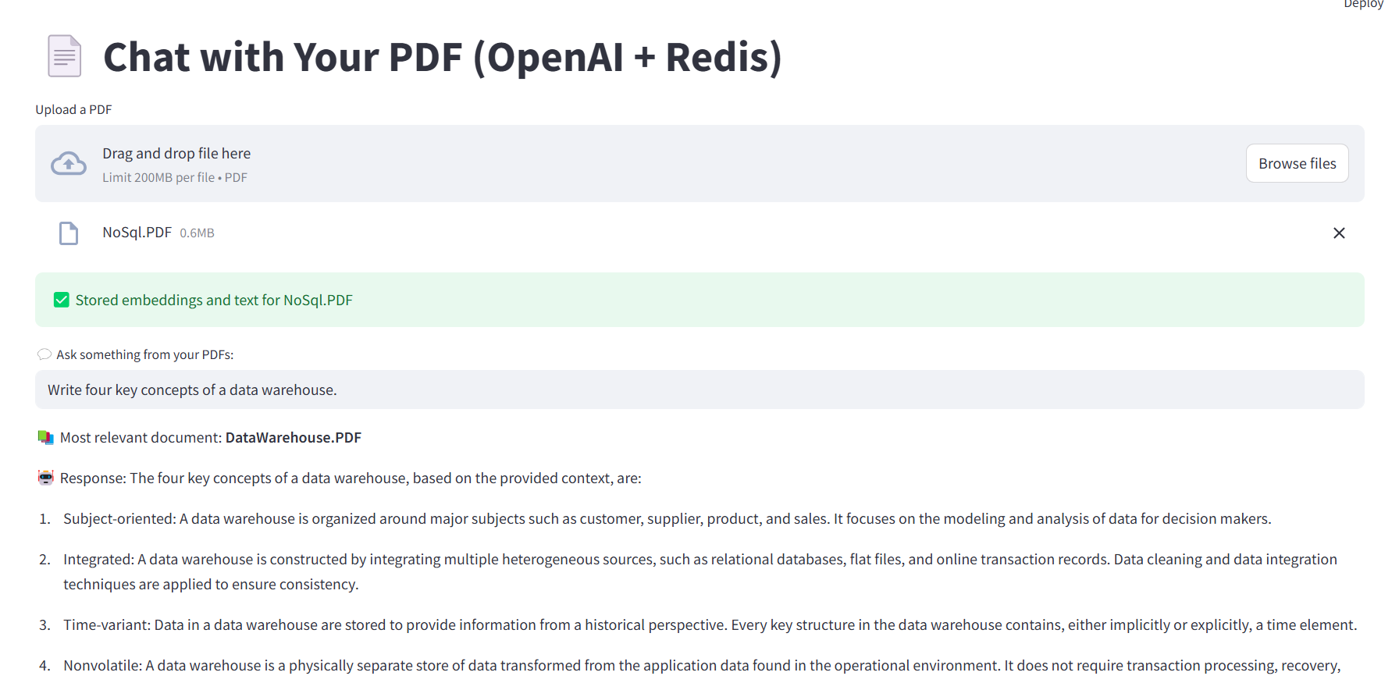
Redis-Powered PDF QA App
RESULTS

Slide 17
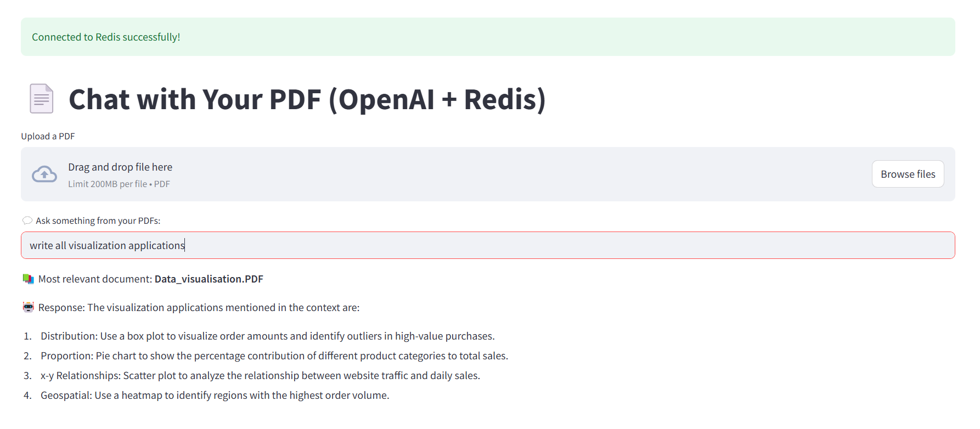
Redis-Powered PDF QA App
RESULTS

Slide 18
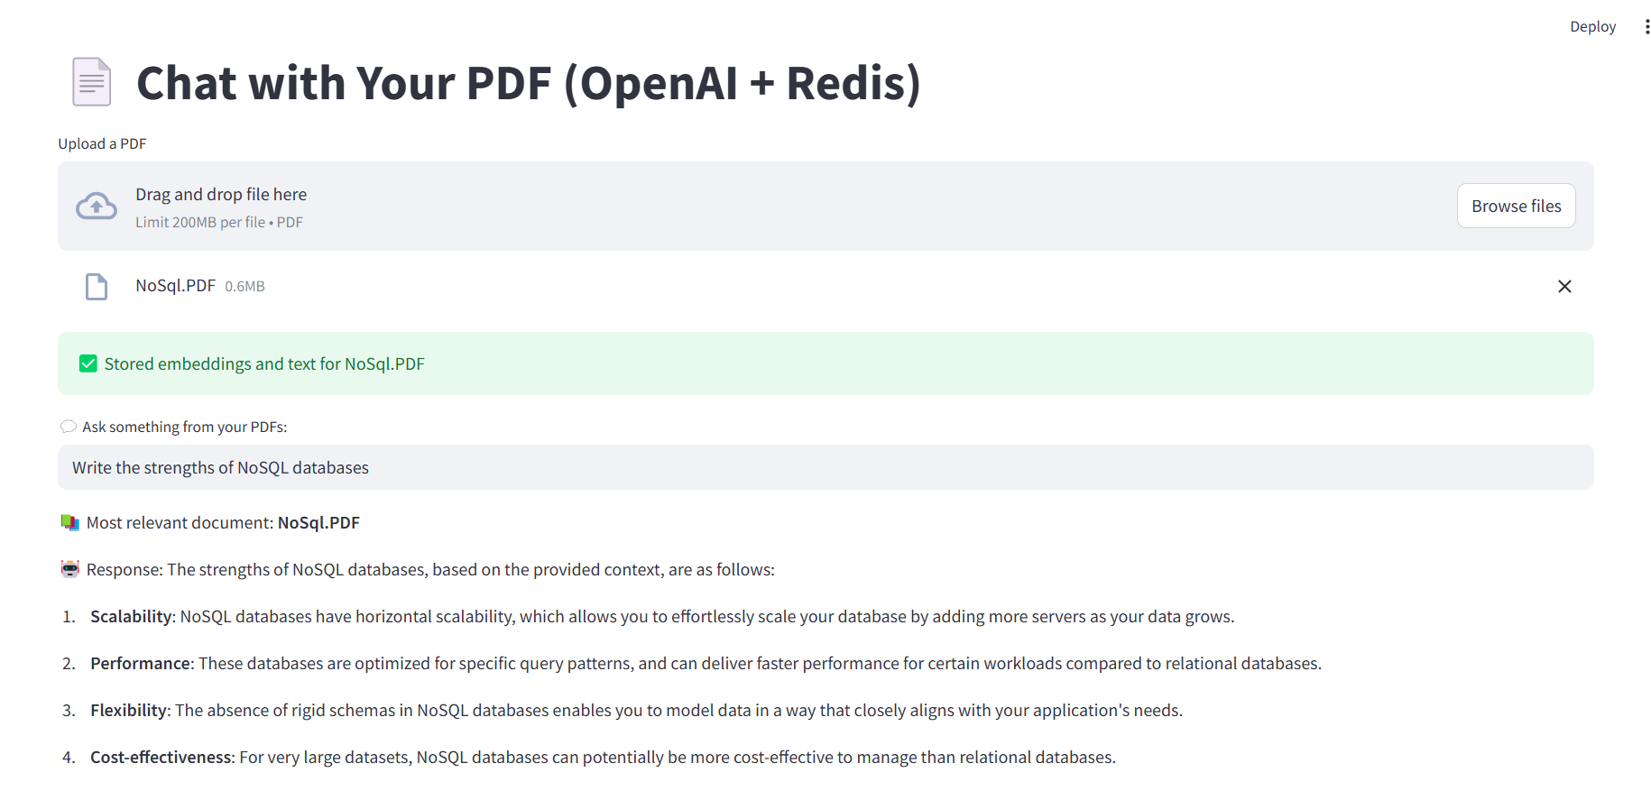
Redis-Powered PDF QA App
RESULTS

Slide 19
REDIS SECURITY OVERVIEW & ACCESS CONTROL
Implementing authentication, access control, and encryption to protect sensitive data in high-performance environments
Why Security Matters
Authentication Methods
Encryption
Options
Redis is high-performance but defaults to speed over security. Exposed instances risk unauthorized access, data corruption, and ransomware attacks.
Requirepass (legacy) one global password
Access Control Lists (Redis 6.0+) define:
User-specific credentials
Allowed/disallowed commands (e.g., +GET, -FLUSHDB)
Key-pattern restrictions (e.g., ~user:*)
In Transit (TLS):
Encrypts client-server & node-node traffic
At Rest:
Use OS-level encryption (e.g., BitLocker, LUKS)
Redis Enterprise: Transparent Data Encryption (TDE)

Slide 20
Redis Threats and Mitigation Strategies
Identifying common attack surfaces and applying best practices to secure Redis deployments from exploitation
Common Security Risks
Mitigations
Best
Practices
Redis faces major security risks like open network access (0.0.0.0), allowing unauthorized connections. Attackers may exploit powerful commands (e.g., CONFIG SET, FLUSHDB, EVAL) to inject malicious instructions or deploy ransomware that deletes or corrupts data
To reduce risk, Redis should bind only to trusted IPs (e.g., 127.0.0.1), with firewalls limiting access. Disable or rename sensitive commands (e.g., rename-command FLUSHDB ""), enforce file permissions, back up data regularly, and enable AOF logging for recovery
Secure Redis using Zero Trust principles. Enable TLS for encrypted communication, use ACLs for fine-grained access control, and implement monitoring to detect suspicious behavior early

Slide 21
Core Metrics for Monitoring Redis performance
Throughput & Latency
Measure ops/sec and response times using tools like redis-benchmark or memtier_benchmark. Use --latency in redis-cli for detailed latency insights.
Scalability
Test vertical scaling by increasing CPU/memory. For horizontal scaling, use Redis Cluster and --cluster benchmarks to analyze performance impact.
Memory Efficiency & Eviction
Monitor via INFO memory, MEMORY STATS, and fragmentation ratios. Always set a max memory limit with an eviction policy to prevent OOM errors and ensure write operations continue under memory pressure.
Monitoring Redis performance is essential to ensure reliability, speed, and efficient resource usage. Key metrics include throughput, latency, scalability, and memory efficiency each influencing system stability

Slide 22

Redis Cost Structure Comparison
Open-Source Redis (Self-Managed)
Redis Enterprise (Subscription-Based)
AWS ElastiCache (Pay-as-you-go)
Azure Cache for Redis
(Tiered Pricing)
Cost: Free (excluding infrastructure)
Features: Basic key-value store, no clustering, manual scaling/backups
Best For: Developers with custom hosting and low-budget environments
Cost: ~$0.50/hour/node (AWS)
Features: Auto sharding, geo replication, RBAC, TLS, 24/7 support
Best For: Small-scale apps, high availability, managed solutions
Cost: $0.022/hr (t2.micro) to $1.135/hr (r6g.4xlarge)
Features: Multi-AZ, backup/restore, failover automation
Best For: Cloud-native, scalable workloads, enterprise needs
Cost: $0.022/hr (t2.micro) to $1.135/hr (r6g.4xlarge)
Features: Multi-AZ, backup/restore, failover automation
Best For: Cloud-native, scalable workloads, enterprise needs

Slide 23
Summary & Future Directions of Redis
Redis is a high-performance, in-memory key-value database with sub-millisecond latency.
Supports diverse data types and is ideal for real-time use cases like caching, pub/sub, and session management.
Offers fault tolerance via RDB/AOF persistence and scalability through Redis Cluster.
Security has improved with ACLs and TLS, but lacks built-in data-at-rest encryption in open-source.
Widely used in AI-driven applications for fast data retrieval and lightweight backend support.
Future improvements may focus on native encryption, better multi-key transactions, and AI-based resource optimization.

Slide 24
Thank You!

