Slide 1


Global Superstore Sales Analysis
Driving Business Intelligence Through Power BI Visualizations
BY: NUMAIRA ZAIB

Slide 2

INTRODUCTION
Data-Driven Decision-Making in Business
In today’s highly competitive business environment, the importance of data-driven decision-making cannot be overstated.
Businesses are increasingly relying on data to optimize sales performance and improve operational efficiency.
Key objective: Analyse and utilize Global Superstore Sales Data to provide actionable insights for business growth.
Project Aims and Key Areas of Focus

Slide 3




Project Objectives & Scope
Project Aims & Key Areas of Focus
Data
Pre-processing
Data
Visualization
Hypothesis
Testing
Business
Insights
Ensuring the integrity, consistency, and quality of the sales data
Creating interactive dashboards in Power BI to identify sales patterns
Validating assumptions and uncovering meaningful statistical relationships within the data
Proposing actionable recommendations based on the data analysis to drive growth

Slide 4

Data Overview
& Key Features
Contains transactional data on sales, customers, shipping, and products.
Offers insights into sales trends, customer segments, shipping preferences, and product performance.
Key Attributes
Order Details: Order ID, Order Date, Ship Date, Ship Mode.
Customer Information: Customer ID, Name, Segment.
Location Data: Postal Code, City, State, Country, Region, Market.
Product Info: Product ID, Category, Sub-Category, Product Name.
Financial Metrics: Sales, Quantity, Discount, Profit, Shipping Cost.
Order Priority: High, Medium, Low, Critical.
Factuality
in
RAG

Slide 5
Initial Observations from the Dataset
Customer Segmentation
Geographic
Insights
Consumer, corporate and home office segments
Product Diversity
Sales recorded across various cities, sates and regions
Includes categories like Technology, Furniture, and Office Supplies
Shipping
Dynamics
Profitability
Factors
Understanding the dataset lays the foundation for data pre-processing, dashboard development, and hypothesis testing.
Discounts and profit margins require strategic pricing analysis
Different modes impact delivery speed and costs

Slide 6

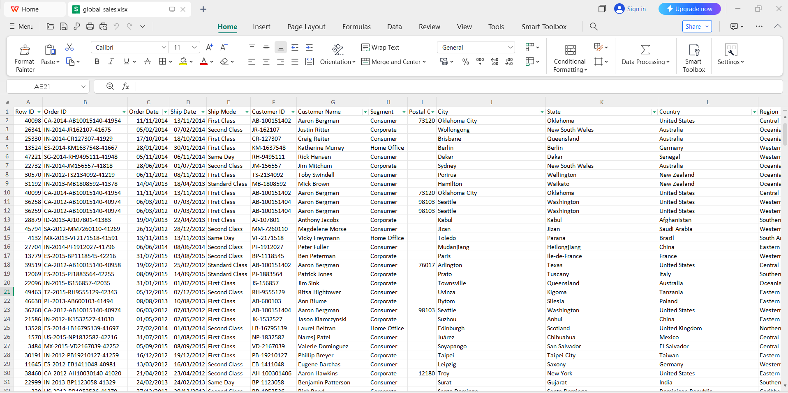
Data Set

Slide 7
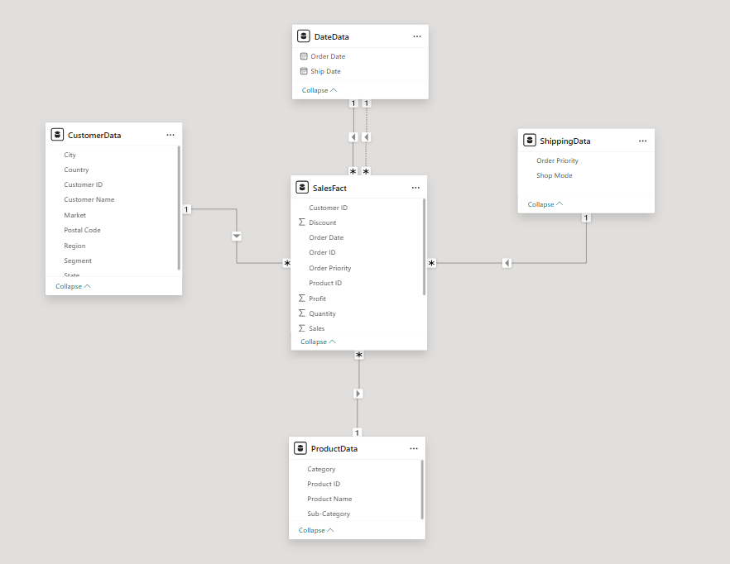
Star Schema: Data Organization
Fact Table: SalesFact — Central transactional data (sales, shipping, discounts, profits)
Dimension Tables & Relationships: (one to many)
SalesFact ➝ CustomerData
▸ Linked by Customer ID (Customer details)
SalesFact ➝ ProductData
▸ Linked by Product ID (Product information)
SalesFact ➝ ShippingData
▸ Linked by Ship Mode (Shipping method details)
SalesFact ➝ DateData
▸ Linked by Order Date (Order timeline)
▸ Linked by Ship Date (Shipping timeline)

Slide 8

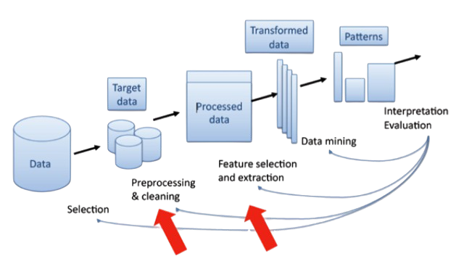
Data Pre-Processing in Power BI
Data preprocessing involves cleaning, transforming, and preparing data for analysis Performed in Power BI using the Power Query Editor
Importance:
Ensures consistency and accuracy.
Removes errors and missing values.
Standardizes data for better insights and visualization.
Improves data quality for strategic decision-making.

Slide 9
Key Pre-Processing
Steps and techniques
Handling Missing Values
Removing Duplicates
Correcting Data Types
Text → Customer Name, Order ID
Date → Order Date, Ship Date
Number → Sales, Profit, Quantity
Currency → Sales, Profit, Shipping Cost.
Postal Code → Fill with "N/A“
Sales, Profit, Quantity, Shipping Cost → Replace with 0
Discount → Set missing values to 0%.
Identify and remove based on Order ID and relevant attributes

Slide 10

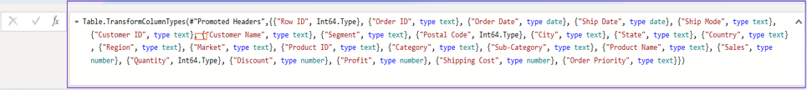
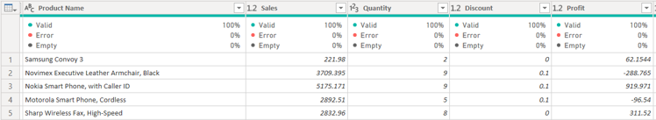
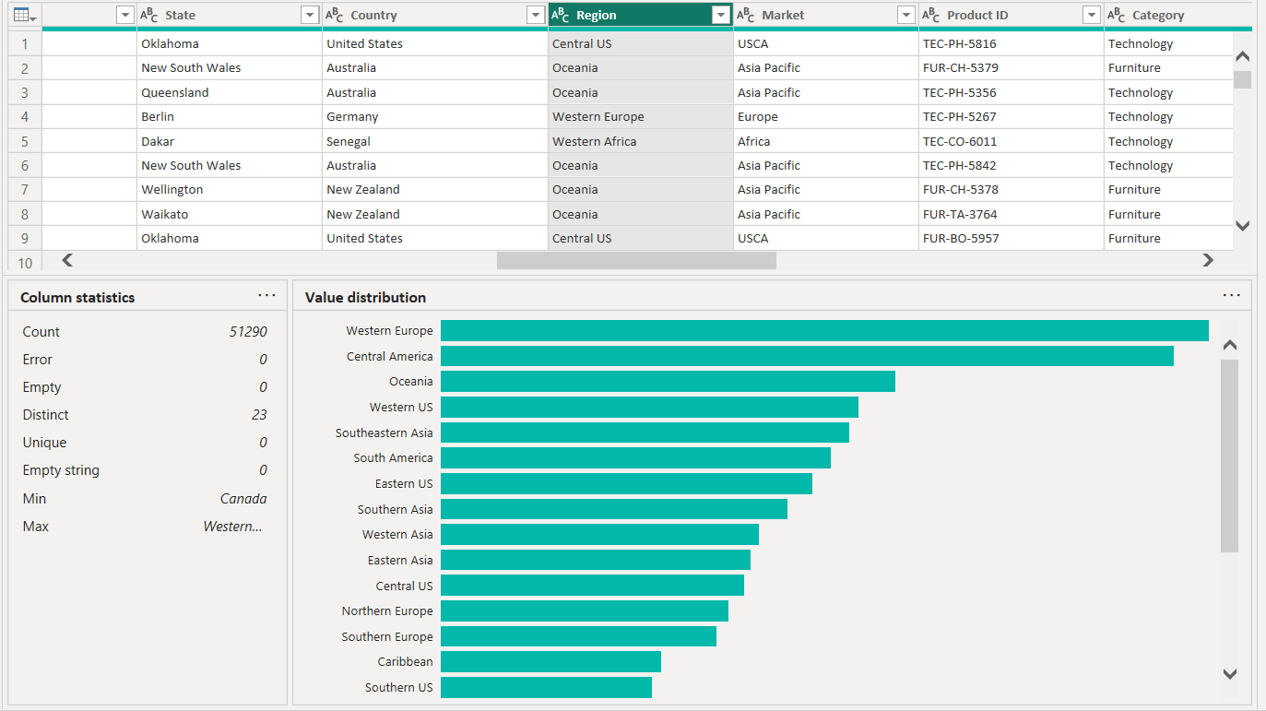
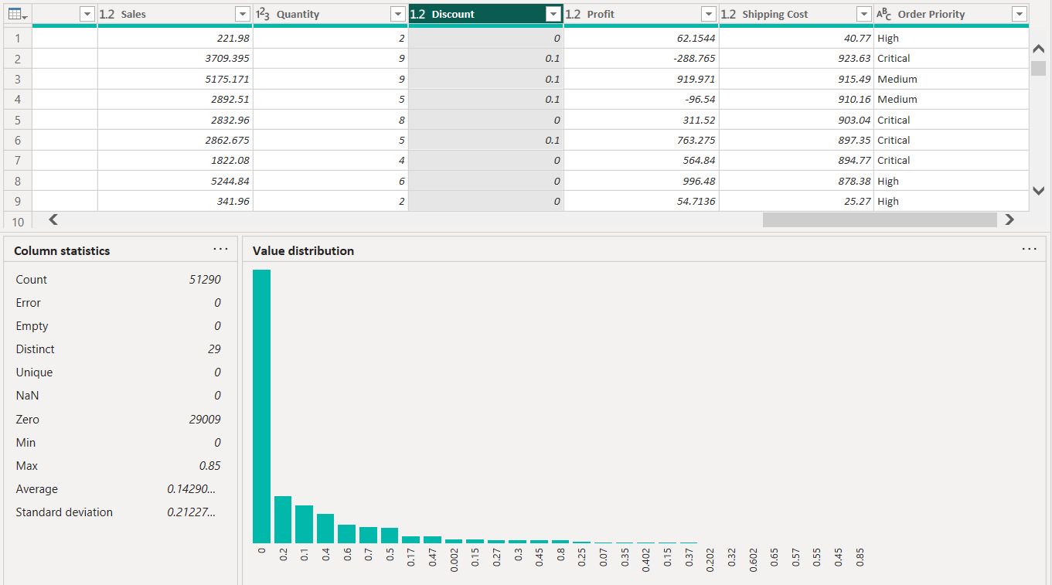
Error Free Data With Some Statistics

Slide 11
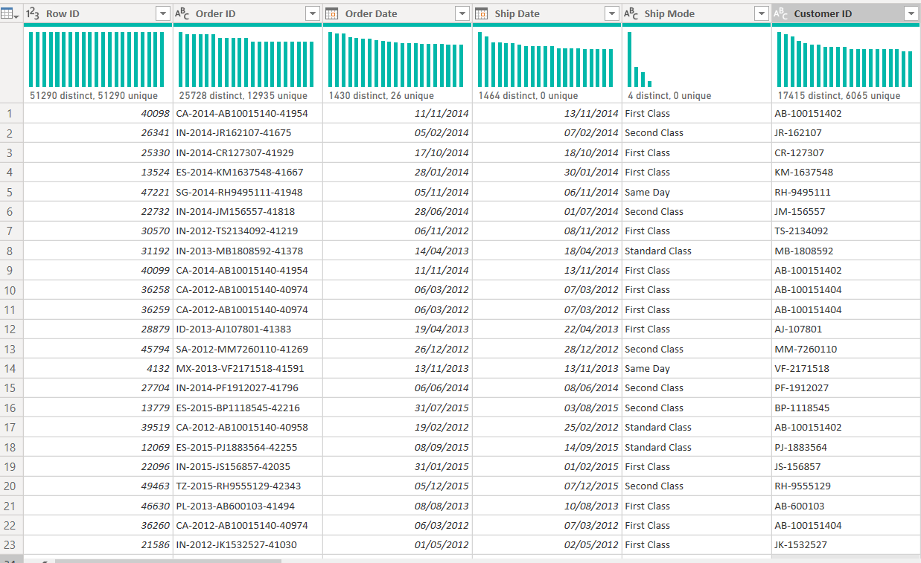
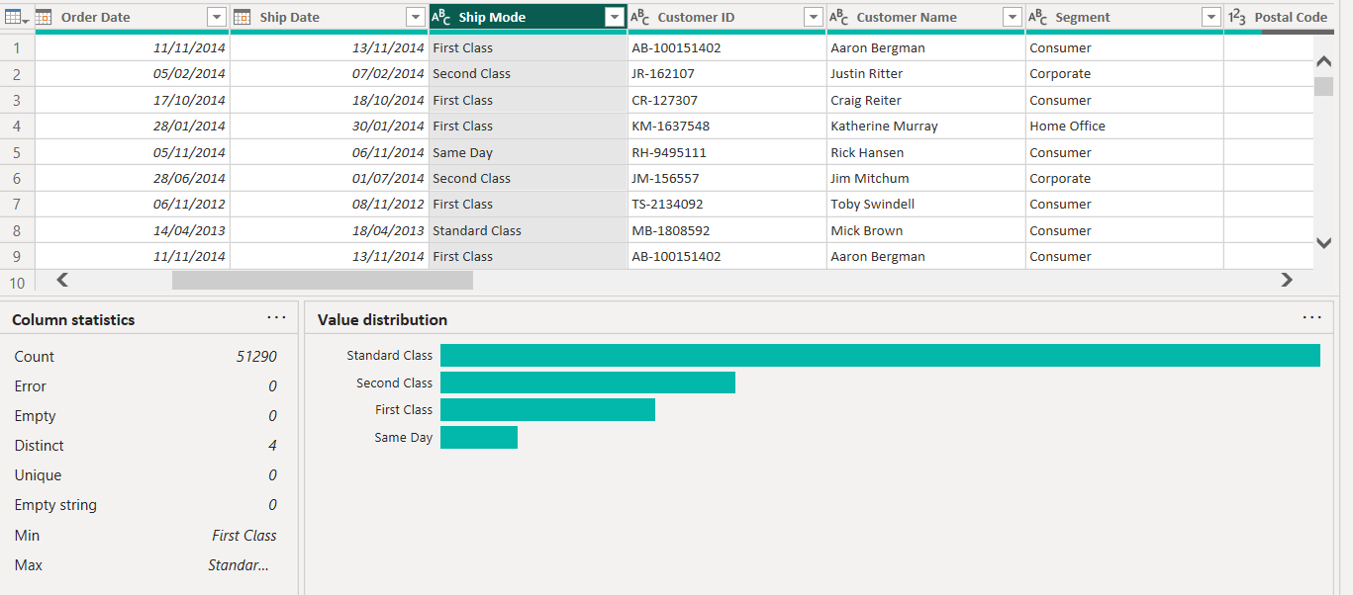
Error Free Data With Some Statistics

Slide 12

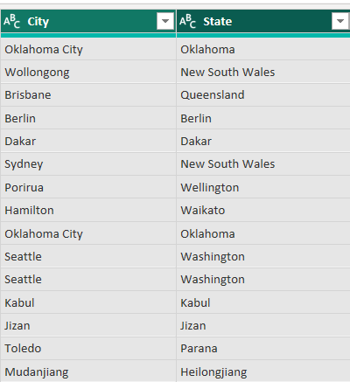
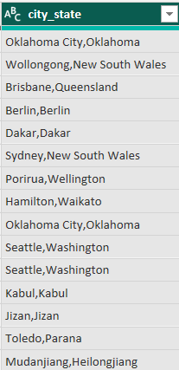
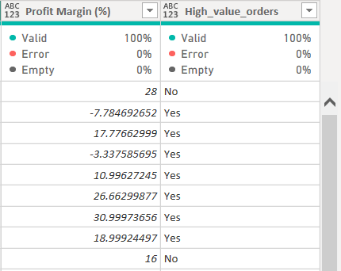
Merging Columns & Feature Engineering
Merging Columns:
Combined City and State into one field for better location insights.
Feature Engineering:
Profit Margin:
Formula: (Profit / Sales) × 100.
Assesses order profitability.
High-Value Orders:
Identifies orders with Sales > $500.
Highlights premium customers and purchasing trends.
Preprocessing ensures error-free, structured data ready for deep analysis.

Slide 13

Sales & Profit Analysis Dashboard
Purpose: Track sales performance, profit trends, and high-value orders to drive business decisions
Problem Statement:
Identify profitable products and categories
Understand sales/profit trends over time
Measure the impact of high-value orders
Optimize product sales strategies
Key KPIs:
Total Sales
Total Profit
Total Orders
Average Profit Margin (%)
High-Value Orders Count

Slide 14
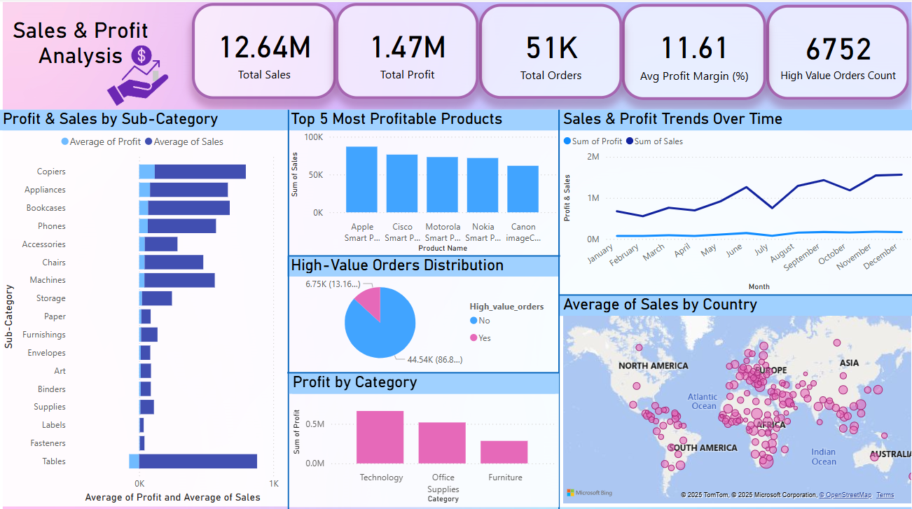

Slide 15
Dashboard Insights
Highlights steady demand for high-end products like Apple Smart Phones
Reveals seasonal sales peaks (June, Sept, Dec) and stable profits
Uncovers pricing inefficiencies (e.g., Tables)
North America, Europe, and Asia dominate in sales, guiding market focus
Only 13.16% are high-value, crucial for premium customer strategies
Technology leads in profitability, Furniture lags behind

Slide 16


Shipping Cost & discount Analysis Dashboard
Purpose: Analyze shipping costs, discount trends, and fulfillment efficiency to optimize logistics and pricing strategies.
Problem Statement:
Identify cost-heavy periods and shipping inefficiencies.
Optimize discounts to protect profitability.
Improve fulfillment times based on shipping mode.
Target high-cost regions for better logistics management.
Key KPIs:
Total Shipping Cost
Average Shipping Cost
High Shipping Orders
Loss Orders
Order Fulfillment Time

Slide 17

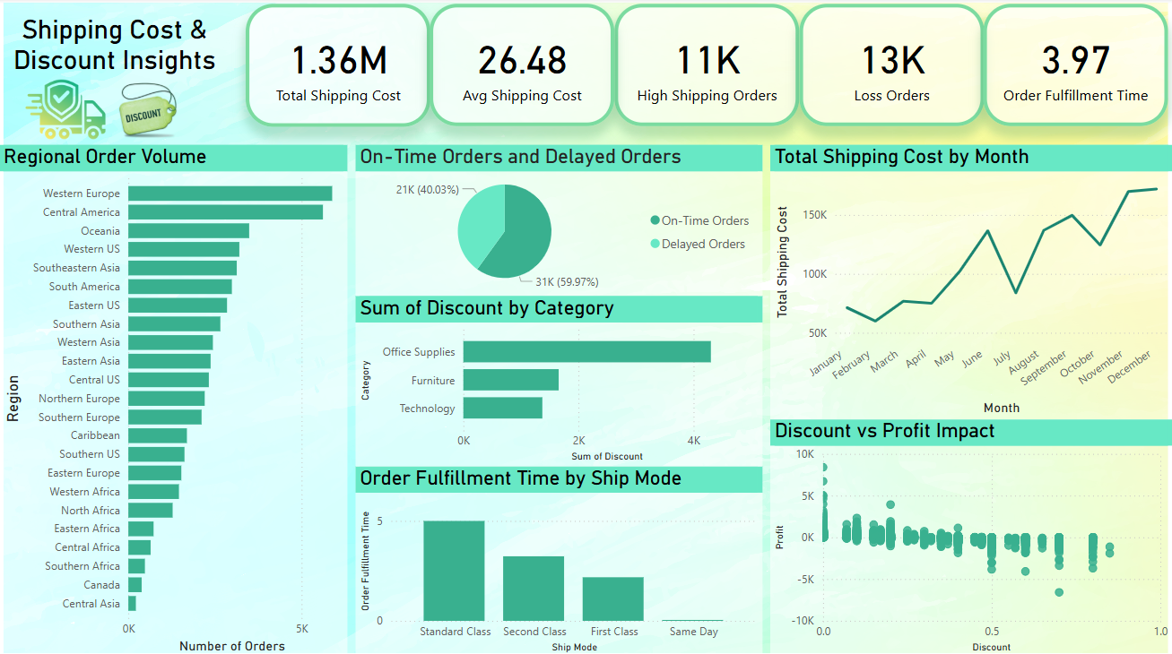

Slide 18
Dashboard Insights
59.97% delays significant supply chain inefficiencies to address
Costs peak in June, September, December important for budgeting
Strong presence in Western Europe and Central America, growth needed in Canada and Central Asia
Office Supplies have the highest discounts, Technology maintains premium pricing
Higher discounts reduce profitability, careful discount strategy needed.
Same-day shipping is fastest, Standard Class is slowest

Slide 19
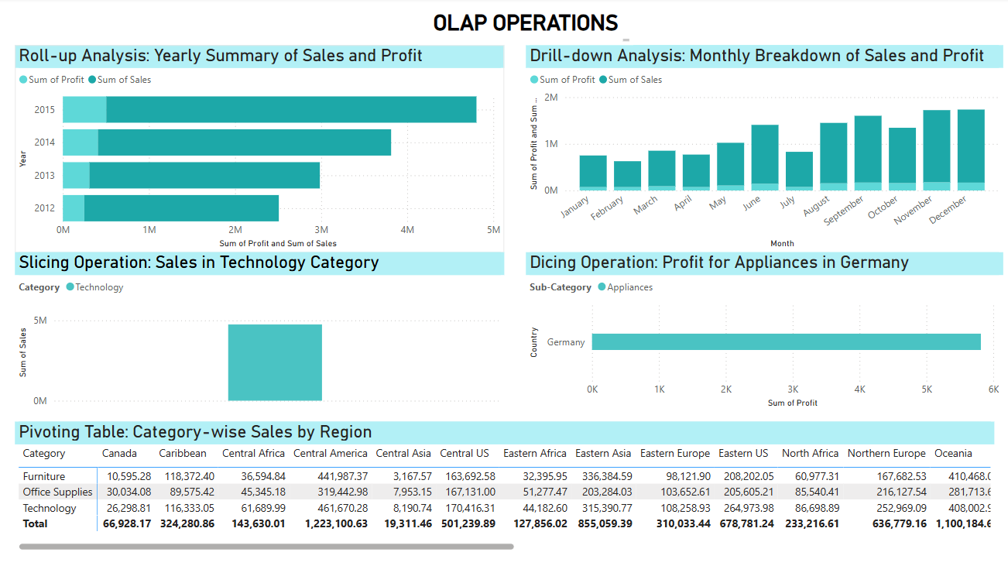

Slide 20
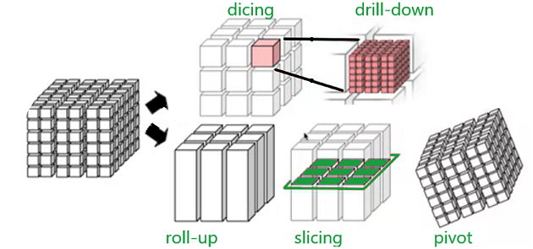
OLAP Operations
1. Roll-up Analysis: Yearly Summary of Sales and Profit → Aggregates data from lower levels (e.g., months) to a higher time level (years).
2. Drill-down Analysis: Monthly Breakdown of Sales and Profit → Explores deeper time granularity within the year for detailed trend analysis.
3. Slicing Operation: Sales in Technology Category → Filters the entire dataset to focus only on the Technology category.
4. Dicing Operation: Profit for Appliances in Germany → A narrow data slice filtered by Country = Germany and Sub-Category = Appliances.
5. Pivoting Table: Category-wise Sales by Region → Rearranges data to compare multiple metrics across Categories and Regions.

Slide 21
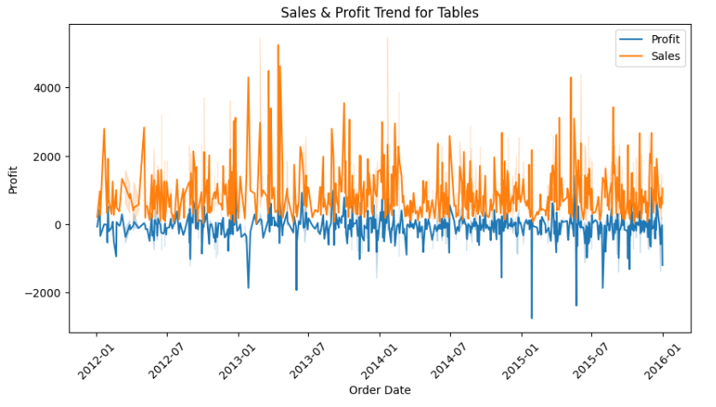
Identifying the Profitability Issue & Key hypothesis
Hypothesis for analysis
Impact of Discounts:
High discounts may be reduce profit margins
Analyzing Profitability Issues at Table
01.
Problem Statement:
Table is experiencing negative profits under certain conditions, which threatens long-term business sustainability
Impact of High Shipping Costs:
High shipping expenses may be eating into profits
02.
High-Value Orders and Shipping Costs:
High-value orders might incur disproportionately high shipping costs.
03.

Slide 22
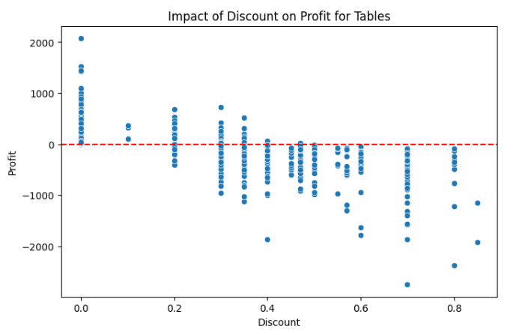
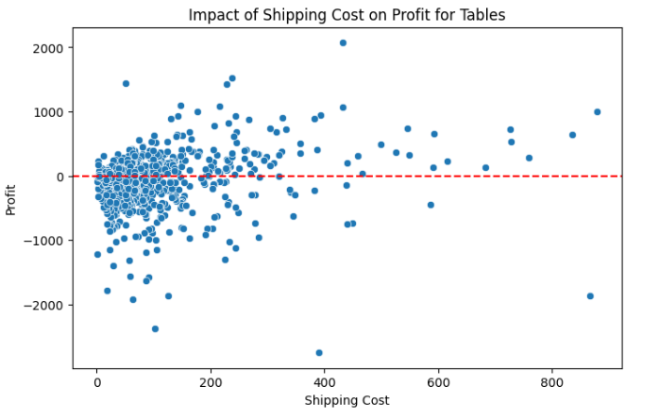
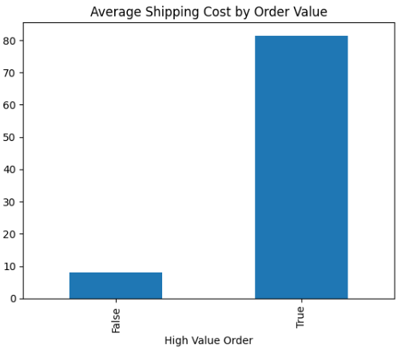
Hypothesis Testing & Key Findings
Hypothesis 1
Hypothesis 1: Impact of Discounts on Profitability:
T-test Result: T-statistic: -18.54, P-value: 3.44e-61
Conclusion: Reject Ho, Discounts significantly reduce profits. A revision of discounting strategy is necessary.
Hypothesis 2: High Shipping Costs on Profitability:
T-test Result: T-statistic: 2.69, P-value: 0.0074
Conclusion: Reject Ho, High shipping costs significantly reduce profitability. Optimization is needed.
Hypothesis 3: High-Value Orders & Shipping Costs:
T-test Result: T-statistic: 88.20, P-value: 0.0
Conclusion: Reject Ho, High-value orders incur significantly higher shipping costs. Shipping cost allocation needs improvement.
Hypothesis 2
Hypothesis 3

Slide 23


Proposed Solutions to improve Profitability
Optimizing Discount Strategies
SOLUTIONS!!
Implement a tiered discount model
Shift to loyalty-based discounts for repeat customers
Controlling High Shipping Costs for
High-Value Orders
Reducing Shipping Costs
Negotiate better shipping rates
Introduce minimum order value for free shipping
Optimize packaging to reduce costs
Establish regional distribution centers
Implement batch shipping to reduce per order costs

Slide 24
Conclusion
✅ Key Findings:
High discounts and high shipping costs significantly contribute to negative profits.
Hypothesis testing confirmed the critical impact of these factors.
✅ Actionable Solutions:
Optimize discount strategies (tiered and loyalty-based discounts).
Improve shipping cost management (negotiations, minimum order policies, better logistics).
✅ Impact:
Align pricing and logistics with sustainable business growth.
Drive profitability through data-driven decision-making.

Slide 25
Thank You!

