Slide 1
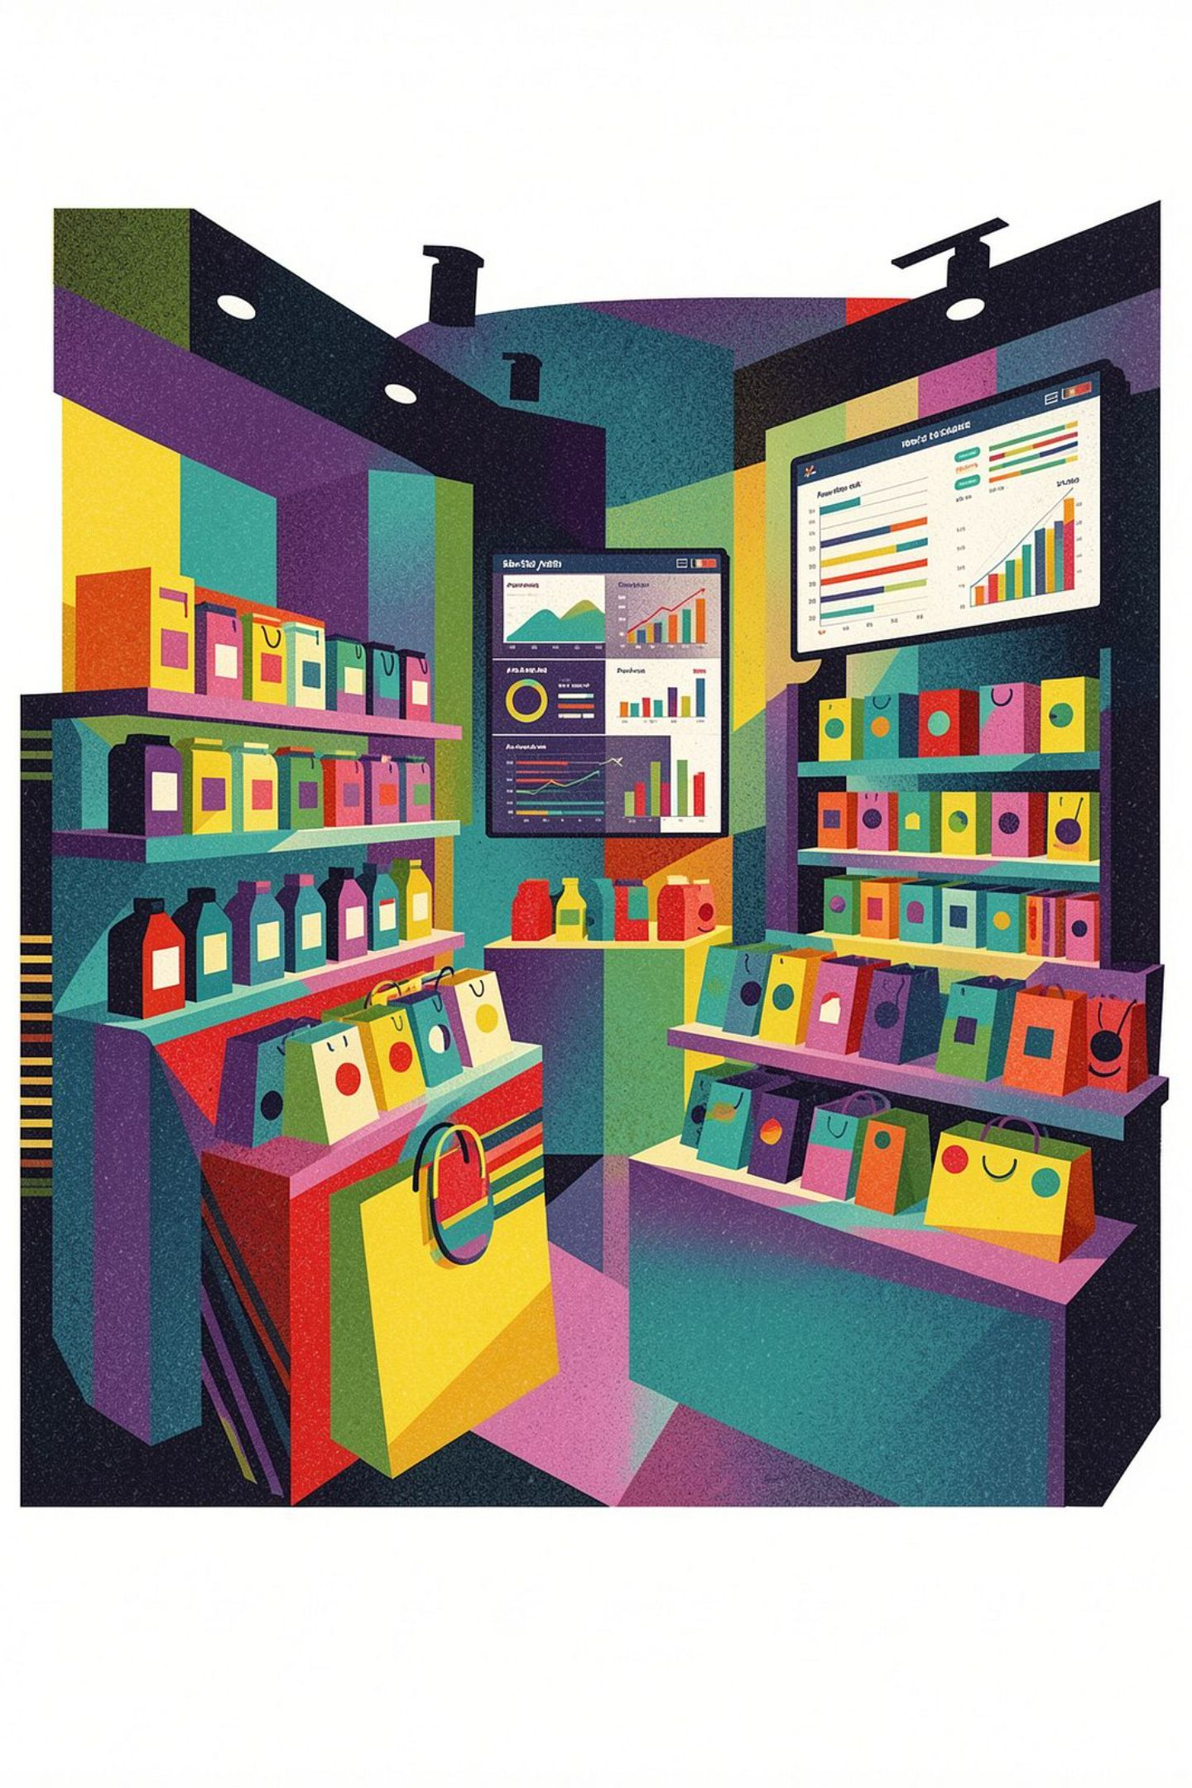
Customer Shopping Behavior Analysis
An End-to-End Data Analytics Project
PYTHON
PANDAS
POSTGRESQL
SQL
POWER BI
Presented By: Numan Momin

Slide 2
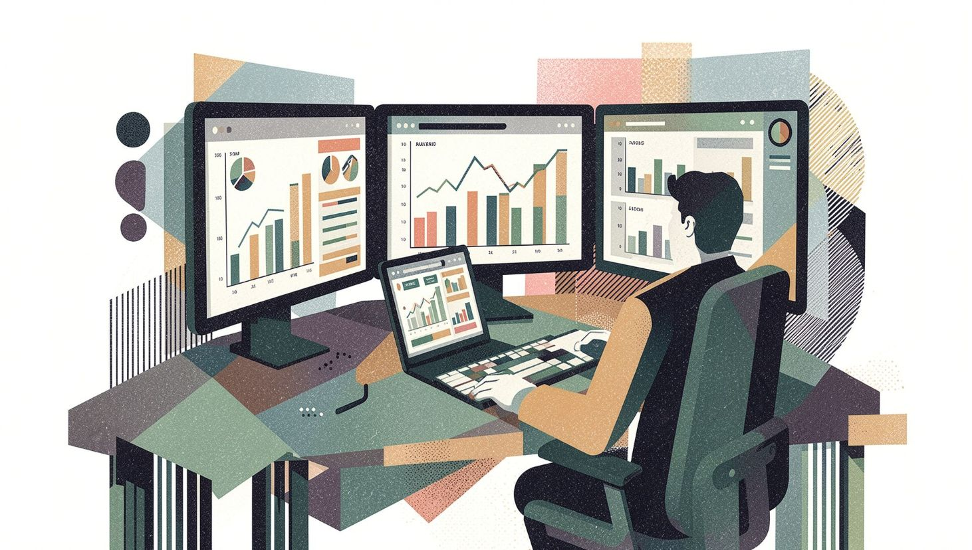

Project Overview & Objectives
Project Overview
This project analyzes customer shopping data to understand purchasing patterns, customer segments, product performance and revenue contribution.
Objectives
Analyze customer purchasing behavior
Clean and prepare data using Python
Perform feature engineering
Store and analyze data using PostgreSQL & SQL
Analyze customer, product and category performance
Build an interactive Power BI dashboard
Generate actionable business recommendations
Dataset: 3,900 Records | 18 Original Columns | 4 Categories | 25 Products

Slide 3
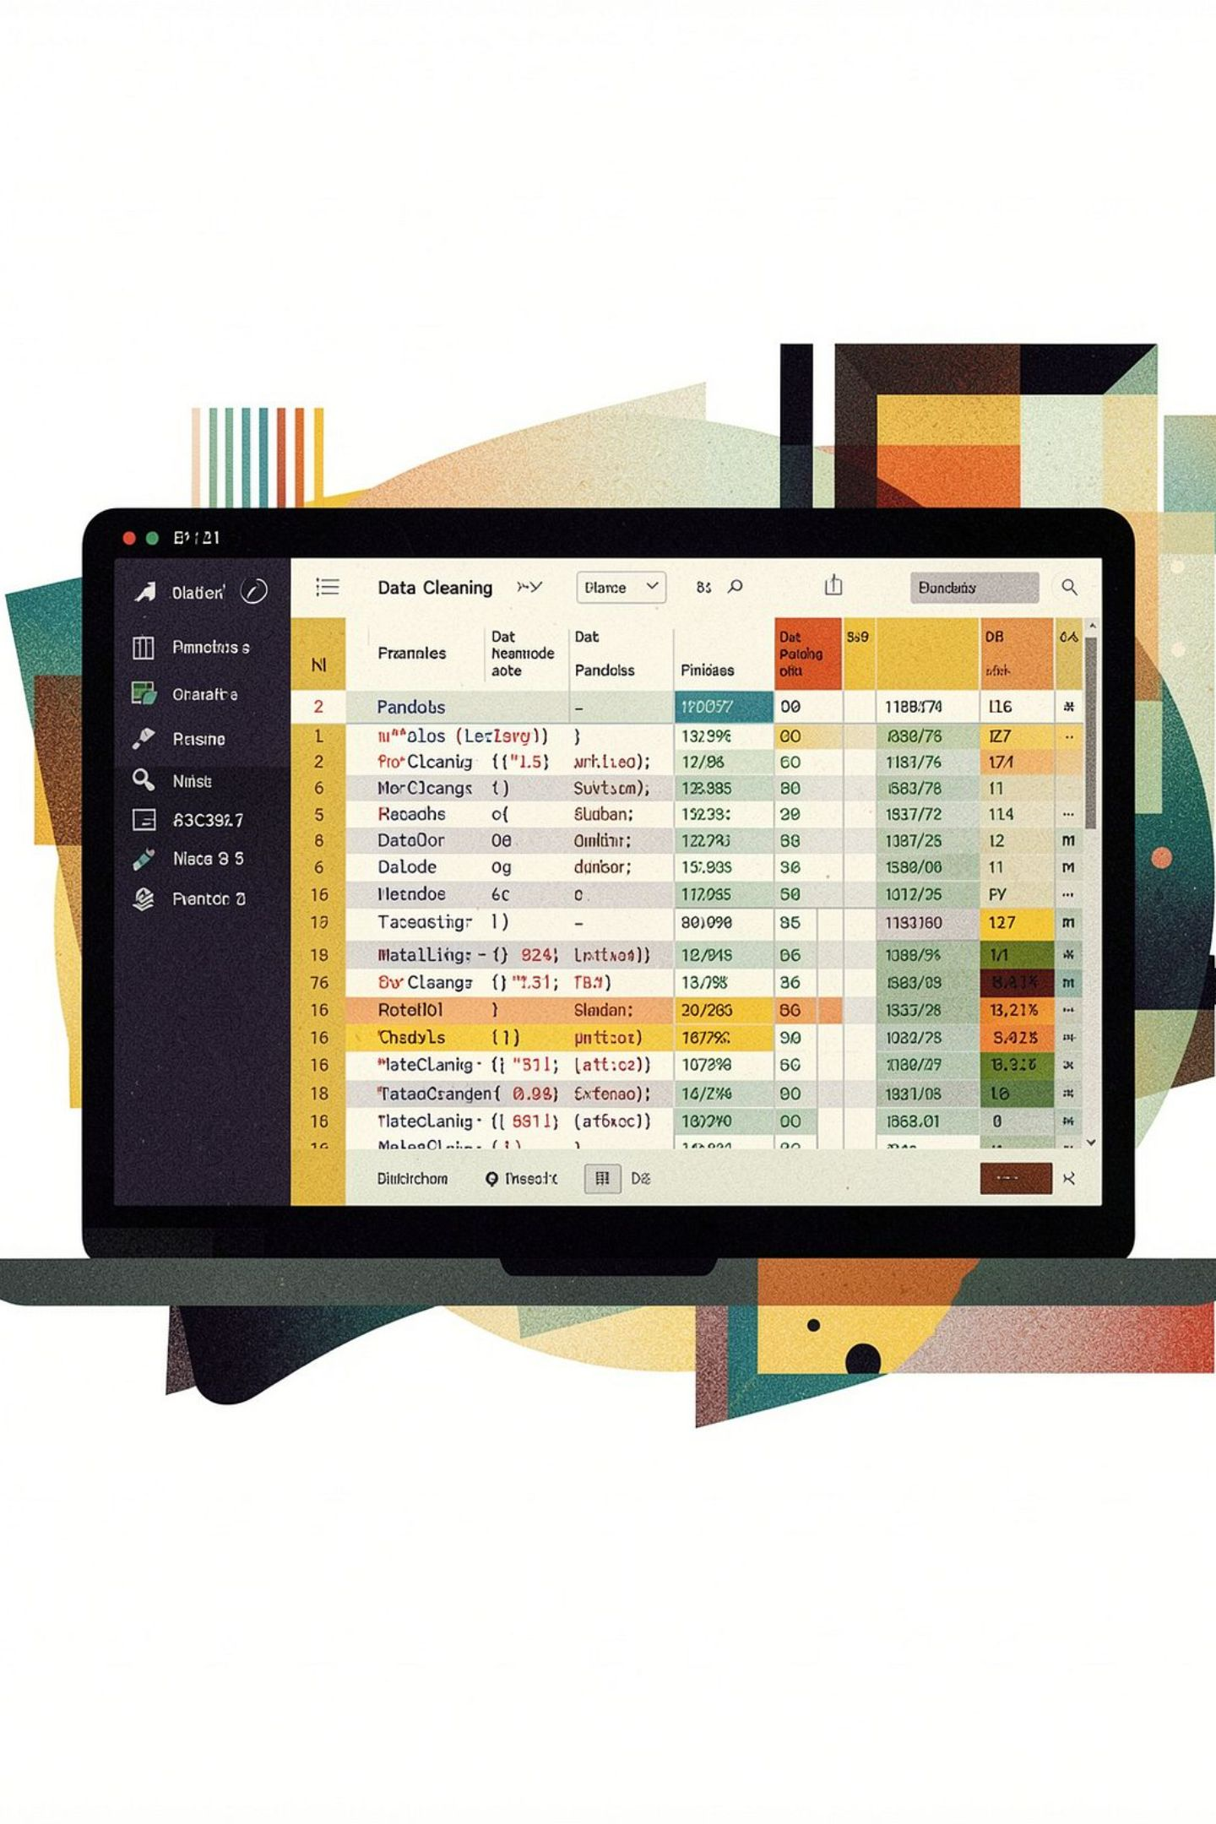


Python: Data Cleaning & Feature Engineering
Data Cleaning
Feature Engineering
Loaded dataset using Pandas
Inspected structure using info() and describe()
Checked missing values — None found
Standardized column names
Renamed purchase_amount_(usd) → purchase_amount
Removed redundant promo_code_used column
Age Group
Young Adult · Adult · Middle-aged · Senior
Purchase Frequency
Weekly (7d) · Fortnightly (14d) · Monthly (30d) · Quarterly (90d) · Annually (365d)

Slide 4
PostgreSQL & SQL Analysis
Data Storage
SQL Business Questions Answered
Database: customer_behavior
Table: customer
Tools: SQLAlchemy + psycopg2
01
Revenue by gender
02
Customer Segmentation
Discounted purchases above average spending
New: 1 previous purchase
Returning: 2–10 previous purchases
Loyal: >10 previous purchases
03
Top-rated products & shipping type spending
04
Subscriber vs non-subscriber spending
05
Product discount rates & customer segmentation
06
Top products by category & revenue by age group

Slide 5
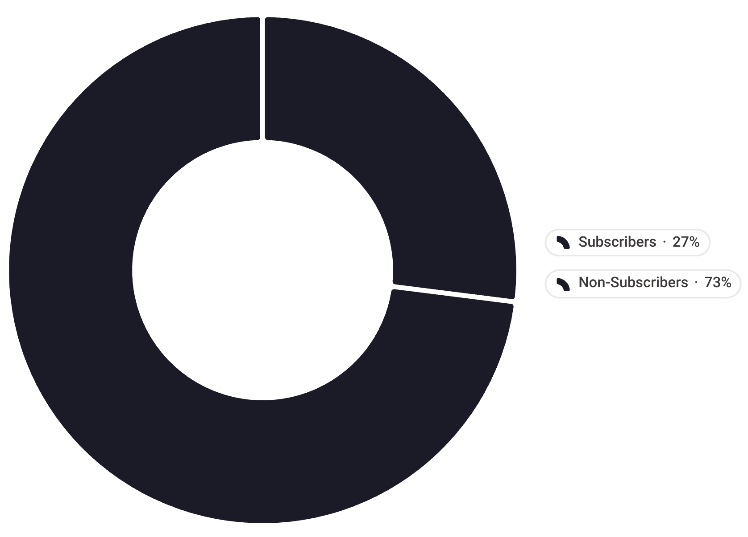
Power BI Dashboard
3,900
$59.76
Total Customers
Avg Purchase
3.75
73%
Avg Rating / 5
Non-Subscribers
Subscription Distribution
Dashboard Features
Filters:
Subscription Status
Gender
Category
Shipping Type
Visualizations:
Revenue by Category
Sales by Category
Revenue by Age Group
Sales by Age Group
Subscription Distribution

Slide 6

Key Analysis & Findings
Category Performance
Age Group Performance
1
1
Young Adult
Highest contribution
2
3
2
Middle-aged
4
3
Adult
1
Outerwear — Lowest
4
Senior
2
Footwear
Lowest contribution
3
Accessories
Average purchase: $59.76 · Average rating: 3.75 / 5 · Majority are non-subscribers
4
Clothing — Highest Sales & Revenue

Slide 7






Business Insights & Recommendations
Customer Retention
Subscription Growth
Use New, Returning, and Loyal segments to develop targeted retention strategies
73% non-subscribers represent a major opportunity for subscription adoption
Category Optimization
Targeted Marketing
Clothing's strong performance warrants increased inventory and marketing focus
Young Adults are the strongest segment — personalize campaigns for this group
Discount Optimization
Product Strategy
Monitor high-discount products to evaluate ROI on discounting
Combine sales, revenue, and review ratings when evaluating product performance

Slide 8
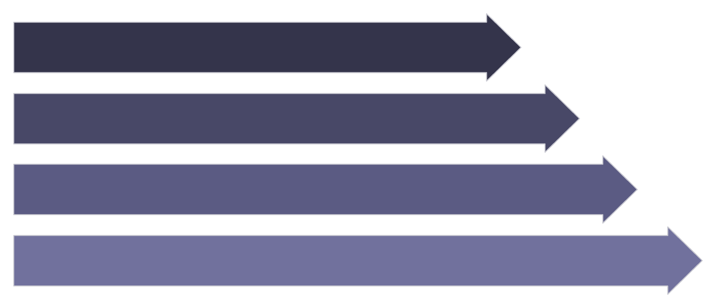

Conclusion & Future Scope
Analytics Pipeline
Future Scope
Customer Churn Prediction
Data Cleaning
RFM Analysis
Data Storage
Interactive Viz
Customer Lifetime Value Modeling
Business Insights
Product Recommendation System
Key Outcomes
Predictive Purchasing Analysis
Clear understanding of customer purchasing behavior
Category and age-group performance analysis
Subscription and segmentation patterns
Product performance insights
Automated Dashboard Reporting

Slide 9
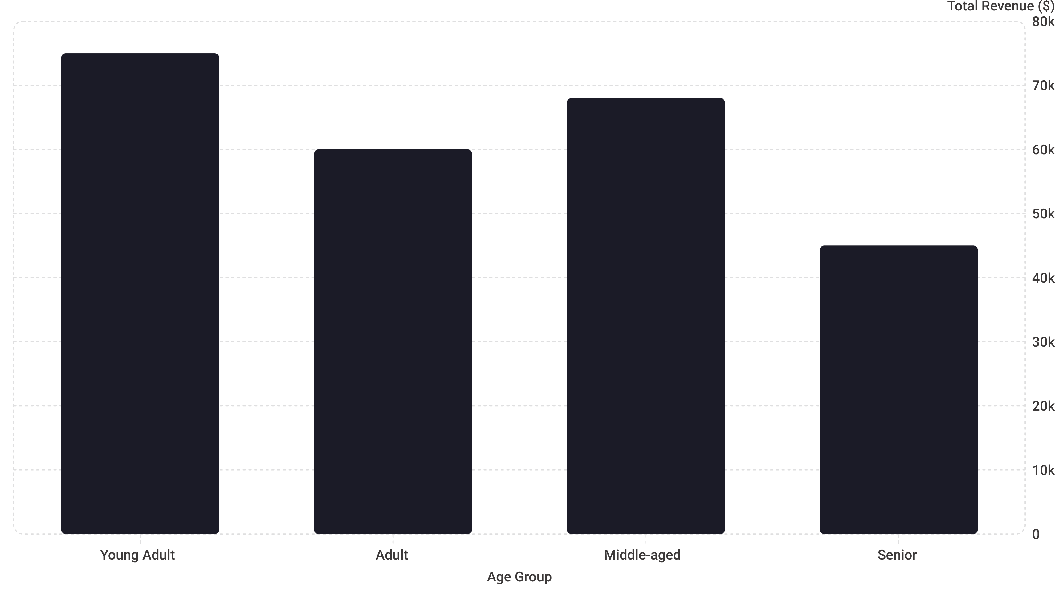
Data Visualization & Insights Summary
A visual recap of key findings and their implications for business strategy.
This chart illustrates the revenue contribution by different age groups, clearly showing that Young Adults are the highest contributors to total revenue, followed by Middle-aged and Adult segments. The Senior segment currently contributes the least. This highlights the importance of tailoring marketing efforts and product offerings to the most impactful demographics.
The strongest segments (Young Adult, Middle-aged) drive the majority of sales and revenue, while areas like Outerwear and the Senior demographic present opportunities for targeted growth initiatives.

Slide 10
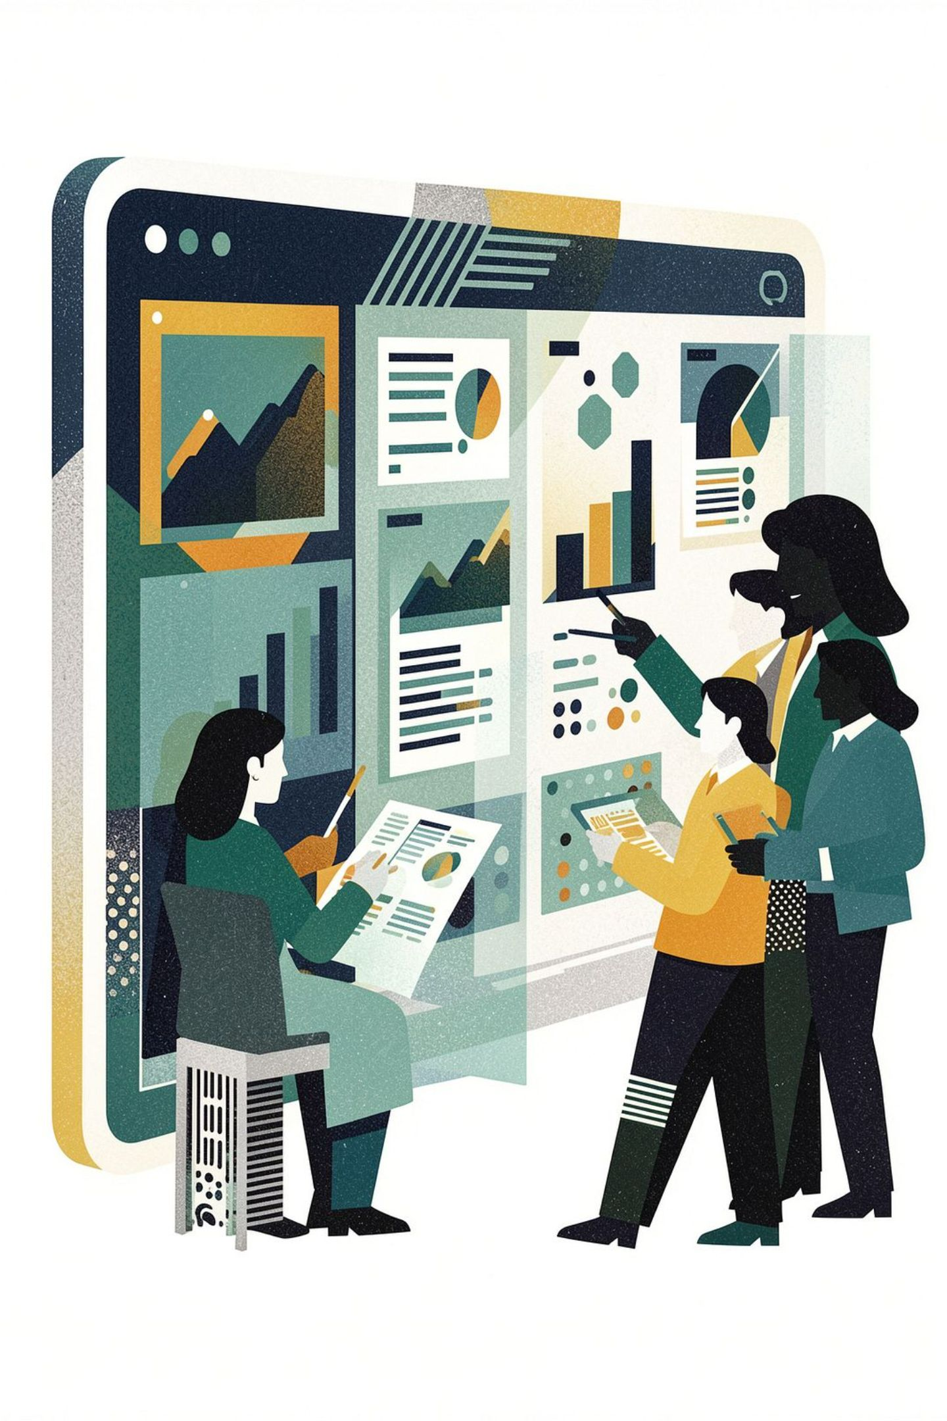
Implementation Roadmap & Next Steps
Phase 1: Advanced Analytics
1
Deep dive into RFM & CLTV modeling for precise customer segmentation.
2
Phase 2: Predictive Insights
Develop churn prediction and product recommendation engine models.
Phase 3: Operational Integration
3
Automate reporting and integrate insights into daily business workflows.
4
Phase 4: Continuous Optimization
Establish A/B testing frameworks and performance monitoring for ongoing improvement.
This roadmap outlines our strategic approach to leveraging advanced analytics for sustained business growth and enhanced operational efficiency.

