Slide 1
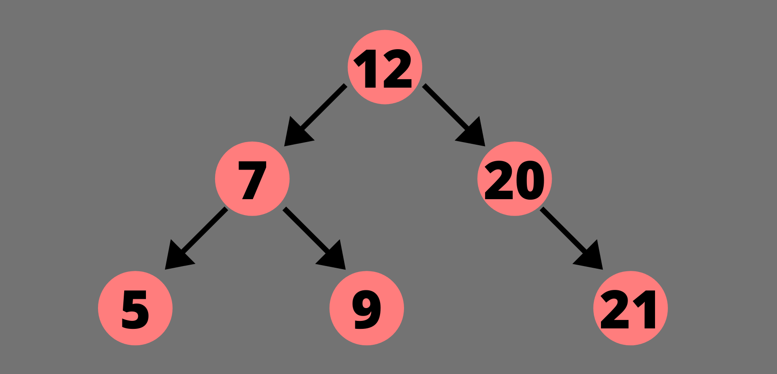
BINARY SEARCH TREE VISUALIZATION
Presented To: Mr. Hassan Tahir – Lecturer
Presented by: Numan Farooqi (ID: 2231080)

Slide 2
Introduction to tree data structure
Tree data structure is a hierarchical structure that is used to represent and organize data in the form of parent child relationship. The following are some real world situations which are naturally a tree.
Folder structure in an operating system.
Tag structure in an HTML (root tag the as html tag) or XML document.
The topmost node of the tree is called the root, and the nodes below it are called the child nodes. Each node can have multiple child nodes, and these child nodes can also have their own child nodes, forming a recursive structure.

Slide 3
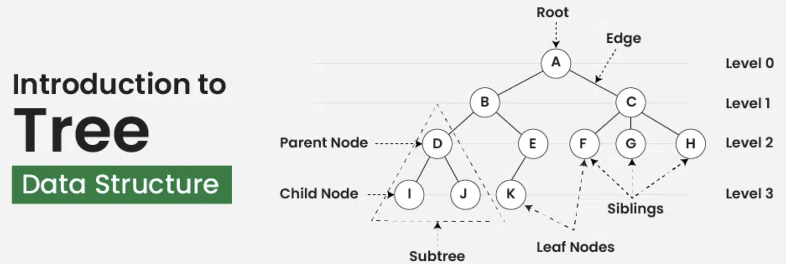
Introduction to tree data structure

Slide 4
Introduction to tree data structure
Basic Terminologies In Tree Data Structure:
Parent Node: The node which is an immediate predecessor of a node is called the parent node of that node. {B} is the parent node of {D, E}.
Child Node: The node which is the immediate successor of a node is called the child node of that node. Examples: {D, E} are the child nodes of {B}.
Root Node: The topmost node of a tree or the node which does not have any parent node is called the root node. {A} is the root node of the tree. A non-empty tree must contain exactly one root node and exactly one path from the root to all other nodes of the tree.
Cont’d

Slide 5
Introduction to tree data structure
Leaf Node or External Node: The nodes which do not have any child nodes are called leaf nodes. {I, J, K, F, G, H} are the leaf nodes of the tree.
Ancestor of a Node: Any predecessor nodes on the path of the root to that node are called Ancestors of that node. {A,B} are the ancestor nodes of the node {E}
Descendant: A node x is a descendant of another node y if and only if y is an ancestor of x.
Sibling: Children of the same parent node are called siblings. {D,E} are called siblings.
Cont’d

Slide 6
Introduction to tree data structure
Level of a node: The count of edges on the path from the root node to that node. The root node has level 0.
Internal node: A node with at least one child is called Internal Node.
Neighbor of a Node: Parent or child nodes of that node are called neighbors of that node.
Subtree: Any node of the tree along with its descendant.

Slide 7
Introduction to tree data structure
Why Tree is considered a non-linear data structure?
The data in a tree are not stored in a sequential manner i.e., they are not stored linearly. Instead, they are arranged on multiple levels or we can say it is a hierarchical structure. For this reason, the tree is considered to be a non-linear data structure.

Slide 8
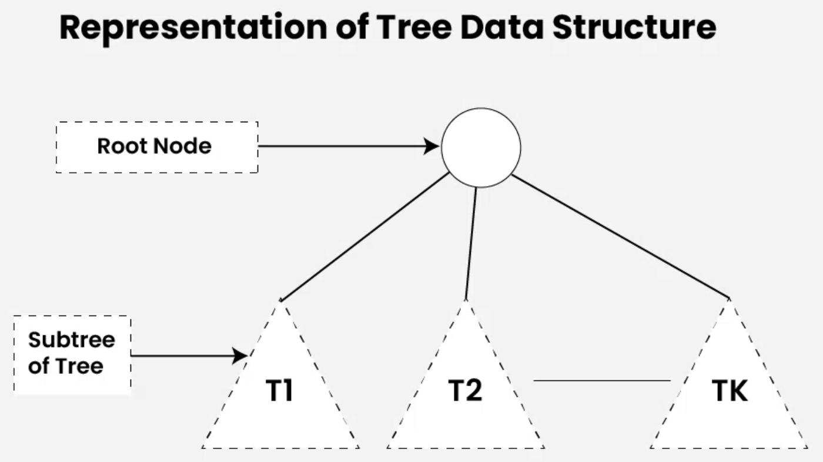
Introduction tree data structure
Representation of Tree Data Structure:
A tree consists of a root node, and zero or more subtrees T₁, T₂, … , T_{k} such that there is an edge from the root node of the tree to the root node of each subtree. Subtree of a node X consists of all the nodes which have node X as the ancestor node.

Slide 9
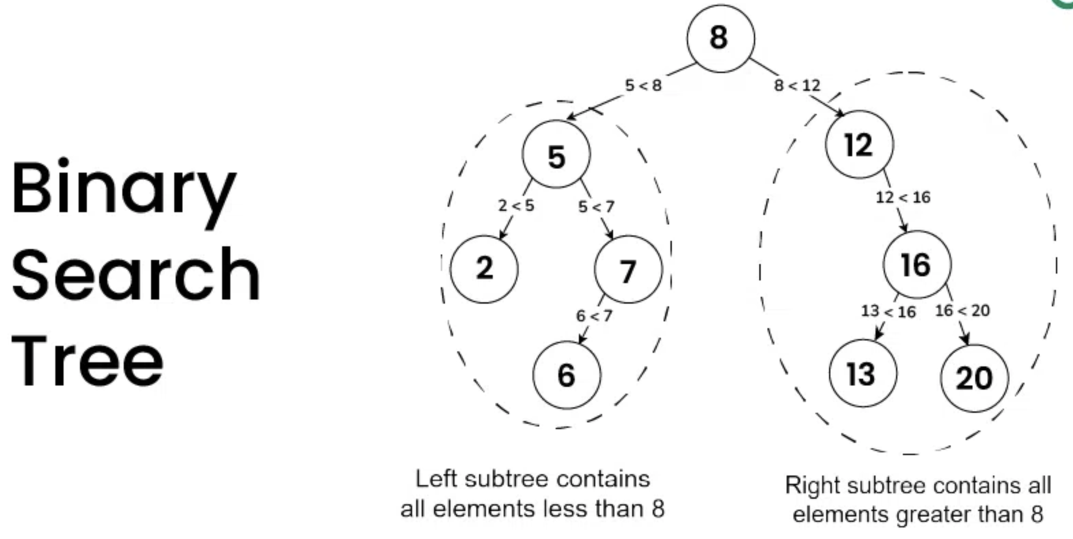
Introduction to binary search tree
Binary Search Tree is a data structure used in computer science for organizing and storing data in a sorted manner. Binary search tree follows all properties of binary tree and for every nodes, its left subtree contains values less than the node and the right subtree contains values greater than the node. This hierarchical structure allows for efficient Searching, Insertion, and Deletion operations on the data stored in the tree.

Slide 10
Introduction to binary search tree
Properties of Binary Search Tree:
The left subtree of a node contains only nodes with keys less than the node’s key.
The right subtree of a node contains only nodes with keys greater than the node’s key.
The left and right subtree each must also be a binary search tree.
There must be no duplicate nodes (BST may have duplicate values with different handling approaches).

Slide 11
Introduction to binary search tree
Important Points about BST
A Binary Search Tree is useful for maintaining sorted stream of data. It allows search, insert, delete, ceiling, max and min in O(h) time. Along with these, we can always traverse the tree items in sorted order.
With Self Balancing BSTs, we can ensure that the height of the BST is bound be Log n. Hence, we achieve, the above-mentioned O(h) operations in O(Log n) time.
When we need only search, insert and delete and do not need other operations, we prefer Hash Table over BST as a Hash Table supports these operations in O(1) time on average.

Slide 12
Introduction to binary search tree
Application of Binary Search Tree
A BST supports operations like search, insert, delete, maximum, minimum, floor, ceil, greater, smaller, etc. in O(h) time where h is height of the BST. To keep height less, self balancing BSTs (like AVL and Red Black Trees) are used in practice. These Self-Balancing BSTs maintain the height as O(Log n). Therefore all of the above mentioned operations become O(Log n). Together with these, BST also allows sorted order traversal of data in O(n) time.
A Self-Balancing Binary Search Tree is used to maintain sorted stream of data. For example, suppose we are getting online orders placed and we want to maintain the live data (in RAM) in sorted order of prices. For example, we wish to know number of items purchased at cost below a given cost at any moment. Or we wish to know number of items purchased at higher cost than given cost.
Cont’d.

Slide 13
Introduction to binary search tree
A Self-Balancing Binary Search Tree is used to implement doubly ended priority queue. With a Binary Heap, we can either implement a priority queue with support of extractMin() or with extractMax(). If we wish to support both the operations, we use a Self-Balancing Binary Search Tree to do both in O(Log n).
There are many more algorithm problems where a Self-Balancing BST is the best suited data structure, like Count Smaller Elements on Right, Smallest Greater Element on Right Side, etc.
A BST can be used to sort a large dataset. By inserting the elements of the dataset into a BST and then performing an in-order traversal, the elements will be returned in sorted order. When compared to normal sorting algorithms, the advantage here is, we can later insert / delete items in O(Log n) time.
Cont’d.

Slide 14
Introduction to binary search tree
Variations of BST like B Tree and B+ Tree are used in Database indexing.
TreeMap and TreeSet in Java, and set and map in C++ are internally implemented using self-balancing BSTs, more formally a Red-Black Tree.

Slide 15
Introduction to binary search tree
Advantages of Binary Search Tree (BST):
Efficient searching: O(log n) time complexity for searching with a self balancing BST
Ordered structure: Elements are stored in sorted order, making it easy to find the next or previous element
Dynamic insertion and deletion: Elements can be added or removed efficiently
Balanced structure: Balanced BSTs maintain a logarithmic height, ensuring efficient operations
Doubly Ended Priority Queue: In BSTs, we can maintain both maximum and minimum efficiently

Slide 16
Introduction to binary search tree
Disadvantages of Binary Search Tree (BST):
Not self-balancing: Unbalanced BSTs can lead to poor performance
Worst-case time complexity: In the worst case, BSTs can have a linear time complexity for searching and insertion
Memory overhead: BSTs require additional memory to store pointers to child nodes
Not suitable for large datasets: BSTs can become inefficient for very large datasets
Limited functionality: BSTs only support searching, insertion, and deletion operations

Slide 17
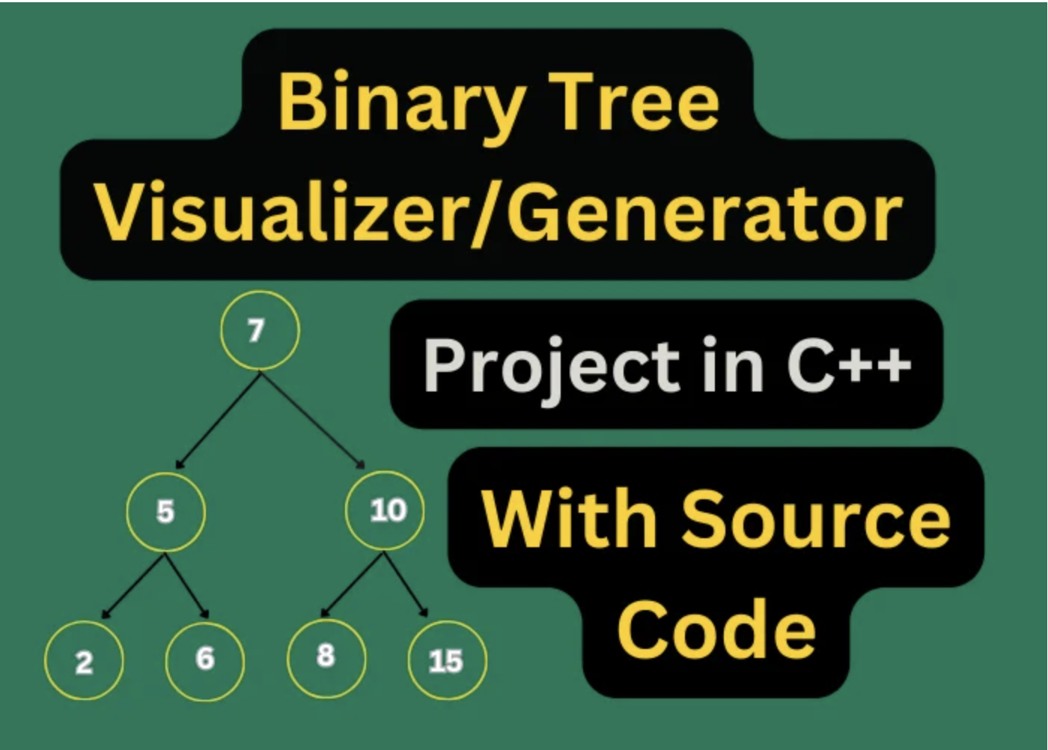
Binary search tree visualizer in C++

Slide 18
Binary search tree visualizer in C++
Binary Search Tree Visualizer introduces a BST implementation in C++ with a unique emphasis on visualization. The primary goal is to provide basic BST functionalities such as insertion and removal and offer users a visual representation of the tree structure. This visual component is crucial for educational purposes, enabling a clear understanding of how the tree evolves with each operation. The main functionalities include insertion, removal, and post-order traversal printing. The visualization aspect allows users to observe the structure of the tree.
In Binary Search Tree Visualizer, we don’t just explore the functionalities of a BST, but we bring it to life visually. But what exactly does it mean to visualize a BST?

Slide 19
Binary search tree visualizer in C++
What is the Binary Search Tree Visualizer or Generator?
A Binary Search Tree is a fundamental data structure known for its efficiency in search, insertion, and deletion operations. However, understanding how the tree evolves and organizes itself can be challenging, especially for learners. This is where visualization steps in.
Visualization of a BST means turning abstract concepts into a tangible, visual experience.
Ever wondered how computers organize and manage vast amounts of data with lightning speed? Enter the fascinating realm of Binary Search Trees (BST), where efficiency meets elegance. This is where the magic happens – and we’re about to unveil it all!

Slide 20
Binary search tree visualizer in C++
The Lowdown on Binary Search Trees
Alright, let’s break it down. Imagine a digital forest where data lives and thrives. Each piece of information is like a tree in this forest, and with the help of Binary Search Tree Visualizer Binary Search Trees are the wise guardians maintaining order. These trees have a unique way of arranging data, ensuring quick and efficient retrieval – a true marvel of computer science!
But Wait, There’s More: Visualization!
Now, here’s the game-changer. We’re not just talking about dry code and algorithms. Oh no! We’re diving deep into the world of Binary Search Tree Visualizer. Picture this: as you insert, remove, and manipulate data, the tree visually adapts and transforms right before your eyes. It’s like gardening for geeks, with data blossoming into a beautifully organized digital landscape. Meet the Players: Your Binary Search Tree Toolkit…

Slide 21
Binary search tree visualizer in C++
1. main.cpp: Your Command Center
Meet the conductor of our digital symphony – the main.cpp file. It’s the central hub where you, the user, get to call the shots. Want to insert some data? Remove a node? Print the magic tree? Or Exit the program? Your wish is its command!
…. Code for main.cpp ….
Cont’d.

Slide 22
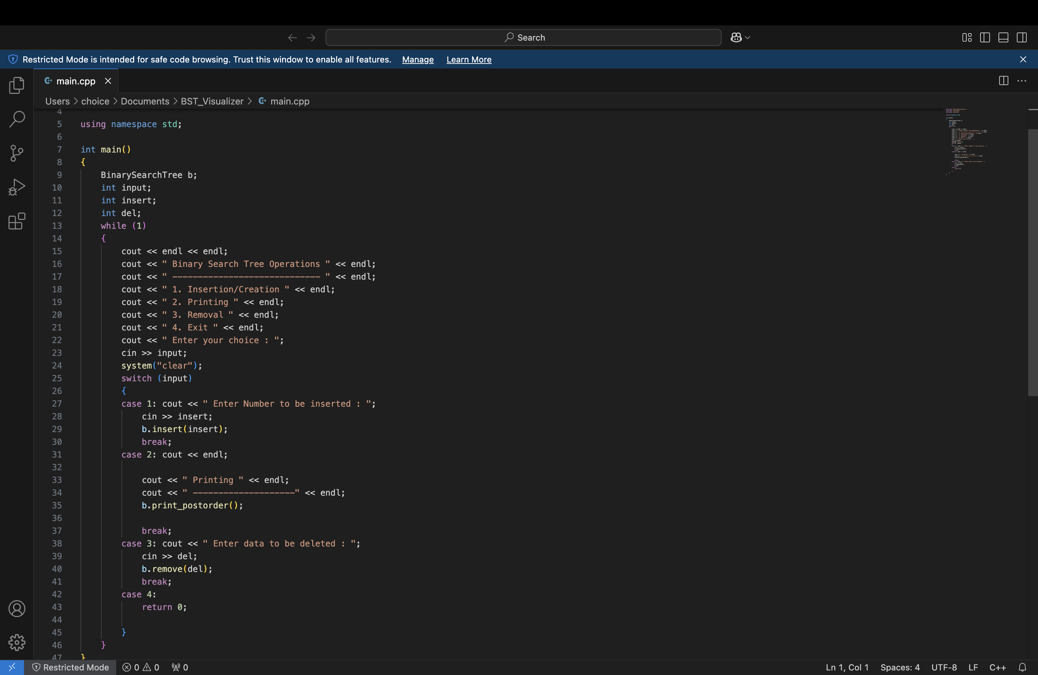
Binary search tree visualizer in C++

Slide 23
Binary search tree visualizer in C++
2. BinarySearchTree.h: The Blueprint
Ever heard of a blueprint for a house in case there is is Binary Search Tree Visualizer? Well, BinarySearchTree.h is our blueprint for the Binary Search Tree class. It declares what the tree is capable of and sets the stage for the grand performance.
… Code for BinarySearchTree.h …
Cont’d.

Slide 24
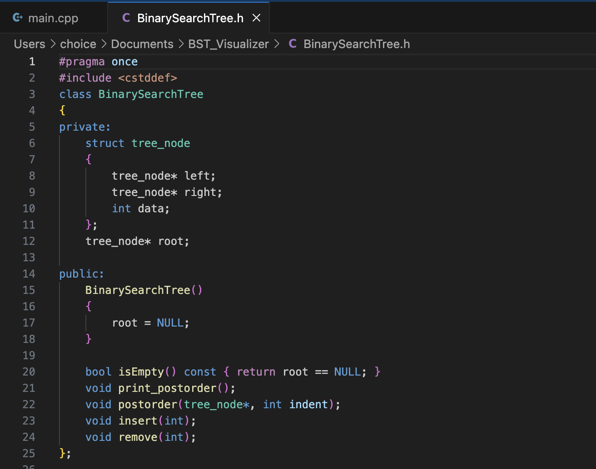
Binary search tree visualizer in C++

Slide 25
Binary search tree visualizer in C++
3. BinarySearchTree.cpp: Where the Magic Happens
The heart of the operation! In BinarySearchTree.cpp, we’ve got the nitty-gritty details. Insertion, removal, and the post-order traversal for that inspiring visual display.
… code for BinarySearchTree.cpp …
[since code consists of almost 162 lines therefore it will be available separately.]

Slide 26
Binary search tree visualizer in C++
Ready, Set, Action: Using Your BST Visualization:
Here’s your backstage pass with Binary Search Tree Visualizer:
Insertion/Creation: Ever played Digital Gardener? Enter a number, and voila! Watch your tree grow dynamically while maintaining its binary search prowess.
Printing: Want to see the fruits of your labor? Option for printing and witnessing the hierarchical display of your tree’s structure through a post-order traversal.
Removal: Time to trim the branches. Enter a value, and see the tree gracefully adapt, ensuring it remains a finely tuned Binary Search Tree.
Exit: When the curtain falls, hit exit. But don’t worry, you can come back and enjoy the show anytime!

Slide 27
Binary search tree visualizer in C++
How to Dive In? Running Your BST Visualization: Compile and execute main.cpp. It’s your ticket to an interactive learning experience where the magic of a binary search tree unfolds in real time, providing not just insights but also a visually captivating adventure.
What’s Next? Future Improvements for the Ultimate Experience: Consider future enhancements like different traversal options, graphical representations, and interactive controls in that Binary Search Tree Visualizer project.
In Conclusion: Binary Search Tree implementation is an experience – a journey into the heart of data organization that combines efficiency with the sheer joy of visualization.

Slide 28
Binary search tree visualizer in C++
How to Run the BST Visualizer:
Create and Save necessary files:
Save the code as three separate files:
BinarySearchTree.h (header file)
BinarySearchTree.cpp (implementation file)
main.cpp (main function)
Launch Terminal:
Navigate to the Project Directory
In the Terminal, use the cd command to navigate to the directory where you saved the files.
cd Documents/BST_Visualizer

Slide 29
Binary search tree visualizer in C++
Compile the Code
Use g++ compiler:
g++ main.cpp BinarySearchTree.cpp -o binary_search_tree
This command:
Compiles the main.cpp and BinarySearchTree.cpp files.
Links the object files together.
Creates an executable file named binary_search_tree.
Run the Program
Execute the program: Type the following in the Terminal:Bash
./binary_search_tree

Slide 30
Binary search tree visualizer in C++
Interact with the Program
The program will display a menu of options:
Choose "1. Insertion/Creation" to insert values.
Choose "2. Printing" to print the tree in post-order.
Choose "3. Removal" to delete a value.
Choose "4. Exit" to quit the program.
7. Observe Output
The program will display the tree structure and any messages (e.g., "Data not found!").

Slide 31
THANK YOU

