Slide 1

Analysis of PM2.5 Pollution & Respiratory Mortality
Numan Siddique
20101767
Siddique-N2@ulster.ac.uk
[1] [2]

Slide 2
Problem Statement
Objective:
Investigate the relationship between PM2.5 air pollution and respiratory mortality using cleaned datasets.
Significance:
Understanding whether high particulate pollution levels correspond to increased deaths informs public health policy and environmental regulations.
Scope:
Year 2019 U.S. county air‑quality data (999 records) and 2015–2021 aggregated mortality statistics from the World Health Organization.
[1] [2]

Slide 3
Data Exploration
List of data sources
Kaggle : Provides datasets belonging to every aspect of life
data.gov: US Govt datasets
data.gov.in: Regional data sets
CDC Data : US public health dataset
HDX : (https://data.humdata.org/)
  Access and share humanitarian data access crises and organization
GDD : https://globaldietarydatabase.org
  The Global Dietary Database (GDD) is an ongoing effort to produce the most reliable estimates of dietary intake worldwide
[1] [2]

Slide 4


Datasets & Justification
Air Quality Dataset (2019)
999 U.S. county records with variables:
• Days_PM2.5
• Days_PM10
• Resp_Death_Rate
Why this dataset?
High‑quality PM measurements and mortality rates allow correlation analysis.
Cleaning steps:
• Converted data types
• Removed missing and outlier rows
• Filtered to < 1k records
Global Mortality Dataset (2015–2021)
Annual deaths attributable to ambient air pollution.
Variables:
• Year
• Value (deaths)
• bounds
Why this dataset?
Provides context on global mortality trends due to air pollution.
Cleaning steps:
• Selected both sexes and all causes
• Converted values to numeric
• Restricted to 2015–2021
[1] [2]

Slide 5
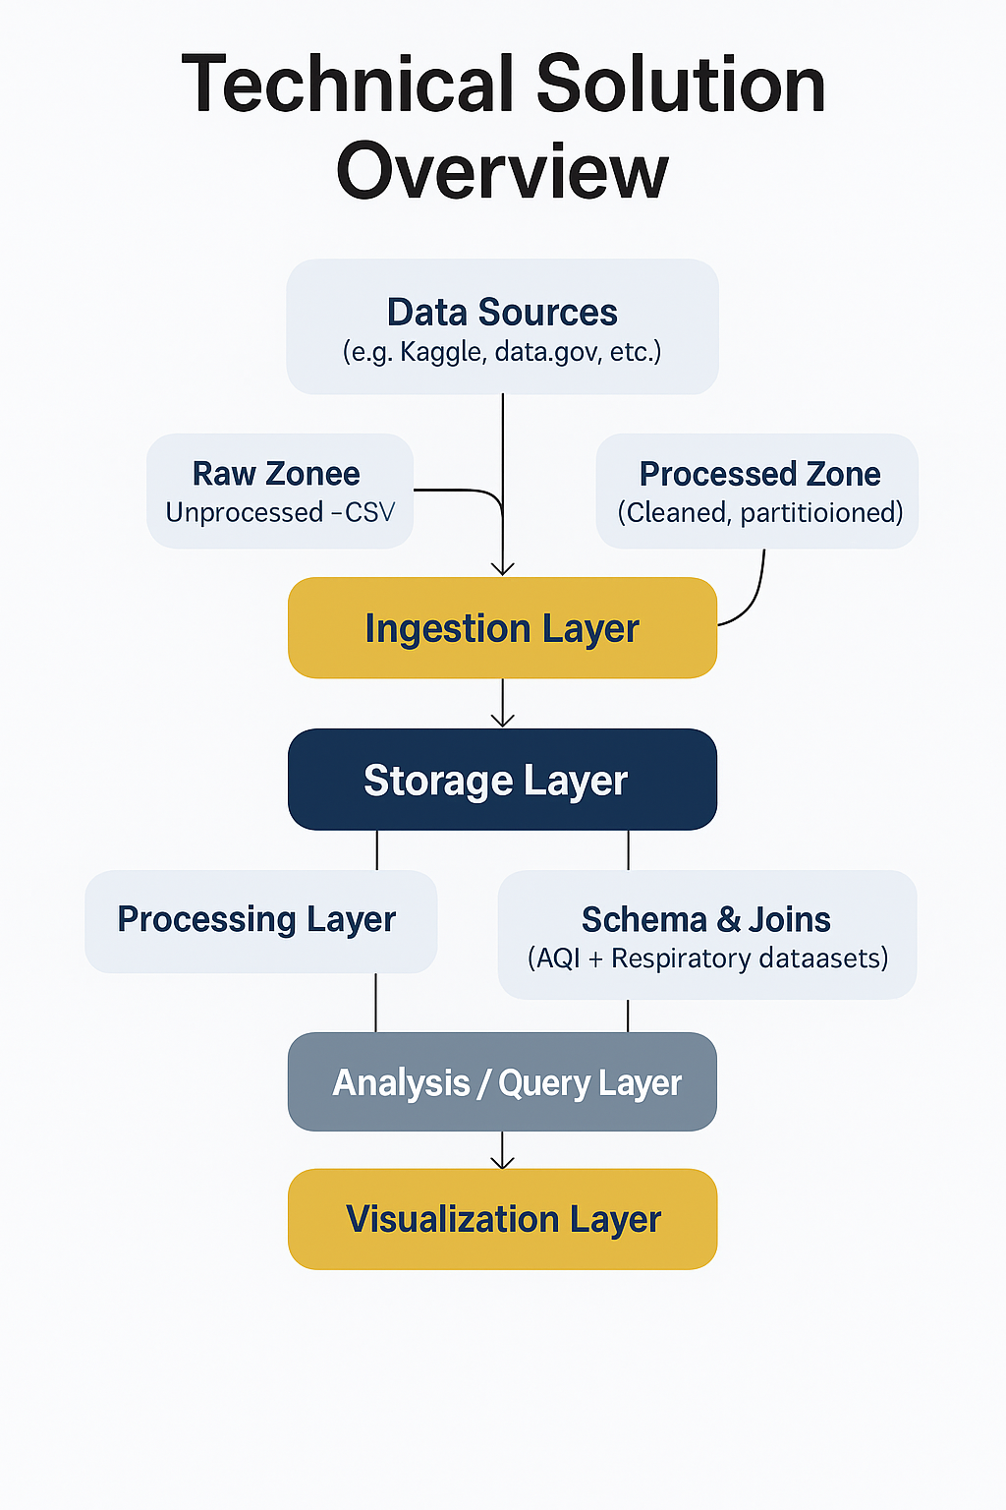
Technical Solution Overview
Architecture & Layers
Tool used (e.g., Hadoop, Hive, Spark, Zeppline)
[1] [2]

Slide 6
Data Ingestion
Tools & Services Used:
• Storage: Hadoop Distributed File System (HDFS)
• Ingestion Method: Direct upload of CSV files via Ambari File View or Hadoop CLI
• Platform: Zeppelin/Spark (integrated with Ambari) for initial preview and loading
File Format Handling:
• CSV files: human‑readable, easily parsed by Hive/Spark, with column headers
• Pre‑processing: remove missing values, standardise dates, infer data types via Spark
Upload Path: /user/cw2/datasets/
[1] [2]

Slide 7
Data Ingestion
Tools & Services Used:
• Ambari-managed Hadoop Cluster
• Ingestion through HDFS file upload of CSV files via Ambari File View or Hadoop CLI
• CSV Format is directly handled by the Hadoop/Hive ecosystem.
• Spark accessed via Zeppeline (integrated with ambari).
Validation:
• Done using Spark (Via Zeppeline)
• Data type interface and filtering
[1] [2]

Slide 8
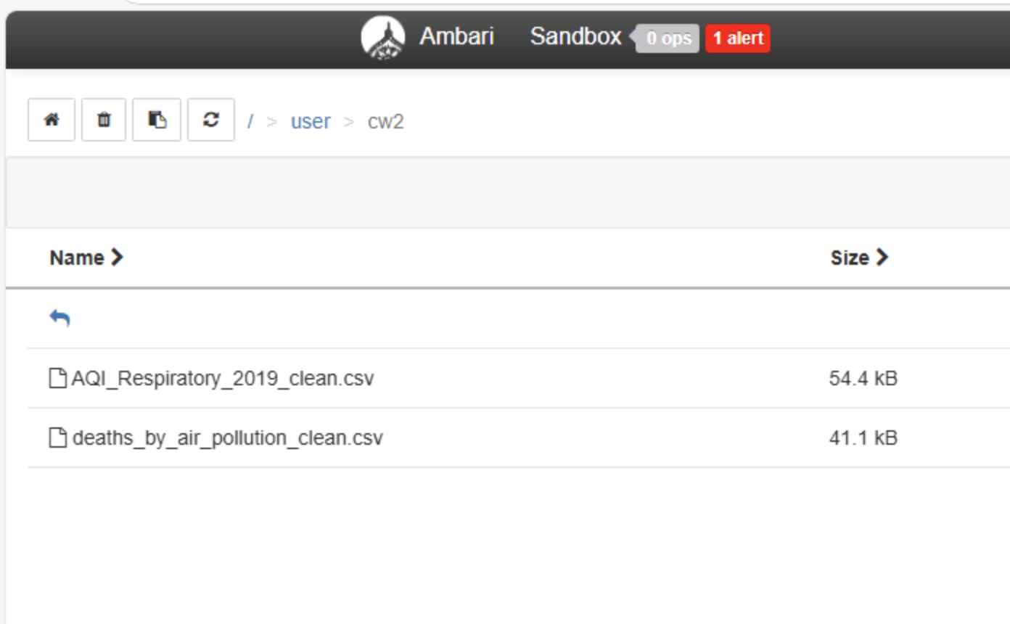
Storage Layer
Storage Type:
• HDFS (Ambari‑managed)
Rationale:
• Ambari GUI simplifies monitoring and configuration
• Easily scale nodes, replicate data and view metrics
Organisation:
• HDFS directorie
• Processed: /user/cw2/ (cleaned & partitioned)
• Example: /user/cw2/AQI_Respiratory_2019_clean.csv
[1]

Slide 9
Processing Layer
Frameworks:
• Hive (Ambari‑controlled service)
• Spark via Zeppelin (integrated with Ambari)
Transformations:
• Data type inference and filtering via Spark
• Hive tables created from cleaned CSVs using Ambari Hive View
Example Query:
CREATE TABLE aqi_respiratory_2019_clean (
location_name STRING,
year INT,
fips INT,
resp_death_rate FLOAT,
days_pm25 INT,
days_pm10 INT
)
ROW FORMAT DELIMITED
FIELDS TERMINATED BY ','
STORED AS TEXTFILE
TBLPROPERTIES ("skip.header.line.count"="1");
[1]

Slide 10
Processing Layer
• Filter data from aqi_respiratory_2019_clean on the basis of different params to get
death_rate belongs to different locations.
[1]

Slide 11


Visualization Layer
Correlation Analysis
Scatter plot of PM2.5 exposure vs death rate
Distribution Charts
Bar charts of top counties by PM2.5 and death rate
Temporal Trends
Line chart showing global ambient pollution deaths over time
Zeppelin notebooks provide an interactive platform to execute Spark SQL queries and instantly visualise results using built‑in chart options.
[1]

Slide 12
Summary & Statistics
Mean Days with PM2.5
145.5
Mean Respiratory Death Rate
0.00022
Correlation (PM2.5 vs Rate)
-0.126
Top Counties by PM2.5 Days
• Lewis County (WA) – 365
• Grant County (WI) – 365
• Klickitat County (WA) – 365
• Kittitas County (WA) – 365
• Whitman County (WA) – 365
Top Counties by Death Rate
• Brooke County (WV) – 0.000667
• Hancock County (WV) – 0.000621
• Claiborne County (TN) – 0.000616
• Bristol City (VA) – 0.000521
• Sheridan County (MT) – 0.000516
[1]

Slide 13
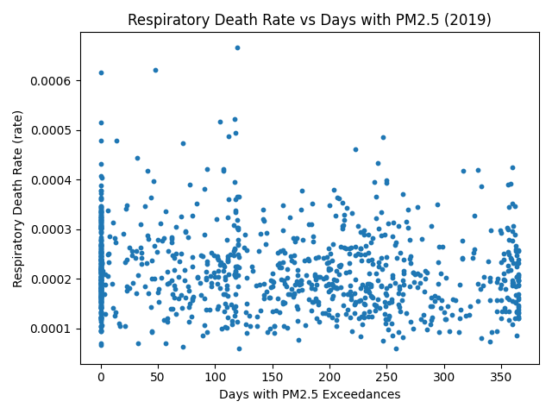
Correlation Analysis
A scatter plot of PM2.5 exposure versus respiratory death rate reveals a weak negative relationship, indicating that higher exposure does not necessarily correspond to higher mortality.
[1]

Slide 14
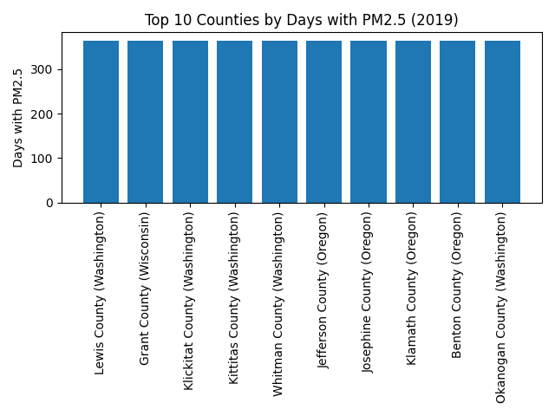
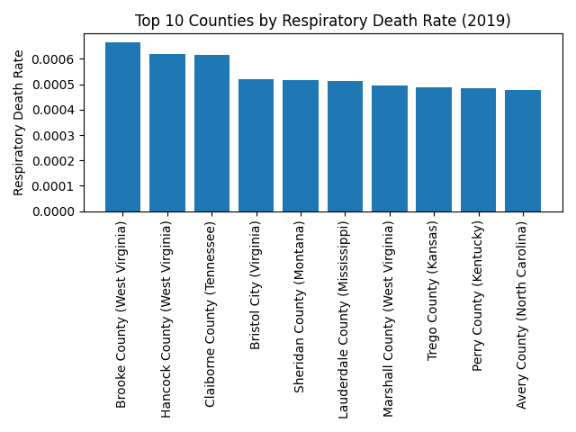
County Distributions
Washington and Wisconsin counties have the highest PM2.5 exposure, whereas Appalachian states exhibit the highest death rates.
PM2.5 Days
Death Rate
[1]

Slide 15
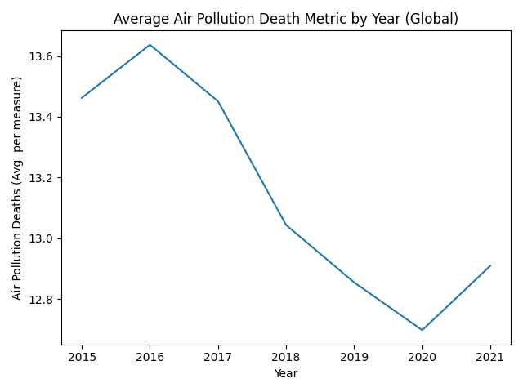
Global Mortality Trends
The number of deaths attributable to ambient air pollution has gradually declined from 2015 to 2021, reflecting global improvements in air quality and health interventions.
[1]

Slide 16
Implementation & Demo
1. Clean Data
• Converted dates and numeric columns
• Removed missing entries
2. Upload to HDFS
• Used Ambari File View → /user/cw2/datasets
3. Create Hive Tables
• Defined schemas reflecting cleaned CSV fields
• Loaded data via LOAD DATA INPATH commands
4. Run Queries & Visualise
• Computed summary statistics and correlations in Hive
• Created scatter, bar and line charts in Zeppelin
[1] [2]

Slide 17
Concluding Comments
Key Insights
• Weak negative correlation between PM2.5 exposure and death rate
• Exposure hotspots in Washington/Wisconsin; mortality hotspots in Appalachia
• Global deaths from ambient air pollution show a declining trend
Limitations
• Data limited to U.S. counties for one year and global aggregates
• Small sample size (< 1k rows) reduces statistical power
• Correlation does not prove causation; omitted socio‑economic factors
Recommendations & Future Work
• Acquire Pakistan‑specific air quality and mortality data
• Extend the timeframe and incorporate other pollutants (NO₂, SO₂, CO)
• Apply regression and causal models; build interactive dashboards
[1] [2]

Slide 18
References
[1] Pakistan Open Data Portal. "Air Quality Index May 2019 – April 2020," 2023.
[2] World Bank. "Mortality rate attributed to household and ambient air pollution (per 100,000 population)," 2024.
[3] World Health Organization. Global Health Observatory Data Repository. Indicator AIR_41: Ambient air pollution attributable deaths, 2025.
[4] Student Project Pipeline and Analysis Steps.
[1] [2]

