Slide 1
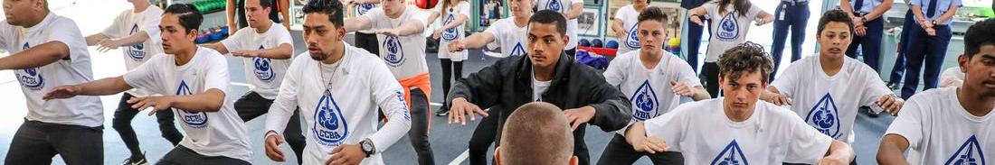



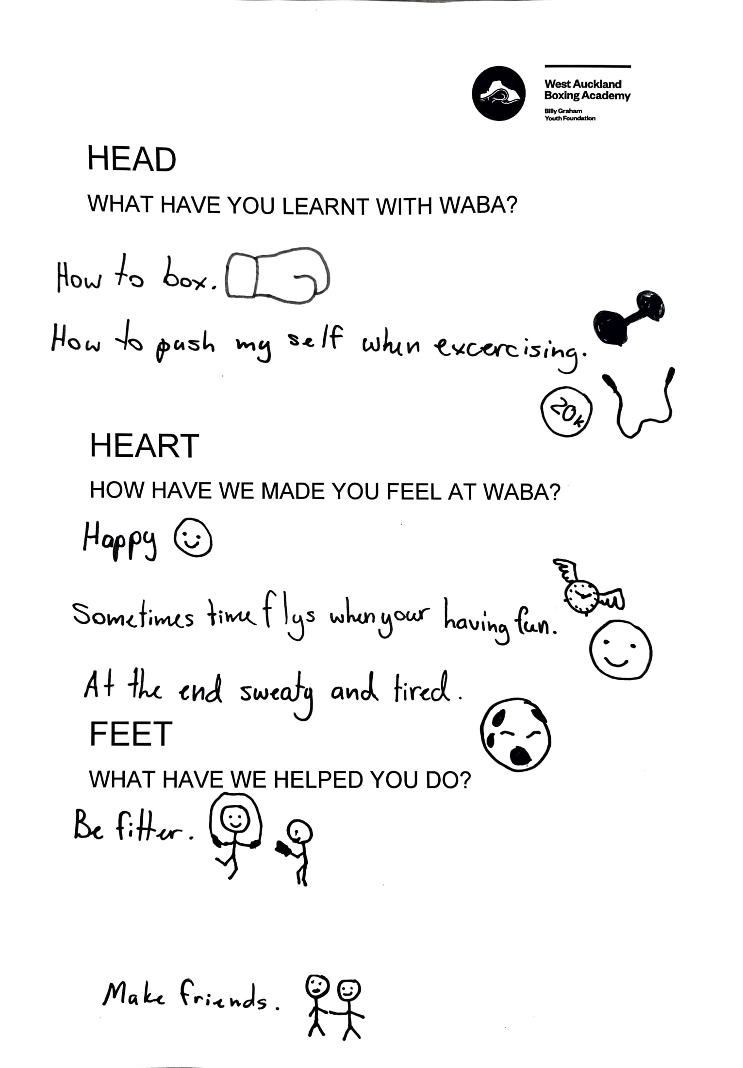
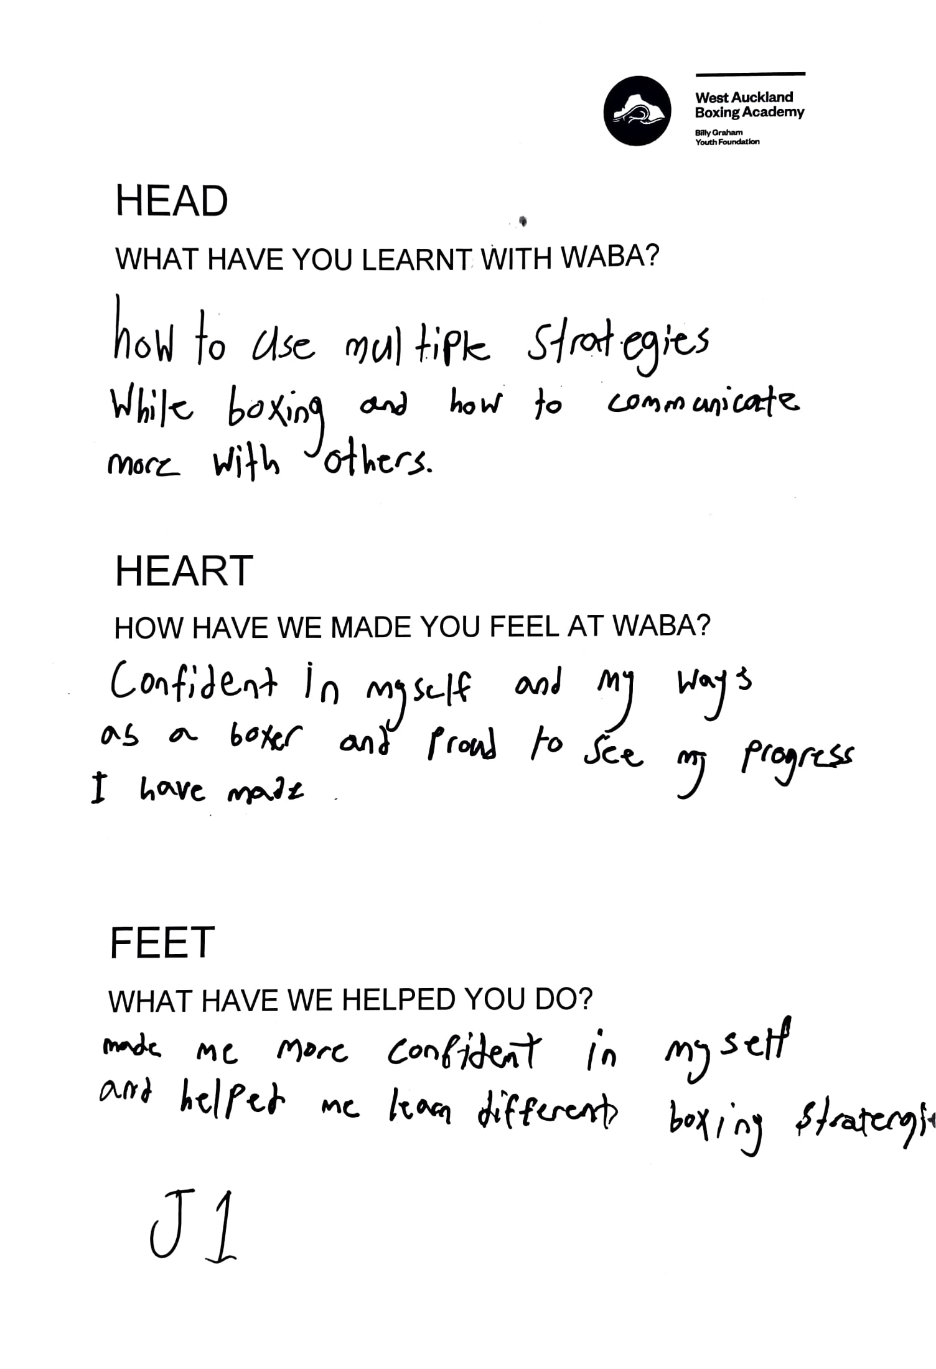
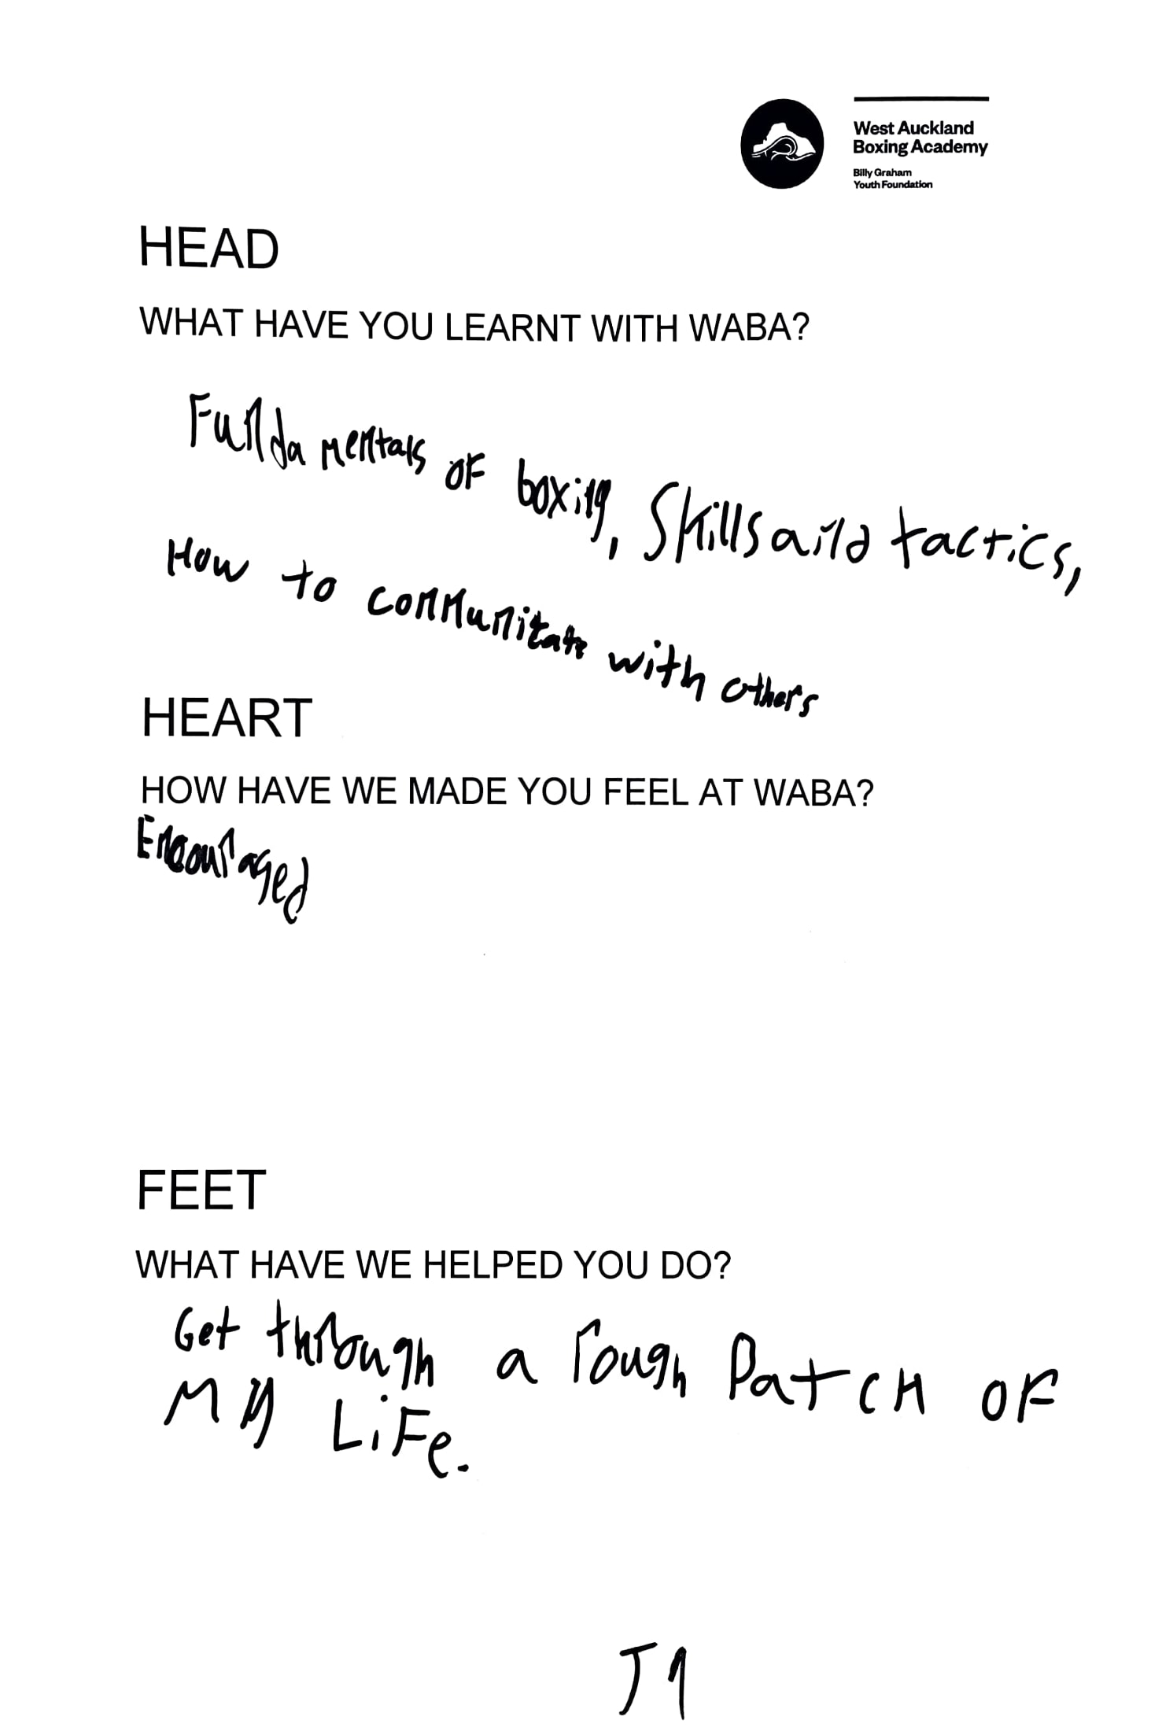

BILLY GRAHAM YOUTH FOUNDATION
WEST AUCKLAND BOXING ACADEMY EVALUATION 2021
The West Auckland Boxing Academy is part of a network of boxing academies supported by the Billy Graham Youth Foundation. The academies are about a whole lot more than boxing; academy staff develop genuine, values-based relationships with their members, families and whānau and work alongside partner organisations to build strong communities. The goal is to make champion young people.
We heard from 43 fundamental and junior members, 22 senior members, 33 families and whānau and 4 community partners.
FUNDAMENTAL AND JUNIOR MEMBERS
SENIOR MEMBERS
The fundamental and junior members completed ‘storyboards’ to provide feedback on what they have learnt as a member of the boxing academy, how the academy has made them feel, and how they have applied what they have learnt at the gym in their everyday lives. Most of them said:
The senior members were asked to complete a survey. They were asked if the boxing academy helped them with any of these things this year, and if so, what has changed and how the academy helped.
Did we help you with:
This is what the senior members said WABA does that helps them make positive change in their lives:
Going to academy was fun and they felt safe there, but it also challenged them
They learnt about values such as respect, discipline and kindness
They have become more confident, respectful, helpful and developed self-discipline and control.
Helped me discipline myself which also helped me at school and home
Showed me that hard work always pays off
Offered a positive and encouraging environment where I could learn
The senior members said WABA helped them become: • More confident • Fit, strong and physically capable • WABA has also helped them develop better relationships with family, friends and others in the community.
Improved my mindset such as the way I see things
I treat people with more respect and have learned to accept people who are different easily
Boxing has helped me gain confidence in both the gym and in myself as a person
Help me achieve NCEA 1. Be more respectful at home and in the community
My weight. Standing up not just for myself but for others
Boxing has helped me a lot with my discipline (self discipline) and being a more respectful person
Helped me discipline myself which also helped me at school and home
Helped with social skills and interacting with others
Notes:
Download more poster presentation templates from FPPT.com

Slide 2





BILLY GRAHAM YOUTH FOUNDATION
West Auckland BOXING ACADEMY EVALUATION 2021
FAMILY AND WHĀNAU
COMMUNITY PARTNERS
We received feedback from 33 of the academy’s families and whānau. They were asked to complete a survey which asked them if the academy has helped their child or rangatahi make positive change in the following areas, and if so, what changed and how the academy helped make that change.
Did we help your child or children with:
We received feedback from 4 community partners of WABA working in education, alternative education and youth development. Three community partners said the academy had contributed to a lot of change in the community this year, and one said the academy had contributed toward some change. They said the academy had helped in the following ways:
Most family and whanau said:
Their children have become more confident
They have developed stronger relationships with other young people and adults
Their fitness has improved and they have become more physically capable.
This is what family and whānau said WABA does that helps the young people make positive change in their lives:
The partners said what WABA does well is meaningfully connect with young people and help them develop positive attitudes and behaviours.
They feel seen when they are there and they feel good and leave with a sense of accomplishment. .
The team treat everyone the same. No one is better than the other.
Everything you do has helped to teach my daughter's in a lot of things in life. In a lot of different ways & aspects. They coming home after every session and are excited to tell me something they learnt or something fun they did. I love hearing about it. They love their coaches and having that bond with your students I think is very important
Many of these students don't have an adult they feel they can talk to within their homes so any opportunity for a positive outside connection is important.
Teaching the students to be respectful of the environment that they are in. Having those solid boundaries really reinforces what we are trying to teach them. I think coach Niwa has a lot of patience with our students and the way he encourages them has been awesome.
Provided an opportunity for students to physically train in a safe, caring & fun environment where they felt comfortable to be themselves - and not be judged.
The family and whānau said WABA has helped make these changes in their children’s lives:
The training and preparation for fights has helped our son’s fitness and wellbeing in managing his eating and watching his weight for fights.
My son isn’t getting into fights at school anymore
Our daughter is a lot more confident. She is learning independency and is not hesitant to try new things. The academy has taught her she can just keep going and it doesn't matter her skill level as long as she is trying.
We had students attend who struggled to build and maintain positive relationships. These students built new friendships within the group around a new shared interest. They also took onboard the messages taught within the programme and applied these at school and home.
The biggest change in my son has been his confidence. Having the support from the boxing gym from people who encourage and believe in him has been amazing
My son has become much more focused on his goals & things he would like to achieve. Since Starting at West Auckland boxing, He is showing commitment and discipline in all areas of his life.
Students who attended had improved focus. Many also developed new positive friendships which was not the case previously.
This is how the partners described WABA’s impact:
Students who were reserved/quiet - gained confidence in themselves & were genuinely more positive and happy
Helped build up my daughter's confidence. Learnt how to defend herself and stand up for herself if she ever needs it in a situation
Notes:
Download more poster presentation templates from FPPT.com

