Slide 1
INTELL: The Craft of Intelligence
Christina Campbell, Dylan Wright, Braden Fullington, Casey O’Kane
Notes:
Hello everyone, we are Team 3 and we are tasked with creating INTELL: The Craft of Intelligence. Our team consists of…
First, I’ll begin by talking about our customer, Mr. Tony Elam and his inspiration for our project.

Slide 2

Customer Description – Tony Elam
Director of Strategic Initiatives in College of Engineering at UK
Graduated from UK in 1977
Previous career at IBM
Created INTELL as an email game during his time at Rice University
Notes:
Many of you may be familiar with him because he works at UK in the College of Engineering
The concept of INTELL, which originated as an email game, was formed while working with members of the intelligence community at RICE university.

Slide 3

Project Description
INTELL - The Craft of Intelligence is a multiplayer, turn oriented, strategy/mystery game that mimics the real life challenges of intelligence gathering and threat analysis
Notes:
Two main aspects of the project: The scenario editor and the game
Scenario editor allows for creation of scenarios that can be played in an individual game instance
Game instances are driven by snippets, which have a small amount of key information relevant to the scenario that users must discover to apprehend individual key characters to win.

Slide 4



Project Description – Development Environment
Using a LAMP stack
Linux
Apache
SQLite 3
Django 1.9
MVC framework with Python
Simplifies database interaction
HTML5
Bootstrap
JS
JQuery

Slide 5
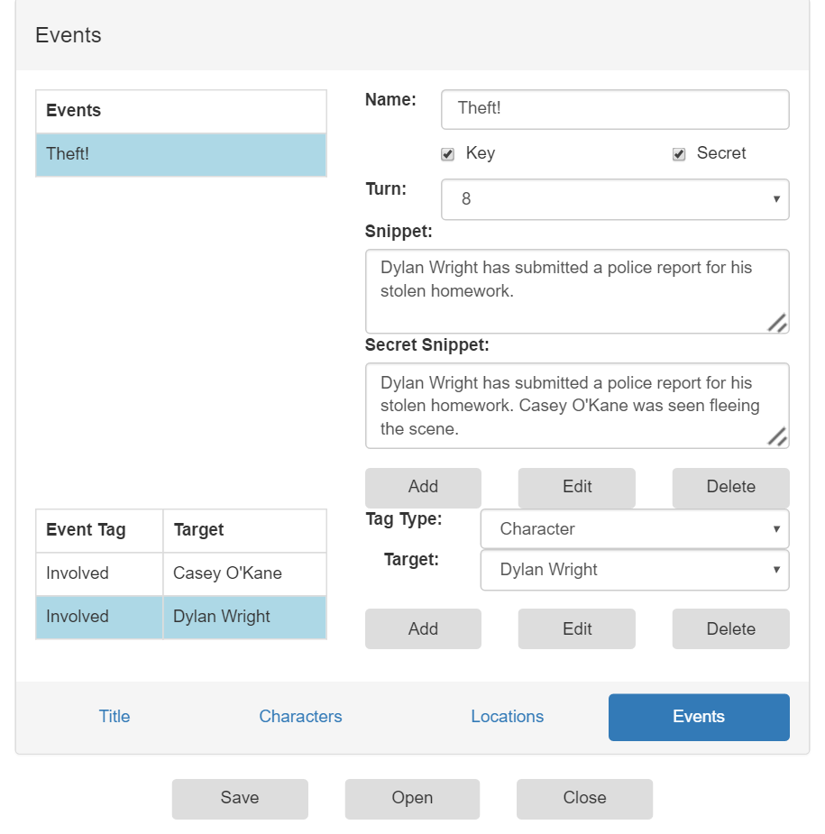
Project Description - Scenario Editor
Allows users to create the storyline of a threat
Includes characters, locations, and events
Some related to threat, many unrelated
Finished scenarios can be played in game instances
Notes:
The scenario editor allows users to enter information regarding characters, locations, and events that follow the storyline of a threat.
Scenario authors can make the scenario more difficult to follow, and thus more difficult to play, by including information that does not relate to the main threat.
Once a scenario has been completed, it can be published and played in active game instances.

Slide 6
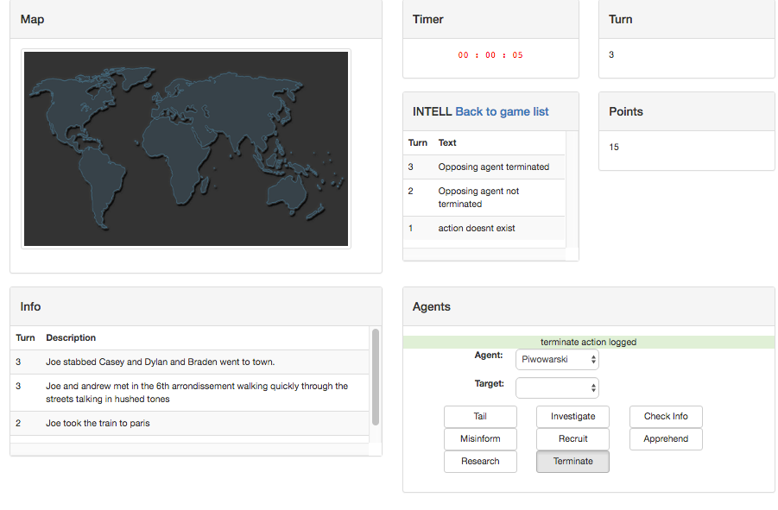
Project Description - Game
Turns:
Snippets of information provided
Players:
Have agent(s) to complete actions
Actions:
Allow players to investigate leads and hinder opponents

Slide 7
Initial Assumptions
Detailed requirements, design, and testing documents would aid in implementation
Members wouldn’t have set roles/titles
Everyone would work equally on implementation, writing documents, etc.
Time would allow for polishing of project
Themed user interface incorporation
In depth user testing
Notes:
-Chris: Project Manager – client liason, documentation, keeping us on track

Slide 8
Initial Assumptions - Design
Scenario Editor will be most time consuming
Code written for editor would be transferrable to game
Game instances will load and run off of a separate database

Slide 9
Problems and Solutions
Problem
Solution
Loading database copy for game instances
Included game instance database in main database
Notes:
One of the first noticeable issues showed up in the early design phase, where we had planned on created a copy of the main database for each instance of the game.
However, later on, we realized that it would be far more beneficial to include a game instance database inside of the primary database, to keep from making unnecessary copies of the main database.

Slide 10
Problems and Solutions
Problem
Solution
No default game action
INTELL Point balance issues
Added “Research” game action
Notes:
Another issue discovered during the design phase, was that there was no action specified in the product proposal that involved a default action, in case a player didn’t select anything.
Our solution to this problem involved creating a brand new action known as “Gather Resources” or “Research”. This action was seen as a way to both combat the previously mentioned issue as well as a balancing mechanic, as the action would allow you to sacrifice your current turn to gather more points to allocate towards other actions.

Slide 11
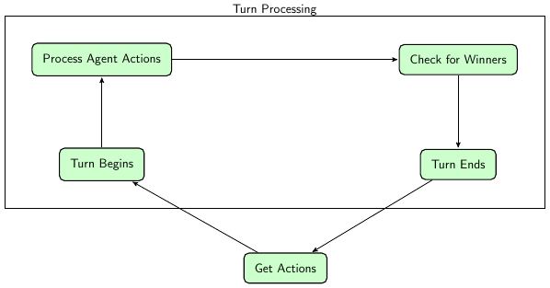
Problems and Solutions
Problem
Solution
Player actions specified in requirements causing issues with gameplay
Implemented action processing order
Notes:
Also discovered in the design phase, was the issue surrounding how user actions would be handled by the backend, considering that these actions could have a great effect on one another.
Our solution for this problem was create an action processing order that the backend would follow to ensure that actions were received and executed in a manner that was balanced and would enhance playability
While these past 3 solutions largely speak to issues discovered during the design, there are also some more general problems that group noticed as well.

Slide 12
Problems and Solutions
Problem
Solution
Learning languages and framework
Completed online tutorials
Discussed implementation
Debugged together
Notes:
One of the major issues that our group experienced was a lack of experience with a lot of the languages/tools that we used in this project.
After the design was finished before spring Break, several members of our team had to take some time to familiarize ourselves with the needed development tools to contribute in the a meaningful way

Slide 13
Problems and Solutions
Problem
Solution
Overestimating features/time
Fulfilled requirements
Divided tasks to improve efficiency
Notes:
One of the primary issues that the team experienced was a clear overestimation of the amount of time needed to complete certain aspects of the project. Because of this overestimation, we realized that not all of the aspects of the application proposed would be feasable to complete by the end of the semseter.
Because of this, our group adapted how work was divided among ourselves, using smaller teams to work on the front and back ends. Also, as the deadline further approached, we also made sure to complete the most necessary requirements to be able to present at least a proof of concept with all the important functionality implemented.
To speak to some of these features that were cut from the our first release is Christina.

Slide 14
Future Enhancements
Move to larger server
Increase application security
Test user friendliness in depth
Add advanced snippet generation
Input validation
Add scenario rating system

Slide 15
Questions?

