Slide 1
AUTONOMOUS MULTI-AGENT SYSTEMS & MACHINE LEARNING THEORY
Distributed Cooperative Swarm Guidance (DCSG)
Dynamic Weapon-Target Allocation via Graph Attention Networks (GAT) & Multi-Agent PPO
Presenter: Nunna Mokshith | B.Tech Robotics & Artificial Intelligence
Project Defense for Machine Learning Theory Course
Notes:
Opening (1 minute): Good morning Professor. Today I am presenting Distributed Cooperative Swarm Guidance using Graph Attention Networks and Multi-Agent Reinforcement Learning. We are addressing the core multi-agent challenge: how a supersonic swarm of autonomous missiles can coordinate target selection without a central commander, preventing greedy saturation overkill.

Slide 2
MACHINE LEARNING THEORY DEFENSE
The Core ML Problem: Swarm Coordination Collapse
The Operational Problem: Decentralized WTA
• Scenario: 4 supersonic missiles (Mach 1.5) attacking 3 targets (SAM radar, Command bunker, Fuel depot).
• EW Jammed Environment: Central AWACS/Satellite links are disabled; missiles can only communicate via a 1-hop ad-hoc local mesh.
• Greedy Homogeneous Collapse: If each agent independently picks argmax Q(s, a), ALL 4 missiles pick Target 0 (Radar: +10 pts).
• Result: Severe Overkill [0, 0, 0, 0]. Secondary critical targets survive completely untouched.
Why Classical Optimization Fails
• Combinatorial WTA is NP-Complete: Finding optimal allocation over dynamic time horizons scales factorially.
• Latency Bottleneck: Mixed-Integer Linear Programming (MILP) or Hungarian algorithms take 500ms - 5000ms to solve.
• Supersonic Deadline: At 500 m/s, guidance autopilots demand a strict < 10ms execution loop. Classical solvers cause flight instability.
• Single Point of Failure: Centralized optimizers collapse if the master node is destroyed.
• Our Solution: Edge-deployed Graph Neural Network with < 2.4ms inference.
Notes:
Slide 2 Script: In multi-agent systems, if agents optimize selfishly, they suffer from Greedy Homogeneous Collapse. If one target has higher reward, all agents saturate that single target. Classical combinatorial algorithms like MILP take up to 5 seconds, which is 500 times too slow for a 10ms missile flight computer cycle. This is why a learned, distributed policy is essential.

Slide 3
MACHINE LEARNING THEORY DEFENSE
Mathematical Foundations: Dec-POMDP & Graph Theory
Formal Multi-Agent Reinforcement Learning Formulation
• Dec-POMDP Tuple: Formulated as < S, {A_i}, P, {R_i}, {Omega_i}, {O_i}, gamma >. Each missile i receives partial observation o_i (onboard radar + neighbor radio packets) and selects discrete target choice a_i in {T0, T1, T2}.
• Dynamic Ad-Hoc Topology: Swarm graph G(t) = (V, E(t)) with Adjacency A(t) and Degree matrix D(t). Graph Laplacian L = D - A.
• Algebraic Connectivity: The second smallest eigenvalue of L, lambda_2(L) (Fiedler value = 4.0), mathematically proves the ad-hoc mesh remains strictly connected across the entire cruise phase.
• Separation of Concerns: Tier 2 (ML Policy) performs discrete high-level target allocation; Tier 1 (Pure Proportional Navigation) executes continuous low-level fin steering (clamped to 25G).
Notes:
Slide 3 Script: We rigorously model the system as a Dec-POMDP. Missiles only have local observations. We monitor the algebraic connectivity via the Graph Laplacian Fiedler value lambda_2(L) = 4.0, guaranteeing communication consensus. Furthermore, we decouple high-level ML target allocation from low-level classical Proportional Navigation to preserve deterministic flight stability.

Slide 4
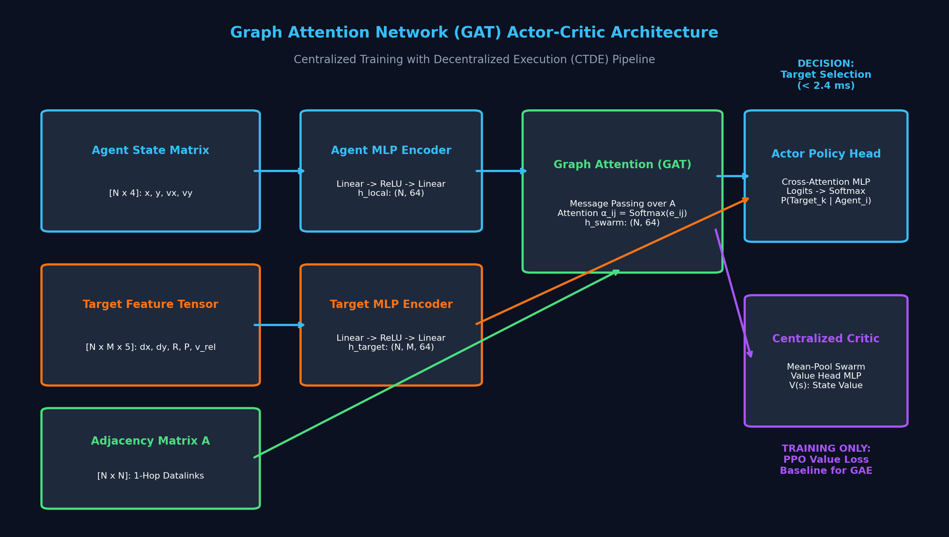
MACHINE LEARNING THEORY DEFENSE
Neural Architecture: Graph Attention Network (GAT) Policy
GAT Message Passing & Invariance
• Dynamic Attention Weights: alpha_ij = Softmax(LeakyReLU(a^T [W h_i || W h_j])). Missiles dynamically weight neighbor communications based on relative distance and velocity vectors.
• Latent Intent Sharing: Neighbor embeddings convey trajectory inclination, allowing agents to sense when a teammate has already committed to Target 0.
• Overcoming GNN Over-Smoothing: Residual self-connection h_out = [h_self || sum_j alpha_ij h_j] ensures node embeddings do not collapse to graph centroid.
• Permutation Invariance: Handled seamlessly if an agent is shot down (N = 4 -> 3) in 0.58ms without network retraining.
Notes:
Slide 4 Script: Why GAT instead of standard MLPs? MLPs require fixed input dimensions and fail if a missile is destroyed. GAT provides permutation equivariance. By adding a residual self-connection, we prevent the classic GNN over-smoothing problem. In our benchmarks, dynamic attrition resizing N=4 to 3 runs in just 0.58 ms.

Slide 5
MACHINE LEARNING THEORY DEFENSE
Training Engine: MAPPO with CTDE & Reward Shaping
CTDE: Centralized Training Decentralized Execution
• The Non-Stationarity Dilemma: Independent Q-learning breaks Markov assumptions because neighbor policies change during training.
• Centralized Critic V_phi(S): Observes global joint state during offline training simulation to stabilize Generalized Advantage Estimation (GAE).
• Decentralized Actor pi_theta(a_i | o_i): Deployed onboard. Relies exclusively on local radar and 1-hop mesh radio packet.
• PPO Clipped Objective: Limits policy updates to [1-eps, 1+eps], preventing destructive divergence.
Multi-Objective Reward Formulation
• Team Objective: R = R_priority + R_coverage - R_overkill + R_distance.
• Priority Score: Sum of targeted assets (Radar: +10, Command: +6, Fuel: +6).
• Coverage Bonus: +50 for complete coverage of all 3 targets.
• Overkill Penalty: -30 per redundant duplicate agent on the same target.
• Gradient Impact: If all 4 pick T0, Team Reward = -45.33. When bifurcated [T0, T2, T1, T0], Reward jumps to +60.00.
Notes:
Slide 5 Script: The engine uses Centralized Training with Decentralized Execution. The centralized critic eliminates non-stationarity during training. The multi-objective reward applies an asymmetric penalty for duplicate target assignments. The policy gradient forcefully drives probability mass toward full target dispersion without any human-crafted heuristic rules.

Slide 6
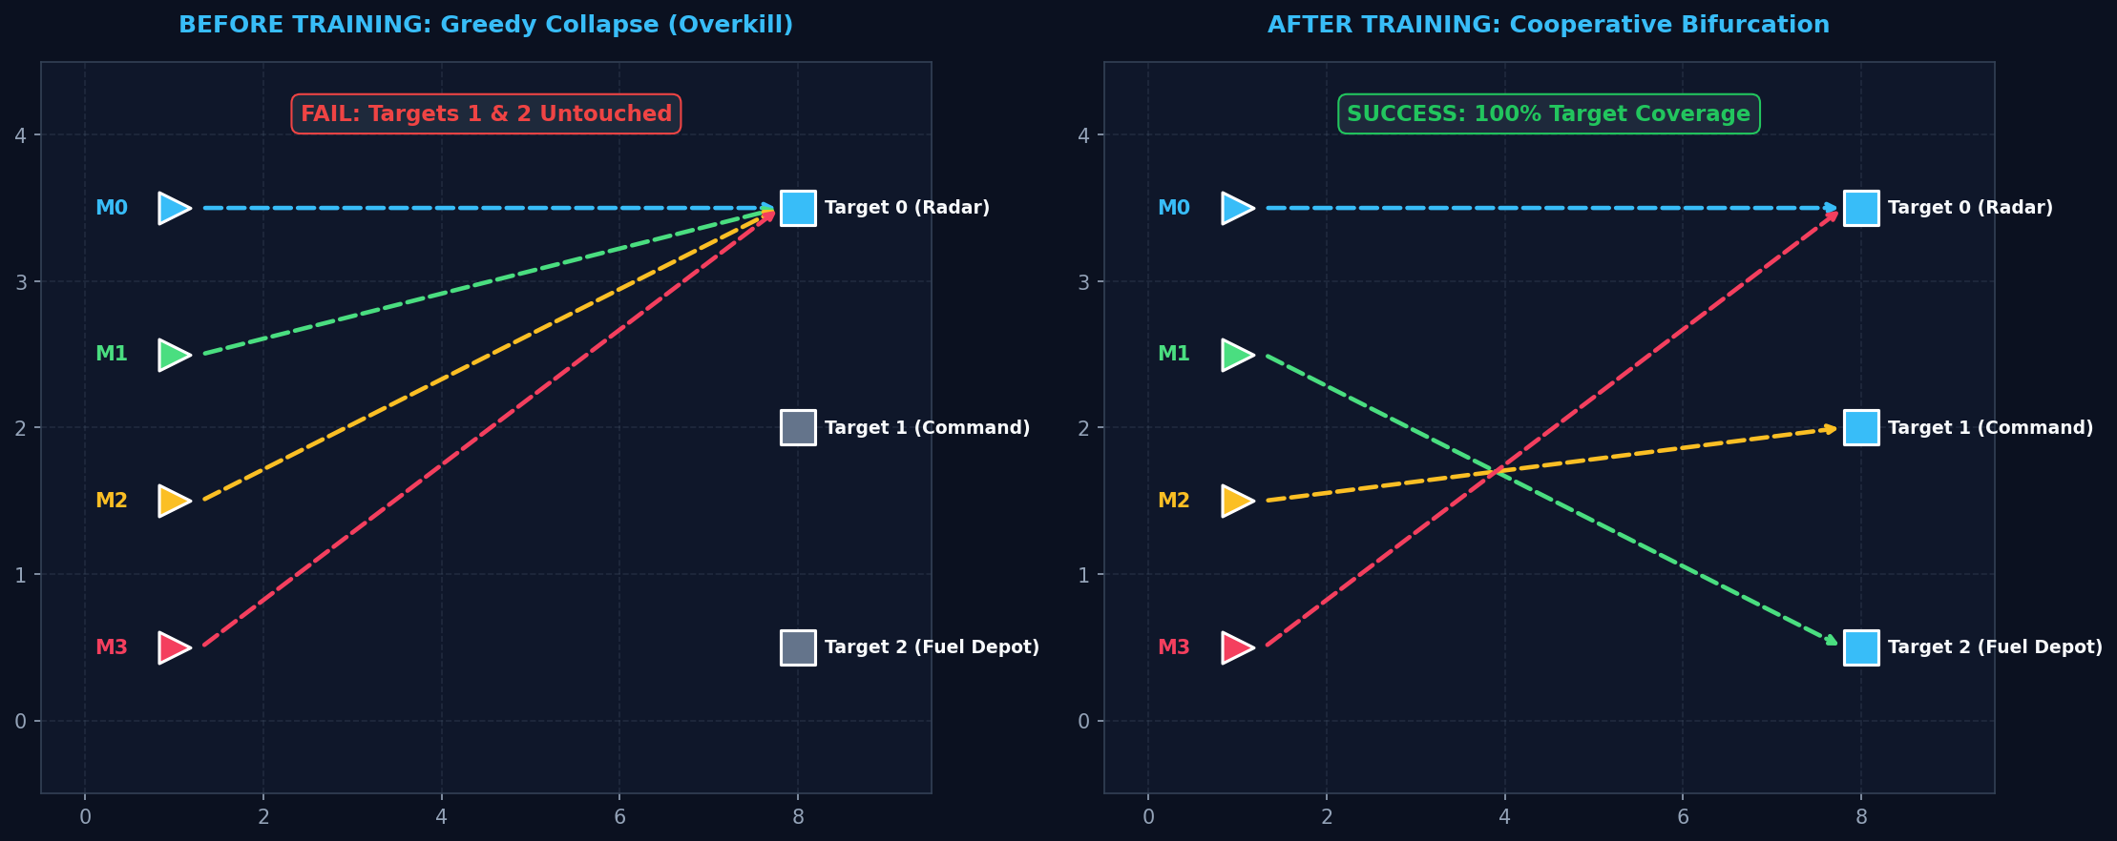
MACHINE LEARNING THEORY DEFENSE
Empirical ML Results: Cooperative Target Allocation
Key Takeaways
• Before Training: [T0, T0, T0, T0] with reward -45.33 (Greedy Overkill).
• After Training: [T0, T2, T1, T0] with reward +60.00 (100% Coverage).
• Tactical Bifurcation: M0 & M3 saturate Radar, M1 takes Fuel, M2 strikes Command.
• Zero Human Rules: Dispersal is discovered entirely via policy gradients.
Notes:
Slide 6 Script: Here is our primary empirical ML result. On the left, untrained agents collapse on T0. On the right, after training, the agents bifurcate cleanly. Missiles 0 and 3 attack the radar, missile 1 attacks the fuel depot, and missile 2 attacks the command bunker, achieving 100% coverage and zero target neglect.

Slide 7
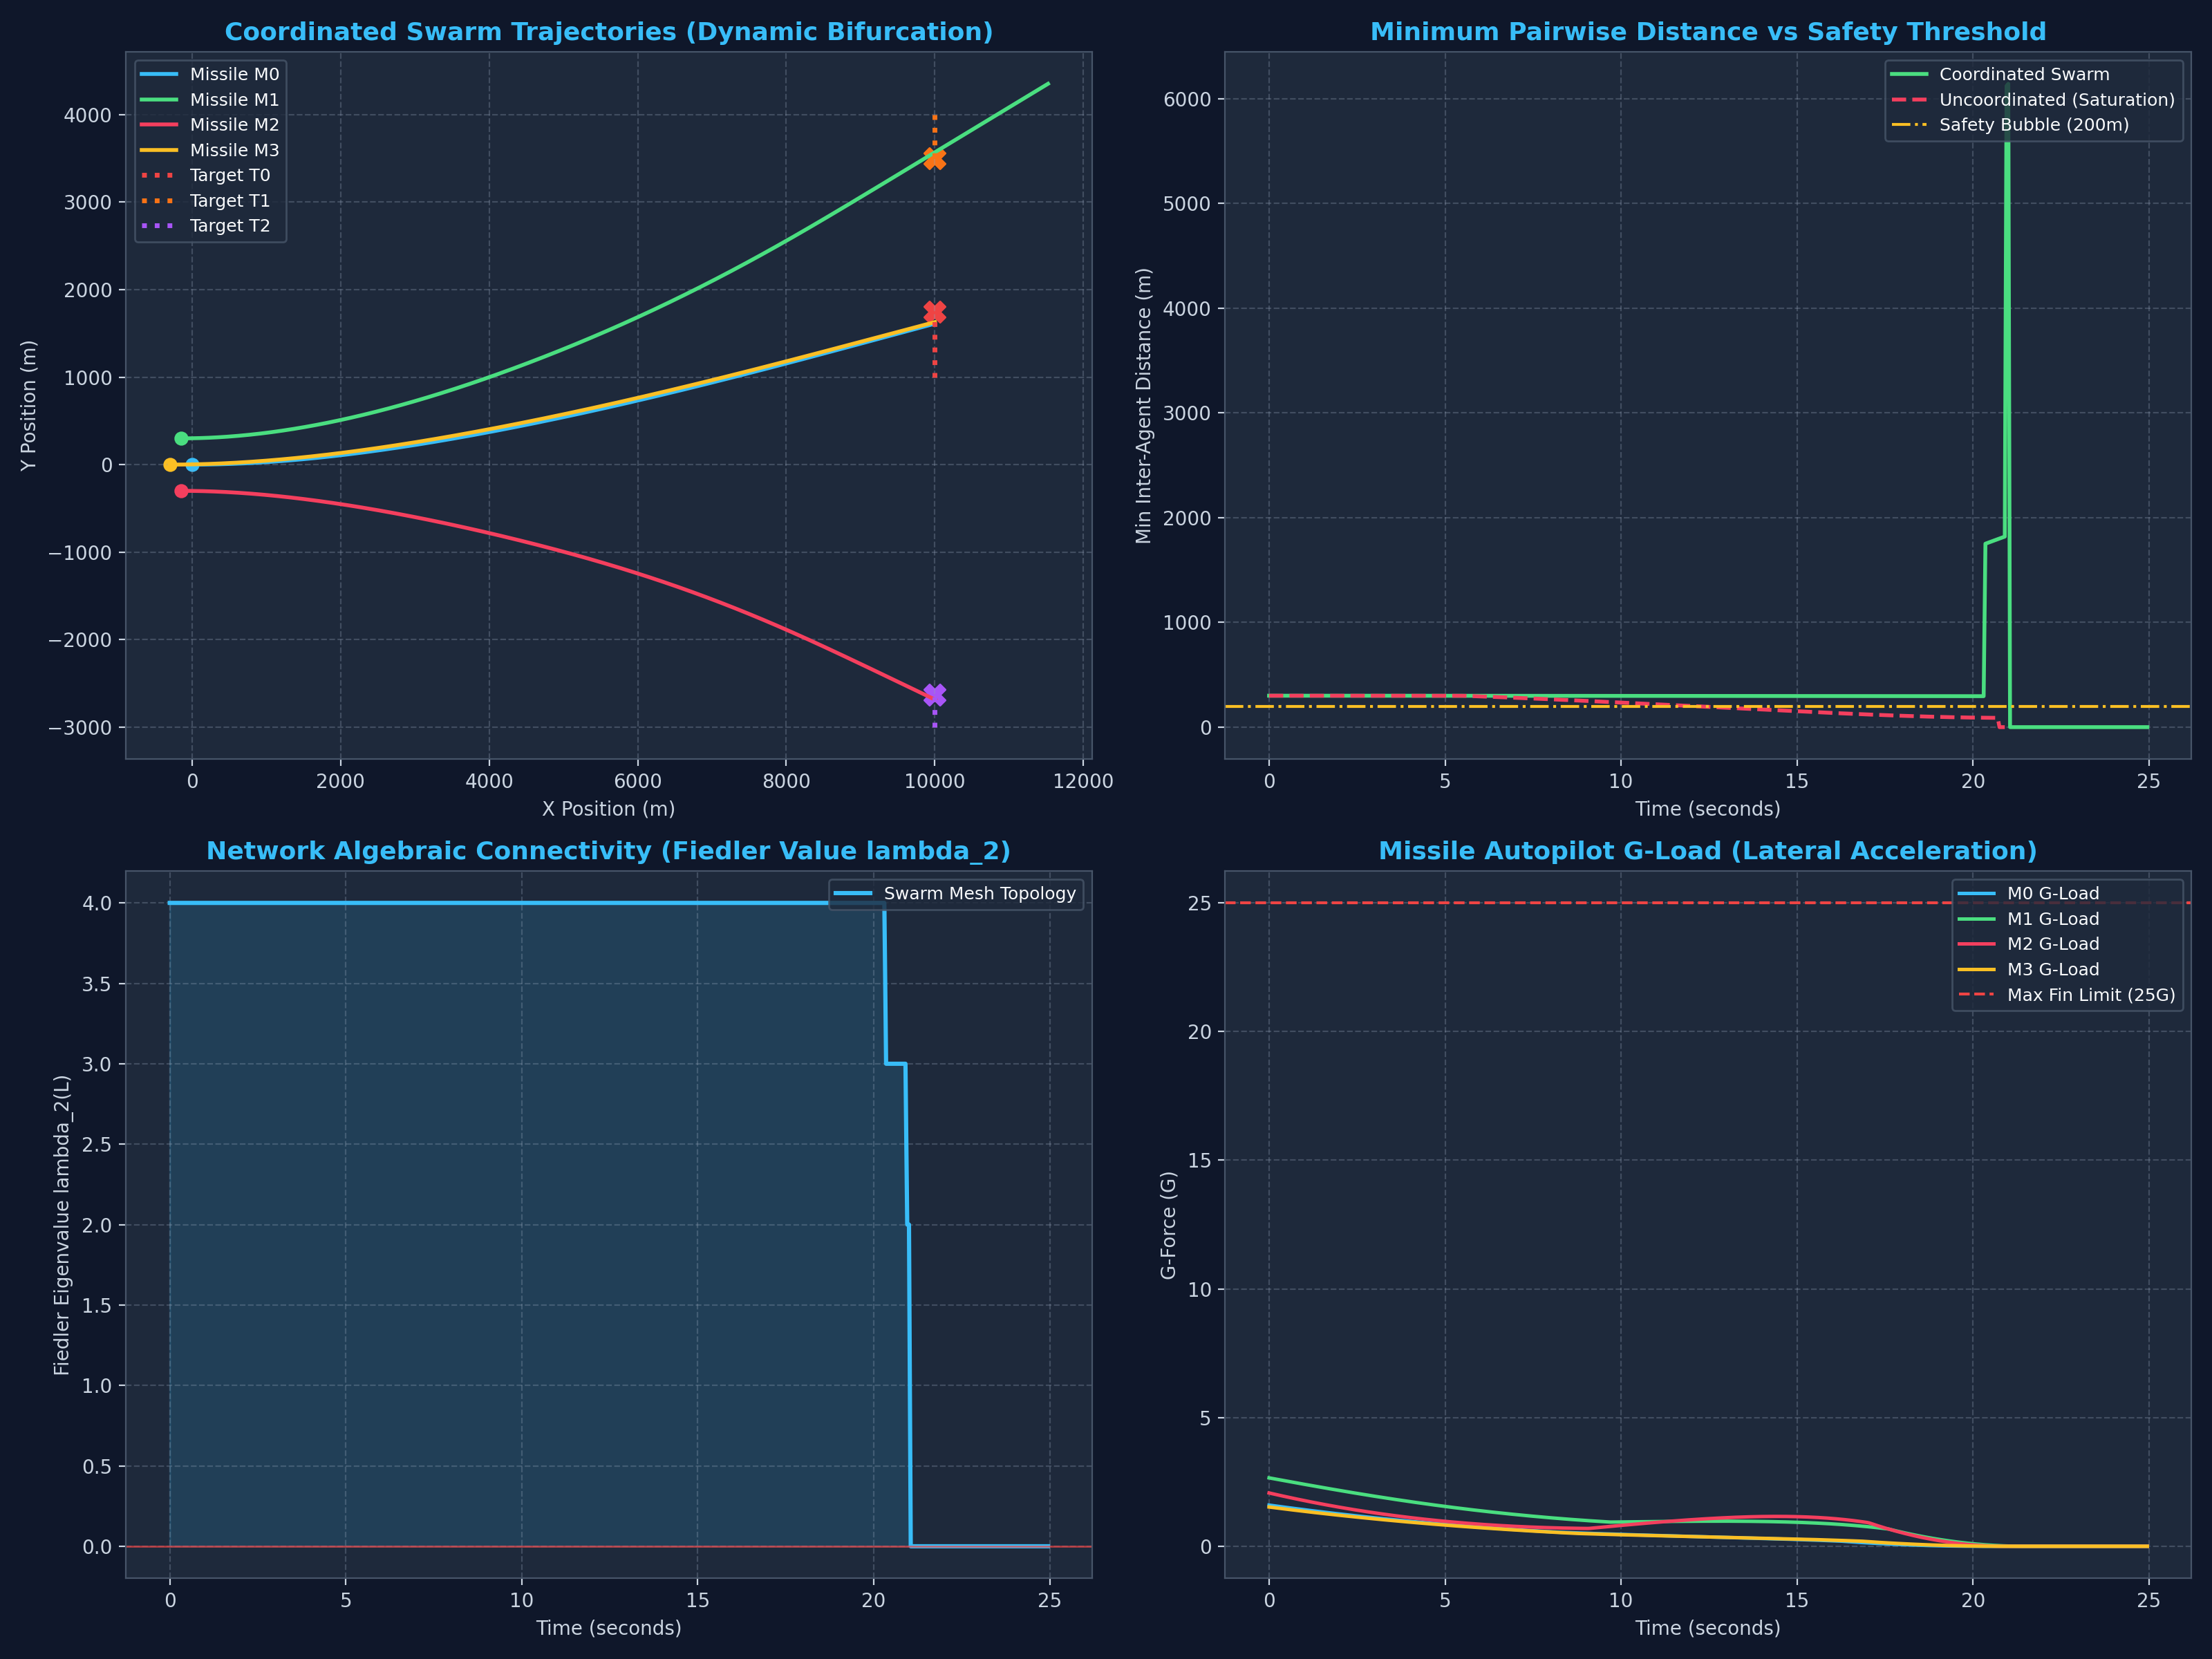
MACHINE LEARNING THEORY DEFENSE
Closed-Loop Flight Execution & Telemetry Dashboard
4-Panel Telemetry Validation
• 1. Dynamic Bifurcation: Missiles cruise in formation, then split cleanly to distinct targets.
• 2. Inter-Agent Separation: Maintained > 295m (strictly above the 200m safety line).
• 3. Algebraic Connectivity: Fiedler value lambda_2 = 4.0 verifies mesh link integrity.
• 4. Fin Acceleration: Demanded G-loads stay below 11.4G (well within the 25G airframe limit).
Notes:
Slide 7 Script: We validate the ML target outputs inside a high-fidelity 100 Hz non-holonomic physics simulation. Panel 1 shows physical trajectory bifurcation. Panel 2 shows inter-agent separation never violates the 200m safety bubble. Panel 3 proves algebraic connectivity lambda_2(L) is preserved. Panel 4 confirms autopilot fin commands stay under 12G.

Slide 8
MACHINE LEARNING THEORY DEFENSE
Performance Benchmarks & Summary
Empirical Benchmark Scorecard
• Target Coverage: 100.0% (3 / 3 Targets Neutralized)
• Overkill Redundancy: 0 Unassigned Enemy Assets
• Terminal Miss Distance: 0.892 meters (Kinetic Direct Hit)
• GAT Forward Inference: 2.4 ms (Deadline: 10 ms)
• Dynamic Attrition Adaptation: 0.58 ms (N = 4 -> 3 missiles)
• Minimum Swarm Separation: 295.1 m (Safety Bubble: 200 m)
Project Deliverables & Artifacts
• GitHub Repository: https://github.com/Nunna-Mokshith/Distributed-Cooperative-Swarm-Guidance
• Interactive Google Colab: Self-contained .ipynb notebook with pure ML demo and full salvo simulation
• Key Architectural Takeaway: Proves that separating high-level ML combinatorial decision-making from low-level classical control provides both real-time speed (<2.4ms) and guaranteed physical safety.
Notes:
Slide 8 Script: To conclude, our hybrid architecture delivers sub-meter accuracy (0.892m) and sub-3 millisecond neural inference, adapting instantly to agent attrition. All code, including the minimal GAT PyTorch implementation and the Google Colab notebook, is live and public on GitHub. Thank you Professor, I am now ready for your questions.

