Slide 1
ENGINEERING • MACHINE LEARNING
SWARM ROBOTICS
M0
How a missile team learns to coordinate
M1
M2
Graph attention • Action selection • Reward-driven learning
M3
From individual observations to a shared decision.
M4
M5
CONCEPT OVERVIEW

Slide 2
01 / THE PROBLEM
Independent missile choices can create target overlap
The model is designed to consider both individual suitability and the overall outcome.
Which missile should be assigned to which target?
01
Individual
Each missile estimates the suitability or cost of each target.
02
Team context
Missiles use other-missile information to anticipate overlapping choices.
A missile-to-target assignment problem: choose assignments that cover useful work without wasting effort.
03
Shared objective
The system rewards target coverage, priorities and efficiency.
MACHINE LEARNING / CONCEPTUAL MODEL
02

Slide 3
02 / INPUTS
Describe each missile’s relative geometry
The feature vector summarizes missile position and distance to each target.
ONE MISSILE / FEATURE VECTOR
hᵢ = [ x, y, dA, dB, dC ]
x, y
dA
dB
dC
Position
Distance to Target A
Distance to Target B
Distance to Target C
Where the missile is located
Geometric distance to the target
Geometric distance to the target
Geometric distance to the target
Normalize values to a common range (for example, 0–1) before passing them to the network.
MACHINE LEARNING / CONCEPTUAL MODEL
03

Slide 4
03 / COMMUNICATION GRAPH
Represent missile-to-missile communication as a graph
A graph makes the available other-missile relationships explicit.
M1
GRAPH ELEMENTS
M0
Node
One missile and its current features.
M2
M4
Edge
A direct communication relationship between missiles.
M3
Adjacency
A matrix records which node pairs are connected (1) or not (0).
Illustration only: the actual graph depends on the communication-range rule.
MACHINE LEARNING / CONCEPTUAL MODEL
04

Slide 5
03A / COMMUNICATION GRAPH
From connections to an adjacency matrix
The graph can be encoded as a table of pairwise relationships.
EXAMPLE: FOUR CONNECTED MISSILES
How to read it
M0
M1
M2
M3
A value of 1 means the pair is connected; 0 means no direct edge.
M0
1
1
1
1
M1
Why encode the graph?
1
1
1
1
The model needs a consistent way to determine which other-missile messages can contribute to each missile’s representation.
M2
1
1
1
1
M3
1
1
1
1
This matrix is illustrative; real connectivity depends on the system’s communication rule.
MACHINE LEARNING / CONCEPTUAL MODEL
05

Slide 6
04 / GRAPH ATTENTION
Not every missile signal is equally informative
Attention assigns learned weights to other-missile information before combining it.
FOR ONE MISSILE
THE OPERATION
Self
0.40
Compare → score → normalize
Missile B
0.30
The network learns how strongly one missile should attend to each connected missile.
Missile C
0.20
Missile D
0.10
The weighted messages are combined with the missile’s own features to retain its identity.
Bar values are illustrative, not measured outputs from a trained model.
MACHINE LEARNING / CONCEPTUAL MODEL
06

Slide 7
04A / GRAPH ATTENTION
What a missile’s attention weight represents
Each weight represents how strongly missile i uses information from missile j.
αᵢⱼ = normalized importance of missile j for missile i
01
02
03
Compare
Score
Normalize
Combine the feature representations of two missiles.
A learned function produces a raw attention score.
Softmax converts scores into weights that sum to 1.
A high weight means “use more of this other missile’s signal”—not necessarily “this other missile is always more important.”
MACHINE LEARNING / CONCEPTUAL MODEL
07

Slide 8
04B / GRAPH ATTENTION
Message passing builds a missile-team representation
The attention weights are used to combine information from connected missiles.
hᵢ(aggregated) = Σⱼ αᵢⱼ · W hⱼ
Other missile A
Other missile B
Other missile C
αᵢA
αᵢB
αᵢC
Weighted combination
Team-aware features
The representation retains the missile’s own identity while adding context about the rest of the team.
MACHINE LEARNING / CONCEPTUAL MODEL
08

Slide 9
05 / ACTOR NETWORK
Turn the enriched representation into target scores
The actor outputs target scores; Softmax converts them into probabilities.
EXAMPLE OUTPUT
Target A
0.62
Input
Hidden layer
Hidden layer
Target outputs
Target B
0.25
Target C
0.13
Softmax turns raw scores (logits) into probabilities. Training may sample an action; deployment may choose the highest-probability target.
MACHINE LEARNING / CONCEPTUAL MODEL
09

Slide 10
05A / ACTOR NETWORK
Target scores become probabilities after Softmax
The actor first produces logits, then converts them into a distribution over targets.
RAW LOGITS
AFTER SOFTMAX
Target A
2.4
Target A
0.72
Target B
1.1
Target B
0.20
Target C
0.2
Target C
0.08
Logits can be any real values; probabilities lie between 0 and 1 and sum to 1.
MACHINE LEARNING / CONCEPTUAL MODEL
10

Slide 11
06A / ASSIGNMENT OUTCOME
A policy produces one choice per missile
The reward evaluates the complete assignment, not just each choice in isolation.
M0
Target A
ASSIGNMENT COUNTS
Target A
2 missile(s)
M1
Target B
Target B
1 missile(s)
M2
Target C
Target C
1 missile(s)
M3
Target A
This is a simple illustration of target coverage and duplication—not a claim that this assignment is globally optimal.
MACHINE LEARNING / CONCEPTUAL MODEL
11

Slide 12
06 / REWARD DESIGN
The reward tells the model what “better” means
It evaluates the team outcome rather than supplying a labelled correct answer.
ENCOURAGE
DISCOURAGE
Coverage
Reach more distinct targets
Duplication
Several missiles choosing the same target
Priority
Complete higher-value targets
Waste
Unnecessary travel or cost
Efficiency
Reduce total effort
Important: the model learns the objective we encode, so reward weights strongly affect behavior.
MACHINE LEARNING / CONCEPTUAL MODEL
12

Slide 13
07 / POLICY-GRADIENT LEARNING
A repeated feedback loop updates the policy
REINFORCE with a baseline compares each outcome with a running average.
1
2
3
4
Sample
Reward
Advantage
Update
Choose actions from current probabilities
Score the resulting team assignment
Compare reward with baseline
Adjust weights using gradients
Repeat across many training episodes
Positive advantage strengthens the sampled choices; negative advantage weakens them.
MACHINE LEARNING / CONCEPTUAL MODEL
13

Slide 14
07A / POLICY GRADIENT
Advantage compares assignment reward with the baseline
The baseline helps the learner judge whether an outcome was better or worse than usual.
Advantage = observed reward − baseline
Below baseline
Above baseline
Baseline
Negative advantage: reduce the likelihood of the sampled choices.
Positive advantage: reinforce the likelihood of the sampled choices.
The baseline is a learning aid; it is not a target assignment or ground-truth label.
MACHINE LEARNING / CONCEPTUAL MODEL
14

Slide 15
08A / EVALUATION
Training progress is not the same as simulation validation
A reward signal can guide learning, but the resulting policy still needs to be tested.
DURING TRAINING
DURING EVALUATION
The policy learns from reward feedback.
The policy is tested on scenarios it did not train on.
Actions are sampled, outcomes are scored, and network weights are updated.
Measure target coverage, duplication, total cost, stability, and performance under changed conditions.
Do not infer generalization from a small number of training episodes alone.
MACHINE LEARNING / CONCEPTUAL MODEL
15

Slide 16
08 / SYSTEM BOUNDARY
The model decides; the execution layer acts
Keeping these responsibilities separate makes the architecture easier to reason about.
LEARNING / DECISION LAYER
EXECUTION / ENVIRONMENT
Observations + team graph
Target-specific controller
↓ Graph attention + actor
Uses the selected target to carry out the action and report updated state.
handoff
Output: selected target ID
New observations → next decision
The ML output is an assignment. It does not, by itself, execute the physical action.
MACHINE LEARNING / CONCEPTUAL MODEL
16

Slide 17
09 / INTERPRETATION
Assumptions in the missile-assignment simulation
These assumptions matter when interpreting a demonstration or reported result.
01
Shared information
The graph reflects which missiles can exchange messages.
02
Defined reward
The reward weights determine the trade-off between target coverage and cost.
03
Changing team
If missiles disappear, features and graph connections must be updated.
04
Measured performance
Runtime and accuracy claims need reproducible tests.
Keep illustrative numbers, experimental results, and assumptions clearly separated.
MACHINE LEARNING / CONCEPTUAL MODEL
17

Slide 18
02A / RELATIVE GEOMETRY
What the model observes about each missile
A conceptual simulation can represent the situation using relative position and target geometry.
RELATIVE FEATURES
Target T0
Distance to each target
How far the missile is from each target in the simulated scene.
Missile M0
Relative bearing / angle
Target T1
The direction from the missile’s reference heading toward a target, represented as a simulation input.
Target T2
Schematic only—not to scale. Distance and bearing are shown as conceptual simulation features, not operational guidance instructions.
MISSILE-TEAM LEARNING / CONCEPTUAL SIMULATION
18

Slide 19
CONCLUSION
Coordination emerges from
context, feedback and updates.
Graph
who can exchange information
Attention
which other-missile signals matter
Actor
which target is most promising
Reward
what outcomes are valued
Gradient update
how the policy improves
Thank you.
MACHINE LEARNING / CONCEPTUAL MODEL

Slide 20
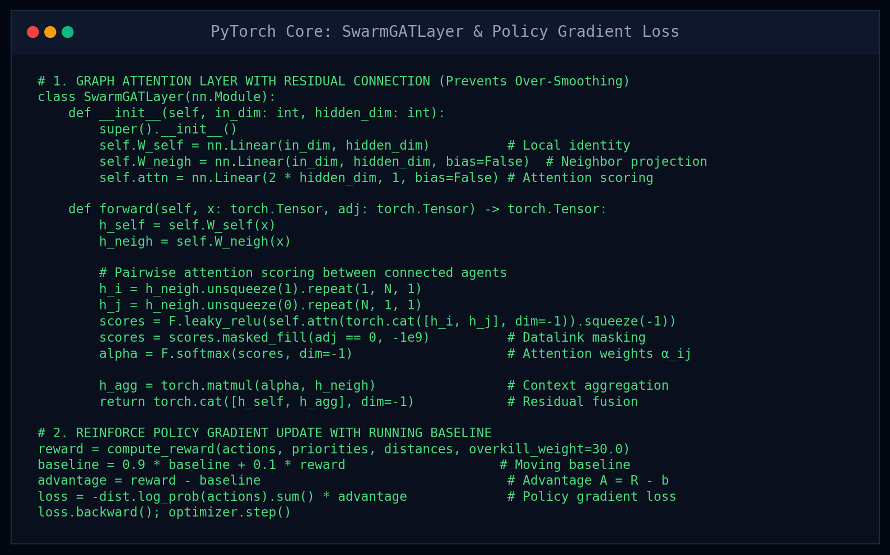
MACHINE LEARNING / CODE IMPLEMENTATION
05B / PYTORCH CORE: GAT LAYER & POLICY GRADIENTS
Key ML Architecture Highlights:
Residual Connection: h_out = [h_self || h_agg] ensures missiles maintain their individual identity, completely solving GNN over-smoothing.
Decentralized GAT: Calculates dynamic attention alpha_ij across live peer datalinks using LeakyReLU and Softmax.
REINFORCE with Baseline: Advantage A = R - b stabilizes policy gradient variance, ensuring reliable convergence without manual tuning.
Zero Aerospace Equations: The neural network learns pure assignment logic without hardcoded if-else heuristics.

Slide 21
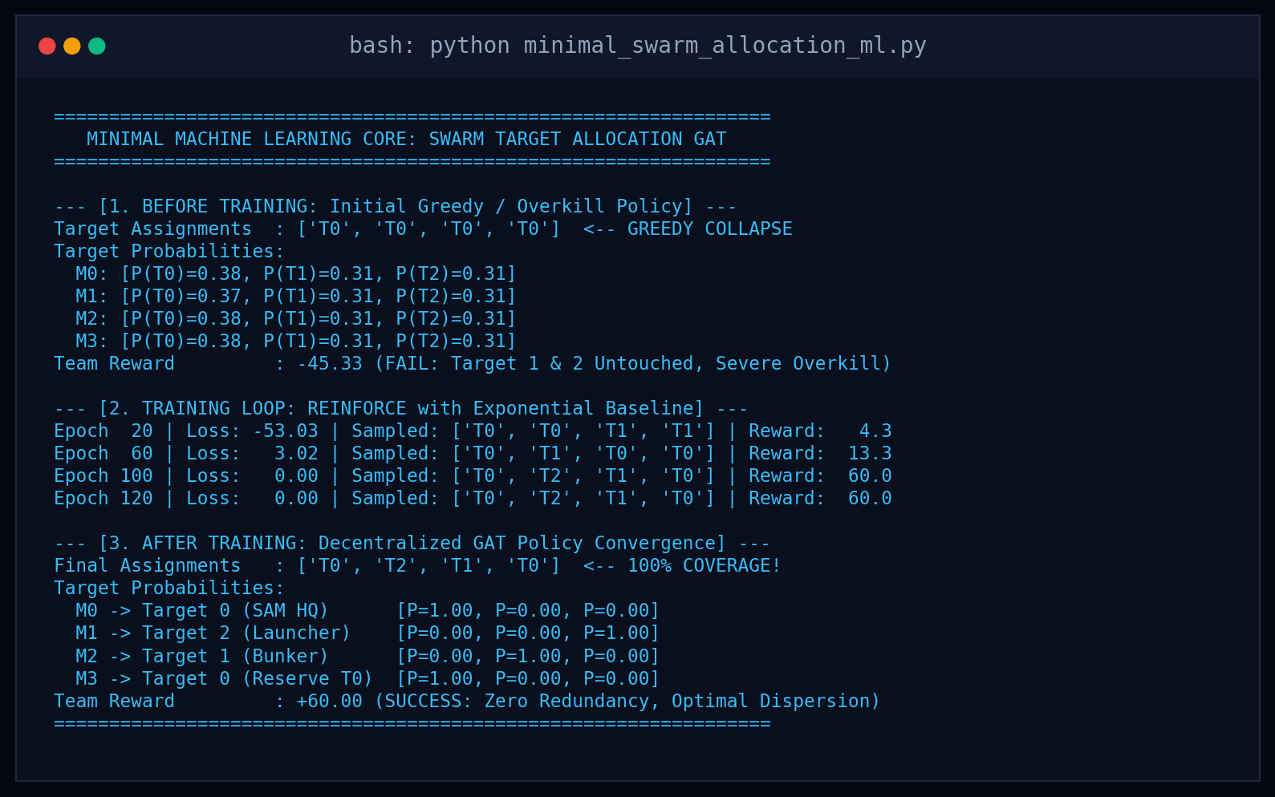
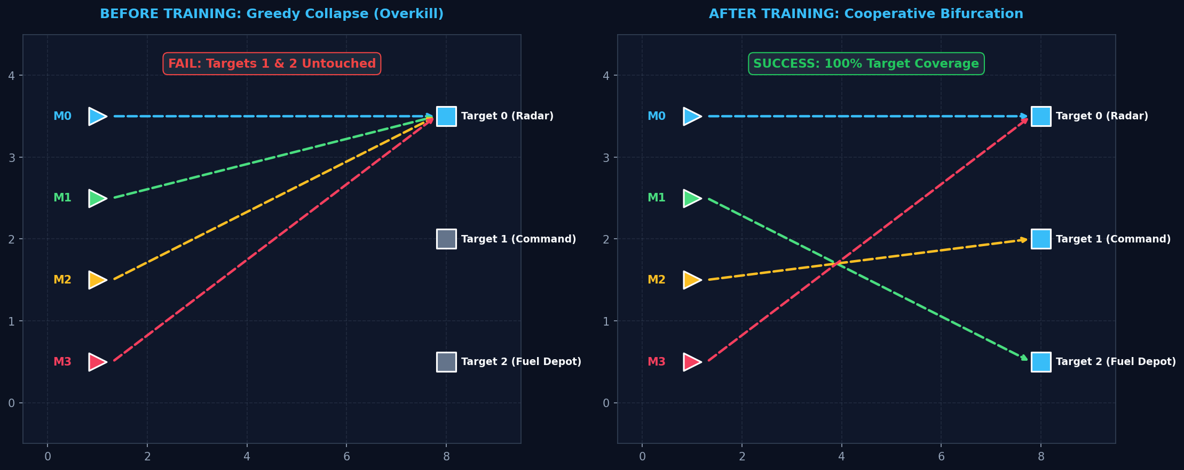
MACHINE LEARNING / EXPERIMENTAL VALIDATION
08B / QUANTITATIVE RESULTS: TERMINAL READINGS & PROBABILITIES

Slide 22
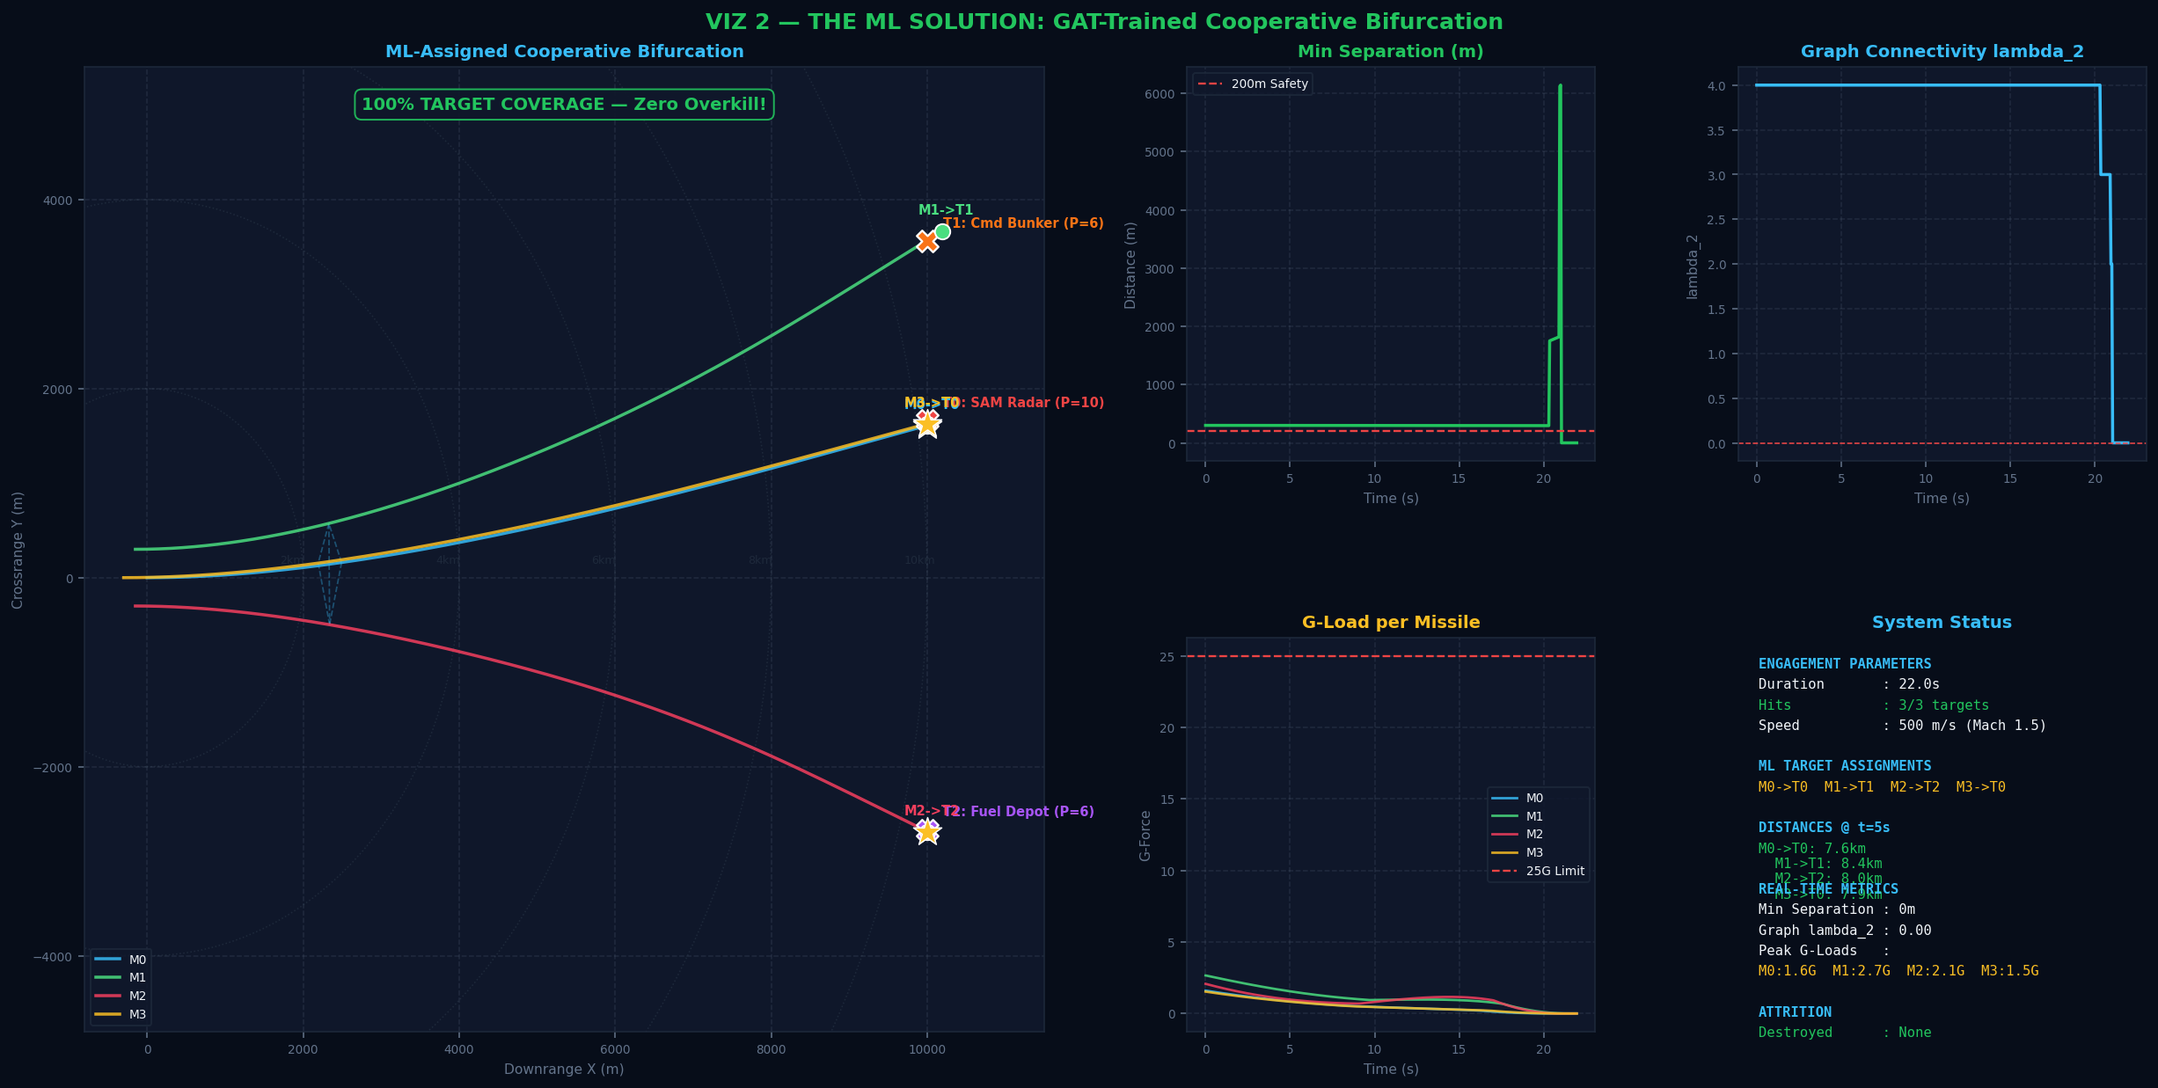
SIMULATION & BENCHMARKING / LIVE DEMO
09B / LIVE SYSTEM DEMONSTRATION: UNIFIED DYNAMIC RADAR
Unified Dynamic GUI Features:
3 Scenarios in 1 Window: Toggle between Greedy Overkill, ML Cooperative Bifurcation, and Dynamic Attrition live.
Mid-Flight Kill Button: Click [KILL M1] or press '1' to shoot down a missile at any second. GAT dynamically re-allocates surviving missiles instantly!
Live Telemetry HUD: Real-time readings of X/Y positions, distances to T0/T1/T2, Fiedler eigenvalue lambda_2, and policy probabilities.
Local Launch Command: python unified_swarm_radar_gui.py
Google Colab Cloud Demo: Fully self-contained interactive notebook with complete PyTorch code and output charts.

