Slide 1



To Develop a CNN Model to Classify Images of Plastic Waste

Slide 2

Learning Objectives
When developing a Convolutional Neural Network (CNN) model to classify images of plastic waste, the following learning objectives should be considered:
Understand the importance of waste classification for environmental sustainability.
Learn how to use Convolutional Neural Networks (CNN) for image-based classification.
Implement waste classification using Python and deep learning frameworks
GOAL
Goal: To develop an lautomated system for classifying waste into different categories using deep earning techniques.
Source :
www.freepik.com/

Slide 3
Tools and Technology used:
Python
TensorFlow/Keras
OpenCV
NumPy & Pandas
Matplotlib for visualization
Google Colab/Jupyter Notebook

Slide 4
Methodology
1.Data Collection: Downloading a labeled dataset of waste images.
2. Preprocessing: Resizing images, rnormalizing pixel values, and augmenting data.
3. Model Development: implementing a CNN model using TensorFlow/Keras.
4. Training: Training the model on labeled waste images.
5. Evaluation: Assessing model accuracy and optimizing performance.
6. Deployment Implementing the model for real-time classification.

Slide 5
Problem Statement:
Manual waste sorting is inefficient and prone to errors, leading to improper waste disposal and environmental harm.

Slide 6
Solution:
A deep learning-based waste classification system that automates the sorting process, improving efficiency and accuracy.

Slide 7


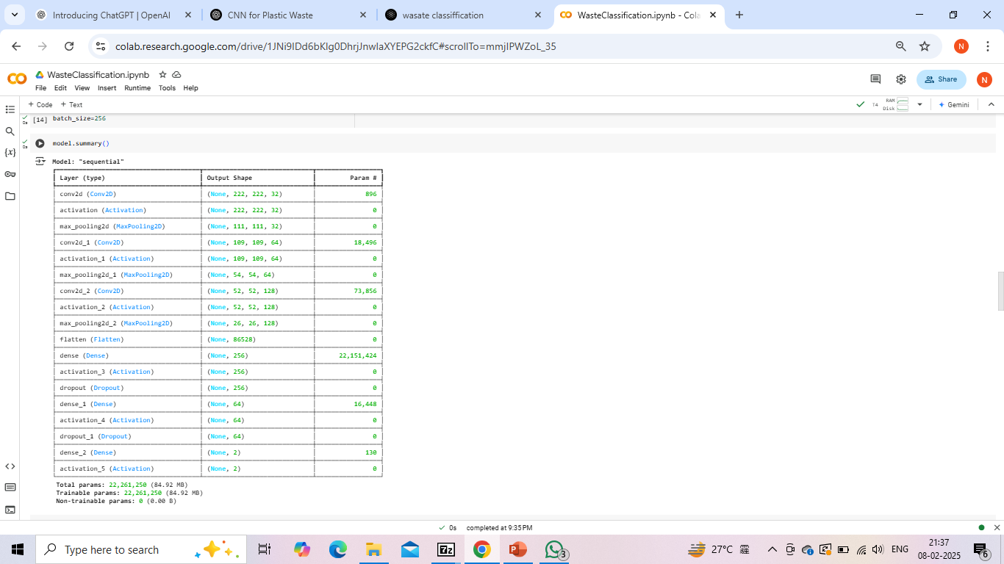
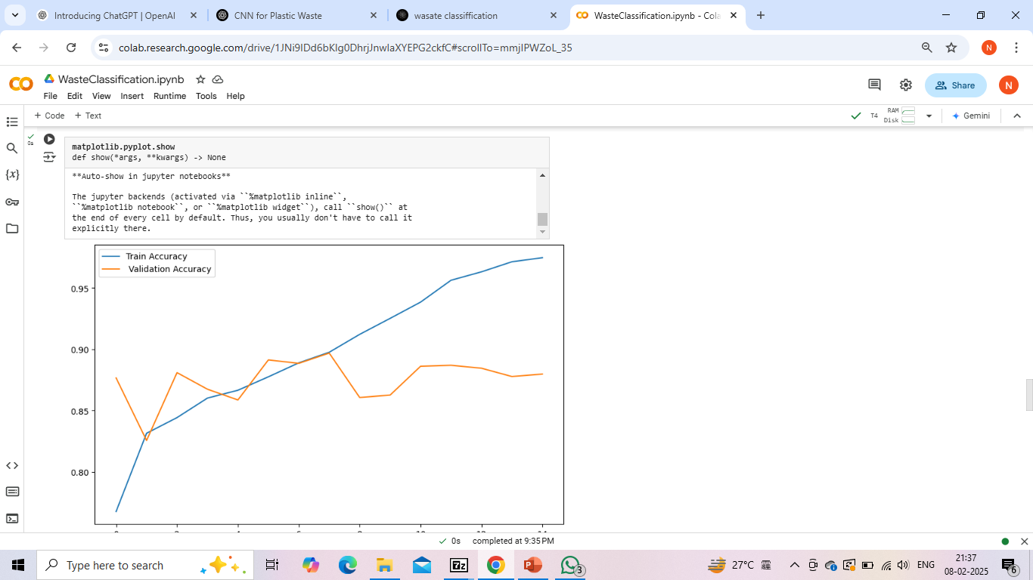
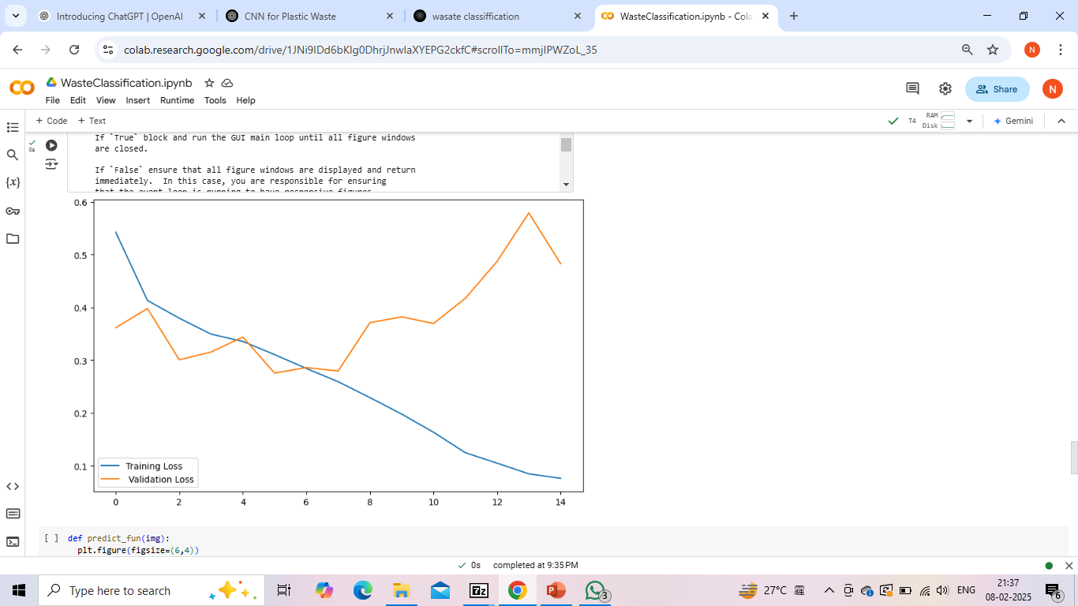
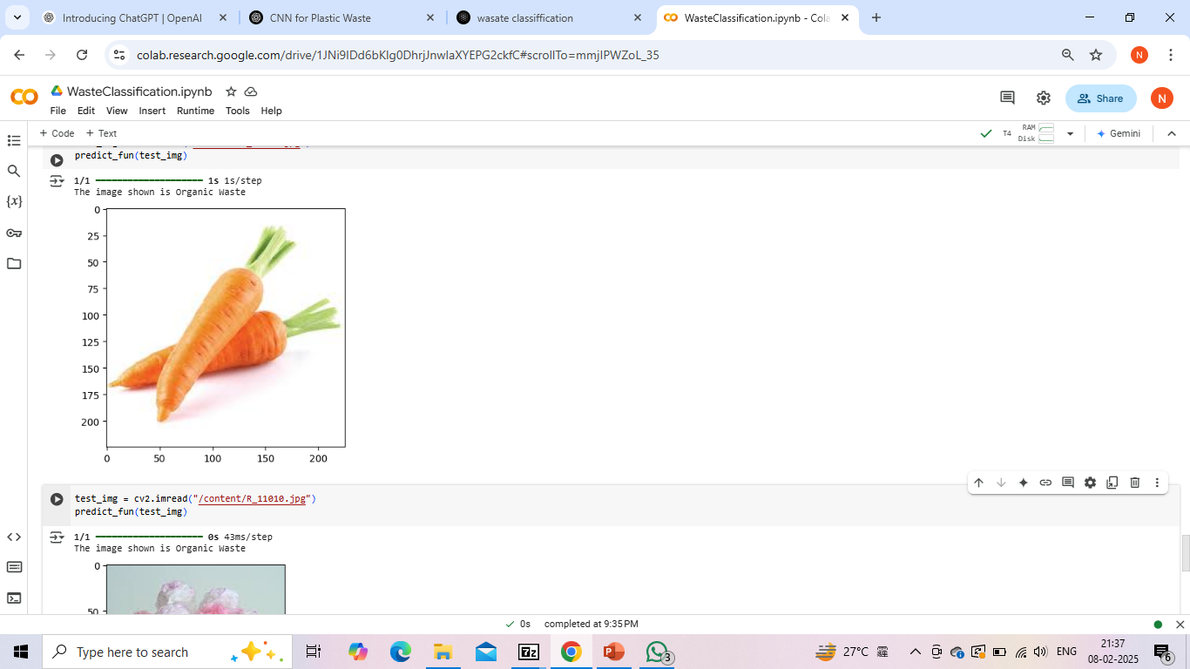
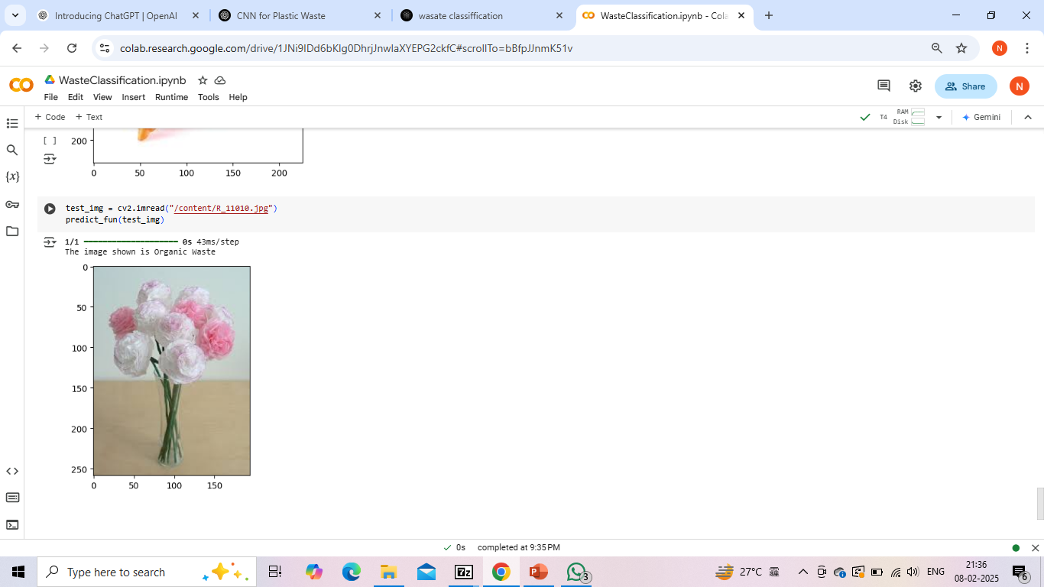
Screenshot of Output:

Slide 8
Conclusion:
The implemented CNN model successfully classifies waste into predefined categories with high accuracy. This approach can be extended to real world applications in smart waste management systems.

